Slide 1
Simple Sales Dashboard – Online Sales
Task 8 | Tableau Design
K.B.SRINIDHI

Slide 2
Key Insights
With $4.30 million in sales, 2014 was the largest year. November 2014 was the peak month at $509K.
With $2.82 million in total sales, the Central region produced the highest profit ($311,000).
With $4.74 million in sales and $664K in profit, technology is the most lucrative and best-selling category.
With $1.34 million, Q4 2014 was the best quarter overall. The Tables subcategory experienced a loss of approximately $-64083.

Slide 3
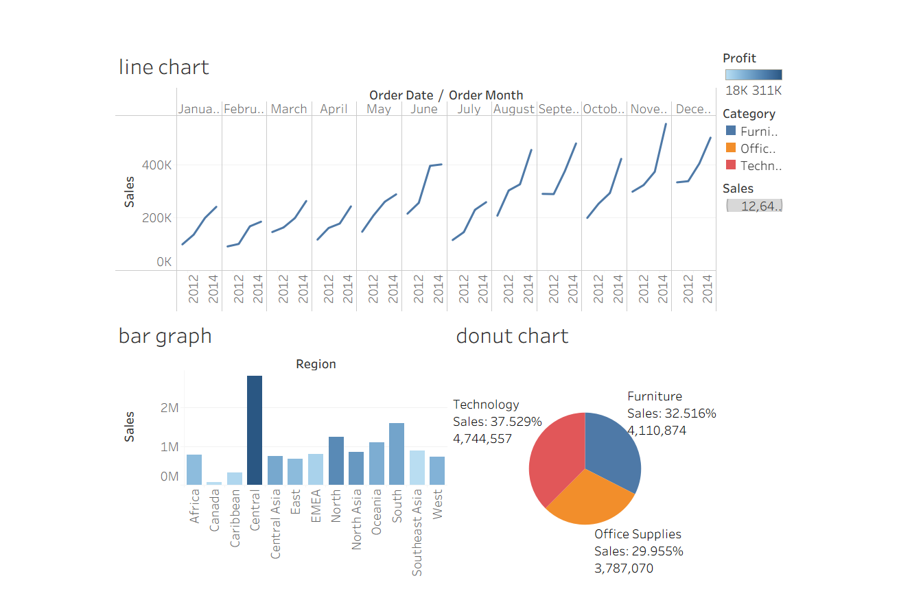
Sales Performance dashboard

Slide 4
Mini Guide – Steps in Tableau
Open Tableau and import online_sales.xlsx.
Use DATETRUNC('month',[order_date]) to create 'Order Month'.
Create visuals: Sales over Months in a Line Chart Sales by Region in a Bar Chart Sales by Category in a Doughnut Chart
Include a Region/Category filter.
Export after assembling into a dashboard.

