Slide 1
Customer Segmentation Using Clustering (Python)
Problem Statement: Use K-Means clustering to segment customers based on behavioral and demographic data to enable targeted marketing strategies.

Slide 2
Week 1 – I. Collect and clean customer dataset. Ii. Perform EDA (Exploratory Data Analysis). Iii. Normalize and scale data

Slide 3
Week 2 – i. Apply K-Means clustering. Ii. Determine optimal clusters using Elbow iii.Method and Silhouette Score. Iv. Visualize clusters using scatter plots and PCA.

Slide 4
Week 3 – i. Profile each cluster (common traits, spending behavior, etc.). Ii. Recommend marketing strategies for each group. Iii. Draft cluster summary report.

Slide 5
Week 4 – Finalize report with supporting charts and tables. Prepare a short presentation with findings.

Slide 6
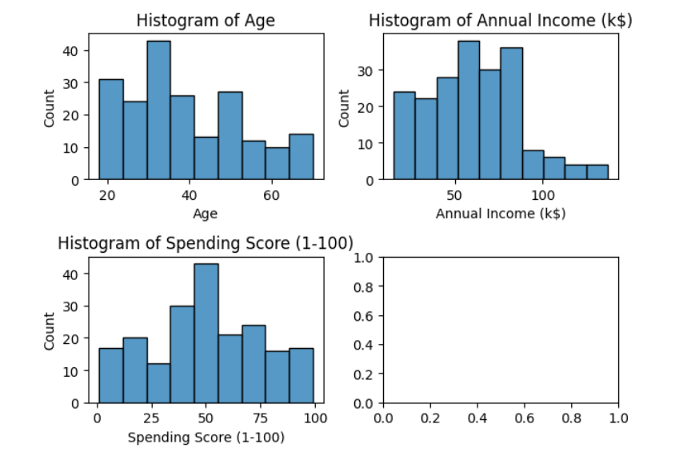

Slide 7
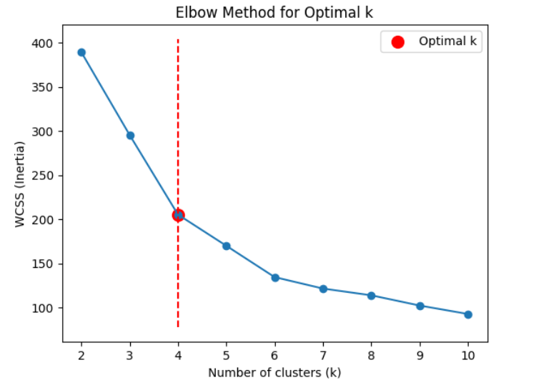
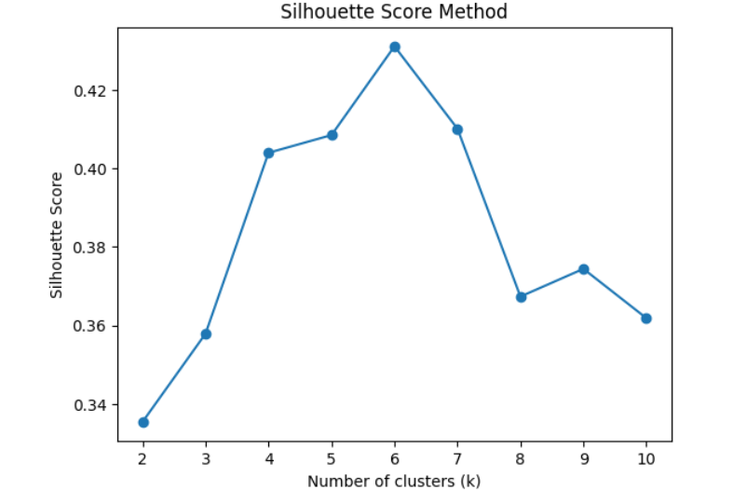

Slide 8
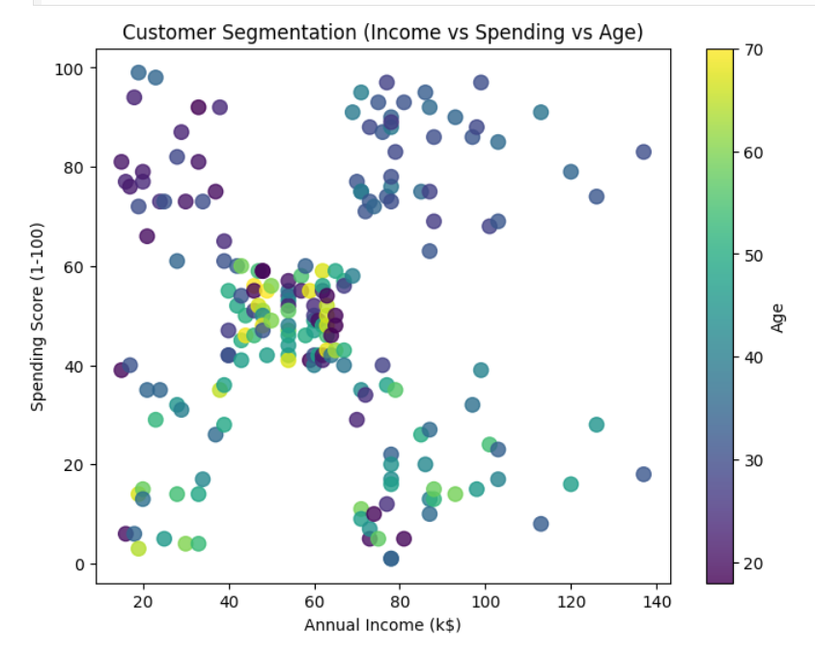

Slide 9
