Slide 1
INTRODUTION TO SPRING FRAMEWORK

Slide 2
Topics to cover :
Spring introduction
Spring feature
Spring Boot Features
Spring Architecture
Spring vs Spring Boot

Slide 3
Spring introduction
Spring is the most popular application development framework for enterprise Java.
Spring framework is an open source Java platform.
It was initially written by Rod Johnson and was first released under the Apache 2.0 license in June 2003.
Spring is lightweight when it comes to size and transparency. The basic version of Spring framework is around 2MB.

Slide 4
Spring Framework is a Java platform that provides comprehensive infrastructure support for developing Java applications. Spring handles the infrastructure so you can focus on your application.
Spring enables you to build applications from “plain old Java objects” (POJOs) and to apply enterprise services non-invasively to POJOs. This capability applies to the Java SE programming model and to full and partial Java EE

Slide 5
Spring feature
Lightweight
Aspect Oriented Programming(AOP)
Transaction Management
Dependency Injection
Integration with other frameworks

Slide 6
Lightweight
The Spring Framework is very lightweight with respect to its size and functionality. It is due to its POJO implementation which doesn’t force to inherit any class or implement any interfaces.
Aspect Oriented Programming(AOP)
It is an important part of Spring Framework. Aspect Oriented Programming is used for separating cross-cutting concerns (for example logging, security etc.) from the business logic of the application.

Slide 7
Transaction Management
Atomicity- It says that transaction is atomic in nature i.e. it is either full or it isn’t.
Consistency- It says that after the end of the transaction the system should be in a be a valid state.
Isolation- It says that all the transactions of the system should be done in isolation.
Durability- It says that a transaction should be durable when all the changes made to the system are permanent.

Slide 8
Dependency Injection
It is a feature of Spring Framework allows you to develop loosely coupled applications. Therefore, the unit testing of these loosely coupled applications becomes easier. This also allows the developer to swap out some of the modules according to its need. Dependency Injection is the main functionality provided by Spring IOC.
IoC :
IOC Stands for Inversion of control, IOC container which is responsible to Instantiate ,configure an Object and also injecting a dependency to our application.

Slide 9
Integration with other frameworks
A great thing about this framework is that it doesn’t try to solve the problems have already solved. It just tries to integrate them with its framework which provides a solution to greater problems. Example IBATIS, Hibernate, Toplink etc.

Slide 10
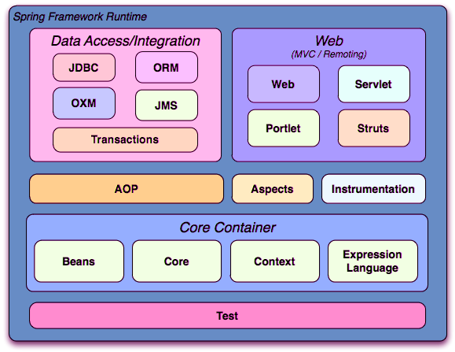
Spring Architecture

Slide 11
Core Container
The Core provides features to fundamental parts of the framework. This includes the IOC as well the DI
A sophisticated implementation of factory pattern called BeanFactory, is provided by, Bean module.
The Context module uses the base provided by the Core and Beans modules. It has access rights for any objects that define and configure. In Context module, the major point is ApplicationContext interface.
In Spring Framework, a powerful language tool for querying is given by Expression language Module. It also does manipulation of an object graph at run-time execution.

Slide 12
Data Access/Integration
The JDBC module contains a JDBC-abstraction layer which removes the need for JDBC related coding.
The Spring Framework doesn’t have its own ORM implementation. But it offers the integration layers with other popular Object Relational Mapping tools such as iBATIS, Hibernate etc.
Spring OXM (Spring Object XML Mappers), a Spring Framework Module. With the help of this module, we can ease the mappings between Java object and XML documents. The module can extend. Hence, it provides integration with various other popular frameworks such as JAXB, Castor, XStream etc.
The JMS module or Java Messaging Services is a Spring module used for sending and receiving messages.

Slide 13
The Web Container
The Web layer has various modules such as Web, Web-MVC, Web-Socket, and Web-Portlet which are as follows: –
The Web module has features of web-oriented integrations. For example, web-oriented application context, multiple file upload functions and initialization of IoC using a servlet.
The Spring Web-MVC module is a Model-View-Controller (MVC) of Spring. It provides the implementation for web applications.
The Web-Socket module of Spring Framework provides support for WebSocket. It is bi-direction communication between server side and client side in web related applications.
The Web-Portlet Spring module insists on implementing MVC in a portlet environment. The functionality of Web-Portlet is same that of the Web-Socket module of Spring.

Slide 14
Miscellaneous
The AOP that is Aspect Oriented Programming is a Spring Framework module. It implements cross-cutting concerns. It can alternatively understand as an interceptor which intercepts some processes like a method which is intercepted by Spring AOP during its execution for adding an extra functionality.
The Aspects Spring module is a mature and a powerful AOP framework. Using it Spring AspectJ integration is possible.
The Testing module is for providing support to classes for writing integration and unit tests. It uses JUnit or TestNG type frameworks.
TestingThe Instrumentation module in Spring Framework is for providing class instrument support. These modules use in various application servers.
The Messaging module does configurative registration of message objects for message consumption from message queues.

Slide 15
Spring Boot Features
Startup Failure
Lazy Initialization
Using the ApplicationRunner or CommandLineRunner
Spring boot Starter
Auto configuration
Embeded Server

Slide 16
Spring | Spring Boot
Spring is an open-source lightweight framework widely used to develop enterprise applications. | Spring Boot is built on top of the conventional spring framework, widely used to develop REST APIs.
The most important feature of the Spring Framework is dependency injection. | The most important feature of the Spring Boot is Autoconfiguration.
It helps to create a loosely coupled application. | It helps to create a stand-alone application.

Slide 17
To run the Spring application, we need to set the server explicitly. | Spring Boot provides embedded servers such as Tomcat and Jetty etc.
To run the Spring application, a deployment descriptor is required. | There is no requirement for a deployment descriptor.
To create a Spring application, the developers write lots of code. | It reduces the lines of code.
It doesn’t provide support for the in-memory database. | It provides support for the in-memory database such as H2.

