Slide 1
Rest Services With Spring Boot

Slide 2
Contents
What is Web Services
Type of Web Service
What is API
What is Rest API
How Rest Works
Restful web service annotations
Implementation of Rest API

Slide 3
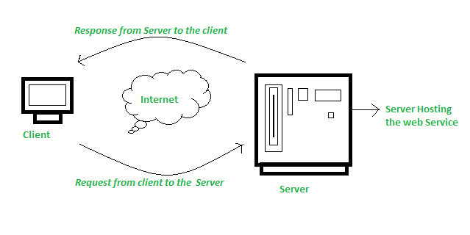
What is Web Services
A web service is a software module that is designed to perform a certain set of tasks

Slide 4
Type of Web Service
There are mainly two types of web services
SOAP web services.
RESTful web services.

Slide 5
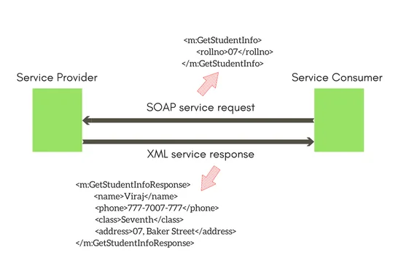
SOAP web services

Slide 6
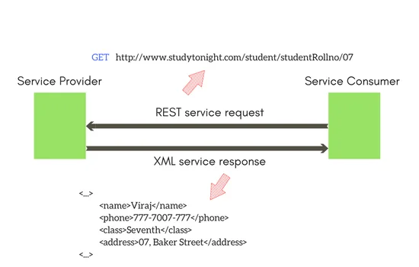
RESTful web services

Slide 7

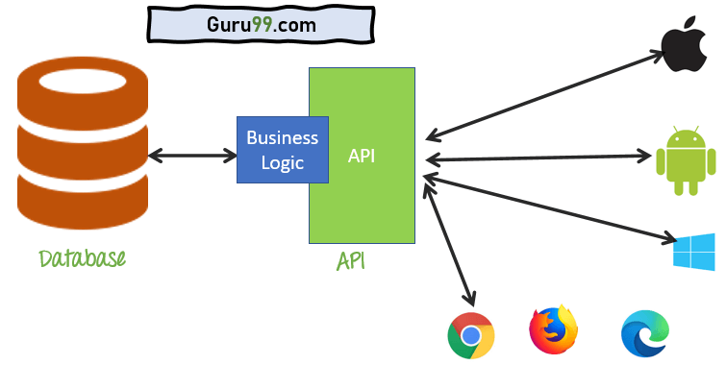
What is API
Application Programming Interface (API) is a software interface that allows two applications to interact with each other without any user intervention.

Slide 8
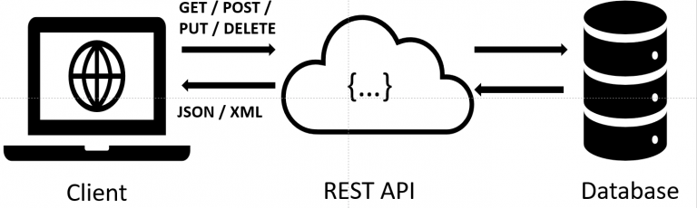
What is Rest API
Representational State Transfer (REST) is an architectural style that defines a set of constraints to be used for creating web services. REST API is a way of accessing web services in a simple and flexible way without having any processing.

Slide 9
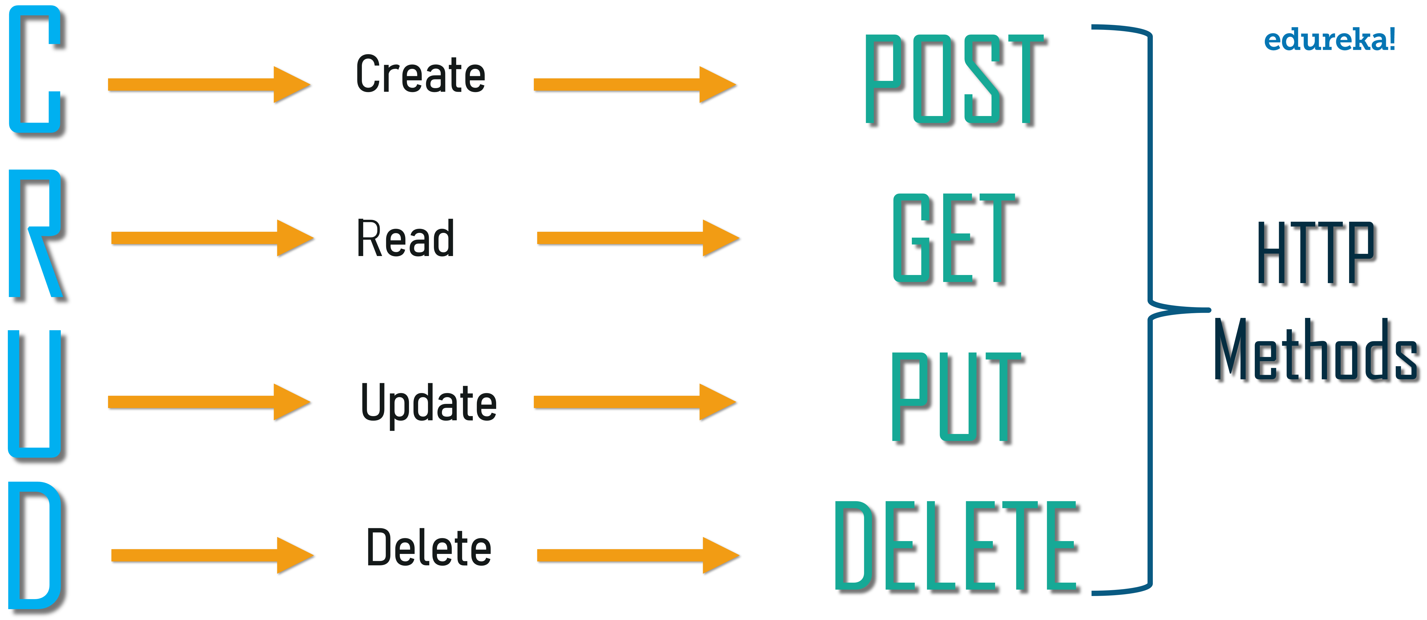
How Rest Works

Slide 10
Restful web service annotations

