Slide 1
Research Track
Task and Motion Planner for Autonomous FireBot

Slide 2
WHY TAMP?
Efficient navigation in complex environments
Swift Response to Fire Emergencies
Adaptability to Dynamic Environments
Goal-Oriented Decision Making
Challenges:
Combining Abstraction Levels
Enabling Online Decision Making
Dealing with Uncertain Perception
Notes:
Autonomous fire bots are often deployed in large and intricate industrial spaces. Task planning allows the robot to break down its overall mission into manageable sub-tasks, such as exploring the environment, locating the fire source, and planning suppression actions. Motion planning ensures that the robot can navigate through complex spaces efficiently and avoid obstacles.
Task planning enables the fire bot to prioritize and sequence its actions during a fire emergency. This includes tasks such as assessing the severity of the fire, determining the optimal route to the fire source, and executing suppression strategies. Motion planning ensures that the robot can move swiftly and safely to the identified location, minimizing response time.
In environments prone to change, such as warehouses with moving objects or fluctuating conditions, task and motion planning allow the robot to adapt dynamically. The robot can modify its plan in real-time based on the evolving situation, ensuring effective response even in unpredictable scenarios.
Task planning integrates with decision-making processes to guide the fire bot towards achieving its mission objectives. This includes decisions on whether to approach the fire directly, assess the surroundings first, or implement specific suppression strategies. Motion planning ensures that these decisions are translated into feasible and safe robot movements.
Challenges:
Combining Abstraction Levels:
Challenge: Dividing a domain into multiple levels of abstraction and finding globally feasible solutions that adhere to all constraints across abstraction levels.
For a fire-fighting robot, combining abstraction levels presents a challenge in dividing the operational domain into multiple levels of abstraction. This involves breaking down the overall mission into different levels of detail, such as high-level mission planning, mid-level task planning, and low-level motion planning. The challenge lies in ensuring that the robot can find globally feasible solutions that adhere to all constraints at each level and seamlessly integrate these solutions across abstraction levels. In the context of a fire bot, this may include dividing the mission into tasks like environment mapping, fire source identification, and fire suppression actions, ensuring that the robot can navigate, make decisions, and execute tasks cohesively while considering the constraints and requirements of each level.
Enabling Online Decision Making:
Challenge: Developing methods for enabling online decision-making in combined task and motion planning and ensuring the consistency of decision-making in dynamic environments.
For a fire-fighting robot (firebot), enabling online decision-making poses a challenge in developing methods that allow the robot to make real-time decisions during a fire emergency. This involves dynamically adapting its actions based on changing conditions and new information. In the context of combined task and motion planning, the challenge is to ensure that the firebot can continuously assess the situation, adjust its planned tasks and motions, and make decisions that are consistent with the overall mission objectives. This becomes crucial in dynamic environments typical of fire emergencies, where the robot must respond promptly to evolving conditions such as spreading fires, changing obstacles, or the presence of humans. Developing algorithms that facilitate quick, consistent, and context-aware decision-making in real-time scenarios is essential for the effective operation of a firebot.
Dealing with Uncertain Perception
Challenge: Addressing uncertain perception in combined task and motion planning, determining whether uncertainty should be considered in decision-making processes, and identifying suitable methods for handling uncertainty in the planning framework.
In the context of a fire-fighting robot (firebot), dealing with uncertain perception is a challenge that involves addressing the inherent uncertainty in the robot's perception of its environment. This uncertainty can arise from factors such as smoke, varying lighting conditions, or sensor limitations. The challenge is to determine whether and how uncertainty should be incorporated into the decision-making processes of the combined task and motion planning. It involves identifying suitable methods to model and handle uncertainty effectively within the planning framework. This is crucial for the firebot to make informed decisions and execute tasks, considering the dynamic and unpredictable nature of fire emergencies. Implementing robust techniques for handling uncertain perception enhances the reliability and adaptability of the firebot in complex and challenge.

Slide 3
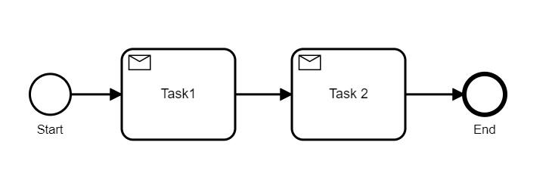
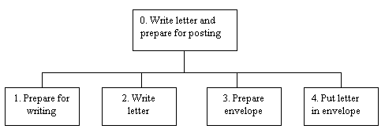
TASK PLANNING
Approaches :
Sequential task planning
Temporal Task Planning
Learning Based Task Planning
Hierarchical Task Planning
Reactive Task Planning

Slide 4
Hybrid Planner
Combination of Hierarchical and Reactive Planner
Hierarchical Task Planning Component
High-Level Mission Planning
Task Decomposition
Sub-Task Planning
Reactive Task Planning Component
Immediate Response
Dynamic Task Adjustment
Quick Decision-Making
Benefits:
Structured Decision-Making
Quick Adaptation
Flexibility
Improved Robustness

Slide 5
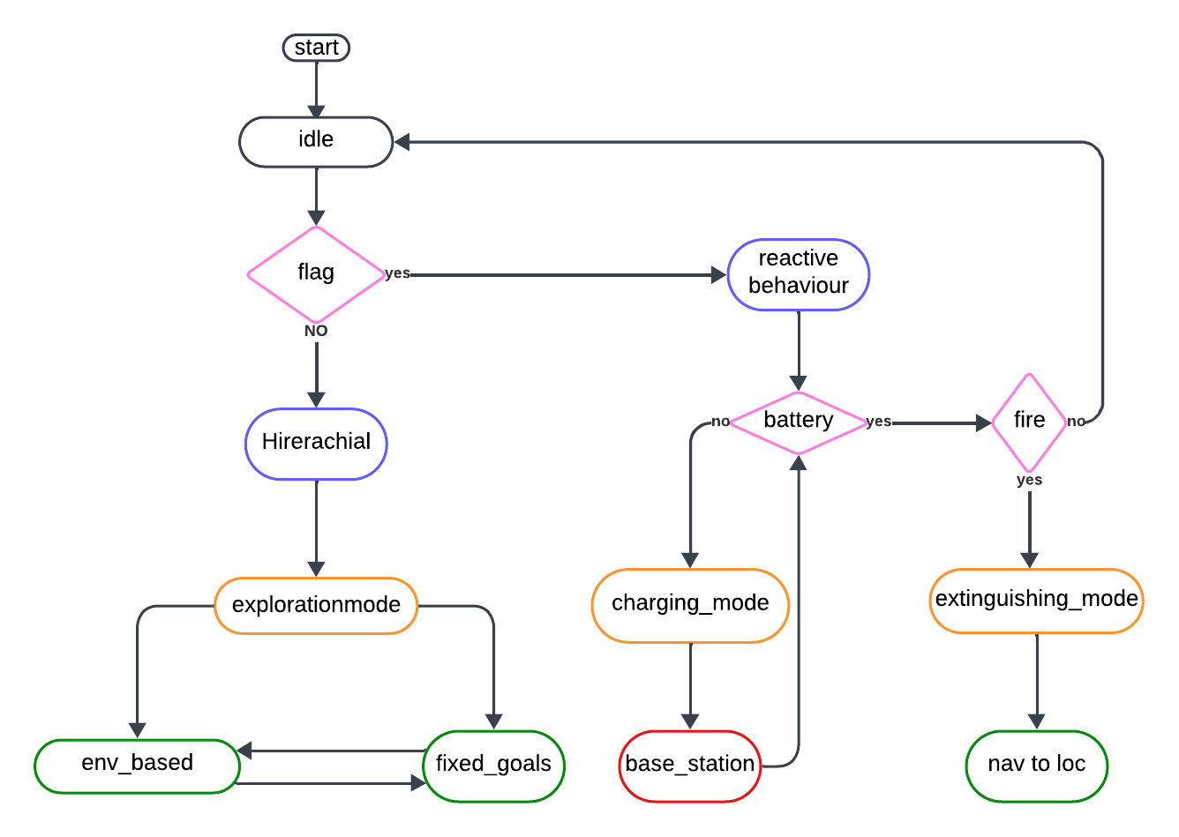
Flow Chart of Hybrid Planner for Firebot

