Slide 1
KEY LOGGER PROJECT
Presented By:
M.Srinikedan
Anjalai Ammal Mahalingam Engineering College
B.tech - Information Technology

Slide 2
OUTLINE
Problem Statement (Should not include solution)
Proposed System/Solution
System Development Approach (Technology Used)
Algorithm & Deployment
Result (Output Image)
Conclusion
Future Scope
References

Slide 3
Problem Statement
Develop a key logger application that can run silently in the background of a computer system, capturing and recording user keystrokes without detection. The key logger should be capable of logging keystrokes across all applications and web browsers, capturing both standard and special keys such as function keys and key combinations.

Slide 4
Proposed Solution
Detection Mechanism: Utilizing Python's libraries such as psutil for
process management and os for file system operations, we will develop a
script to scan system processes, files, and registry entries.
Prevention Strategies:
User Permission Controls: Utilizing Python's subprocess module, we will
manage user permissions to restrict installation of unauthorized software.
Behavioral Monitoring: Employing Python's logging module, we will
monitor system behaviors, detecting anomalies that may signal keylogging
activities and triggering alerts for further investigation.
Real-time Monitoring: A key component of our solution is real-time
monitoring of keystrokes. By interfacing with Python's keyboard library

Slide 5
System Approach
Signature-based Detection: Utilize pattern matching algorithms to scan system
files, processes, and registry entries for known keylogger signatures.
Behavioral Analysis: Employ machine learning algorithms to analyze user
behavior and identify deviations that may indicate the presence of a keylogger.
API Hooking: Implement API hooking techniques to intercept and analyze
system calls related to keyboard input, identifying suspicious activities.
Access Controls: Enforce user permissions to restrict installation and execution of
unauthorized software using system-level controls.
Software Whitelisting/Blacklisting: Maintain a database of trusted and untrusted
software to prevent the execution of known keylogging applications.
Code Integrity Checks: Implement checksum verification mechanisms to ensure
the integrity of system files and prevent tampering by malicious software.

Slide 6
Algorithm & Deployment
Agent-based Deployment:
Deploy lightweight agents on endpoint devices to monitor system activities and detect keylogger
threats.
Centralized Management Console:
Implement a centralized management console to deploy, configure, and monitor keylogger
detection agents across all endpoints.
Real-time Monitoring and Alerting:
Configure agents to monitor system activities in real-time and analyze incoming data for signs of
keylogger activity.
Automated Response Actions:
Define automated response actions to mitigate detected keylogger threats, such as quarantining
infected files, terminating malicious processes, or blocking network communication.

Slide 7
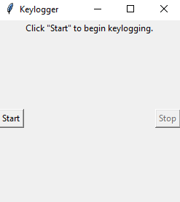
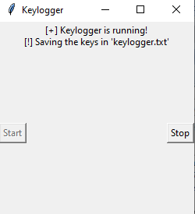
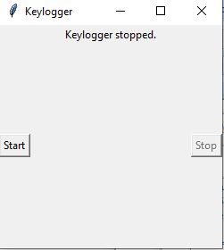
Result
The keylogger runs and save all key strokes to c:\output.txt
KEY LOGGER
Start:
Running:
Stop:

Slide 8
Conclusion
In summary, the threat of keyloggers poses a significant risk to
cybersecurity, potentially compromising sensitive information through
covert keystroke monitoring. Effective detection, prevention, and user
education are essential in mitigating this threat. By employing sophisticated
algorithms, proactive deployment strategies, and user awareness initiatives,
organizations can bolster their defenses against keylogger attacks.
Prioritizing these measures is crucial for safeguarding digital assets,
preserving privacy, and maintaining trust in an increasingly interconnected
environment.

Slide 9
Future scope
Enhanced AI algorithms for more accurate detection.
Integration with blockchain technology for immutable logging.
Development of hardware-based prevention mechanisms.
Implementation of biometric authentication to supplement keystroke
analysis.
Expansion of keylogger detection to IoT and mobile devices.
Collaboration with cybersecurity firms for threat intelligence
sharing.

Slide 10
References
Title: "Keylogger Threats:
Detection and Prevention" Authors: [Your Name]
Publication Date: [Publication Date]
Publisher: [Publisher Name]
DOI/URL: [DOI or URL if available]

Slide 11
THANK YOU

