Slide 1
Methoden und Anwendungen des maschinellen Lernens
Project by
Srinivas Kachavarapu

Slide 2
PROJECT WORKFLOW
Build and test
model_1
Train
data_collection
pre_processing
prediction
Test
trained model 1
DATA BASE
closed
predictions
trained model 2
model_2
open
Train
pre_processing
Test
pre_processing

Slide 3
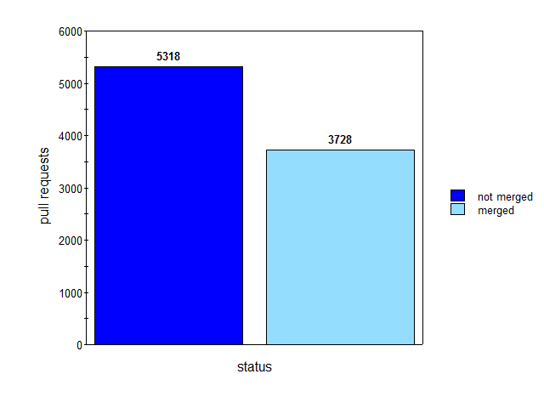
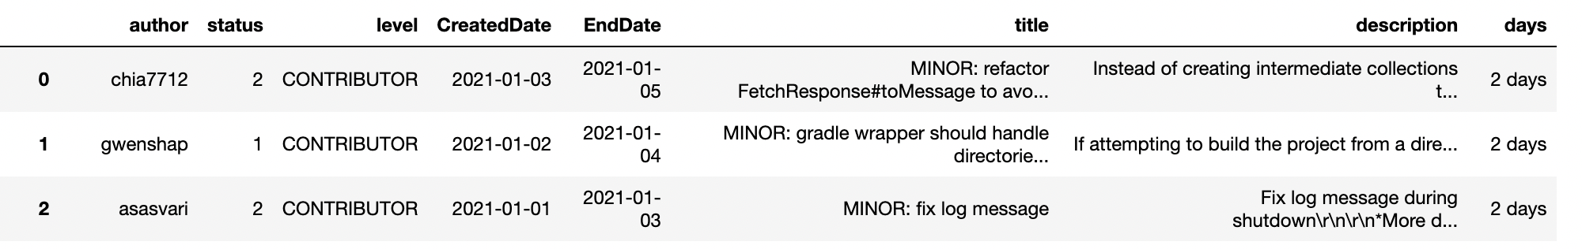
DATA COLLECTION:
closed_pull_requests
chosen project for pilot run
kafka → variety and volume of data
closed pull requests: 9046
open pull requests: 1574
data frame: first three closed pull_requests

Slide 4
Model 1: prediction of accepted or withdraw of pull requests
pre_processing:
input_data made using description, title and role of author of each pull request (not clean )
cleaning text data: NLTK
1. Normalizing Text (lower case)
2. Removing Unicode Characters (Punctuations, Emoji’s, URL’s and special symbols)
3. Removing Stopwords
4. Lemmatizing (groups words by their root stem and tense)
text - numbers (CountVectorizer) → class = 1 (not_ merged) , class = 2 (merged)
training and testing:
training_data = 80% , testing_data = 20% and random_state = 100
initial_accuracy = 62% to final_accuracy = 86% with feature engineering and parameters tuning
feature engineering
replacing NaN values with a string
adding more variables to input_data
limiting features in countVectorizer
parameters tuning
max_iter
max_depth
activation_function

Slide 5
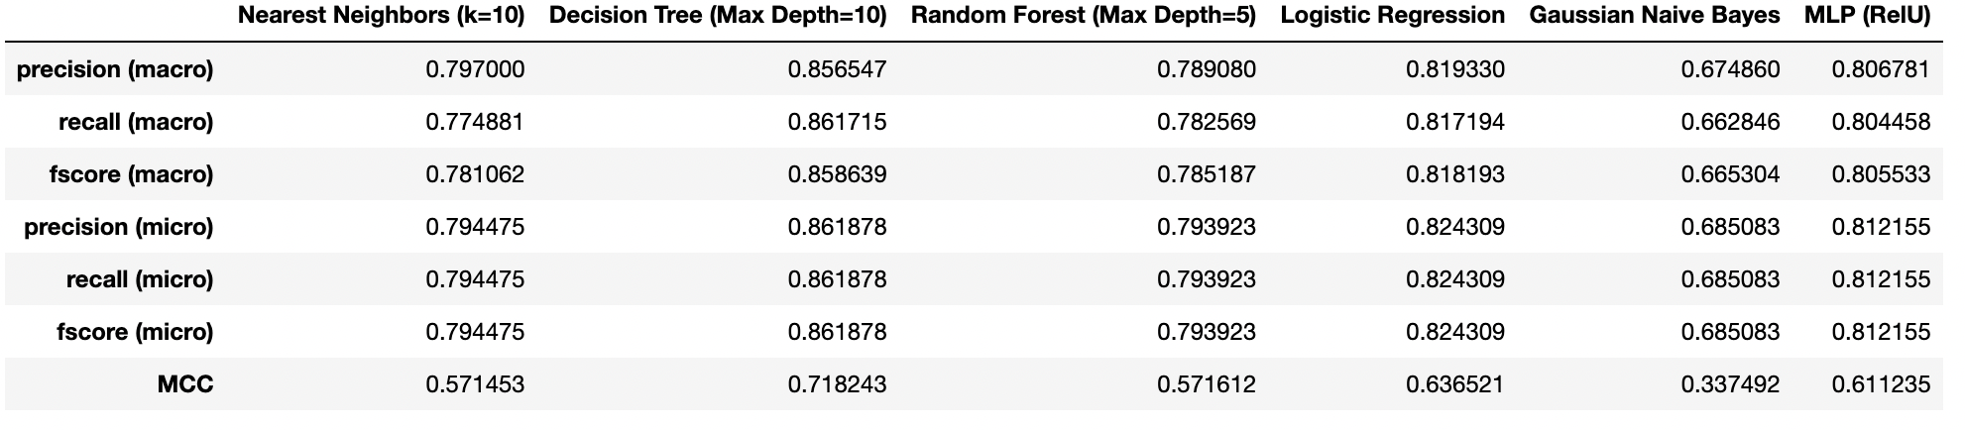
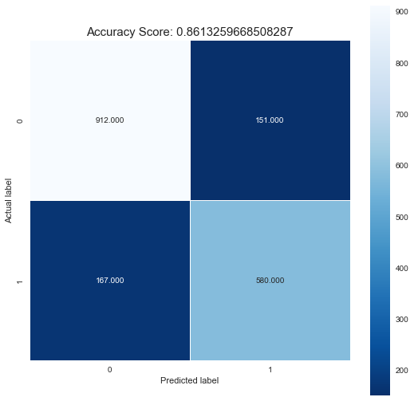
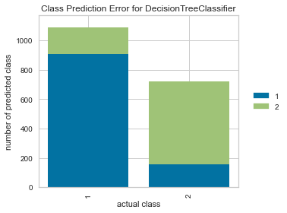
Model 1: prediction of accepted or withdraw of pull requests
Decision Tree: Max Depth = 10

Slide 6
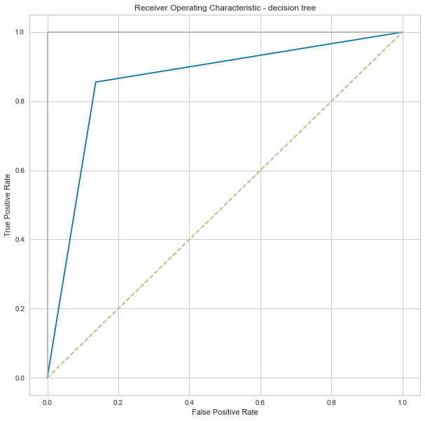
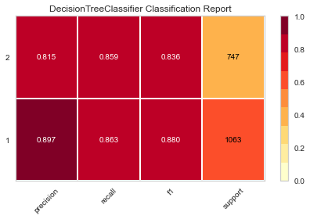
Model 1: prediction of accepted or withdraw of pull requests
Evaluation:

Slide 7
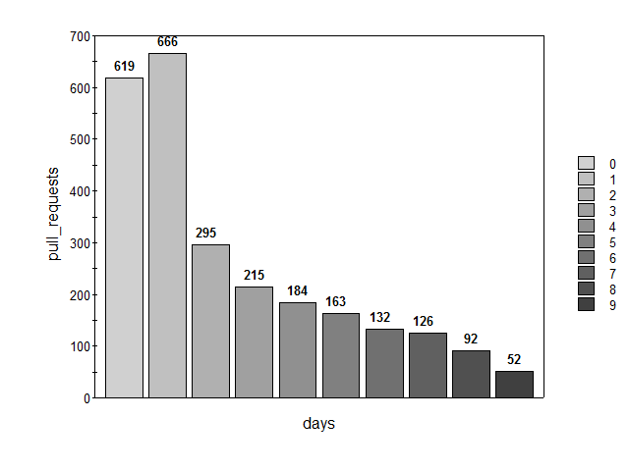
Model 2: prediction of the time needed for closed pull requests
preprocessing:
input data made with titles and level of author from data frame and cleaned data similarly as in model 1
time taken by each pull request based on start date and end date
only took pull requests into account which are merged within less than 9 days
labels:
1 = 0 to 2 days
2 = 3 to 9 days
Training & Testing:
tried with LSTM → high training time >2 hours per epoch
MLP huge problem with overfitting, bad generalization
best performance so far is decision tree classifier:
accuracy score : 0.6286836935166994
f1 score : 0.6330097087378641
Precision score : 0.652
recall score : 0.6150943396226415
mcc: 0.2583572218956644
Days taken to accept PR

Slide 8
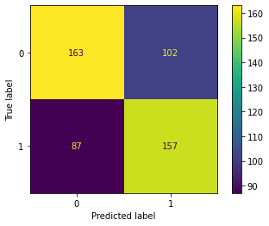
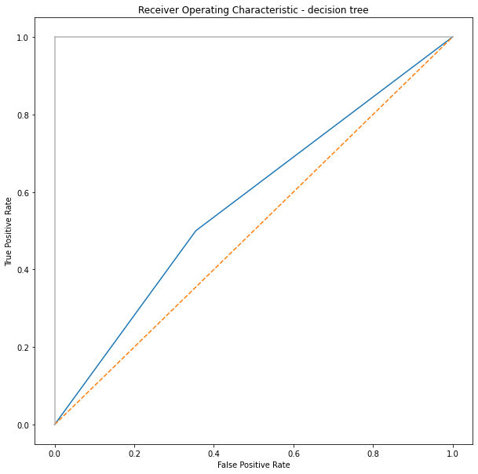
Model 2: prediction of the time needed for closed pull requests
evaluation:

Slide 9
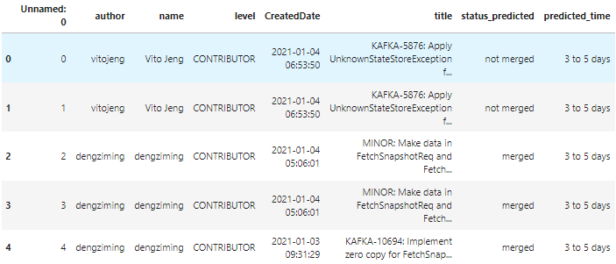
predicting open pull requests:
getting all open PRs from a certain project
let both models run over it
every model adds one column to dataframe
status_predicted: if PR is likely to be merged or not
time_predicted: time which is most likely to pass before PR is accepted or rejected

Slide 10
Performance on all projects
Project | status prediction accuracy | time prediction accuracy
kafka | 86% (good balance in data) | 63%
Common math | 70% | 62%
Zookeeper | 100%? most of closed PR rejected | not enough data
Zeppelin | 98%? mcc = 0 (no variety in data, almost all pull requests either rejected or merged) | not enough data
Flume | 97%? same as Zeppelin | not enough data
Phoenix | 75% | 60%
Project still in pilot phase
Status prediction is of acceptable performance
Time prediction still needs to be tuned
constant monitoring and incrementally upgrades with new data mandatory for both models
better generalization needed
use model only as additional feature for information, humans need to be kept in the loop

Slide 11
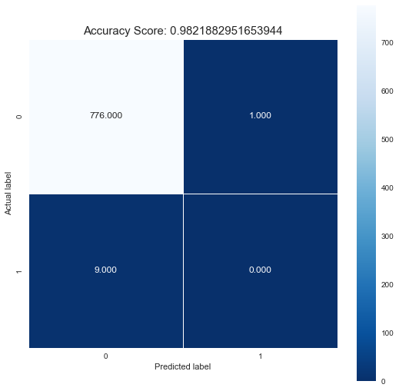
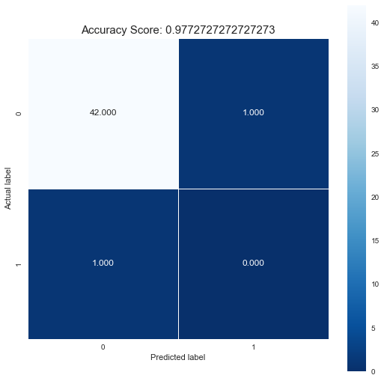
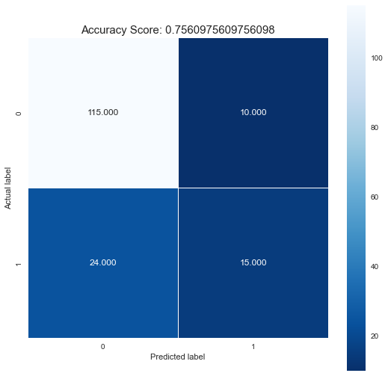
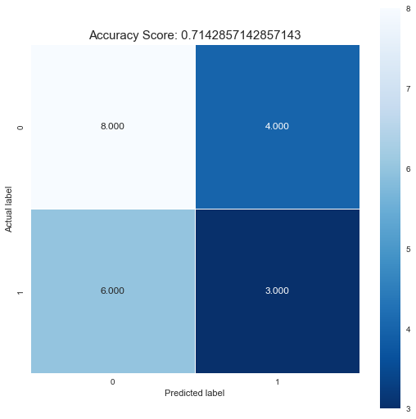
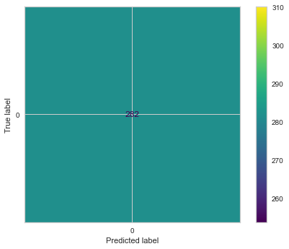
Performance on all projects
zepplin
flume
phoenix
commons-math
zookeeper

Slide 12
Key benefits & risks
Benefits | Risks
less workload for maintainers | to much trust on the model leads to faulty PRs getting merged
less PR-”corpses” → maintainers can look why some PRs taking longer to merge | model is rejected by users
PR creators can get a warning when PR will most likely be rejected | cost of maintenance is too high - monitoring, constant updating, needed infrastructure
can be unique selling point when properly introduced | label leakage can lead to “too good results” → underperformance on data largely different from training data
quality of PRs increase | currently just english texts supported

Slide 13
THANK YOU :)
Any Questions ?

