Slide 1




Edge IoT Based Assistive Device for Respiratory Patients Based on Geospatial data
Guided By:
Prof. Chandrasekar Vuppalapati
Team Members:
Kavya Balihallimatta (013819923)
Nithya Kuchadi (013769665)
Sahana Ramesh (013832065)
Notes:
Hello everyone,
Our project is Edge IoT Based Assistive Device for Respiratory Patients Based on Geospatial data. We have done this project under the guidance of professor chandrashekar vuppalpati. I am sahana and my team members are Kavya and Nithya.

Slide 2

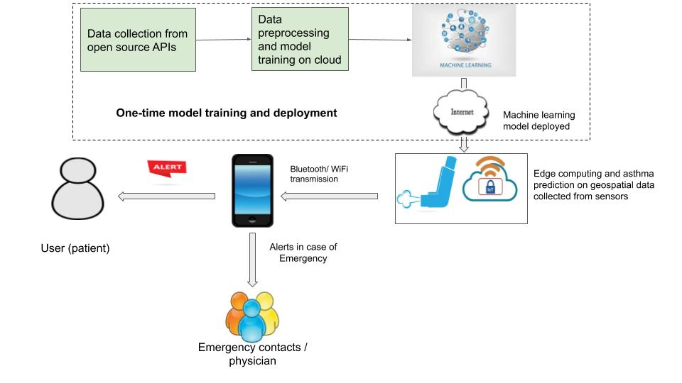
Project Architecture

Slide 3
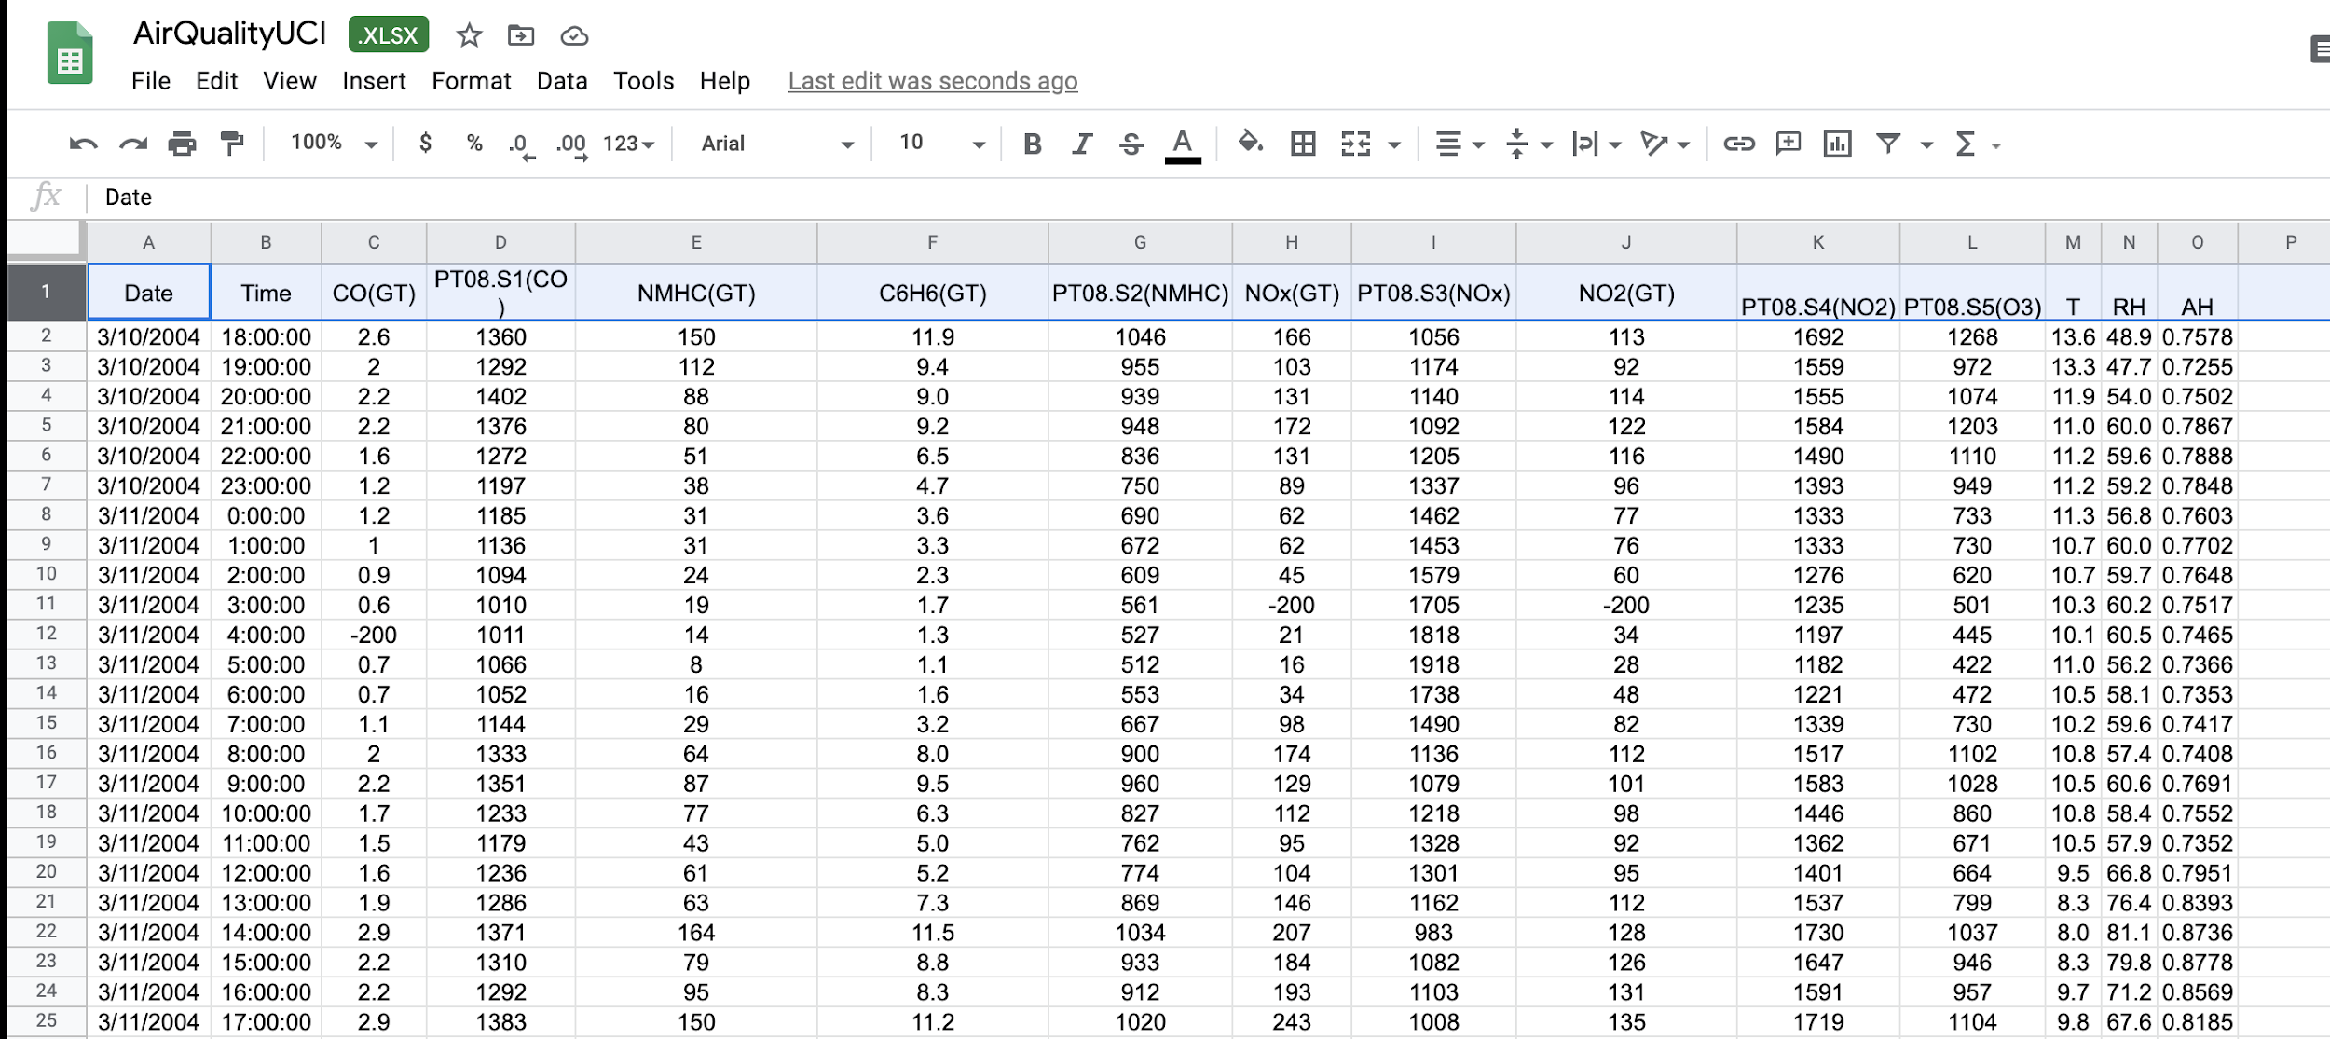
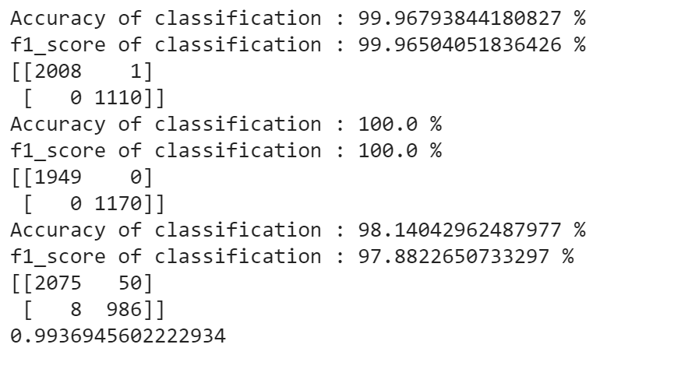
Implementation - Machine Learning
Steps involved:
1) Data cleaning
2) Feature selection
3) Model training
4) Model Evaluation

Slide 4
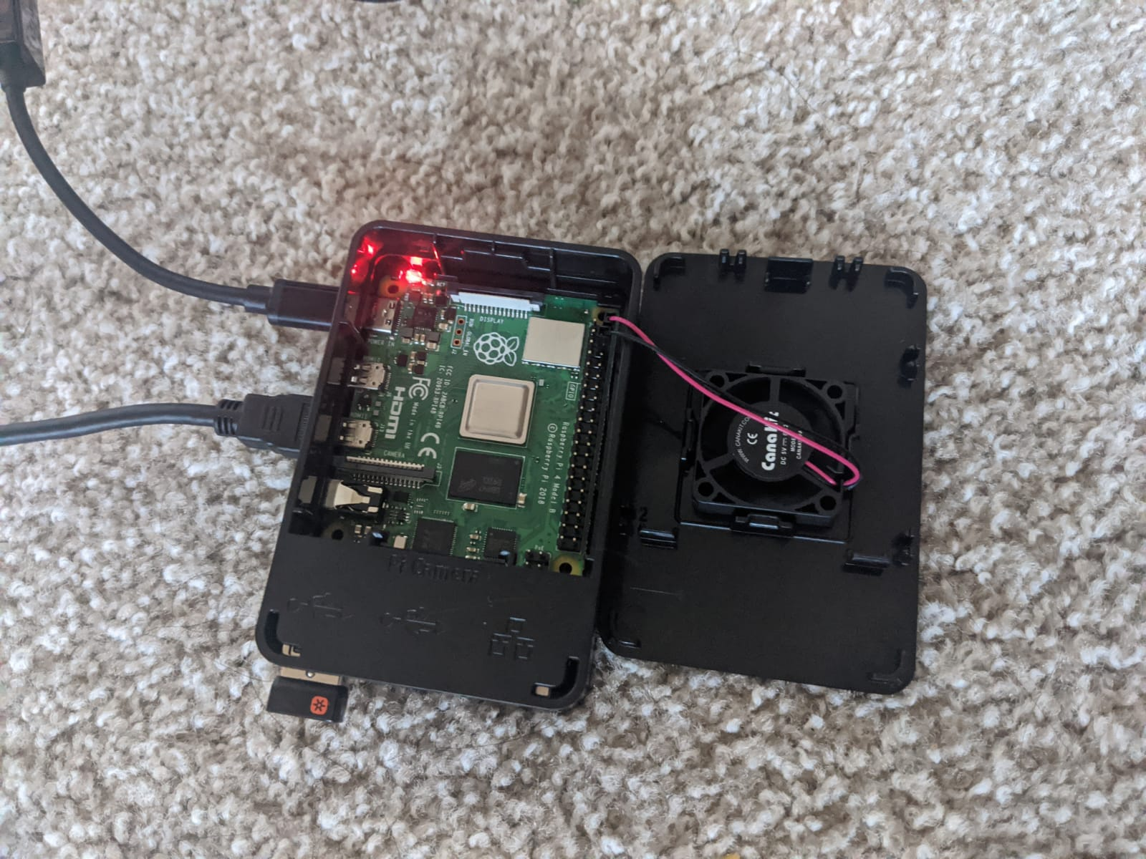
Edge IoT Analytics

Slide 5


Slide 6


