Slide 1


WORD COUNTER
SUPERVISOR Mr.A.Malarmannan,M.E., AP/CSE.
PRESENTED BY
2303811710422156-SRINITHI D

Slide 2

PRESENTATION OVERVIEW
Objective
Project Introduction
Problem Statement
Methodologies (Programming concepts relevant to problem statement)
Architecture of the proposed system
List of Modules
7. Merits
8. Results and Discussion
9. Queries

Slide 3
OBJECTIVE
Counts the total number of words in any given text.
Provides the frequency of each word (word occurrences).
Counts the total number of lines.
Counts the total number of characters (including spaces and punctuation).
Handles multiple lines of input with accurate and case-insensitive processing.

Slide 4
PROJECT INTRODUCTION
Automates text analysis for word, line, and character counts with word frequency insights.
Handles multiple lines, removes punctuation, and provides case-insensitive analysis.
Quick, error-free solution for structured text analysis across various domains.

Slide 5
PROBLEM STATEMENT
Manually analyzing a large block of text to count words, characters, and lines is inefficient and error-prone.
Basic Text Processing
While it handles punctuation and case, the program doesn't consider more complex linguistic structures, such as stemming or lemmatization (e.g., treating "running" and "run" as the same word).
Limited Character Encoding Support:
The program doesn’t handle special character encodings like Unicode for non-English characters or symbols well, which might limit its use in multilingual environments.

Slide 6
Methodologies (Programming concepts relevant to problem statement)
GUI Development: Designed a user-friendly interface using Java AWT components like Frame, TextArea, and Button.
Event Handling: Managed user interactions with ActionListener and WindowAdapter.
Text Processing: Used string manipulation and regular expressions for text cleaning and analysis.
Data Structures: Leveraged HashMap for efficient word frequency computation.

Slide 7
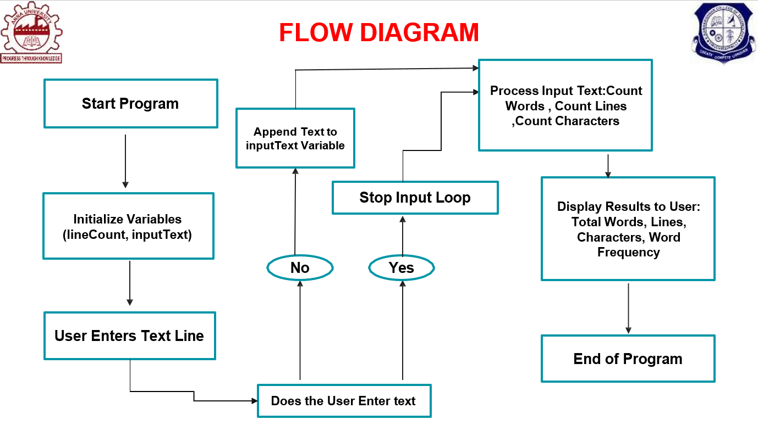
FLOW DIAGRAM

Slide 8
MODULE DESCRIPTION
Input Module :
1. Allows the user to input multiple lines of text.
2. Input loop terminates when the user types "exit".
3. Stores the input in a single string variable.
Processing Module :
Word Counting: Processes the text, removes punctuation, and splits it into words.
Word Frequency Analysis: Uses a HashMap to count occurrences of each word, ignoring case sensitivity.
Character Counting: Calculates the total number of characters, including spaces and punctuation.
Line Counting: Counts the total number of lines entered by the user.
Output Module :
Displays total words, lines, characters, and word frequency in a clear format.

Slide 9
MERITS
Automated and Detailed Text Analysis:
Unlike simple word counters, this program not only counts words but also analyzes the structure of the text by counting lines and characters and providing word frequency.
Punctuation Handling:
The program removes punctuation before counting words, ensuring that
words like "hello!" and "hello" are treated as the same word.
Reusability:
Can be adapted for various use cases like analyzing text files, articles, chat logs, or any textual data where word analysis is needed.

Slide 10
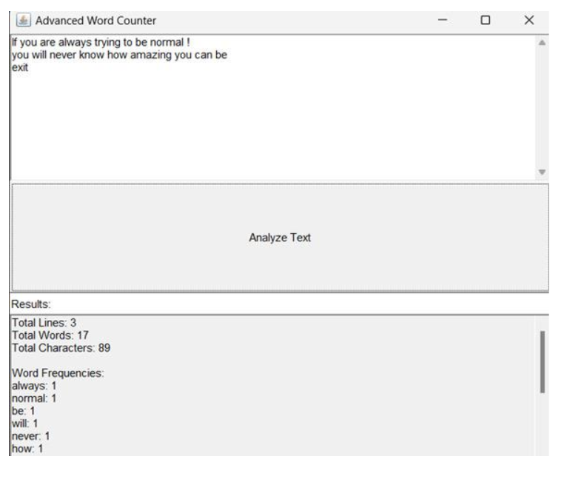
RESULT AND DISCUSSION

Slide 11
ANY QUERIES ?

Slide 12
THANK YOU

