Slide 1
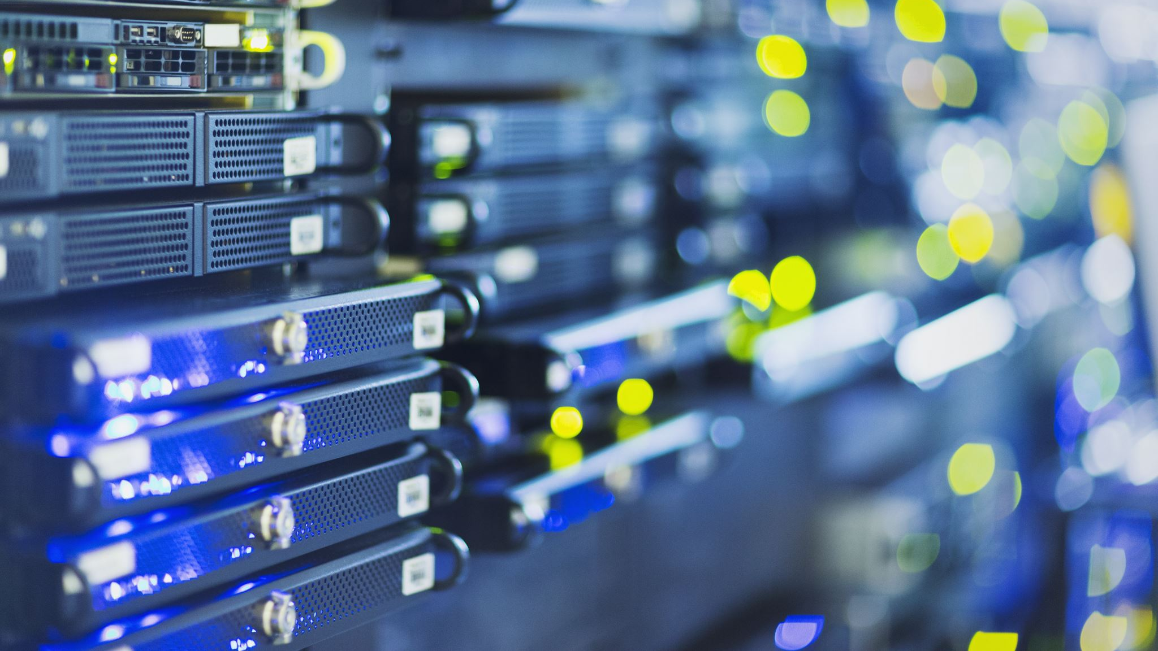


Serverless IOT Data Processing

Slide 2
Team Members :
M.SRINITHI
P.YOGAMEENA
L.A.SUBIKSHA
P.PREETHIKA
V.N.VARSHA
M.LEKA
S.SHALINI

Slide 3
Serverless Iot Data Processing:
Serverless Data Processing. Find resources to build and run data processing applications without thinking about servers.
Serverless data processing exploits Function as a service (FaaS) that is a category of services that provides a platform allowing customers to develop, run, and manage application functionalities without the complexity of building and maintaining the infrastructure typically associated with developing and launching an app.
The Internet of things (IoT) is the network of physical devices, vehicles, home appliances, and other items embedded with electronics, software, sensors, actuators, and connectivity which enables these things to connect, collect and exchange data.

Slide 4
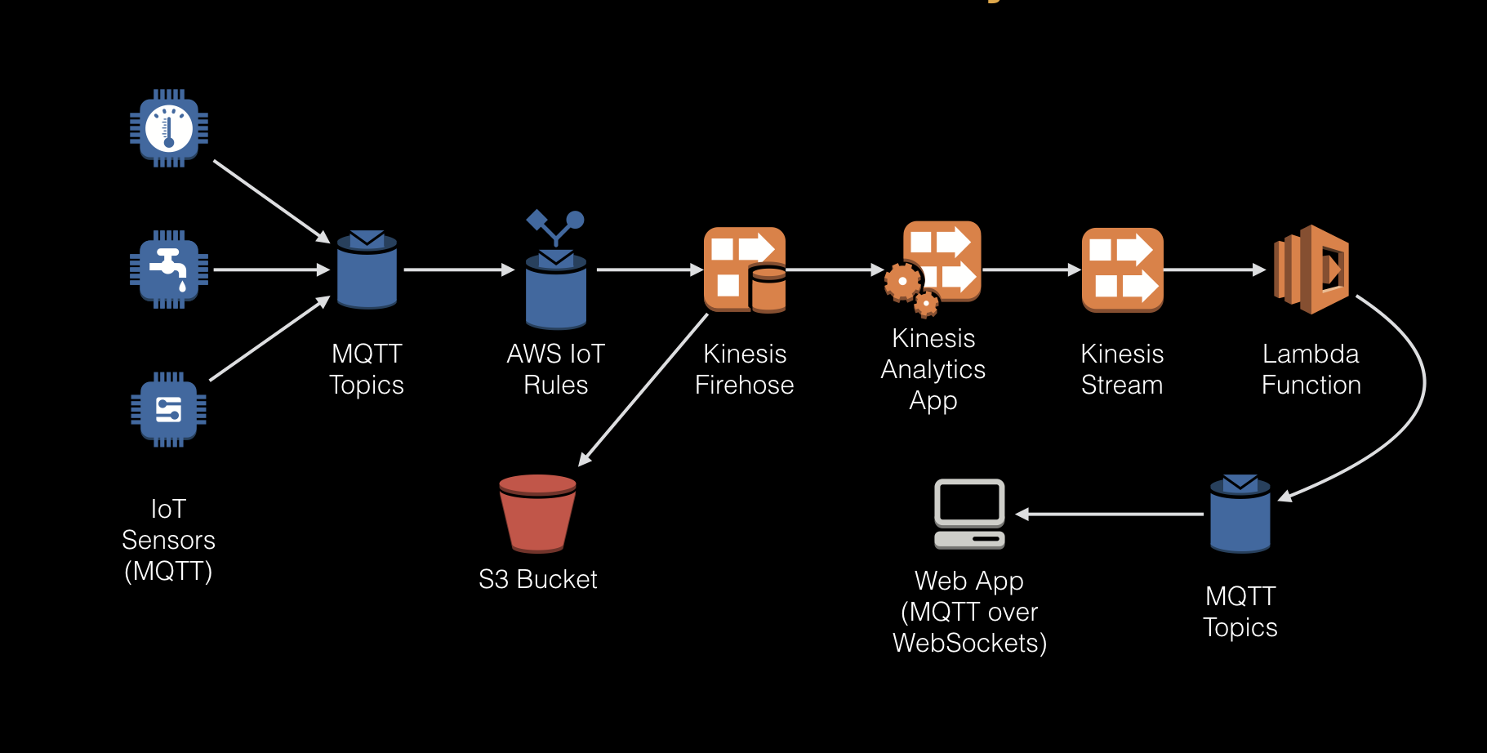
Prerequisites
OS:
Ubuntu
Software:
Nuclio (Serverless computing provider)
Node.js

Slide 5
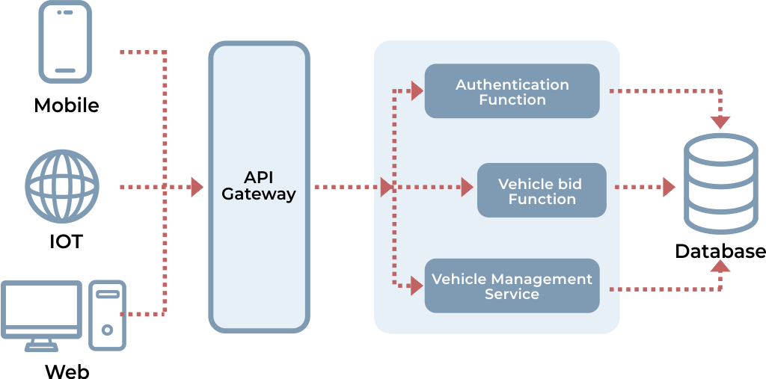
Scalability: Serverless architectures offer greater scalability, more
WORKING :
Serverless is a cloud-native development model that allows developers to build and run applications without having to manage servers.
This Framework is open source software that builds, compiles, and packages code for serverless deployment, and then deploys the package to the cloud.
Important three core components of serverless involved in development are FaaS (Function As A Service), BaaS (Backend As A Service), API Gateway.

Slide 6
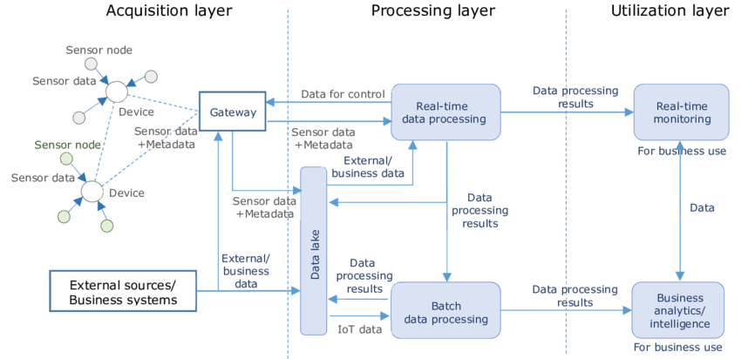
Work flows in the IoT system layers

Slide 7
Python code to integrate smart devices with IoT:
import paho.mqtt.client as mqtt
import jsonimport time
# MQTT settings
mqtt_broker = "mqtt.example.com“
mqtt_port = 1883
mqtt_topic = "smart_home/devices“
# Device settings
devices ={
"light_1": {"state": False},
"light_2": {"state": True},
"thermostat": {"temp": 22}
}
def on_connect(client, userdata, flags, rc):
print("Connected with result code "+str(rc))
def on_message(client, userdata, msg):
print(msg.topic+" "+str(msg.payload))

Slide 8
client = mqtt.Client()
client.on_connect = on_connect
client.on_message = on_message
client.connect(mqtt_broker, mqtt_port)
while True:
for device, state in devices.items():
payload = json.dumps(state)
client.publish(mqtt_topic+"/"+device, payload)
time.sleep(5)
client.loop_forever()

Slide 9
EXPLANATION :
This code creates a MQTT client to connect to a MQTT broker. It has a devices dictionary containing the state of some sample smart devices. \
In the main loop, it publishes the state of each device to a MQTT topic periodically. The topic is in the format "smart_home/devices/<device_id>".
The MQTT broker can then distribute these messages to other clients like a home automation controller to take action based on the device state. Additional devices can be added to the devices dictionary.
Some key points:
- paho.mqtt.client library is used for MQTT messaging.
- json is used to serialize the device state into JSON payload.
- Devices publish state messages periodically to broker using MQTT topics.
- Broker can distribute messages to interested clients like a home automation system.

Slide 10
Python code to collect data from the integrated IoT devices using MQTT:
import paho.mqtt.client as mqtt
import json
# MQTT settings
mqtt_broker ="mqtt.example.com“
mqtt_port = 1883
mqtt_topic ="smart_home/devices“
# Callback for when a PUBLISH message
is received from the server.
def on_message(client, userdata, msg):
# Decode JSON payload
data =json.loads(msg.payload.decode())
device_id = msg.topic.split("/")[-1]
# Print device data
print(f"Received data from {device_id}: {data}"))

Slide 11
# Store device data to database/file etc.
store_device_data(device_id, data)
# Connect MQTT
Clientclient=mqtt.Client()
client.connect(mqtt_broker, mqtt_port)
client.on_message=on_message
# Subscribe to all device topicsclient.subscribe(mqtt_topic+"/#")
# Loop forever to receive dataclient.loop_forever()

Slide 12
EXPLANATION :
This code creates a MQTT client and subscribes to all topics under "smart_home/devices".
When a new message is received, the on_message callback parses the JSON payload, extracts the device id from topic and processes the data.
The data can be stored to a database, file or processed further.
Additional logic can be added to the on_message callback for specific data handling required for different devices.
This allows collecting data published by the variety of IoT devices in an automated way for further analytics and visualization.

Slide 13
CONCLUSION :
The accelerating growth of IoT devices increases the pressure on the organization by developing technologies in project management. Therefore, it emphasizes the importance of clearly defined organization, policy, framework or guidelines that focus on every area under the IoT umbrella. Serverless is a cloud-native development model that allows developers to build and run applications without having to manage servers.
So our upcoming document of phase 4 will describe the implementation of our project

