Slide 1



Serverless IOT Data Processing

Slide 2
Team Members :
M.SRINITHI
P.YOGAMEENA
L.A.SUBIKSHA
P.PREETHIKA
V.N.VARSHA
M.LEKA
S.SHALINI

Slide 3
Serverless IoT Data Processing" is a project that aims to efficiently handle and analyze data from IoT devices using serverless computing, making it cost-effective and scalable. This system will leverage serverless computing technologies to automate data ingestion, storage, and analysis processes without the need for managing traditional servers.
PROJECT DEFINITION :
DESIGN THINKING :
- Learn about the needs of IoT users and data analysts.
- Define the project's goals and objectives.
- Create the serverless IoT data processing system.
- Test it to ensure it works as intended.
- Gather input from users and make improvements.
- Test again and refine as needed
- Deploy the system for real-world use.
- Monitor and maintain it post-launch

Slide 4
PROBLEM WITH SERVERLESS COMPUTING
One of the most commonly discussed challenges when working with serverless is called the cold start problem. While the goal with serverless is allow functions to immediately be executed on demand, there are some scenarios that may result in predictable delays.
Top level security features are needed to maintain the integrity of the data and the trustworthiness of the hardware devices handling the cloud data. Data leaks and privacy breaches will reduce the confidence of cloud computing users to store their sensitive personal information on cloud servers.

Slide 5
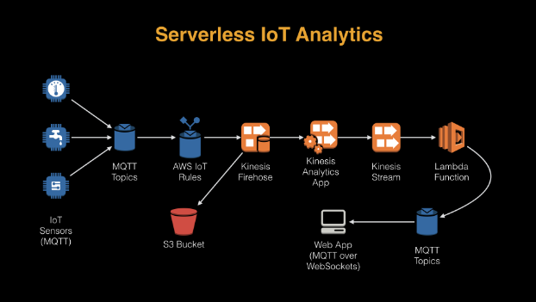
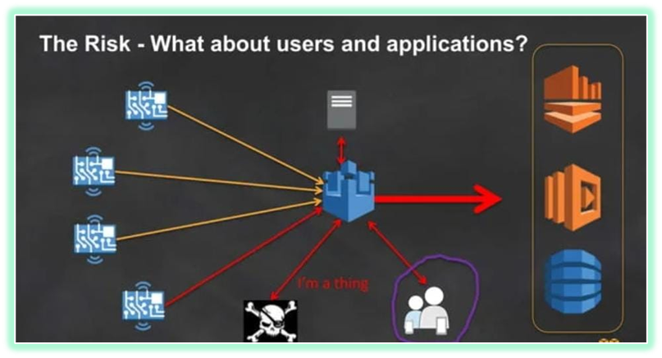
ANALYTICS :

Slide 6
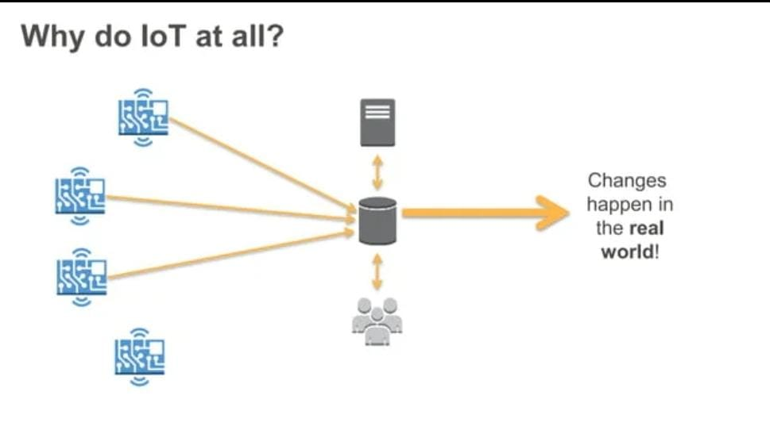
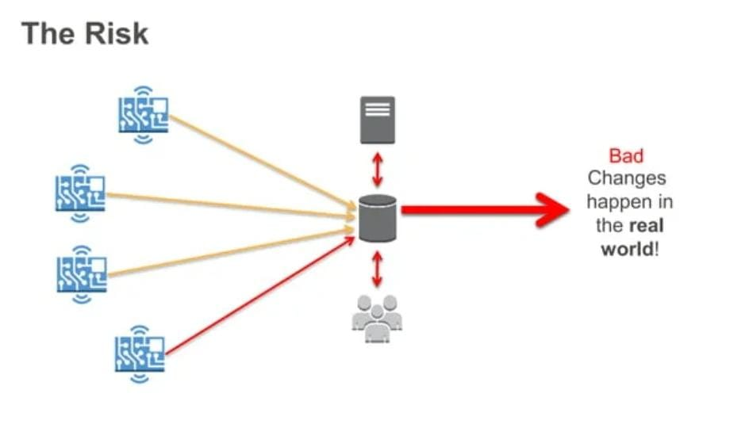
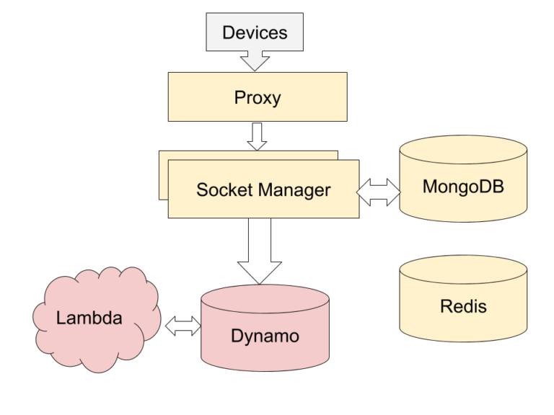
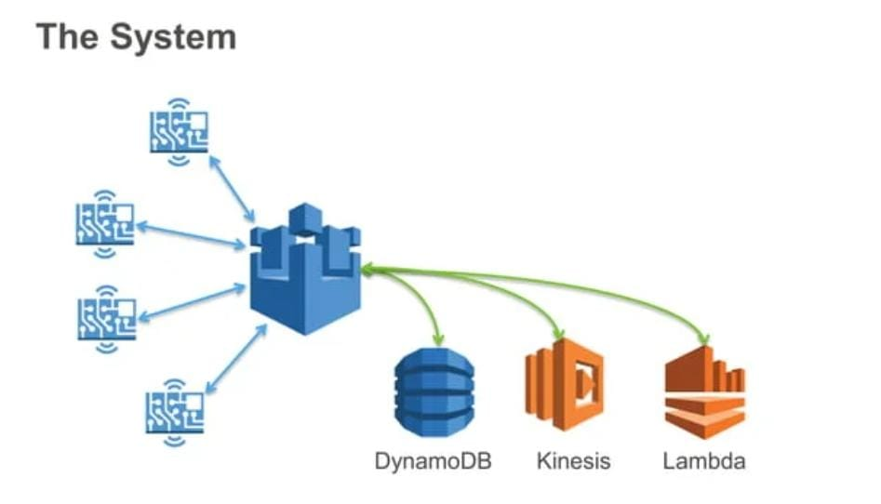
RISK AND THE SYSTEM :

Slide 7
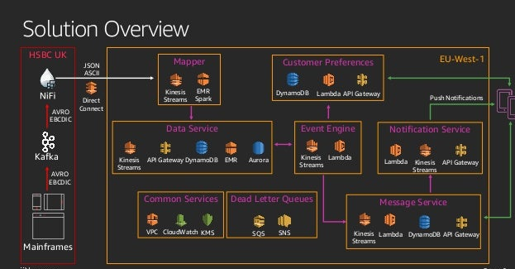
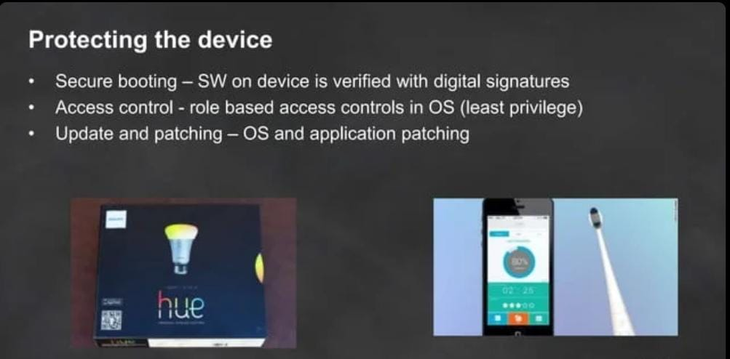
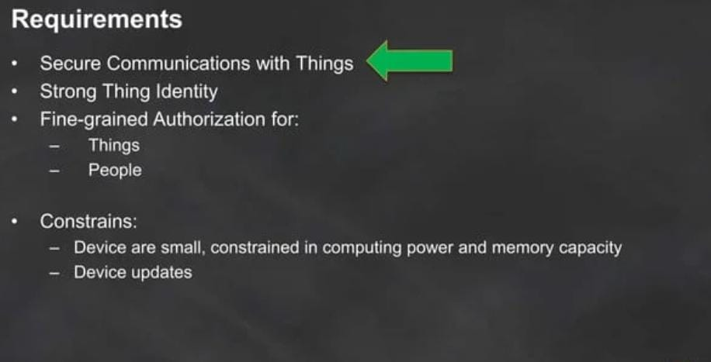
SOLUTION :

Slide 8
CONCLUSION :
The accelerating growth of IoT devices increases the pressure on the organization by developing technologies in project management.
Therefore, it emphasizes the importance of clearly defined organization, policy, framework or guidelines that focus on every area under the IoT umbrella.
Serverless is a cloud-native development model that allows developers to build and run applications without having to manage servers.
There are still servers in serverless, but they are abstracted away from app development.
So our upcoming document of phase 2 will describe the specification and implementation of our project

