Slide 1



Serverless IOT Data Processing

Slide 2
Team Members :
M.SRINITHI
P.YOGAMEENA
L.A.SUBIKSHA
P.PREETHIKA
V.N.VARSHA
M.LEKA
S.SHALINI

Slide 3
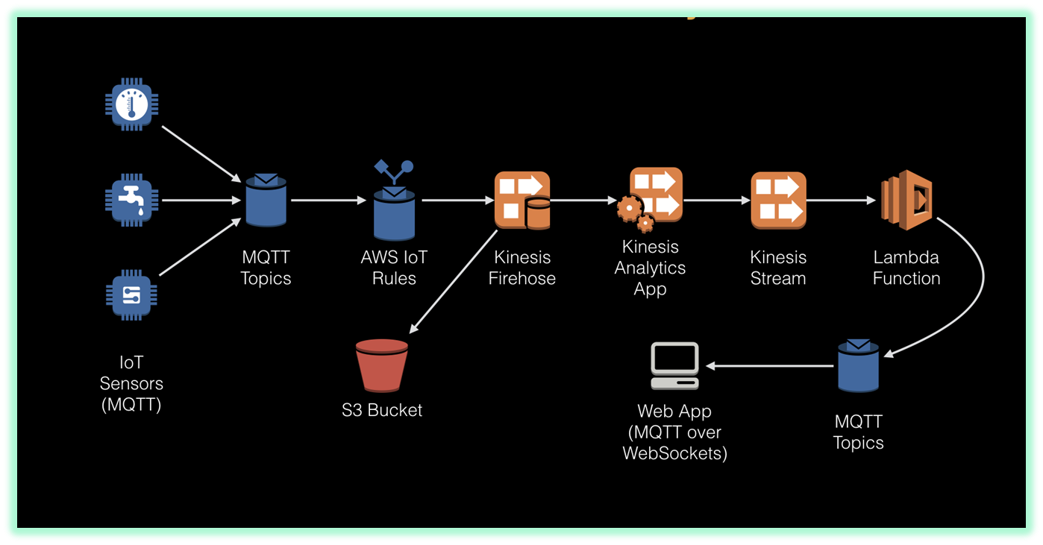
Serverless Iot Data Processing:
Serverless Data Processing. Find resources to build and run data processing applications without thinking about servers.
Serverless data processing exploits Function as a service (FaaS) that is a category of services that provides a platform allowing customers to develop, run, and manage application functionalities without the complexity of building and maintaining the infrastructure typically associated with developing and launching an app.
The Internet of things (IoT) is the network of physical devices, vehicles, home appliances, and other items embedded with electronics, software, sensors, actuators, and connectivity which enables these things to connect, collect and exchange data.
Prerequisites
OS:
Ubuntu
Software:
Nuclio (Serverless computing provider)
Node.js

Slide 4
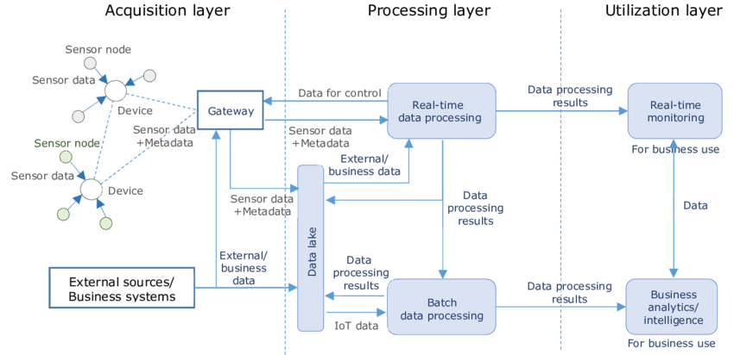
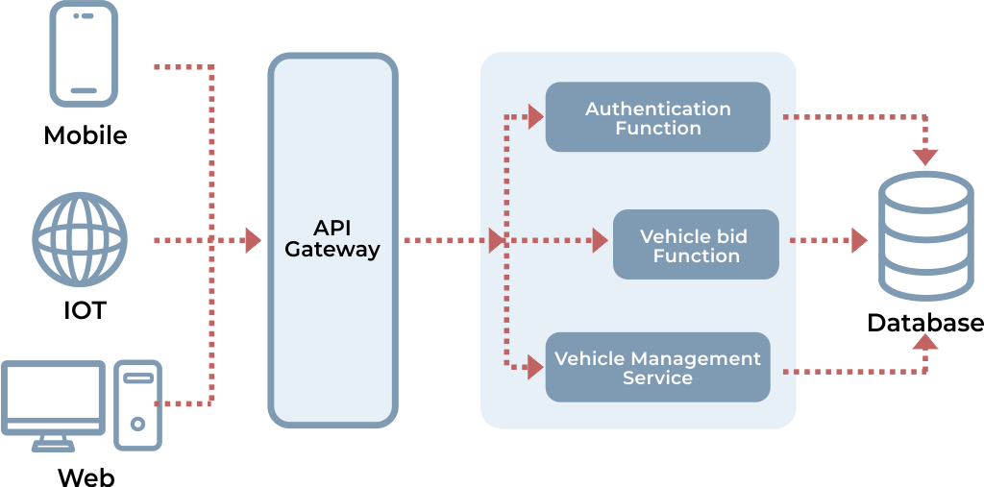
DESIGNING :
Serverless is a cloud-native development model that allows developers to build and run applications without having to manage servers.
This Framework is open source software that builds, compiles, and packages code for serverless deployment, and then deploys the package to the cloud.
Important three core components of serverless involved in development are FaaS (Function As A Service), BaaS (Backend As A Service), API Gateway.
Work flows in the IoT system layers

Slide 5
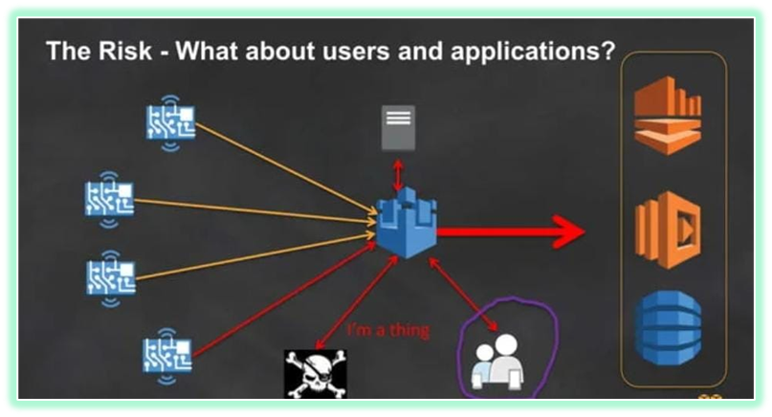
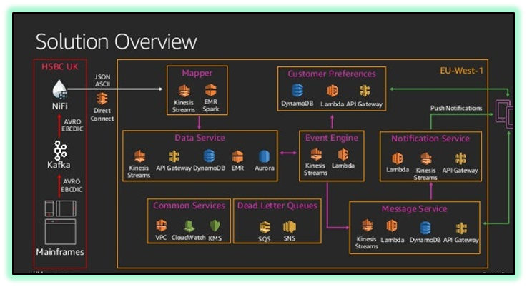
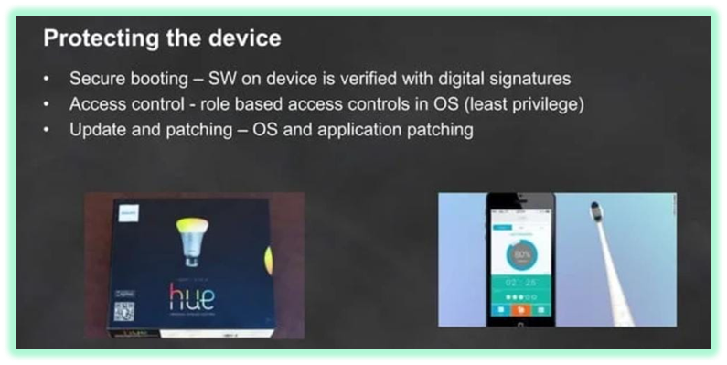
PROBLEMM WITH SERVERLESS COMPUTING :
One of the most commonly discussed challenges when working with serverless is called the cold start problem. While the goal with serverless is allow functions to immediately be executed on demand, there are some scenarios that may result in predictable delays.
Data leaks and privacy breaches will reduce the confidence of cloud computing users to store their sensitive personal information on cloud servers.

Slide 6
Python code to integrate smart devices with IoT:
client = mqtt.Client()
client.on_connect = on_connect
client.on_message = on_message
client.connect(mqtt_broker, mqtt_port)
while True:
for device, state in devices.items():
payload = json.dumps(state)
client.publish(mqtt_topic+"/"+device, payload)
time.sleep(5)
client.loop_forever()
import paho.mqtt.client as mqtt
import jsonimport time
# MQTT settings
mqtt_broker = "mqtt.example.com“
mqtt_port = 1883
mqtt_topic = "smart_home/devices“
# Device settings
devices ={
"light_1": {"state": False},
"light_2": {"state": True},
"thermostat": {"temp": 22}
}
def on_connect(client, userdata, flags, rc):
print("Connected with result code "+str(rc))
def on_message(client, userdata, msg):
print(msg.topic+" "+str(msg.payload))

Slide 7
EXPLANATION :
This code creates a MQTT client to connect to a MQTT broker. It has a devices dictionary containing the state of some sample smart devices. \
In the main loop, it publishes the state of each device to a MQTT topic periodically. The topic is in the format "smart_home/devices/<device_id>".
The MQTT broker can then distribute these messages to other clients like a home automation controller to take action based on the device state. Additional devices can be added to the devices dictionary.
Some key points:
- paho.mqtt.client library is used for MQTT messaging.
- json is used to serialize the device state into JSON payload.
- Devices publish state messages periodically to broker using MQTT topics.
- Broker can distribute messages to interested clients like a home automation system.

Slide 8
Python code to collect data from the integrated IoT devices using MQTT:
import paho.mqtt.client as mqtt
import json
# MQTT settings
mqtt_broker ="mqtt.example.com“
mqtt_port = 1883
mqtt_topic ="smart_home/devices“
# Callback for when a PUBLISH message
is received from the server.
def on_message(client, userdata, msg):
# Decode JSON payload
data =json.loads(msg.payload.decode())
device_id = msg.topic.split("/")[-1]
# Print device data
print(f"Received data from {device_id}: {data}"))
client = mqtt.Client()
client.on_connect = on_connect
client.on_message = on_message
client.connect(mqtt_broker, mqtt_port)
while True:
for device, state in devices.items():
payload = json.dumps(state)
client.publish(mqtt_topic+"/"+device, payload)
time.sleep(5)
client.loop_forever()

Slide 9
EXPLANATION :
This code creates a MQTT client and subscribes to all topics under "smart_home/devices".
When a new message is received, the on_message callback parses the JSON payload, extracts the device id from topic and processes the data.
The data can be stored to a database, file or processed further.
Additional logic can be added to the on_message callback for specific data handling required for different devices.
This allows collecting data published by the variety of IoT devices in an automated way for further analytics and visualization.

Slide 10
To collect data from IoT devices and process it using IBM Cloud without the need for a dedicated server :
Device Data Collection: Set up your IoT devices to collect data from sensors or sources. These devices can be integrated with MQTT or other IoT protocols to send data to the cloud.
IBM IoT Platform: Utilize IBM's IoT platform, such as IBM Watson IoT, to manage your devices, receive data, and control them remotely. This platform provides tools for device management and data ingestion.
Data Storage: IBM Cloud provides data storage services like IBM Cloud Object Storage or IBM Db2, where you can securely store your IoT data. Choose the appropriate storage service based on your data volume and structure.
Data Processing: Use IBM Cloud services like IBM Watson Studio or IBM Cloud Functions to process and analyze the collected data. You can set up data pipelines and apply machine learning models to gain insights from the data.

Slide 11
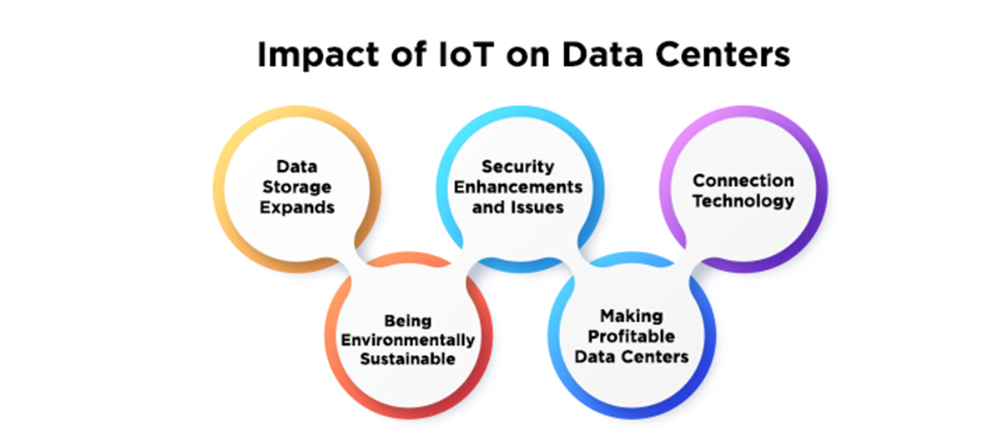
Data Visualization: Create dashboards or use IBM Cloud services like Watson Studio to visualize the processed data. This enables you to monitor your IoT devices and make informed decisions.
Automation: Implement automation using IBM Cloud Functions or Node-RED to trigger actions based on the data received from IoT devices. For example, you can automate responses to specific sensor readings.
Security and Compliance: Ensure that your IoT data and processes comply with security and privacy standards. IBM Cloud provides security features and services to protect your data and applications.

Slide 12
Scalability: Serverless architectures offer greater scalability, more
DATA STORAGE :
Python
import ibm_boto3
from ibm_botocore.client import Config
# Initialize SDK credentials
ibm_api_key_id = "<ibm_api_key>"
service_instance_id = "<service_instance_id>“
# Create resource for accessing
IBM Cloud Object Storage
cos = ibm_boto3.resource("s3",
ibm_api_key_id=ibm_api_key_id,
ibm_service_instance_id=
service_instance_id,
config=Config(signature_version="oauth"),
endpoint_url='https://s3.private.us-south.cloud-object-storage.appdomain.cloud’)
# Get reference to bucket
bucket = cos.Bucket("iot-data-bucket")
#Sample IoT data
iot_data = {
"timestamp": "1608150940",
"device_id": "sensor1",
"temperature": 29,
"humidity" : 80
}
# Upload data as object to COS
object = bucket.Object("iot-data.json")
response = object.put(
Body=json.dumps(iot_data)
)
print(response)
EXPLANATION :
This saves the IoT data dictionary as a JSON object in IBM Cloud Object Storage. The credentials, service instance ID, bucket name etc. would need to be configured as per your environment. The data can then be processed and analyzed from COS.

Slide 13
DATA PROCESSING :
Python
import json
import ibm_boto3from ibm_botocore.client
import Config
# SDK credentials
api_key = "<ibm_api_key>“
service_instance_id = "<service_instance_id>“
# COS access
cos = ibm_boto3.resource("s3",
ibm_api_key_id=api_key,
ibm_service_instance_id=
service_instance_id,
config=Config(signature_version="oauth"),
endpoint_url='https://s3.private.us
cloud-object-storage.appdomain.cloud’)
bucket = cos.Bucket("iot-data-bucket")
# Read object containing IoT data
obj = bucket.Object("iot-data.json“)
file_content = obj.get()
['Body'].read()
# Deserialize JSON data
iot_data = json.loads(file_content)
# Process data
device_id =iot_data['device_id’]
temperature = iot_data['temperature'] humidity = iot_data['humidity’]
# Print processed results
print(f"Device {device_id}
recorded temperature {temperature} and humidity {humidity}")
EXPLANATION :
This loads the IoT data JSON from COS, deserializes it and extracts the device ID, temperature and humidity. These values are printed, but additional processing and analysis can be done on the extracted data based on your requirements.The same approach of reading data from COS and processing it can be implemented in a serverless function as well.

Slide 14
DATA VISUALIZATION :
Python
import json
import ibm_boto3from ibm_botocore.client
import Config
import matplotlib.pyplot as plt
# SDK credentials
api_key = "<ibm_api_key>“
service_instance_id = "<service_instance_id>"
# COS access
cos = ibm_boto3.resource("s3",
ibm_api_key_id=api_key,
ibm_service_instance_id=
service_instance_id,
config=Config(signature_
version="oauth"),
endpoint_url='https://s3.private.us.cloud-object-storage.appdomain.cloud')bucket = cos.Bucket("iot-data-bucket")
# Read JSON object from COS
obj = bucket.Object("iot-data.json")
file_content = obj.get()
['Body'].read()
# Deserialize JSON
iot_data = json.loads(file_content)
# Extract data
timestamps = []
temps = []
for d in iot_data:
timestamps.append(d['timestamp'])
temps.append(d['temperature’])
# Plot visualization
plt.plot(timestamps, temps)
plt.title("Temperature Sensor Data")
plt.xlabel("Time")
plt.ylabel("Temperature (C)")
plt.show()

Slide 15
EXPLANATION FOR VISUALIZATION:
This loads the IoT JSON data from COS, extracts the timestamp and temperature values into lists, and uses matplotlib to plot a graph with time on x-axis and temperature on y-axis.Similar visualizations can be created using IBM Cloud services like Watson Studio notebooks leveraging various Python libraries like matplotlib, seaborn, plotly etc. based on the specific visualization needs.
# Cloud Function to process IoT data
@client.function.invoke
def process_iot_data(iot_data):
# Extract sensor readings
device_id = iot_data['device_id']
temperature = iot_data['temperature']
# Check temperature threshold
if temperature > 30:
send_alert(device_id)
# Cloud Function to send alert
@client.function.invoke
def send_alert(device_id):
print(f'Alert! High temperature on device
{device_id}')
# Sample IoT data
iot_data = { "device_id": "sensor-1", "temperature": 35 }
AUTOMATION :
Python
import json
from ibm_cloud_sdk_core
.authenticators import
IAMAuthenticator
from ibm_funcs.runtime_client
import RuntimeClient
# IBM Functions credentials
ibm_api_key = '<ibm-api-key>’
function_namespace = '<function-namespace>’
authenticator = IAMAuthenticator(ibm_api_key)
client = RuntimeClient(authenticator=authenticator)

Slide 16
EXPLANATION FOR AUTOMATION :
This code defines two IBM Cloud Functions - one to process IoT data and another to send alerts. The process_iot_data function checks the temperature reading and invokes send_alert if it exceeds the threshold. The functions can be triggered through events, webhooks or directly with data as shown. This demonstrates how serverless functions can automate actions based on IoT data analysis.
SECURITY AND COMPLIANCE :
# Encrypt data
encrypted_data = crypto_client
.encrypt('<plaintext-data>’
)# IoT platform service client
service_client = client('iot’,
authenticator=authenticator)
# Securely send data
response =
service_client.publish_event(
typeId='sensor-data',
deviceType='raspberry-pi’,
deviceId='pi01',
eventId='event01',
data=json.dumps({'encrypted_data’:
encrypted_data}),
qualityOfService=0)
print(response)
Python
import json
from ibm_cloud_sdk_core.security
import BaseAuthenticator,
IAMTokenAuthenticator
from ibm_boto3 import client
# Authentication using IAM API
Key
iam_api_key = '<iam_api_key>’
authenticator = IAMAuthenticator(iam_api_key)
# Encryption using IBM Hyper Protect Crypto
from hpcs_python_sdk import
HPCSClient
crypto_client = HPCSClient('<service-URL>’)

Slide 17
EXPLANATION FOR SECURITY AND COMPLIANCE :
Using IAM authentication instead of API key for service access- Encrypting IoT data before sending to platform - Publishing events securely over HTTPS- Storing encryption keys in secure vault like Key ProtectOther measures like VPC, firewall rules, VPN, role-based access, audit logs etc. can be implemented in Infrastructure-as-Code templates.This demonstrates a secure approach for building IoT applications on IBM Cloud.
CONCLUSION :
The accelerating growth of IoT devices increases the pressure on the organization by developing technologies in project management. Therefore, it emphasizes the importance of clearly defined organization, policy, framework or guidelines that focus on every area under the IoT umbrella. Serverless is a cloud-native development model that allows developers to build and run applications without having to manage servers.

