Slide 1
Data science internship (Nov 25-Feb 26) UNIFIED MENTOR PRIVATE LIMITED
Sri Nithya s
UMID18112570810

Slide 2
TABLE OF CONTENTS
Projects List
Tools Used
Project – 1
Objectives & Code
Results & Observations
Interpretation
Project – 2
Project – 3
Project – 4
References

Slide 3
PROJECTS LIST
01
IBM HR Analytics - Employee Attrition & Performance
02
Supply Chain Management Analytics
03
Supermart Grocery Sales
04
Drugs, Side Effects and Medical Condition

Slide 4
Tools used
EDA
Python
Pandas, NumPy, Matplotlib, Seaborn, Plotly
ML
Python
Scikit-Learn, Shap
Dashboard
Power BI
Streamlit

Slide 5

PROJECT -1 IBM HR ANALYTICS - EMPLOYEE ATTRITION ANALYTICS
Project Overview
Employee attrition is a critical challenge for organizations, impacting productivity, morale, and long-term costs. This project delivers an end-to-end HR analytics solution to:
Understand who is leaving
Diagnose why they are leaving
Provide actionable insights for HR policy and retention strategies

Slide 6
Objectives Code
Analyze employee data to understand attrition patterns across demographics, roles, and organizational factors.
Identify key drivers of turnover using explainable machine learning and validated insights.
Translate analytics into executive dashboards that support data-driven HR decisions.
Enable proactive retention strategies through early-risk detection and actionable recommendations.
CODE
1. Exploratory Data Analysis
2. Dashboard

Slide 7
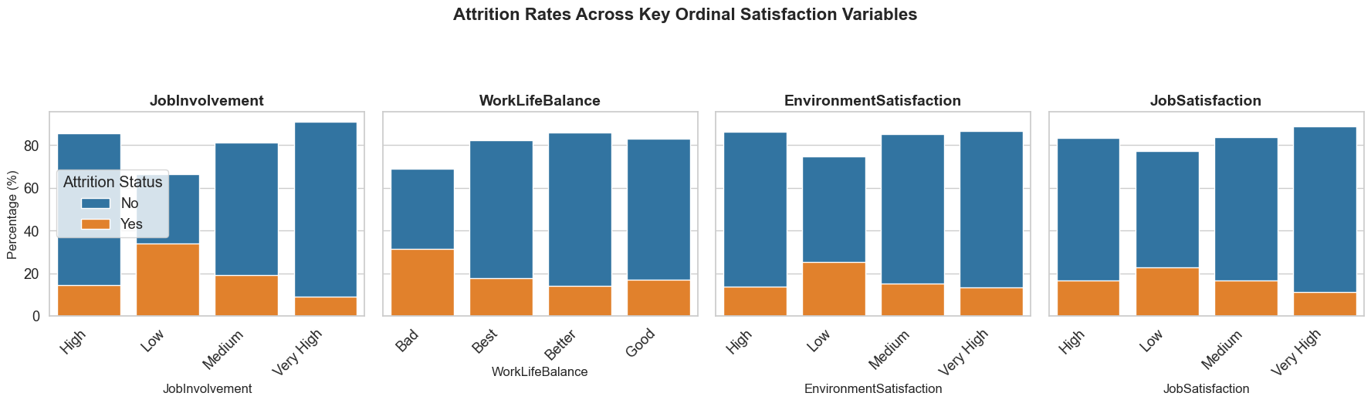
Step 1 – Exploratory Data Analysis - Results
The overall proportion of employees leaving remains relatively constant across varying levels of job satisfaction, involvement, work-life balance, and environment satisfaction

Slide 8
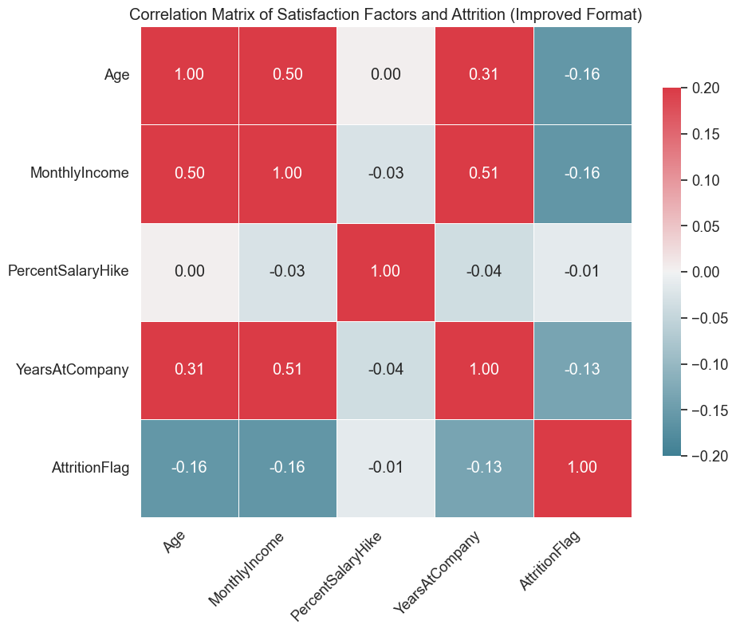
Step 1 – Exploratory Data Analysis - Results
Job Involvement, Environment Satisfaction, and Job Satisfaction are identified as the strongest predictors of employee attrition.
Lower levels in these areas indicate an increased likelihood of an employee leaving.

Slide 9
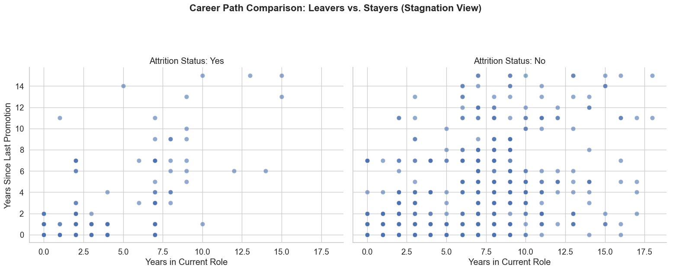
Step 1 – Exploratory Data Analysis - Results
The "Yes" attrition group contains a higher concentration of individuals who accumulated substantial time within the same role without significant vertical movement.
Lack of upward mobility in a non-advancing position is a primary trigger for employees to seek opportunities elsewhere.

Slide 10
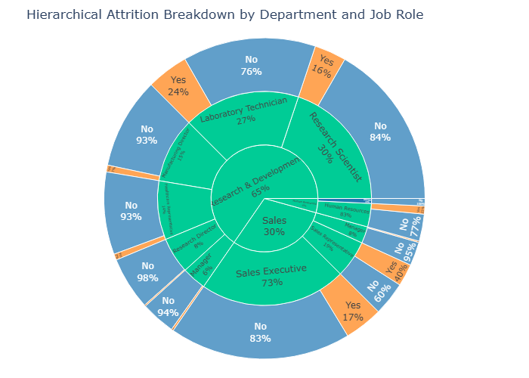
Step 1 – Exploratory Data Analysis - Results
The clear dominance of blue segments confirms that the majority of the workforce in most roles chooses to stay with the company, but attrition hotspots exist in specific high-volume roles within Sales and R&D.
The Sales Executive (17% attrition) and Laboratory Technician (24% attrition) roles have the highest specific turnover rates.

Slide 11
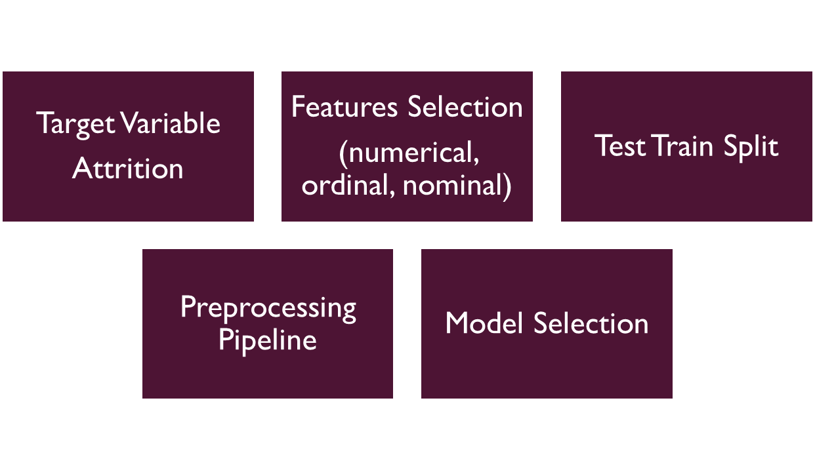
Step 2 – Feature Engineering - Results

Slide 12
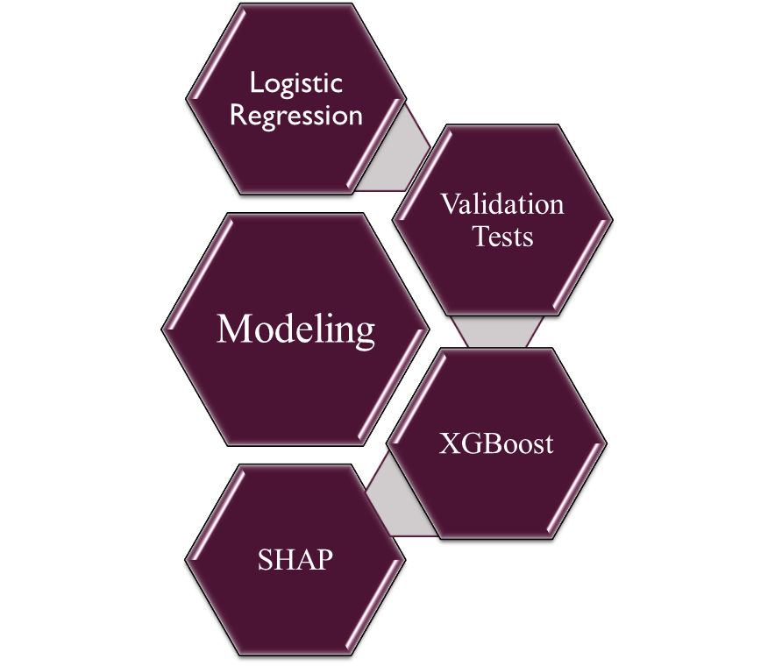
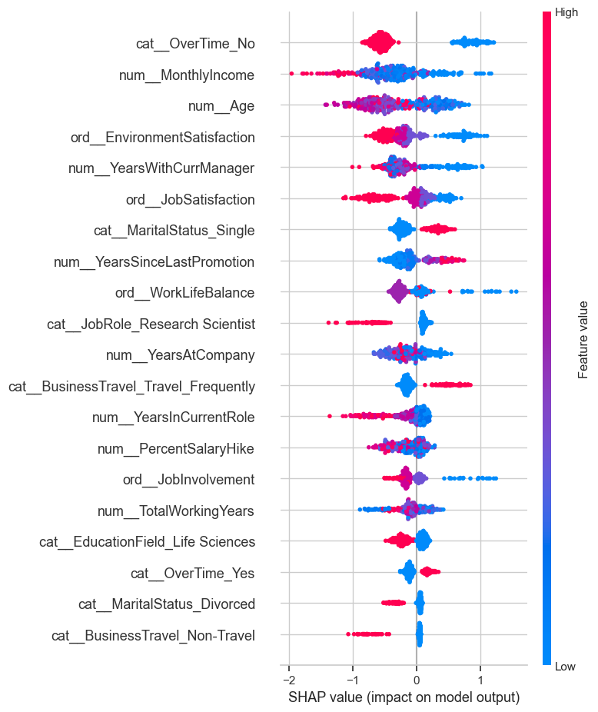
Step 3 - Modeling - Results

Slide 13
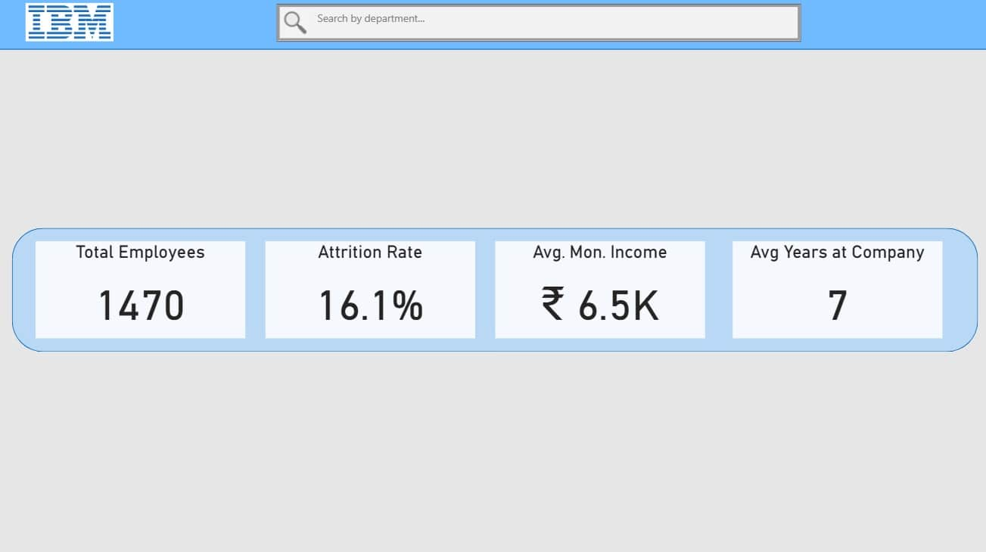
Step 3.1 - HR Analytics Dashboard – KPI Visualization

Slide 14
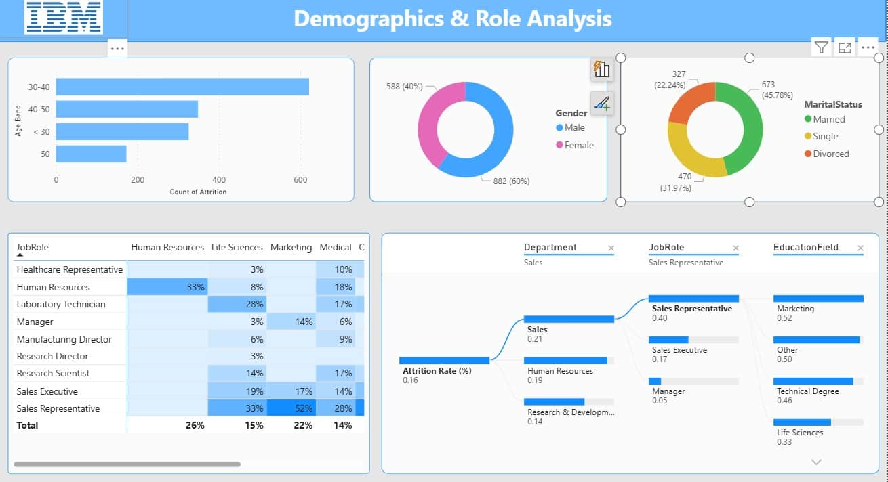
Step 3.2 - HR Analytics Dashboard – Demographic Visualization

Slide 15
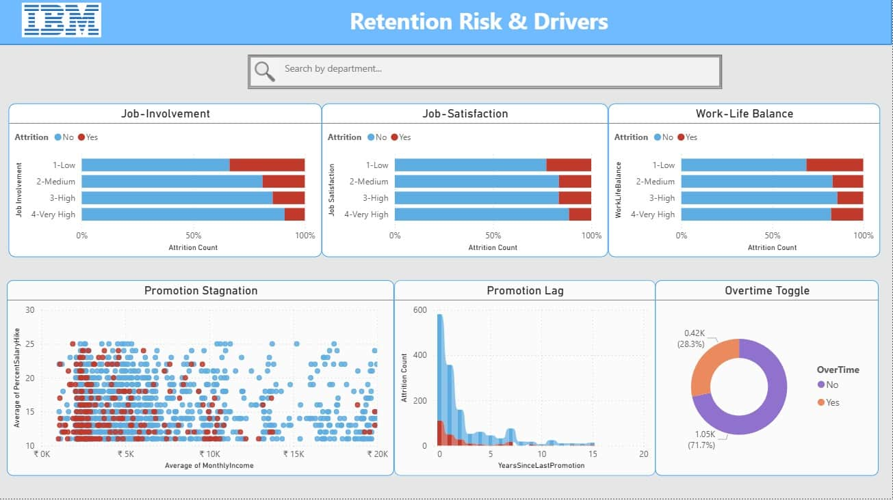
Step 3.3 - HR Analytics Dashboard – Retention Risk Visualization

Slide 16
Interpretation
Attrition is driven primarily by work strain (overtime, travel), career stagnation, and low engagement, with compensation acting as a stabilizing threshold rather than a primary trigger.
Attrition Prevention Strategies:
Focus retention efforts on employees with low involvement and long promotion gaps
Use compensation as a stabilizer, not sole lever
Deploy model outputs as early‑warning signals, not termination predictors

Slide 17

PROJECT - 1
PROJECT -2 SUPPLY CHAIN MANAGEMNET ANALYTICS
Project Overview
This project implements a Machine Learning-powered Supply Chain Optimization System for a Fashion & Beauty startup. Using historical supply chain data, we build predictive models to forecast product demand, optimize inventory levels, and identify operational bottlenecks that impact revenue and efficiency.

Slide 18
Objectives Code
Build an end-to-end supply chain analytics pipeline from data exploration to predictive modeling and dashboard deployment.
Identify key drivers of demand, inventory risk, and operational efficiency using business-aligned feature engineering.
Develop an interpretable demand prediction model with explainability to support data-driven making.
Translate analytical insights into an interactive Streamlit dashboard for practical supply chain optimization.
CODE
1. Exploratory Data Analysis
2. Feature Engineering
3. Predictive Modeling
4. Streamlit

Slide 19
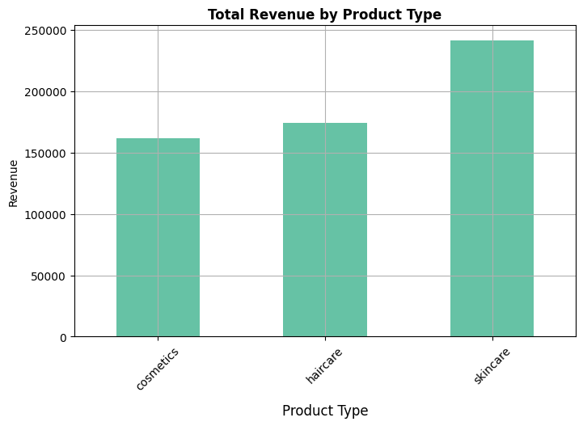
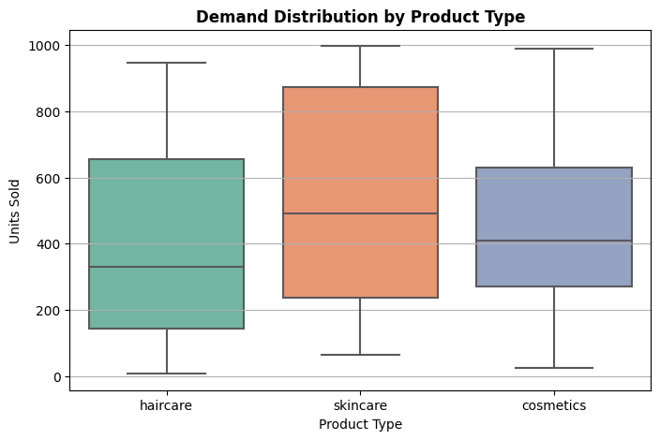
Step 1 – Exploratory Data Analysis - Results
Skincare generate the highest revenue.
Skincare products show the highest variability and demand as well.

Slide 20
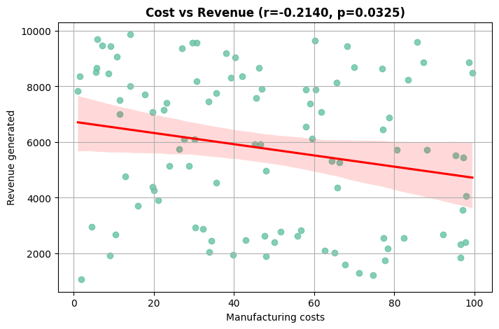
Step 1 – Exploratory Data Analysis - Results
There is a slight inverse relationship; as costs go up, revenue tends to go down.

Slide 21
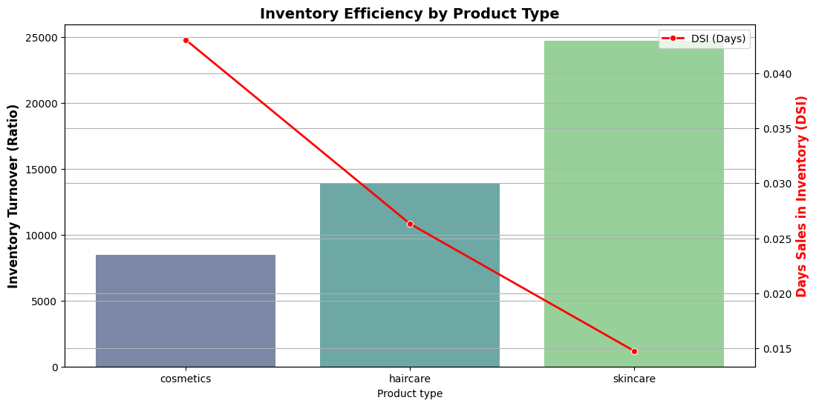
Step 1 – Exploratory Data Analysis - Results
Skincare has the highest turnover, indicating it is the most efficient and fastest-moving product category.
Cosmetics inventory moves slower than other types, resulting in a higher DSI and increased holding costs.

Slide 22
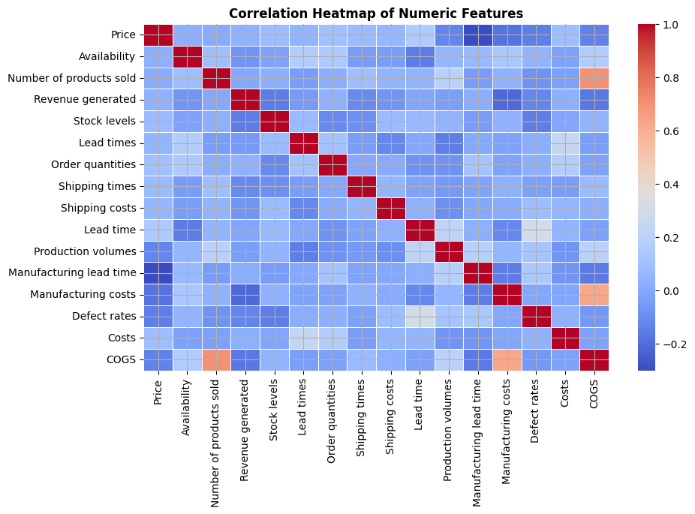
Step 1 – Exploratory Data Analysis - Results
Total costs are driven primarily by sales volume rather than unit price fluctuations.
Simply increasing prices may not lead to higher returns and that demand is likely driven by other factors like product type or brand loyalty.
Lead times, defect rates, and shipping costs are not yet hurting the top-line revenue, but they represent hidden risks.

Slide 23
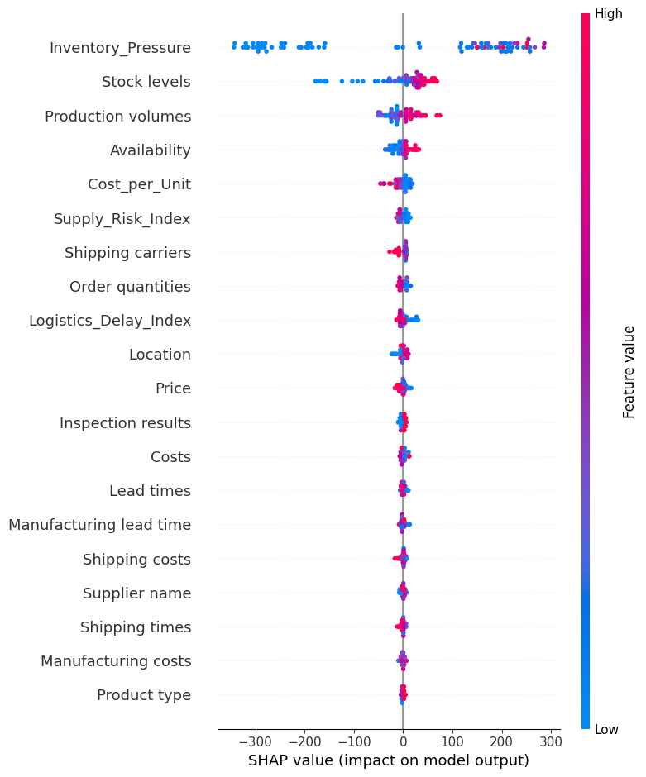
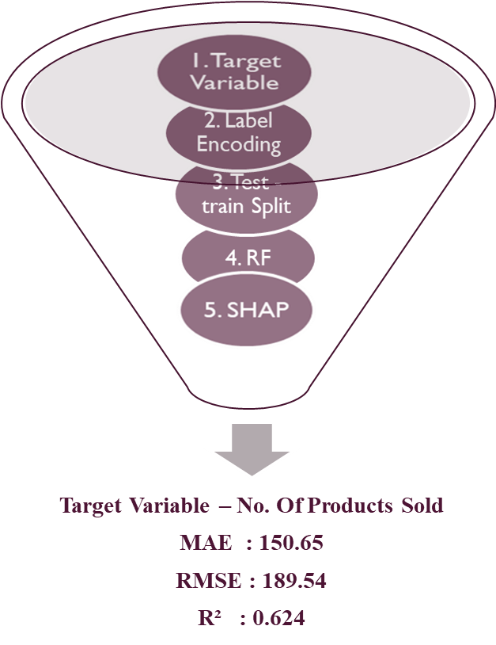
Step 2 - Modeling - Results

Slide 24
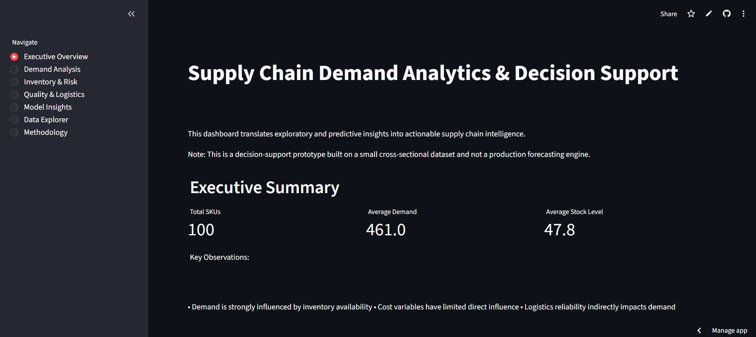
Step 3 - Streamlit Dashboard – Insights Overview
Dashboard

Slide 25
Interpretation
The nature of dataset is small and cross sectional (no time series), constraining the SHAP explanations to only training distributions.
Inventory Pressure is a leading indicator.
This modeling framework demonstrates that demand in supply chains is supply-constrained rather than cost-driven.

Slide 26

PROJECT - 1
PROJECT -3 SALES ANALYTICS
SUPERMART 360: RETAIL PROFIT ANALYTICS & PREDICTIVE MODELING
Project Overview
End-to-end retail analytics combining Exploratory Data Analysis (EDA) and Machine Learning to understand profit drivers and evaluate the feasibility of profit prediction in a grocery retail setting. Supermart360 is a portfolio data science project built on grocery retail transaction data.

Slide 27
Objectives Code
Build an end-to-end supply chain analytics pipeline from data exploration to predictive modeling and dashboard deployment.
Identify key drivers of demand, inventory risk, and operational efficiency using business-aligned feature engineering.
Develop an interpretable demand prediction model with explainability to support data-driven making.
Translate analytical insights into an interactive Streamlit dashboard for practical supply chain optimization.
CODE
1. Exploratory Data Analysis
2. Model Evaluation

Slide 28
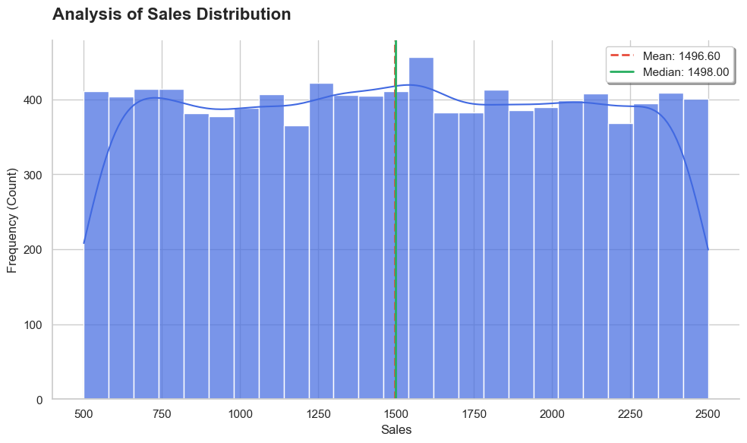
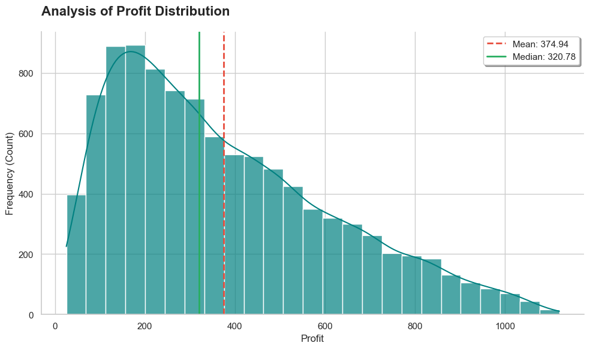
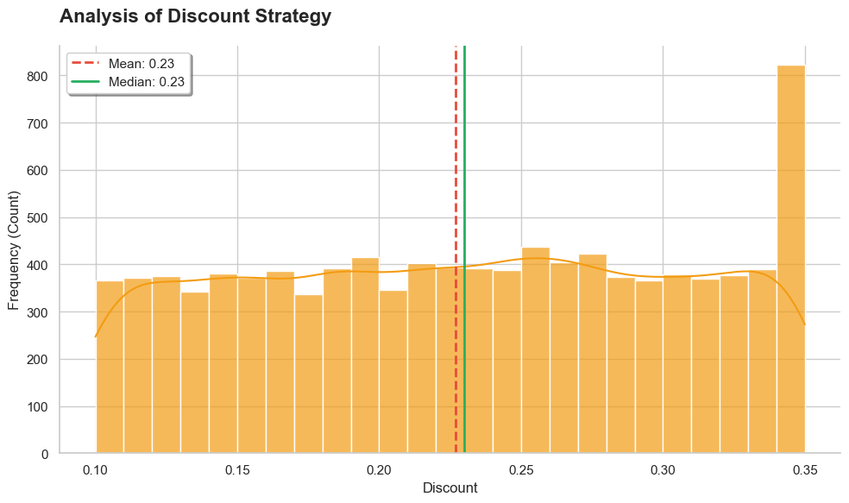
Step 1 – Exploratory Data Analysis - Results
Volume Driven Profitability
Uniform Revenue Generation
(500 – 2500 Units)
Tiered Promotional Strategy
(rule based promotion)

Slide 29
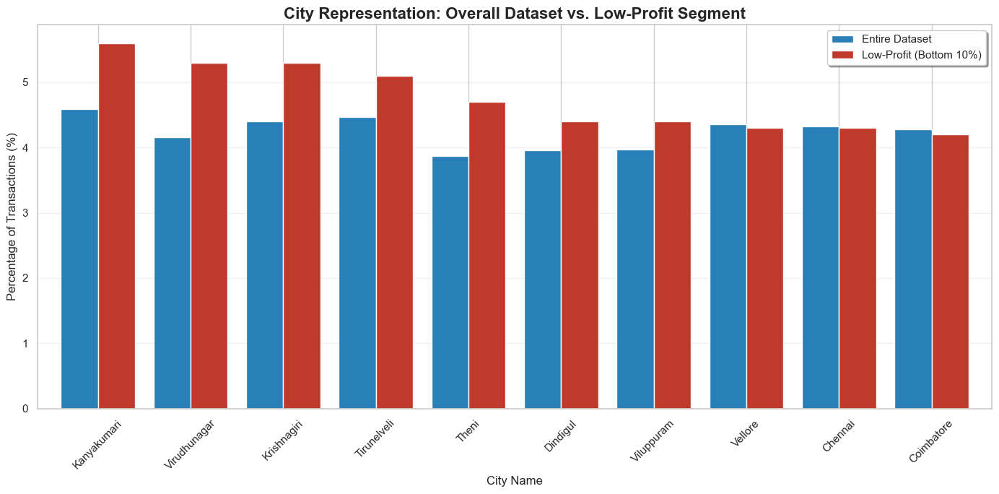
Step 1 – Exploratory Data Analysis - Results
Kanyakumari and Virudhunagar are the most underperforming regions, likely due to localized logistical costs or aggressive discounting in those areas.

Slide 30
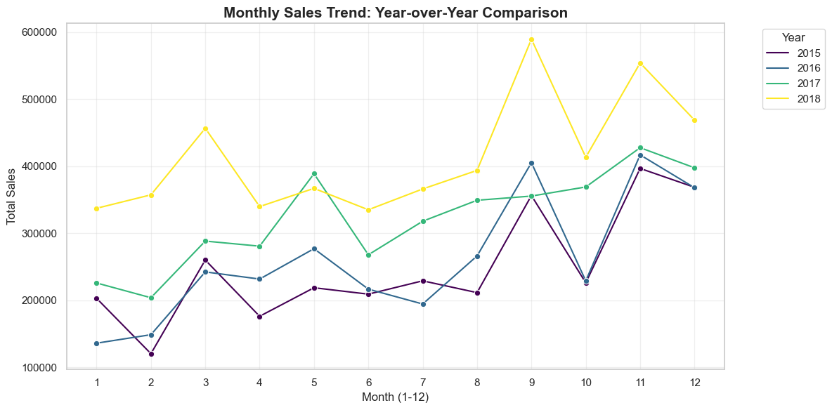
Step 1 – Exploratory Data Analysis - Results
The business has significant growth peak during the November festive season while maintaining a consistent seasonal rhythm that allows for predictable inventory planning.

Slide 31
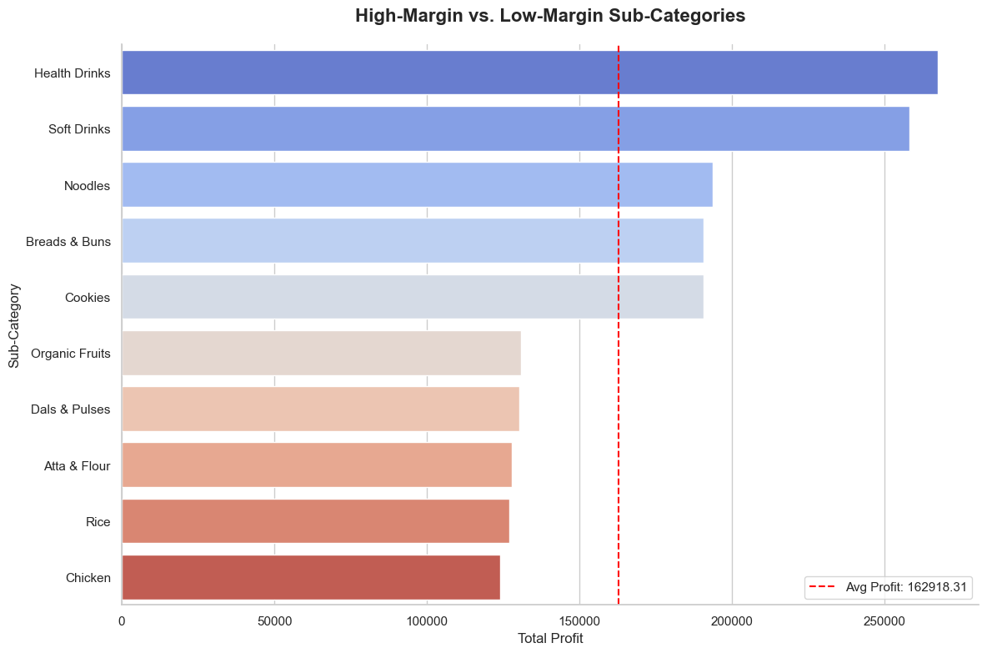
Step 1 – Exploratory Data Analysis - Results
Health and Soft Drinks are the clear profit leaders, significantly exceeding the average profitability.
Kitchen essentials like Rice, Atta, and Chicken underperform, highlighting a business model where processed goods subsidize low-margin raw staples.

Slide 32
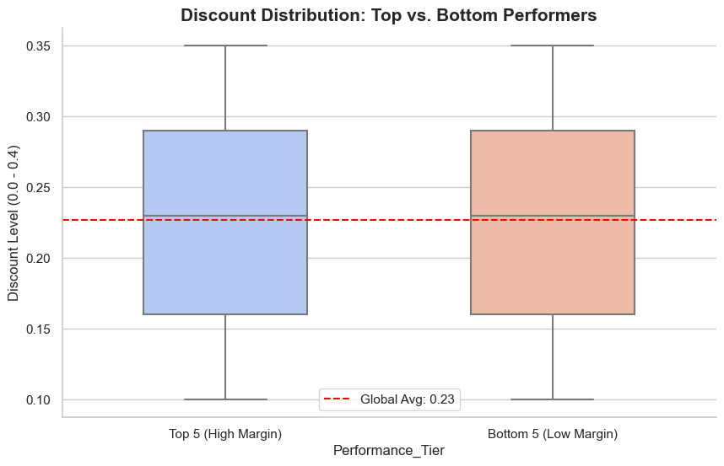
Step 1 – Exploratory Data Analysis - Results
Discounting is not the cause of low profitability for the bottom performers.
Both the High-Margin (Top 5) and Low-Margin (Bottom 5) sub-categories share nearly identical discount structures.

Slide 33
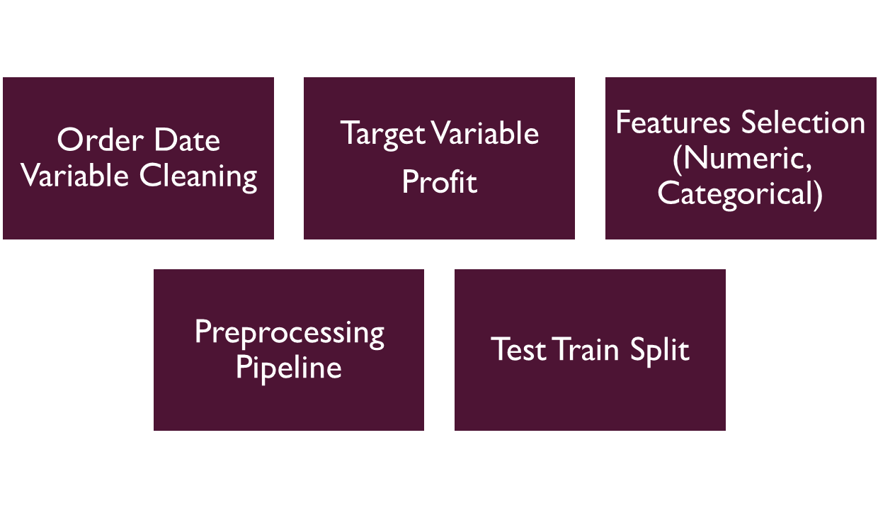
Step 2 – Feature Engineering - Results

Slide 34
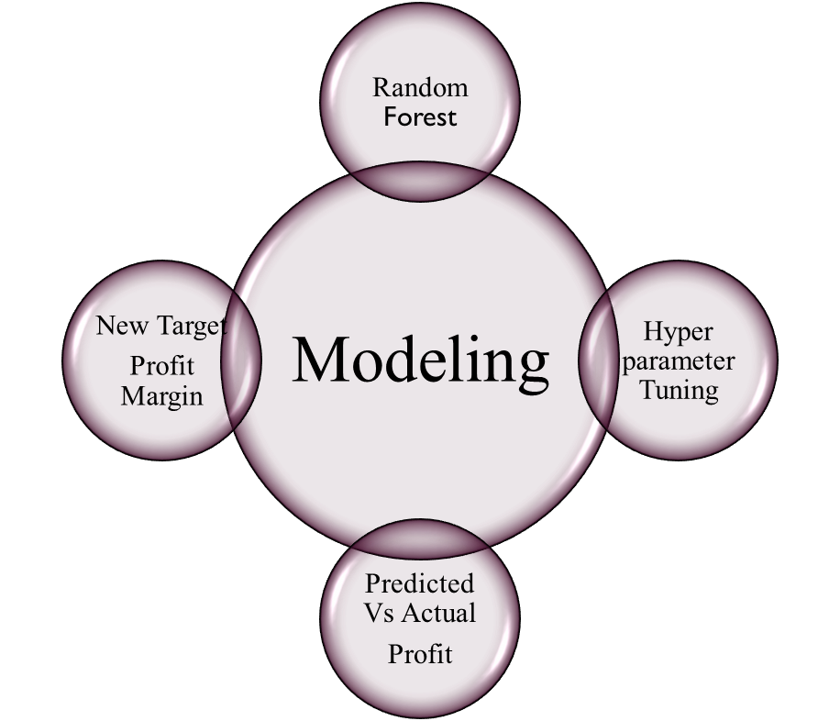
Step 3 - Modeling - Results
Validation
The Hyperparameter tuned RF model didn’t outperform the baseline model (R²=0.33, MAE, RMSE slightly worsened).
The data reached a feature ceiling, not a model ceiling.
New target variable: Profit Margin is predicted using baseline RF Regressor.

Slide 35
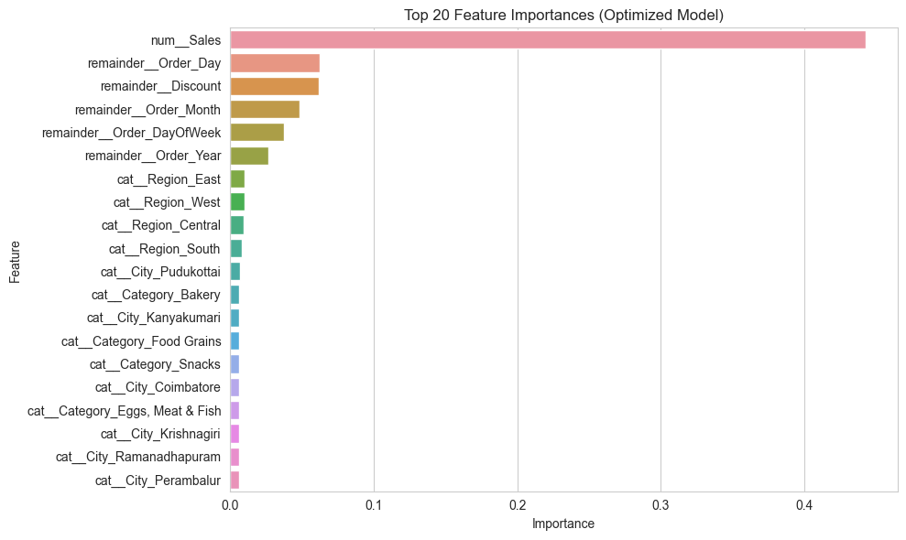
Step 3 - Modeling - SHAP

Slide 36
Interpretation
The baseline Random Forest Regressor is the best-performing and most reliable model for this dataset because of the following limitations:
Synthetic training dataset
No cost, supplier, or procurement features
Profit closely tied to Sales by construction
Sales volume is the primary driver of profit.
Discount strategy influences profit but within a constrained range.
Regional and category effects exist but are secondary.
Large profit improvements require volume growth or pricing policy changes

Slide 37
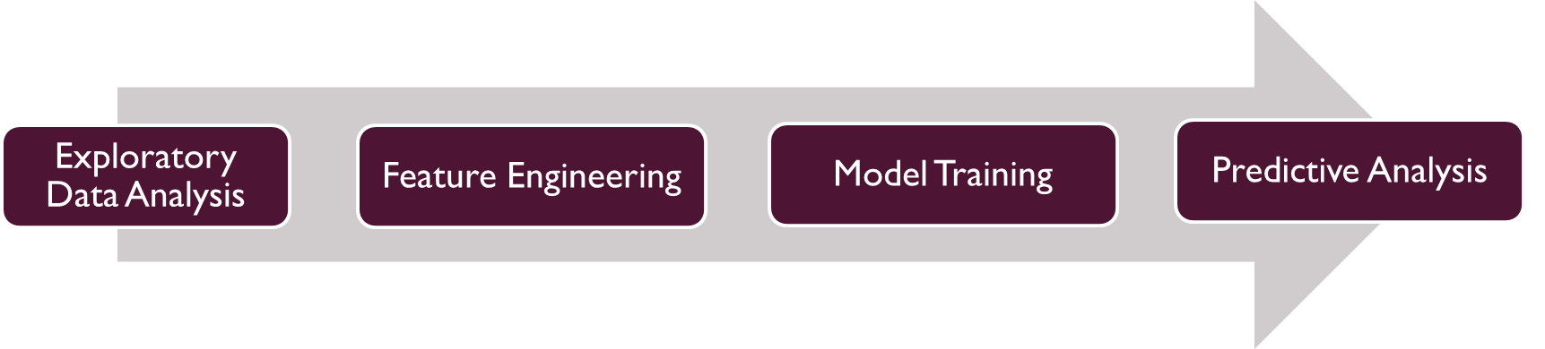
PROJECT - 1
PROJECT -4 – DRUGS SIDE EFFECTS TO MEDICAL CONDITION PREDICTION
Project Overview
This project builds an end-to-end Natural Language Processing (NLP) pipeline to predict the medical condition associated with a drug based solely on its reported side effects text. This project demonstrates how to:
Extract signal from noisy medical text
Handle imbalanced multi-class clinical data
Produce predictions that communicate both outcome and confidence

Slide 38
Objectives Code
Build an NLP pipeline that predicts a drug’s associated medical condition using side-effects text.
Apply TF-IDF and machine learning models to extract meaningful clinical signals from unstructured data.
Incorporate confidence scoring and Top-K predictions to support safer, uncertainty-aware decision making.
Deliver an interpretable, reproducible system suitable for clinical analytics and pharmacovigilance use cases.
CODE
1. Exploratory Data Analysis
2. Feature Engineering
3. Model Training
4. Predictive Analysis

Slide 39
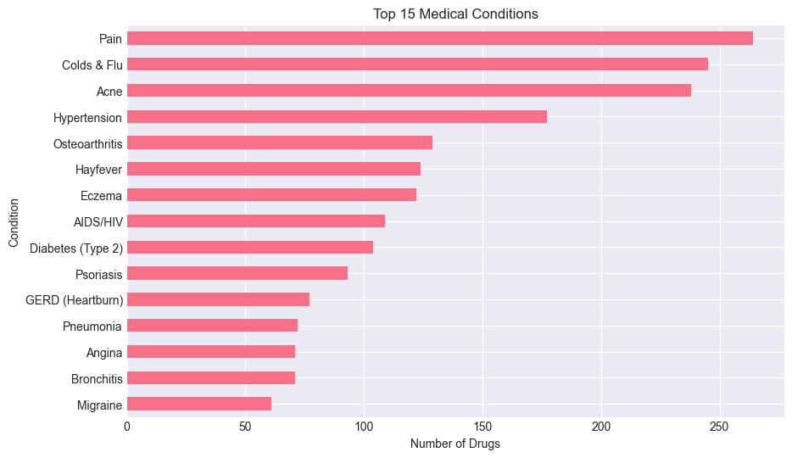
Step 1 – Exploratory Data Analysis - Results
Highly imbalanced dataset with 47 classes – unstable.
Merge rare classes into Other

Slide 40
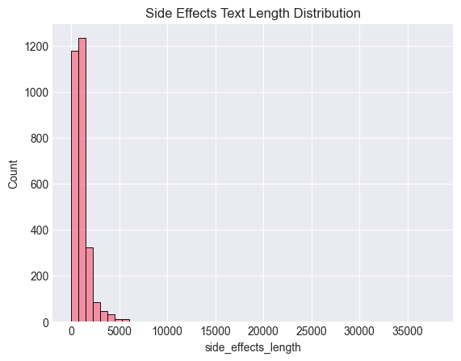
Step 1 – Exploratory Data Analysis - Results
Structural Imbalance
99% of the dataset lives under ~5K characters.
The top ~1% is 8×–10× longer than the rest.
These are regulatory-style monographs, not typical side-effect summaries.

Slide 41
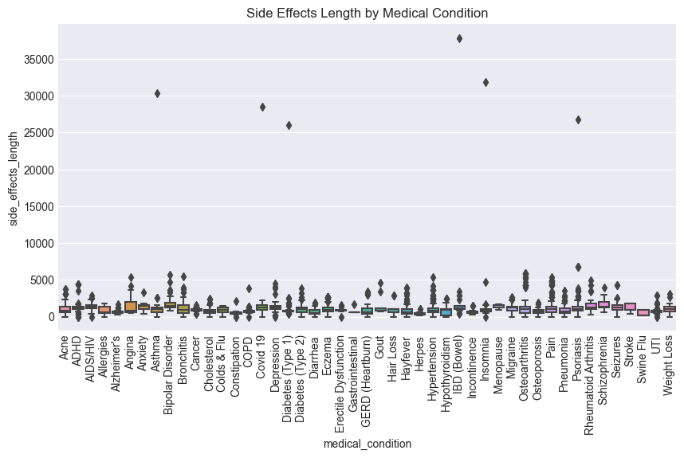
Step 1 – Exploratory Data Analysis - Results
These long texts are unevenly distributed across medical conditions, introducing the risk that document length may inadvertently encode target-related information.

Slide 42
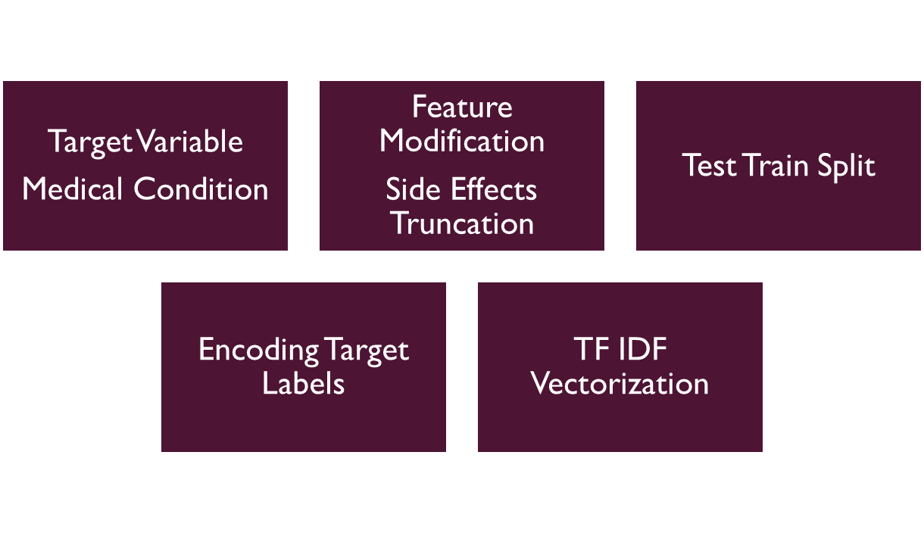
Step 2 – Feature Engineering - Results

Slide 43
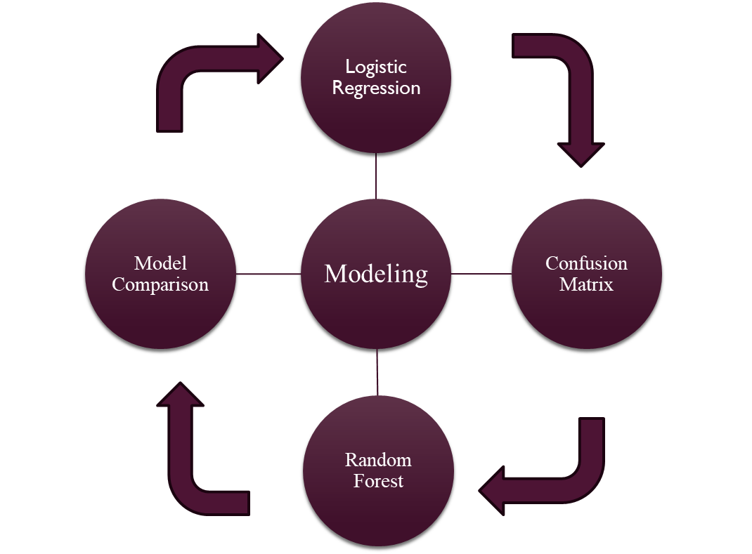
Step 3 - Modeling - Results
Validation
Selected Model: Random Forest Classifier
Justification:
Higher Macro F1 → better minority condition performance
Higher Weighted F1 → better overall reliability
Robust to noisy and overlapping features
Logistic Regression remains a strong baseline but Random Forest is selected for deployment.

Slide 44
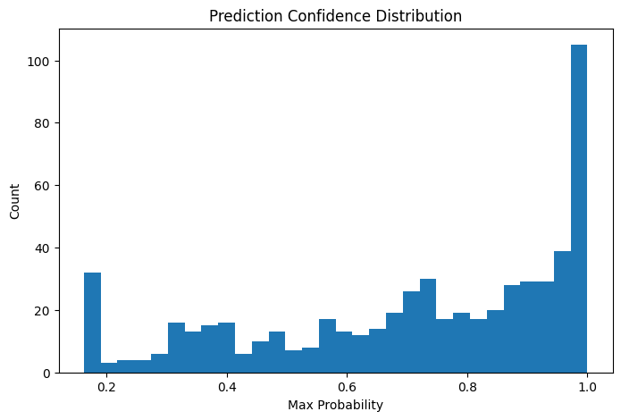
Step 3 – Prediction Analysis - Results
The confidence distribution reveals three distinct regions:
Low confidence (<0.35): Ambiguous or generic side-effect descriptions
Medium confidence (0.35–0.70): Overlapping symptom profiles
High confidence (>0.70): Strong condition-specific signals.
This validates the need for a confidence-aware prediction strategy rather than forced single-label outputs.

Slide 45
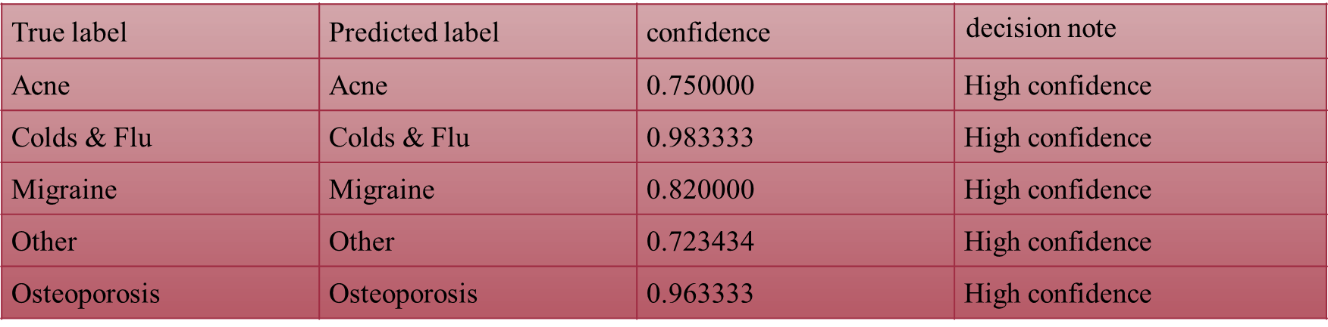
Step 3 – Prediction Analysis - Results

Slide 46
Interpretation
TF-IDF combined with Random Forest performs strongly for clinical text classification
The prediction pipeline produces:
Predicted medical condition
Prediction confidence score
Decision note (high / medium / low confidence)
Optional Top-3 condition suggestions

Slide 47
REFERENCE
Github Repository – https://github.com/Srinithya1503/UM-Projects
Pandas Data Cleaning - https://www.programiz.com/python-programming/pandas/data-cleaning
Streamlit - https://pypi.org/project/streamlit/
Markdown Template - https://markdownlivepreview.com/

