Slide 1
ONCO-2023-001: Independent TMF Compliance Audit & Site Risk Analytics Framework
Presenter: Sri Nithya S
Context: Self Driven Clinical Operations Quality Initiative
Repository: Github Project

Slide 2
Table of contents
Project Background
Objectives
Step 1: Regulatory Standards Construction
Step 2: Simulating Global Trials
Step 3: Clinical Operation Analytics
TMF Validation Outputs
Strategy Value

Slide 3
PROJECT BACKGROUND The Necessity of Proactive TMF Management in CRO Operations
The Reality → vast document volumes across multiple investigator sites,
The Vulnerability → Traditional "reactive" TMF cleanups create high-risk backlogs, delay database locks, and strain sponsor relationships.
The Strategy → an independent auditing workflow to bridge the gap between regulatory theory and real-world CRO monitoring actions.
Inspection Ready TMF
Regulatory Inspection
Patient Safety Documentation
Sponsor Oversight
ICH GCP Compilance

Slide 4
PROJECT OBJECTIVES Designing a Regulatory-Aligned TMF Auditing Framework
Standardize → Define expected trial documentation benchmarks across international boundaries.
Validate → Evaluate document completeness, quality, timelines, and signature authenticity.
Identify →Pinpoint site-level compliance risks before they trigger regulatory audit findings.
Execute → Generate operational outputs that exactly mirror CRO clinical operations workflows.

Slide 5
PILLAR- I: CONSTRUCTING REGULATORY STANDARDS
Master TMF Baseline
DIA Reference Model
Core taxonomy and Zone Mapping
ICH E6 R3
Essential Document Compliance
21 CFR Part 11
Electronic Signature and Data Integrity Validation

Slide 6
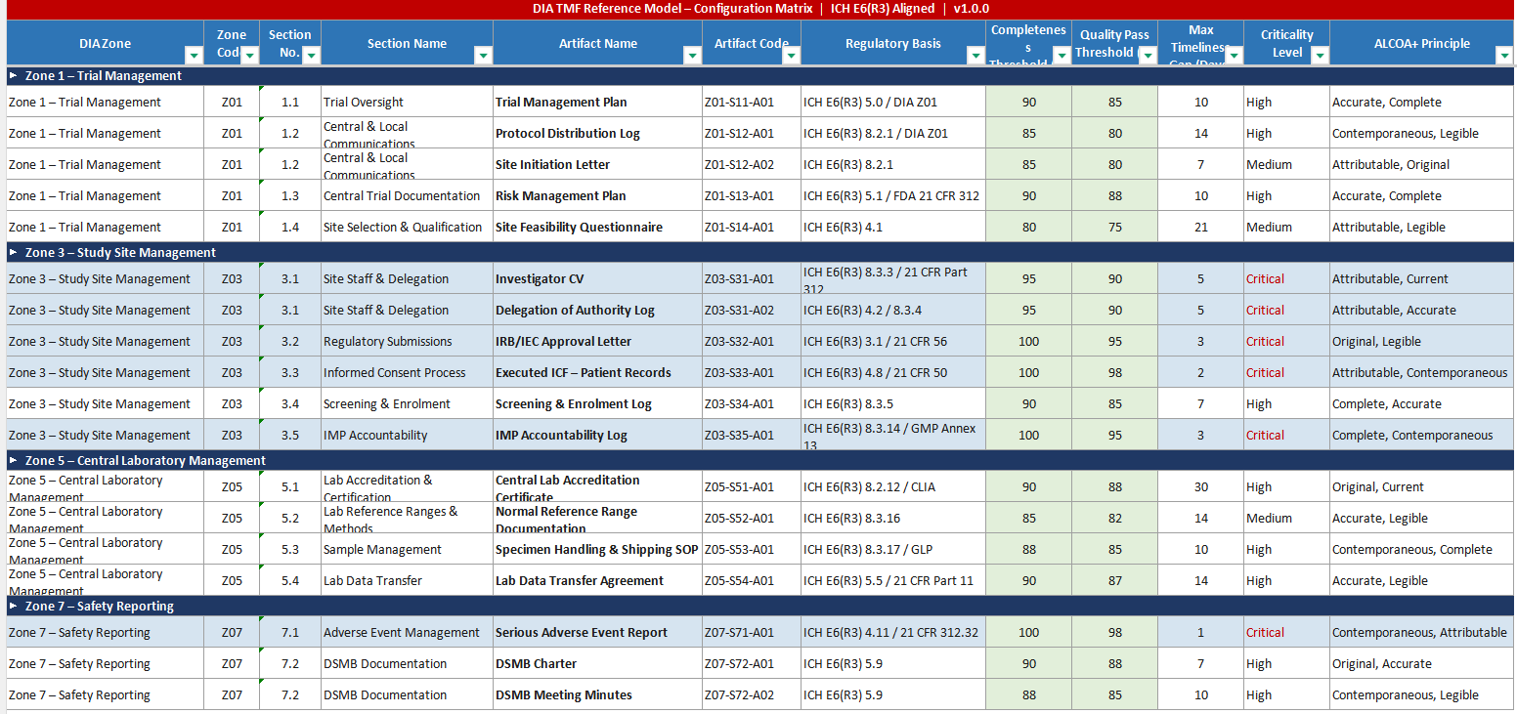

Slide 7
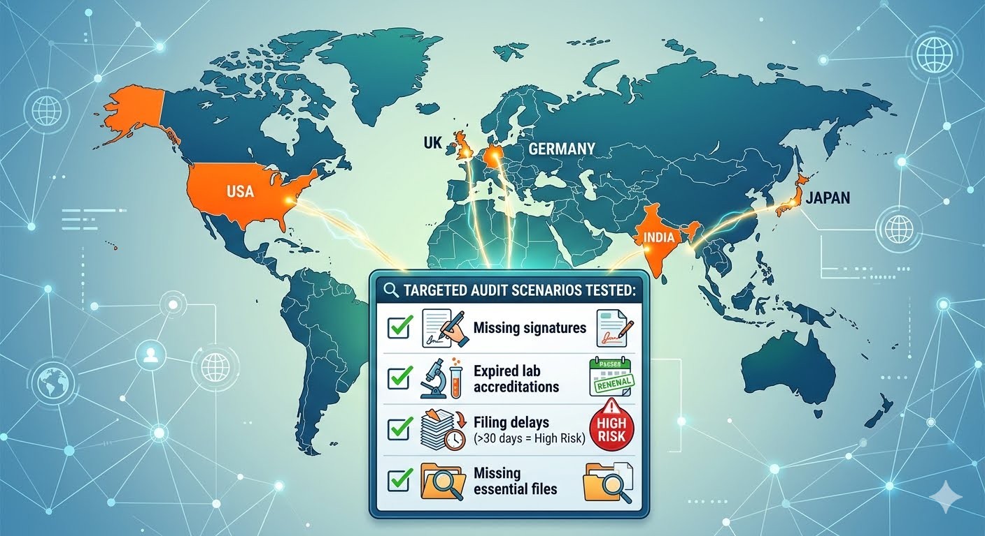
PILLAR- Ii: SIMULATING GLOBAL TRIAL COMPLEXXITY

Slide 8
PILLAR- III: CLINICAL OPERATIONS ANALYTICS
📊
🚦
🟢 Low: >85% Score
Completeness rate = Available required docs %
Expected required docs
Quality pass rate = Passed docs %
Reviewed docs
🟡 Moderate: 70% - 85% Score
🔴 High: <70% Score

Slide 9
PROJECT OPERATIONAL OUTPUTS – GOVERNANCE & SOP WORKFLOWS
TMF Reconciliation Report
01
Site Risk Scorecard
02
Discrepancy Query Log
03
Issue detected
Query Created
CRA Assigned
Site Responds
Verified & Closed

Slide 10
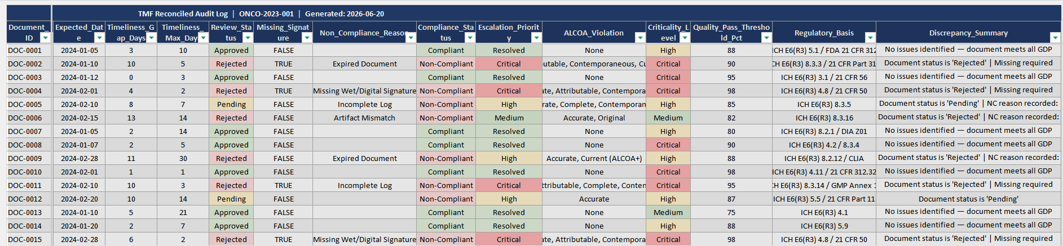
OUTPUT FILE – TRIAL RECONCILIATION LOG

Slide 11
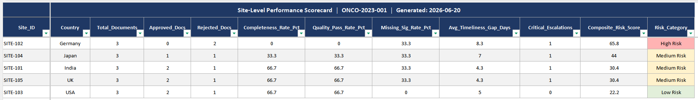
OUTPUT FILE – SITE RISK ANALYSIS

Slide 12
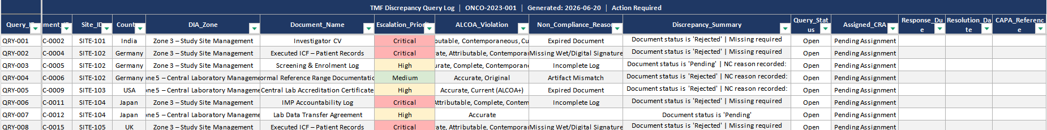
OUTPUT FILE – DISCREPANCY LOG

Slide 13
KEY TAKEAWAYS & STRATEGY VALUE Transforming TMF Management from a Burden to a Competitive Advantage
Proves that continuous data-driven TMF auditing reduces regulatory exposure.
Demonstrates robust CRO oversight capabilities, directly boosting sponsor trust and retention.
Ensures the simulated study remains in a constant state of inspection-readiness for global regulatory authorities.

Slide 14
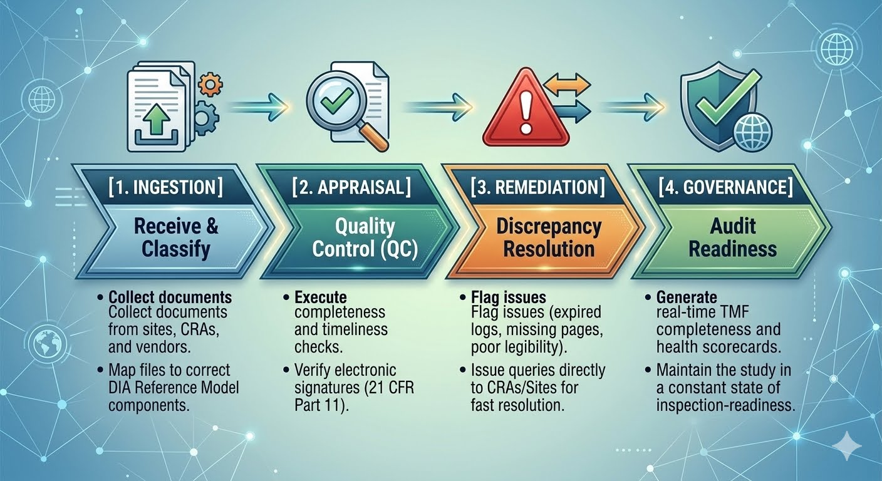
REAL WORLD EXECUTION : TMF SPECIALIST ROLE

Slide 15
THANK YOU !

