Slide 1
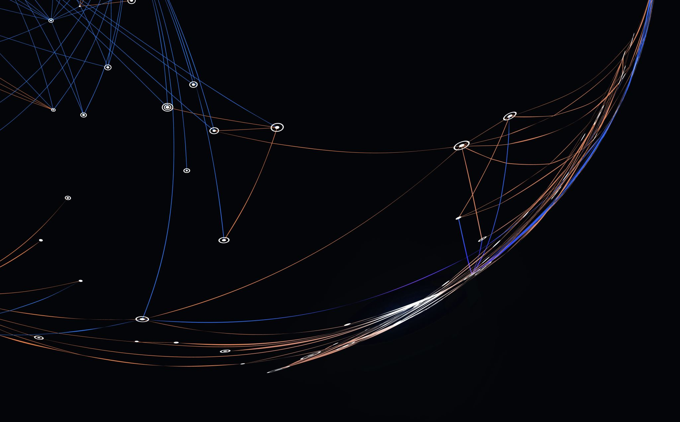
Prevention of data leakage in various cloud computing platforms and detection of sensitive data(Data Analysis)
2100030236 – Srinithya Kandukuri

Slide 2

agenda
This project aims to securely manage, streamline, and perform analysis on the structured and semi-structured YouTube videos data based on the video categories and the trending metrics.

Slide 3
introduction
The company's Information security depends on employees by learning the rules through training and awareness-building sessions. And the data leakage is mainly happening via insider employees or other hacker which they try to steal or use it to their own or selling it This uncontrolled data leakage puts business in a vulnerable position. Once this data is no longer within the domain, then the company is at serious risk The main concept is water marking. Digital watermarking is the process of embedding information into a digital signal, such as an image, video, or audio file, in a way that is imperceptible to the human senses but can be detected and extracted by special software or hardware. Watermarking can serve various purposes, such as identifying the owner or distributor of the content, tracking its usage and distribution, protecting against copyright infringement, and detecting tampering or unauthorized modifications.

Slide 4

Dataset
This Kaggle dataset contains statistics (CSV files) on daily popular YouTube videos over the course of many months. There are up to 200 trending videos published every day for many locations. The data for each region is in its own file. The video title, channel title, publication time, tags, views, likes and dislikes, description, and comment count are among the items included in the data. A category_id field, which differs by area, is also included in the JSON file linked to the region.
https://www.kaggle.com/datasets/datasnaek/youtube-new

Slide 5
Services used
Amazon S3 - Amazon S3 is an object storage service that provides manufacturing scalability, data availability, security, and performance.
Amazon QuickSight - Amazon QuickSight is a scalable, serverless, embeddable, machine learning-powered business intelligence (BI) service built for the cloud.
AWS Glue - A serverless data integration service that makes it easy to discover, prepare, and combine data for analytics, machine learning, and application development.
AWS IAM - This is nothing but identity and access management which enables us to manage access to AWS services and resources securely.
AWS Lambda - Lambda is a computing service that allows programmers to run code without creating or managing servers.

Slide 6
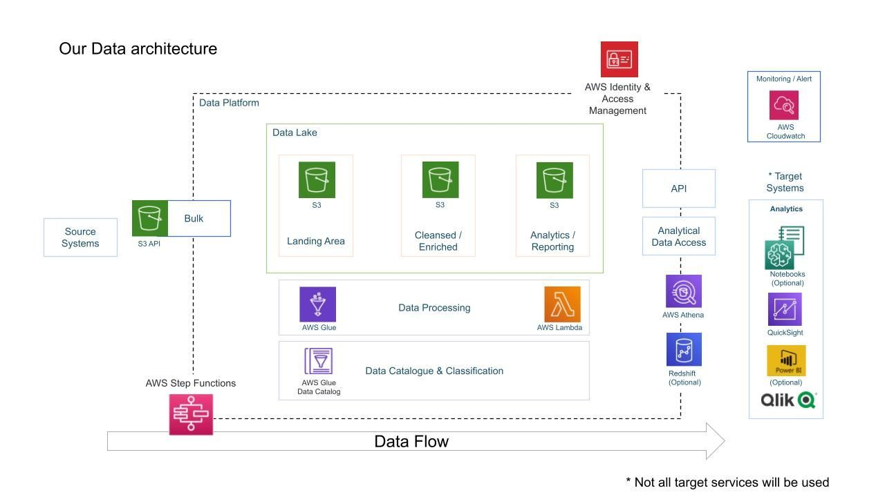
Architecture diagram

Slide 7
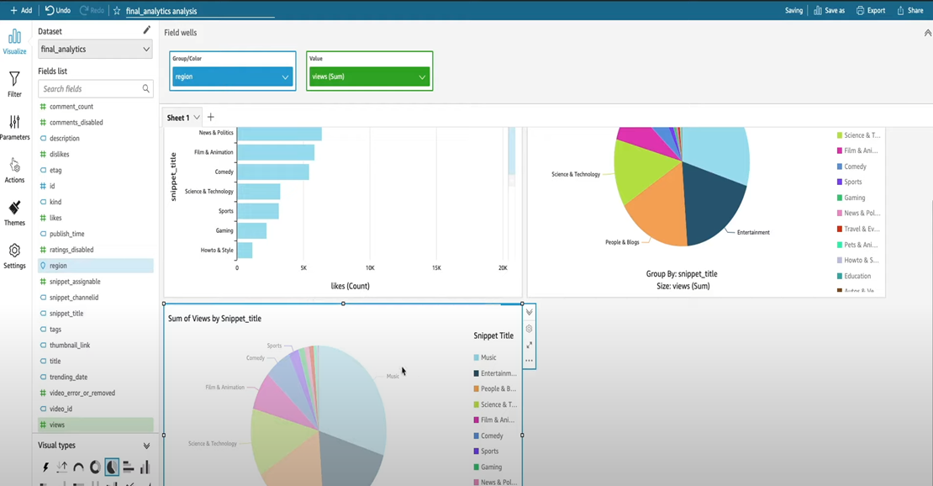
output

Slide 8
conclusion
We showed how AWS IoT services and amazon kinesis service ,quick sight can be used to detect real-time leaks in fire hydrants and pin-point the exact location of the leaks. This solution can lead to a reduction in time to fix the leaks, thereby reducing water wastage and improving environmental impact.

