Slide 1

SHIPPING DATA ANALYSIS
BY
SRINIVAS DASH

Slide 2
Capstone Power BI Project:- Shipping Sales
Project Goals :- In this project, I'm going to preprocess and clean data, run exploratory data analysis (EDA) and find descriptive statistical measurements as analysis data with making an interactive dashboard for a dataset which contains nearly 16000+ shipping company Data.
Language , libraries , tools :-
Language :- Python
Libraries :- Pandas, Numpy
Application :- Microsoft Excel , Microsoft Power BI .
IDE :- Jupyter Notebook .

Slide 3
Data Columns
CurrencyKey :- The identifier for the currency used in the transaction .
CustomerKey :-The unique identifier for the customer associated with the sales order.
ProductKey :-The unique identifier for the product included in the sales order.
SalesOrderNumber :- The unique identifier or reference number for the sales order.
ShipDate :- The date on which the products are scheduled or were shipped to the customer.
Price :- The unit price of the product in the specified currency.
Tax :- The tax amount associated with the sales transaction.
TotalCost :- The total cost of the sales order, including price and tax.

Slide 4
DATA SOURCES
Primary Data: Extracted shipping sales data from Kaggle’s dataset, focusing on transaction details, shipping routes, and customer information.
Address any inconsistencies or missing values in the primary data through cleaning process.
Secondary Data :Obtain relevant secondary data from market research reports, industry analyses, and studies on shipping trends.
Ensure secondary data complements the primary dataset, covering aspects such as shipping routes, customer demographics, and industry trends.

Slide 5
METHODOLOGY
Data Collection and Integration: Extract insights from Kaggle's " Adventure Works " dataset, blending key aspects like Sales data, gender, Currency,Products, occupation etc for a comprehensive foundation.
Dashboard Design: Designing a visually appealing and user-friendly dashboard using Tableau/Power BI. Incorporating features for interactive exploration of user preferences and viewing habits.

Slide 6
TOOLS AND TECHNOLOGIES :
PowerBI/Tableau for interactive dashboard creation.
Microsoft Excel for accessing to the datas.
PowerPoint for clear and compelling presentations.

Slide 7
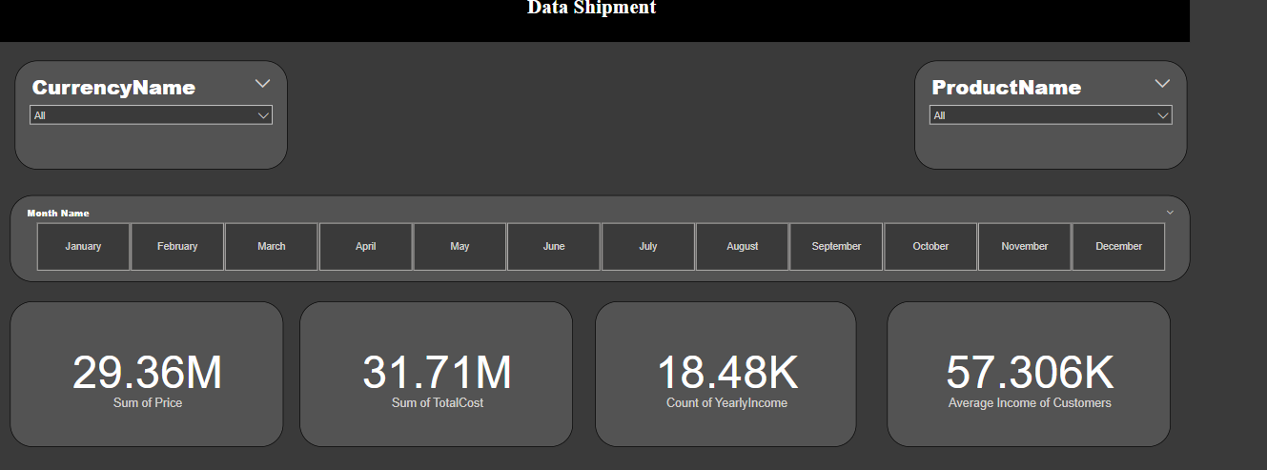
OUTCOMES :

Slide 8
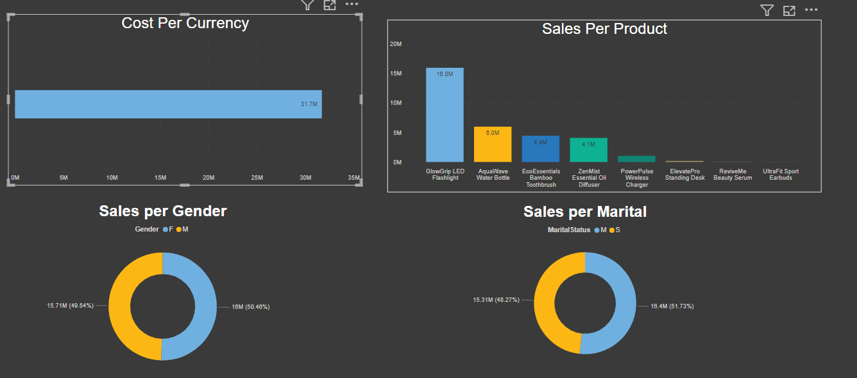
OUTCOMES:

Slide 9
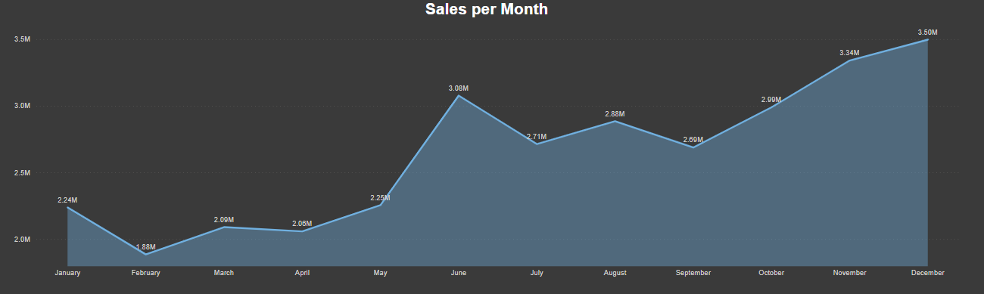
OUTCOMES:

Slide 10
CONCLUSION
In summary, the Shipping Sales Power BI dashboard stands as a robust tool, seamlessly blending visual appeal and user-friendly design. Through interactive features, it facilitates a comprehensive exploration of sales data, empowering informed decision-making in the dynamic landscape of shipping operations.

Slide 11
Thank you !
By Srinivas Dash

