Slide 1
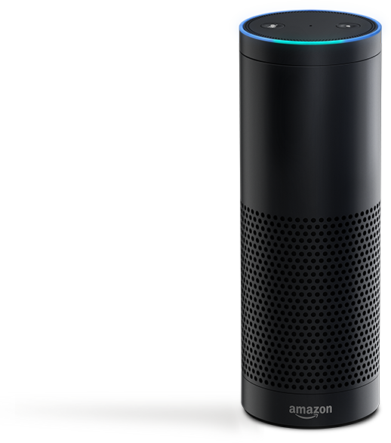
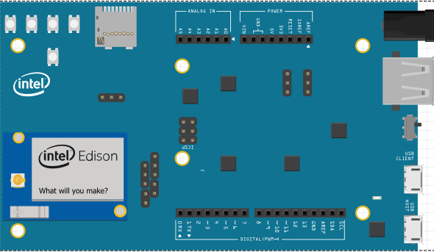
Temperature/Humidity Sensor (Atmosphere)
Motion Sensor
Amazon AWS
Buzzer
Water Pump
Moisture Sensor
Light Sensor

