Slide 1

trAIner
A form fixing assistant

Slide 2
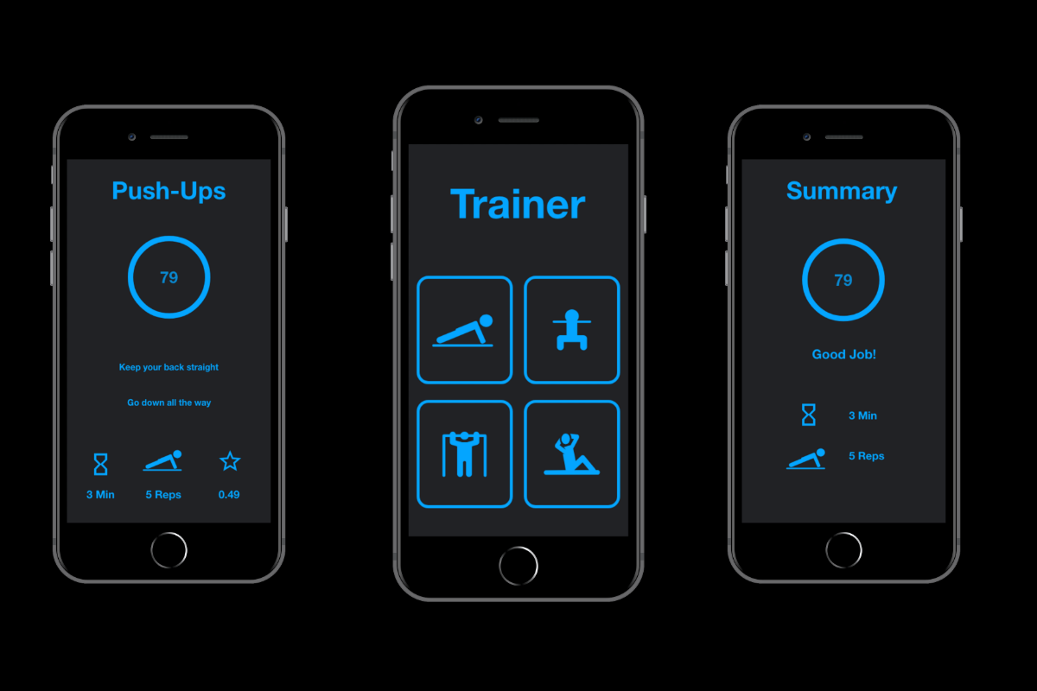
WHAT?
trAIner is a form-fixing assistant that utilizes both haptic and graphical feedback to provide tips on improving one’s posture when doing common exercises, such as pushups and squats.
There are three parts to the assistant:
Mobile Application
Web Application
Haptic Feedback

Slide 3
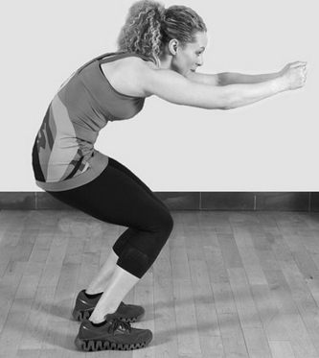
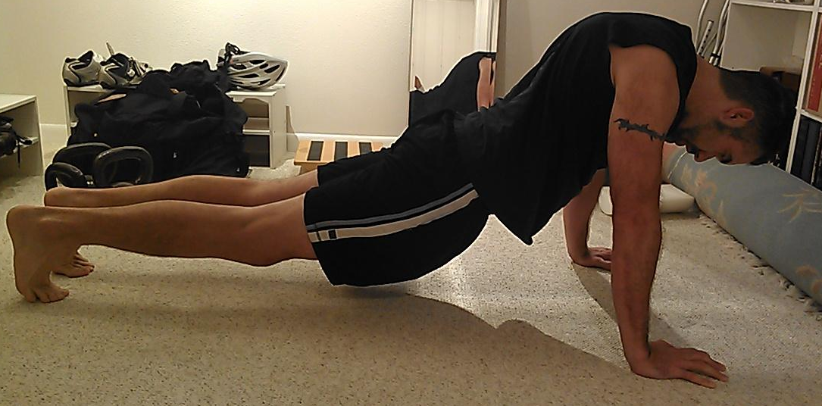
PROBLEM
We were inspired to build this app to solve two specific issues:
Bad posture when doing simple exercises, such as pushups and squats
High cost of personal trainers

Slide 4
DESIGN
Computer Vision Module
Backend - Python
Haptic Feedback Module

Slide 5
HOW?
Challenges?
We built this app by dividing the workload into three parts.
Gathering data from a computer vision module
Processing and transforming raw data into a readable format
Displaying the data on our front-end via mobile and web applications
D*
Data processing and algorithm decision for rep count and score generation
Determining back curvature as the CV library used gave access to only certain joints
Data visualization through the front-end mobile and web applications

Slide 6
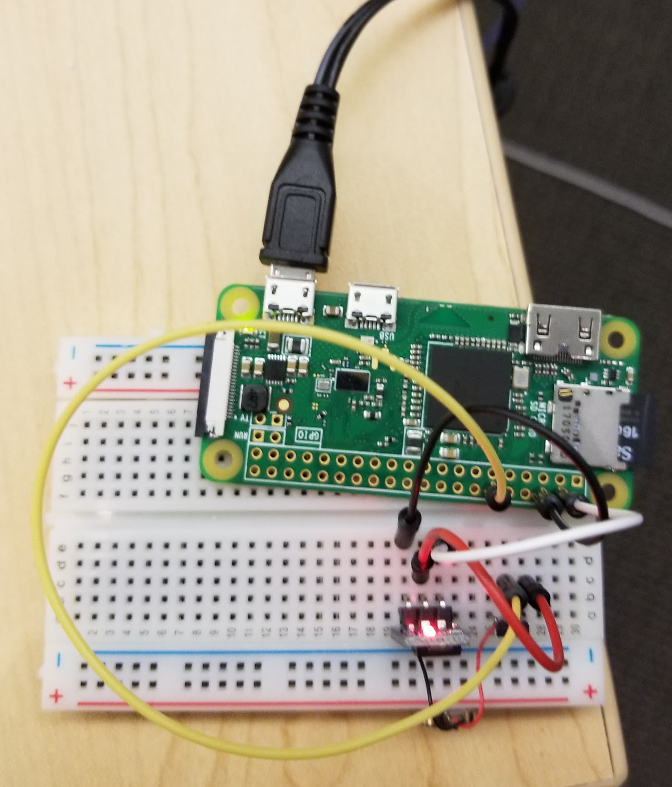
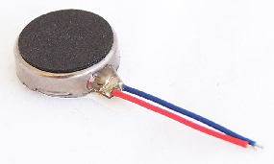
HAPTIC FEEDBACK
Raspberry Pi Zero with Vibration motor attached to a belt to provide feedback on the posture with different intensity of vibrations

Slide 7
MOBILE APP (ANDROID AND IOS)

Slide 8
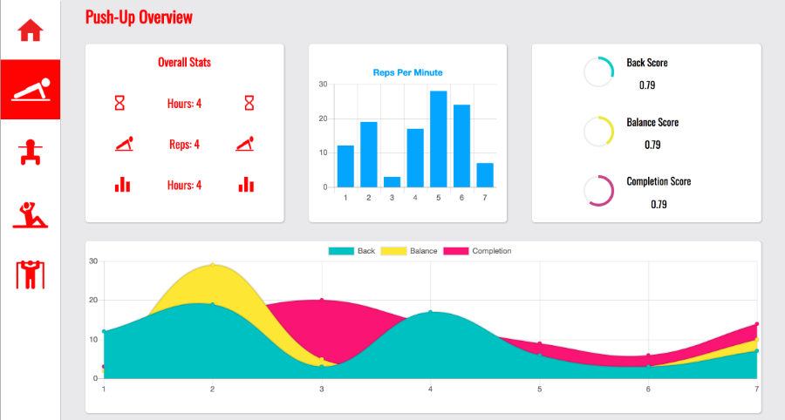
WEB APP

