Slide 1

Presentation

Slide 2
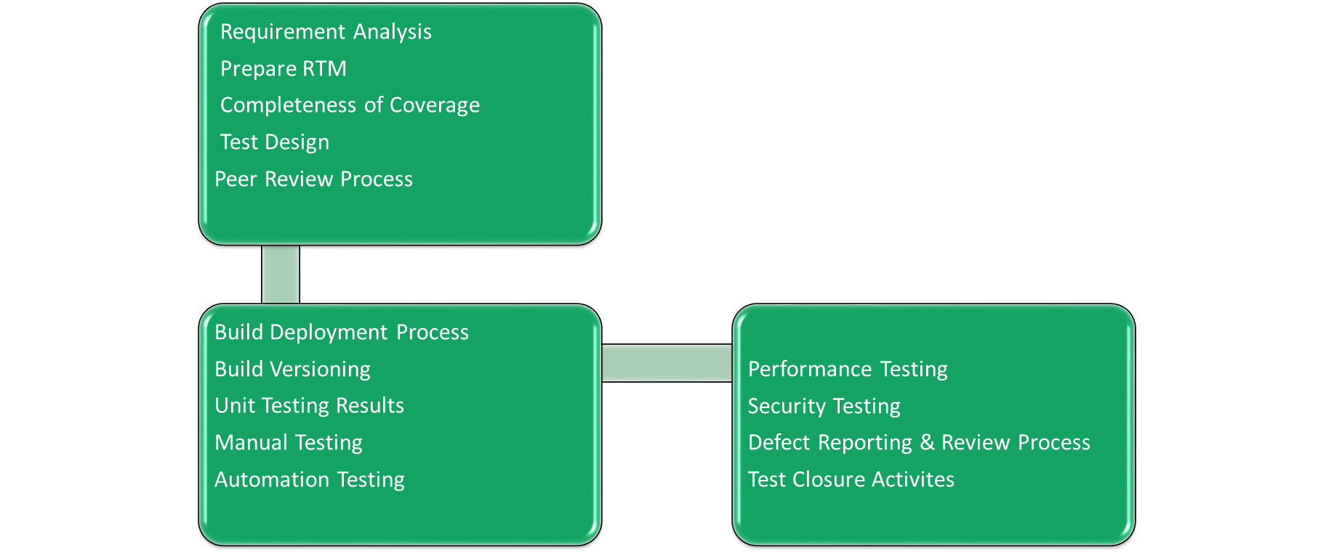
QA Process - Purpose
The purpose of this document is to define the QA process across the product following Quality Standards

Slide 3

Requirement Analysis
➢ QA team needs Updated/Approved requirement documents and required information in user stories to test the given functionality
➢ QA team will analyze the requirement and identify the impact analysis if there are any change request added
➢ We will maintain all the Queries related to product in Query tracker and once review is done by QA Manager will update in respective project management tool
➢ QA team will not only test as per requirement but also give Improvements, Idea’s how to improve the product

Slide 4
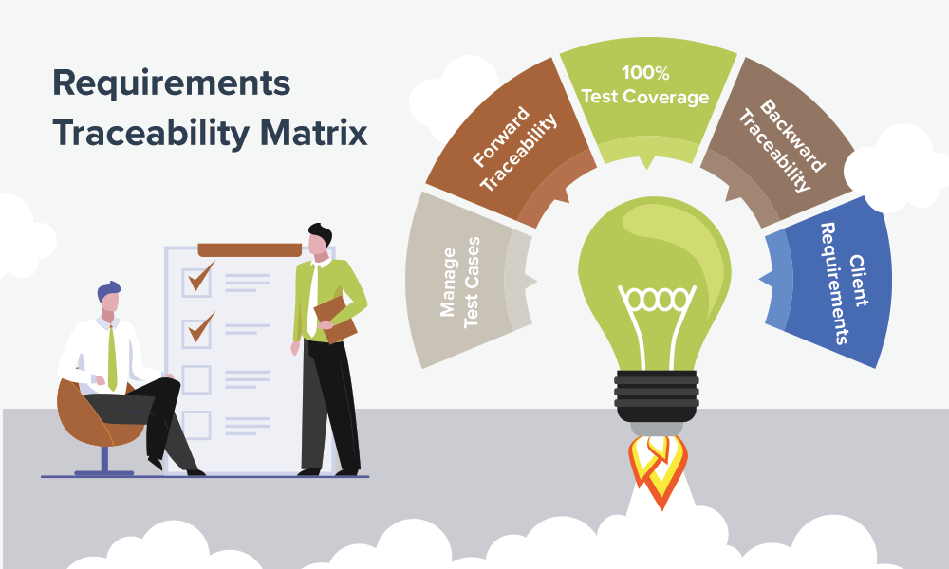
Requirement Traceability Matrix
➢ It maps the requirements to test cases
➢ It confirms 100% test coverage
➢ It highlights any requirements missing or document inconsistencies
➢ It shows the overall defects or execution status with a focus on business requirements
➢ It helps in analyzing or estimating the impact on the QA team's work with respect to revisiting or reworking on the test case

Slide 5
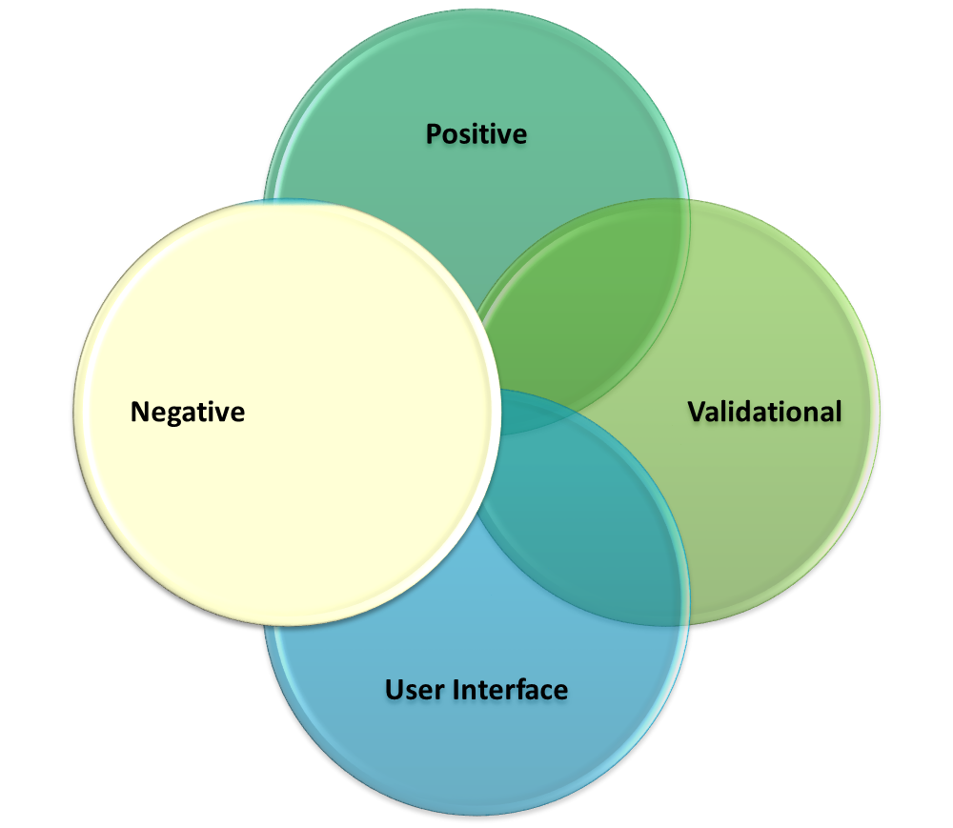
Test Design
Basically, test design is the act of creating and writing test suites for
testing a product.
Test Design Techniques: There are two techniques to write the test
cases
➢ Boundary Value Analysis
➢ Equivalent Class Partition
Test Case: Test case contains below list of items
1. Positive: Includes test cases related to valid input data.
2. Negative: Includes test cases related to invalid input or unexpected
user behaviour
3. Validational : Verifying the rules for various fields in respective
screens
4. User Interface : Includes test cases related to Alignment, Font Size,
Colors, Spelling etc

Slide 6
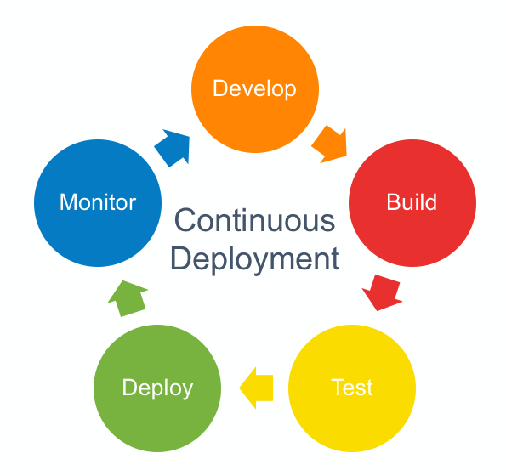
Build Deployment Process
Build Deployment Process:
QA team should be aware of the deployment process, they will understand the importance
of completing their tasks within the planned time-frame.
Advantages:
Testers will get an idea if the issue is really a functionality bug or something caused during deployment.
Many non-issues could be avoided if the testers really are aware of the list that got deployed.
Before Deployment :
The entire test design phase takes place before the code is actually moved to the environment.
It’s the test execution that depends on the code availability in the QA environment while the
Deployment team works on getting the code deployed in QA, the QA team should ensure to
have completed below activities:
➢ Ensure the test cases are reviewed and approved
➢ Ensure the test team is available and resource planning is completed
➢ Ensure the test data needs are identified After Deployment

Slide 7

Build Deployment Process
After Deployment:
After deployment, QA team started with our Sanity test. But before we start our sanity test, we should ensure following has been taken care:
➢ The QA team should have received notification from the deployment team about
successful deployment and ready for QA.
➢ The QA team should keep a track of the deployed build.
➢ Make sure the QA team has the list of changes successfully deployed and also of
items not deployed even if they were planned. It may happen that the deployment team
couldn’t deploy due to missing details etc
Build Versioning:
Build Versioning should be added on every build deployment on product to track
how many builds are deployed in QA Instance. Build versioning is important as it will
help QA team to Sign off on respective build. If there is any fall back they will revert to previous build to continue testing.

Slide 8
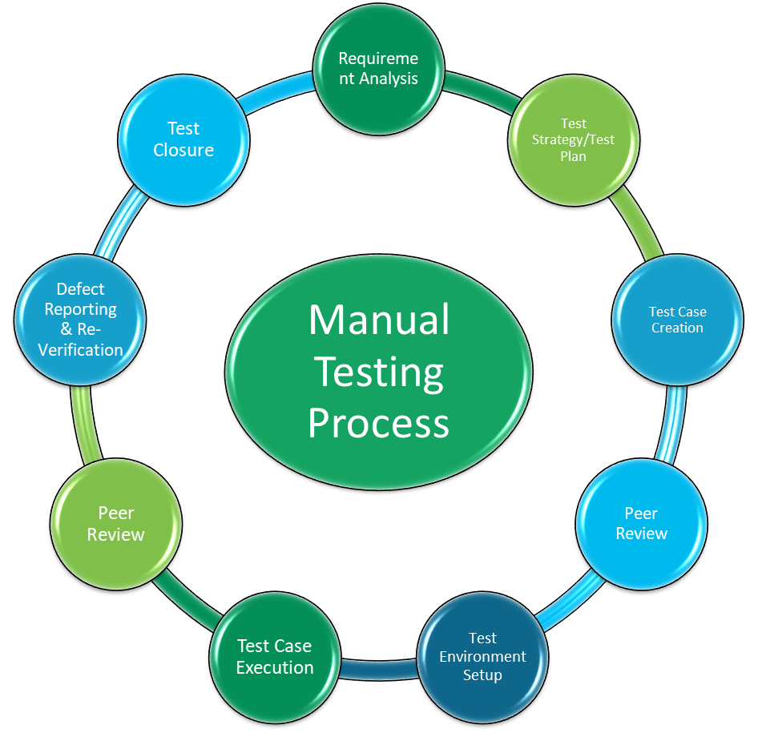
Manual Testing Process
Requirement Analysis
Prepare RTM
Verify the completeness of coverage
Prepare Test Design (Includes Test Scenario’s and Test Cases)
Peer Review Process
Build Deployment Process
Build Version
Unit Testing Results
Manual Testing
Automation Testing
Performance Testing
Security Testing
Defect Reporting Structure & Review Process
Test Closure Activities

Slide 9
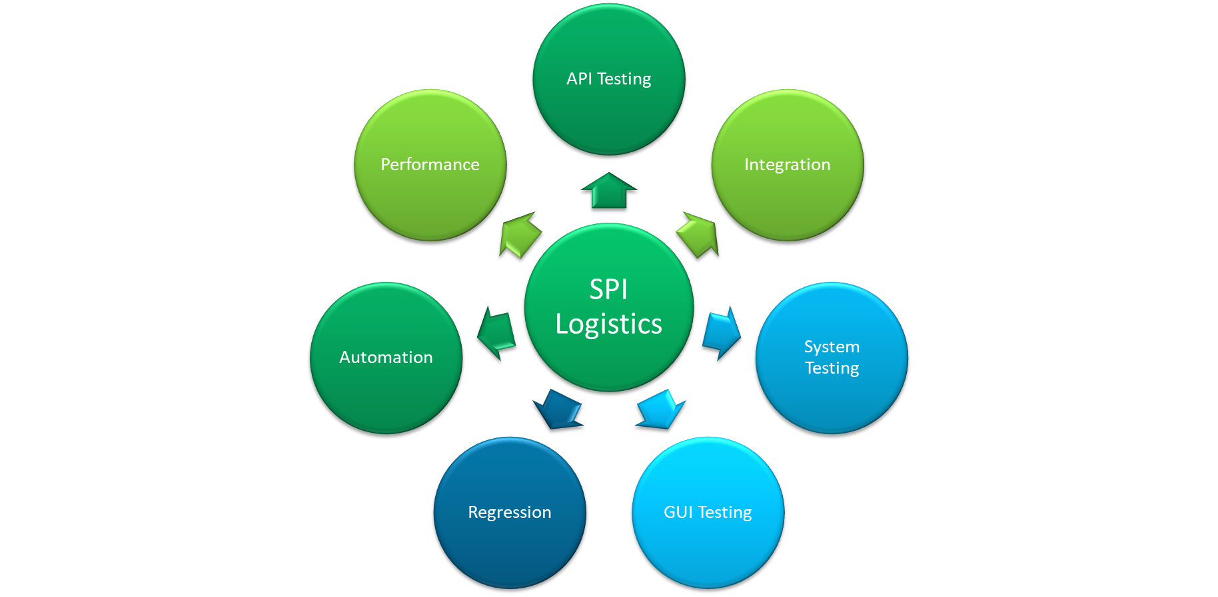
SPI Logistic : Testing Types

Slide 10
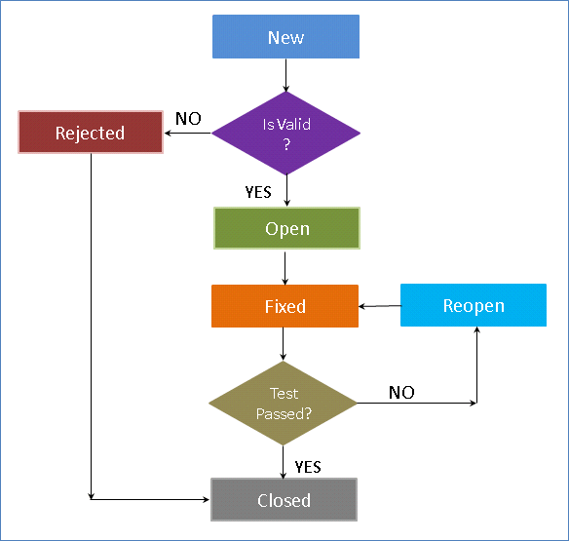
Defect Reporting Process

Slide 11
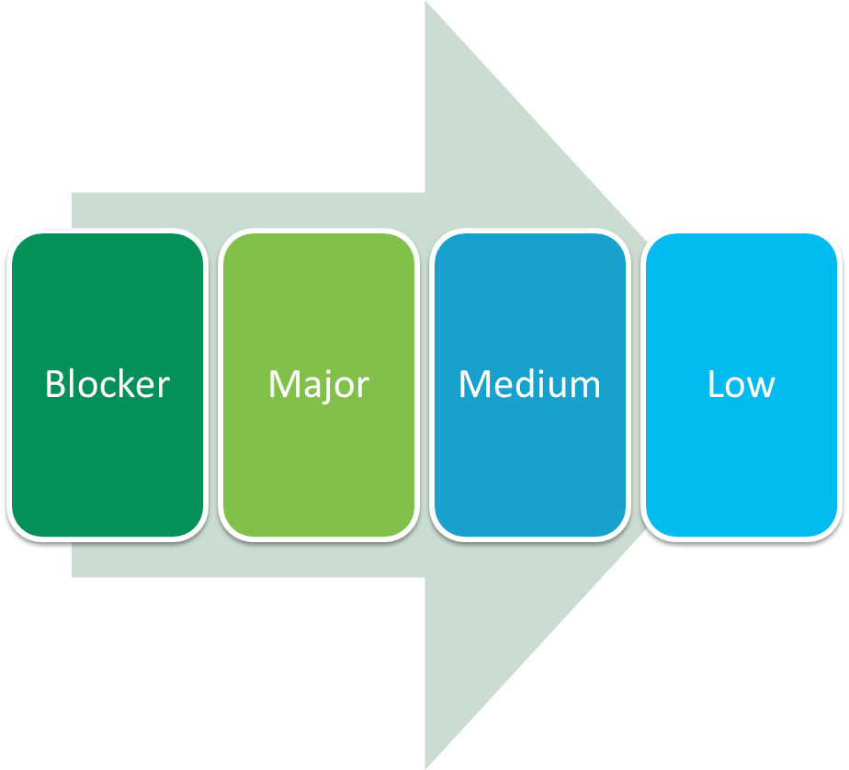
Defect Reporting - Severity
Defect Severity | Description
Blocker | Any defect that is making us not to achieve the Main functionality of the System. And there is no alternative way to proceed.
Major | Any defect that is impacting the major functionality of the application and there is an alternative way to achieve.
Medium | Any defect that is impacting the normal functionality and there is an alternative way to achieve.
Low | Any defect that is impacting minor functionalities of the application.

Slide 12
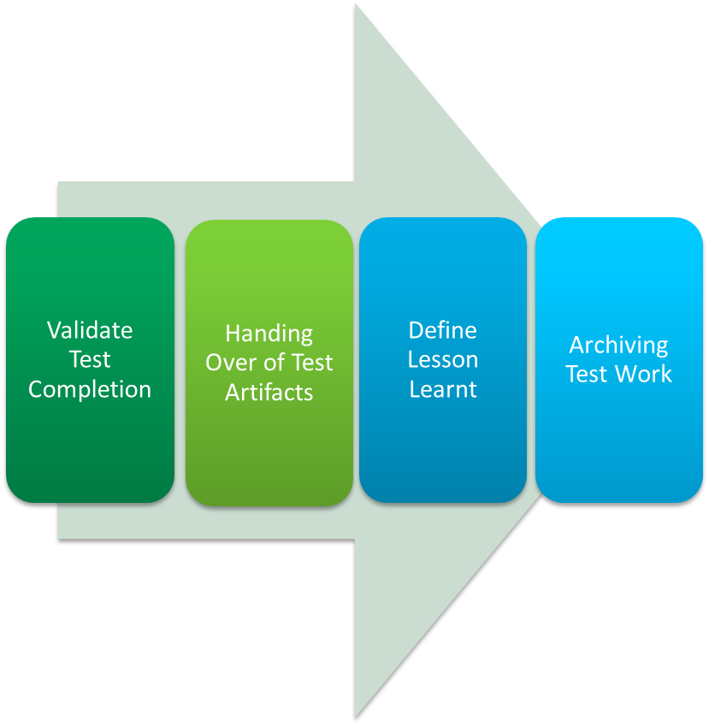
Test Closure Activities
Validate Test Completion: While performing this activity, the QA manager validates the completion of every test work and process. QA Manager is responsible to cross-check the various test plans, test cases, and strategies to ensure that nothing was left out during the course of testing. Moreover, all the known bugs and defects must be corrected, deferred by the test manager.
Handing Over of Test Artifacts & Test ware: After the validation of test completion, relevant Test Artifacts and work products will be shared to all stakeholder’s
Define Lessons Learnt: The most important aspect of test closure activities is that it offers a chance to evaluate and record various lessons learnt
Archiving Test Work: QA manager will archive all the important and relevant test work product and documents, such as test logs, test report, test cases, test results etc

Slide 13
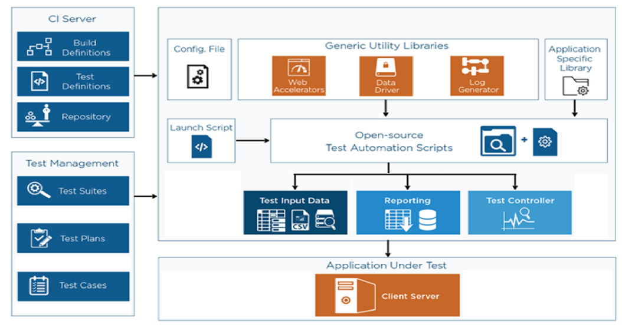
ideyaLabs Test Automation Framework (iTAF)

Slide 14
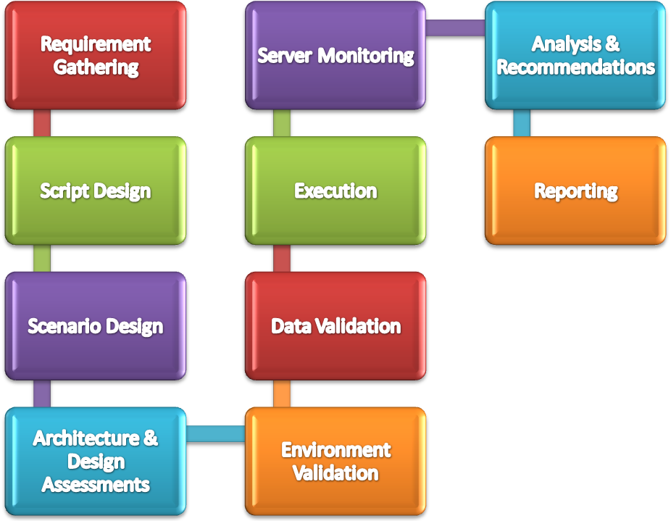
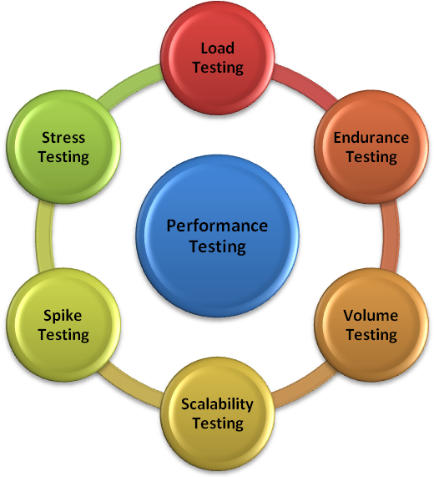
Performance Testing
Performance testing is type of testing performed to determine the performance of system to measure, validate or verify quality attributes of the system like responsiveness, Speed, Scalability, Stability under variety of load conditions.

Slide 15
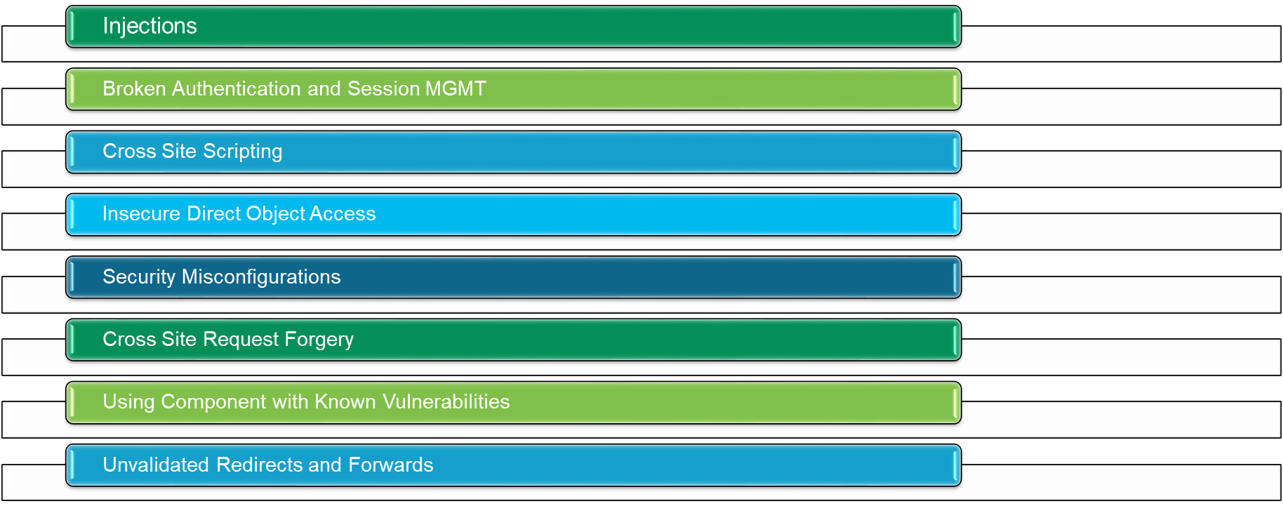
Security Testing
Security testing: We will perform OWASP Top 10 Vulnerability check against the application. We will perform one round on Pre - Prod Environment and regression after Vulnerabilities Fixing.

Slide 16

Thank You
Contact:
ideyaLabs Team

