Slide 1
SQL_Analysis_Report

Slide 2
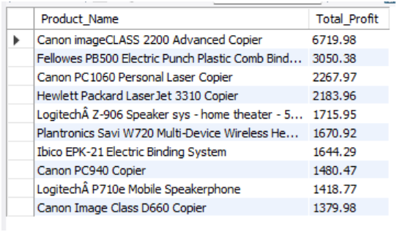
1. Top 10 Products by Profit
select Product_Name,round(sum(profit),2) as Total_Profit
from amazon_Cleaned
group by Product_Name
order by Total_Profit desc limit 10;
OUTPUT:
Key Insight:
Canon imageCLASS 2200 Advanced Copier was the most profitable product.

Slide 3
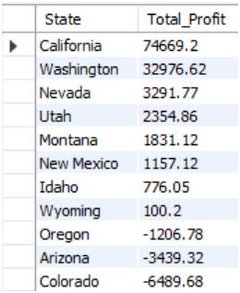
2.Profit by State
select trim(substring_index(geography, ',',-1)) as State , round(sum(profit),2) as Total_Profit
from amazon_Cleaned
group by State
order by Total_Profit desc;
OUTPUT:
Key Insight:
California generated the highest overall profit among all states.

Slide 4
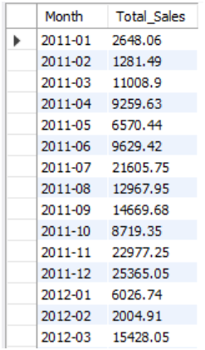
3. Monthly Sales Trend
select date_format(order_date,'%Y-%m') asMonth,
round(sum(Sales),2) as Total_Sales
from amazon_ Cleaned
group by Month order by Month;
OUTPUT:
Key Insight:
Sales showed a consistent upward trend from 2011 to 2014.

Slide 5
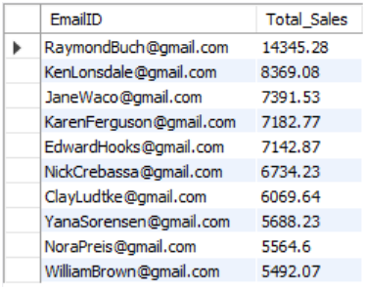
4.Top 10 Customers
select EmailID,round(sum(Sales),2) as Total_Sales
from amazon_ Cleaned
group by EmailID
order by Total_Sales desc limit 10;
OUTPUT:
Key Insight:
A small group of customers contributed a significant portion of total sales.

Slide 6
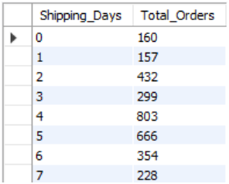
5.Shipping Performance
select Shipping_Days,count(*) as Total_Orders
from amazon_ Cleaned
group by Shipping_Days
order by Shipping_Days;
OUTPUT:
Key Insight:
Most orders were delivered within a few days, indicating efficient shipping operations.

Slide 7
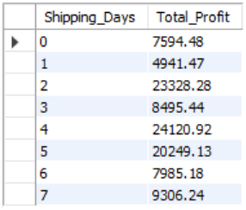
6.Profit vs Shipping Time
select Shipping_Days,round(sum(profit),2) as Total_Profit
from amazon_ Cleaned
group by Shipping_Days
order by Shipping_Days;
OUTPUT:
Key Insight:
Profitability varied across shipping durations, highlighting operational efficiency opportunities.

Slide 8
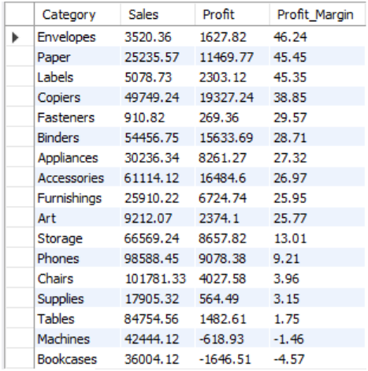
7.Category-wise Profit Margin
select Category,round(sum(sales),2) as Sales,
round(sum(profit),2) as Profit,
round((sum(profit)/sum(sales))*100,2) as Profit_Margin
from amazon_ Cleaned
group by Category
order by Profit_Margin desc;
OUTPUT:
Key Insight:
Certain categories generated higher profit margins despite lower sales volumes.

Slide 9
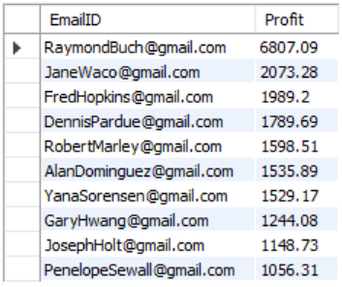
8.Most Profitable Customers
select EmailID,round(sum(profit),2) as Profit
from amazon_ Cleaned
group by EmailID
order by Profit desclimit 10;
OUTPUT:
Key Insight:
High-revenue customers were not always the most profitable customers.

Slide 10
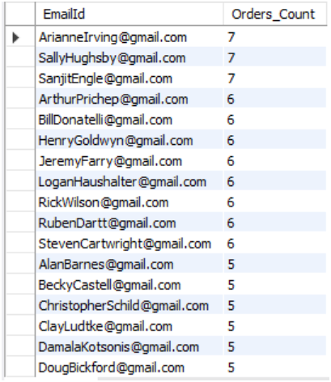
9.Repeat Customers
select EmailId ,count(distinct Order_ID) as Orders_Count
from amazon_ Cleaned
group by EmailID having count(distinct Order_ID) > 1
order by Orders_Count desc;
OUTPUT:
Key Insight:
Repeat customers represented a valuable customer segment and contributed significantly to revenue.

Slide 11
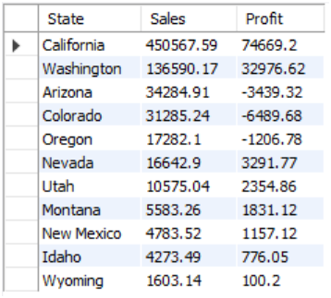
10.Sales vs Profit by State
select trim(substring_index(geography, ',',-1)) as State, round(sum(sales),2) as Sales,round(sum(profit),2) as Profit
from amazon_ Cleaned
group by State
order by sales desc;
OUTPUT:
Key Insight:
States with high sales did not always generate the highest profit.

Slide 12
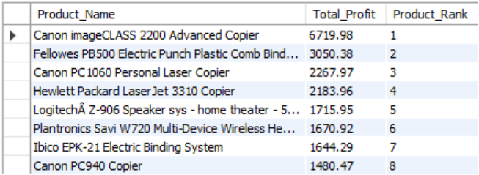
11.Rank Products by Profit
with product_profit as(
select Product_Name,round(sum(profit),2) as Total_Profit
from amazon_ Cleaned
group by Product_Name
)select *,
rank() over(order by Total_Profit desc) as Product_Rank
from product_profit;
OUTPUT:
Key Insight:
A small number of products accounted for a large share of total profits.

Slide 13
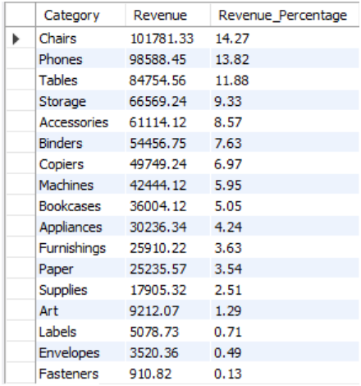
12.Revenue Contribution %
select Category,round(sum(sales),2)as Revenue,
round(sum(sales) *100/(select sum(sales) from amazon_ Cleaned),2) as Revenue_Percentage
from amazon_ Cleaned
group by Category
order by Revenue desc;
OUTPUT:
Key Insight:
A few categories contributed the majority of total revenue, following the Pareto principle.

