Slide 1
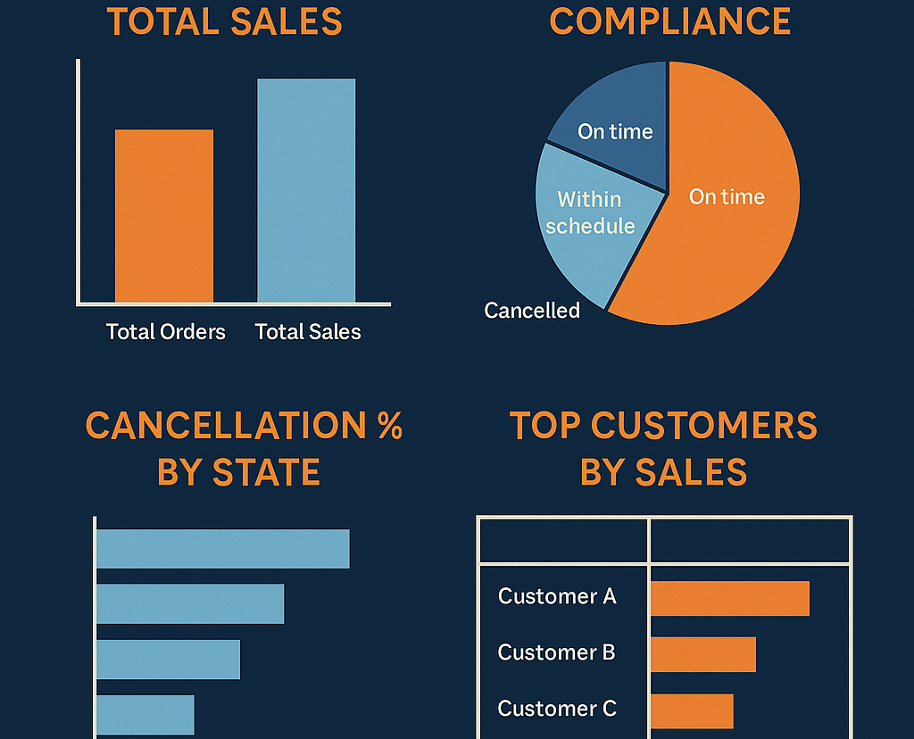
Order Fulfillment And Customer Analytics Using SQL (supply_db)
Notes:
NOTE:
To change the image on this slide, select the picture and delete it. Then click the Pictures icon in the placeholder to insert your own image.

Slide 2
Being an analyst for a retail company , you need to know
order performance
shipping efficiency
customer behaviour
cancellations & fraud

Slide 3
Objectives & key points
Objectives
measure order fulfillment efficiency
analyse shipping performance and delays
identify high-value customers
understand cancellation and suspected fraud patterns
key points
total orders, total sales
order cancellation %
shipment compliance categories
delayed orders by shipping mode
top customers by completed orders
orders by department & shipping mode

Slide 4
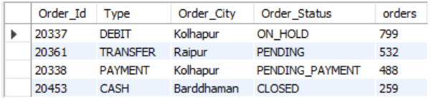
*Get the number of orders by the Type of Transaction. Please exclude orders shipped from Sangli and Srinagar. Also, exclude the SUSPECTED_FRAUD cases based on the Order Status. Sort the result in the descending order based on the number of orders.i result in the descending order based on the number of orders.
Expected Output :

Slide 5
CODE:
select Order_Id, Type, Order_City, Order_Status,count(order_id) as orders
from orders
where order_city not in ("sangli", "srinagar")and order_status <> "suspected_fraud"
group by type
order by orders desc;

Slide 6
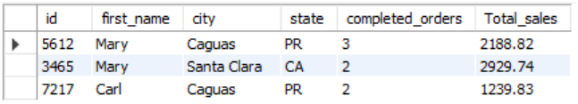
* Get the list of the Top 3 customers based on the completed orders along with the following details:
→ Customer Id
→ Customer First Name
→ Customer City
→ Customer State
→ Number of completed orders
→ Total Sales of completed order
Expected Output :

Slide 7
CODE :
with com_ord as
(
select o.order_id,o.customer_id,o.order_status,oi.sales
from orders as o join ordered_items as oi
using(order_id)
where o.order_status = 'complete'
),o_summary as
(
select order_id,customer_id,sum(sales) as ord_lev_sales
from com_ord
group by order_id
)
select c.id , c.first_name , c.city , c.state ,
count(os.order_id) as completed_orders,
sum(ord_lev_sales) as Total_sales
from o_summary as os join customer_info c
on os.customer_id = c.id
group by c.id
order by completed_orders desc,total_sales desc
limit 3;

Slide 8
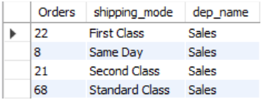
*Get the order count by the Shipping Mode and the Department Name. Consider departments with at least 40 closed/completed orders.
Expected Output:

Slide 9
CODE :
with order_dept as
(
select o.order_id, o.order_status, o.shipping_mode, d.name as dep_name
from orders o join ordered_items oi using (order_id)
join product_info p on oi.item_id = p.product_id
join department d on p.department_id = d.id
), dep_40 as
(
select dep_name, count(distinct order_id) as orders
from order_dept
where order_status in ("Complete", "Closed")
group by dep_name
having orders>=40
)
select count(distinct order_id) as Orders, shipping_mode, dep_name
from order_dept
where dep_name in (select dep_name from dep_40)
group by shipping_mode, dep_name;

Slide 10
*Create a new field as shipment compliance based on Real_Shipping_Days and Scheduled_Shipping_Days. It should have the following values:
Cancelled shipment - If the Order Status is SUSPECTED_FRAUD or CANCELED
Within schedule - If shipped within the scheduled number of days
On time - If shipped exactly as per schedule
Upto 2 days of delay - If shipped beyond schedule but delay upto 2 days
Beyond 2 days of delay - If shipped beyond schedule with delay beyond 2 days
Which shipping mode was observed to have the greatest number of delayed orders?

Slide 11
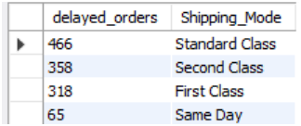
Expected Output:

Slide 12
CODE:
with cte as
(
select *,
case when order_status = 'suspected_fraud'or order_status ='canceled' then 'cancelled shipment'
when real_shipping_days < scheduled_shipping_days then 'within schedule'
when real_shipping_days = scheduled_shipping_days then 'on time'
when real_shipping_days - scheduled_shipping_days <=2 then 'upto 2 days of delay'
when real_shipping_days - scheduled_shipping_days >2 then 'beyond 2 days of delay'
end as shipment_compliance
from orders
)
select count(order_id) as delayed_orders, shipping_mode from cte
where Shipment_Compliance in ("Upto 2 days of delay", "beyond 2 days of delay")
group by shipping_mode
order by delayed_orders desc;

Slide 13
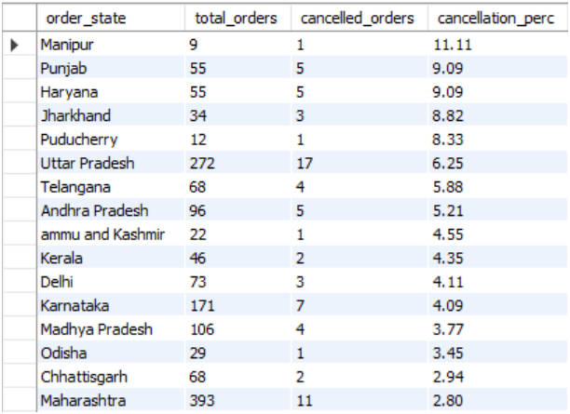
*An order is cancelled when the status of the order is either cancelled or SUSPECTED_FRAUD. Obtain the list of states by the order cancellation % and sort them in the descending order of the cancellation %
Definition: Cancellation % = Cancelled orders / Total Orders
Expected Output:

Slide 14
CODE:
with c_orders as
(
select Order_State,count(Order_Id) as cancelled_orders from orders
where order_status in ('canceled', 'suspected_fraud')
group by Order_State
),t_orders as
(
select Order_State,count(Order_Id) as Total_orders
from orders
group by Order_State
)select t.order_state,t.total_orders ,c.cancelled_orders,round((c.cancelled_orders/t.total_orders)*100,2) as cancellation_perc
from t_orders t join c_orders c
using(Order_State)
order by cancellation_perc desc;

