Slide 1


Title:Web Scraping and Analysis of Online Bookstore Data

Slide 2

Introduction:
This project is about collecting book data from an online bookstore.
We used web scraping to extract book details (title, price, rating, category, etc.).
The data collected was cleaned to remove errors and unnecessary text.
We created new useful columns using feature engineering and regular expressions.
The cleaned dataset was analyzed to understand price patterns, rating trends, and category insights.
This analysis helps in understanding which types of books are popular and how pricing varies.

Slide 3

Business Problem:
Book information on online websites is not available in a structured format.
It is difficult to compare book prices, ratings, and categories directly from the website.
Customers may not easily find which books are good value or most preferred.
Businesses cannot analyze trends like which category sells more or how ratings affect price.
There is a need to collect, clean, and analyze book data to understand market patterns.

Slide 4
Objectives
To extract book details like title, price, rating, and category from the website using web scraping.
To clean and organize the collected data for proper analysis.
To create new useful features (Clean Price, Numeric Rating, Category Type, etc.) using feature engineering.
To perform univariate, bivariate, and multivariate analysis to understand patterns in the data.
To identify insights such as price trends, popular categories, and rating influence.
To prepare the dataset for future use in dashboards or machine learning models.

Slide 5
The Dataset & Target Variable
Source: https://books.toscrape.com/
Scope: 1,000 Books • 19+ Features
Key Features Collected:
Book Details: Product Name, Category, Description, Product Link, Image Link
Pricing & Rating: Price, Clean_Price (numeric price), Rating, Numeric_Rating (1–5)
Feature Engineering:
Category_Type (Grouped book categories)
Description_Type (Short / Medium / Long)
Description_Word_Coun
UPC, UPC_Numbers
🎯 Target Variable:
Clean_Price — Used to study how price varies across rating, category, and description features.

Slide 6
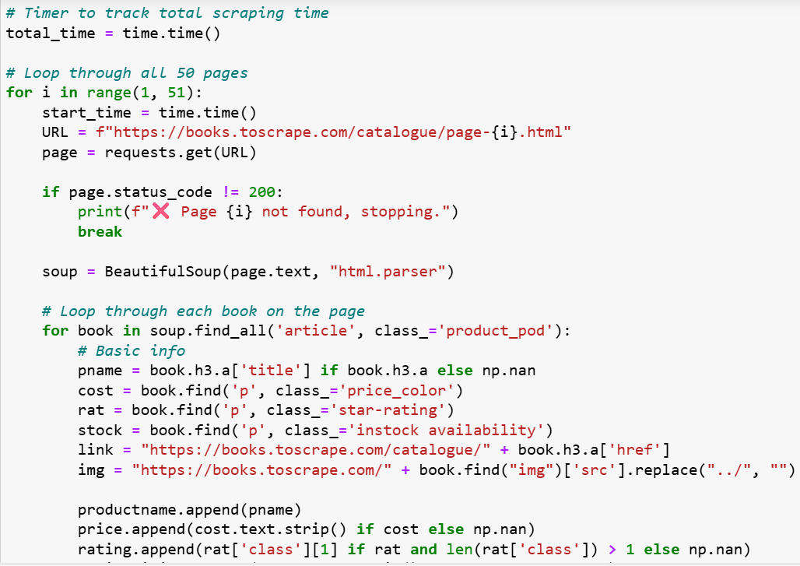
Web Scraping
The data was collected from the website books.toscrape.com.
Python was used to scrape the book details.
Requests library was used to send page requests and download HTML content.
BeautifulSoup was used to parse the HTML and extract required information.
We extracted details like Book Name, Price, Rating, Category, Description, and Product Links.
Scraping was performed for multiple pages to collect around 1000 books.
The collected data was stored into a structured dataset for further cleaning and analysis

Slide 7






Tools Used

Slide 8
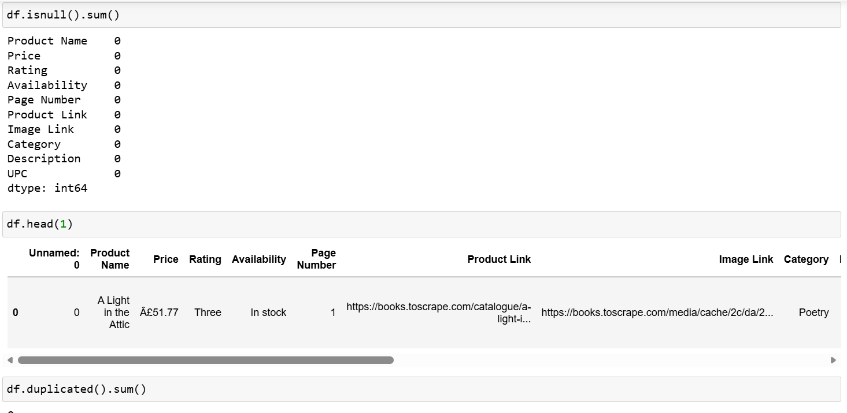
Data Cleaning Steps
Initial State: The scraped dataset contained text formatting issues, inconsistent rating values, and encoded price symbols.
Handled Data Issues Carefully:
Price Column: Removed special characters (e.g., “Â£”) and converted to a numeric column (Clean_Price) for analysis.
Rating Column: Converted rating text (One, Two, Three, etc.) into a numeric scale (Numeric_Rating: 1–5).
Description Field: Missing or empty descriptions were replaced with “No description” to maintain completeness.
Category Standardization: Category names were cleaned and later grouped into Category_Type for easier comparison.
UPC Processing: Extracted numeric patterns from UPC to create UPC_Numbers and UPC_Numbers_Num using regular expressions.
Result:
A clean, structured dataset with 1,000 rows and 19+ meaningful columns, ready for feature engineering and visual analysis.

Slide 9
PART 1: UNIVARIATE ANALYSIS

Slide 10
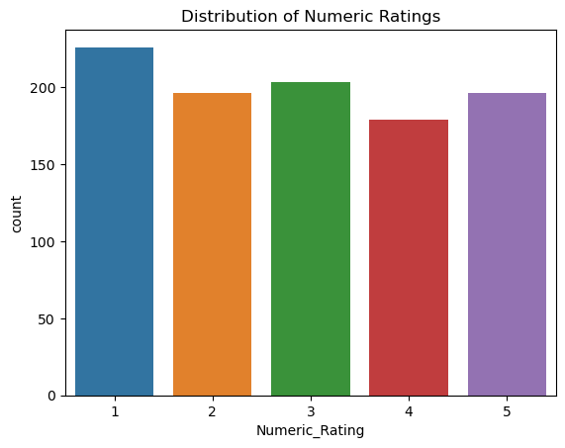
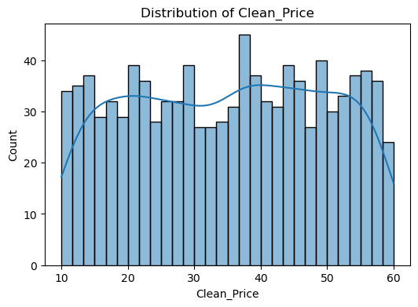
Book Price Distribution
Book Rating Distribution
Most books are priced between £20 and £50.
Very few books are very cheap or very expensive.
Prices are mostly stable and consistent across the website.
The store seems to target affordable and mid-range customers.
Overall pricing is balanced with no large price gaps.
All rating levels from 1 to 5 are present in the dataset.
Most books have ratings between 1 and 3, showing mixed reader feedback.
Books with high ratings (4 and 5) are fewer, meaning only some books are highly liked.

Slide 11
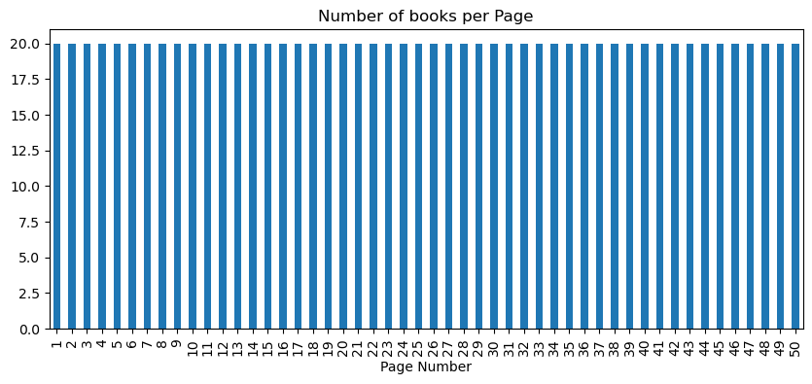
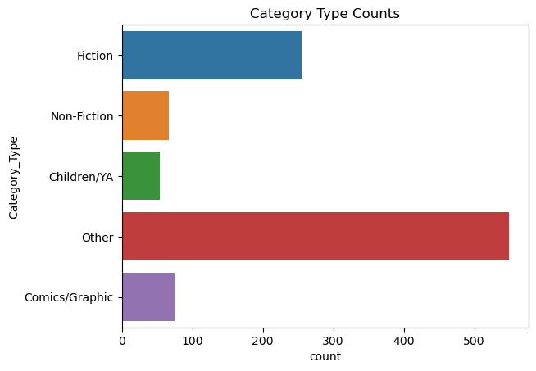
Books per Page Distribution
Book Category Distribution
Fiction and Other categories are the most common, showing most books belong to general reading genres.
Non-Fiction, Children/YA, and Comics/Graphic have fewer books, indicating limited variety in these categories.
The website focuses more on general and broad-interest books rather than niche or specialized categories.
Each page contains about the same number of books (around 20).
This shows the website displays books in a consistent layout across all pages.
The dataset is uniform, so there is no missing or extra book data from any page.

Slide 12
PART 2: BIVARIATE ANALYSIS

Slide 13
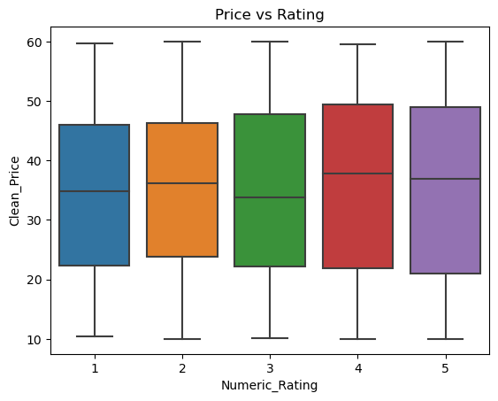
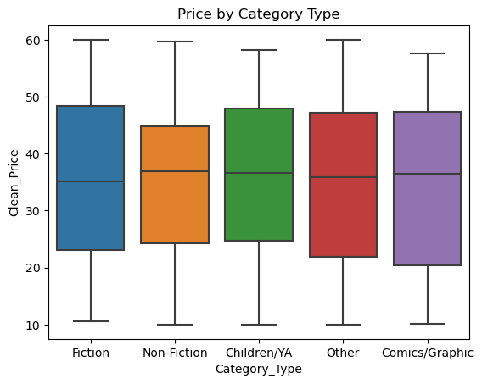
Price vs Rating (Boxplot)
Price by Category Type
Books with higher ratings tend to have slightly higher prices, but the difference is not very large.
Prices are spread across all rating levels, meaning price is not strictly based on rating alone.
High-rated books still appear in both low and high price ranges, showing that factors like category or book type also influence price.
All categories have almost similar prices — no big difference between them.
Fiction and Children books are priced a little higher than others.
Every category has both cheap and expensive books, so price does not depend only on the category

Slide 14
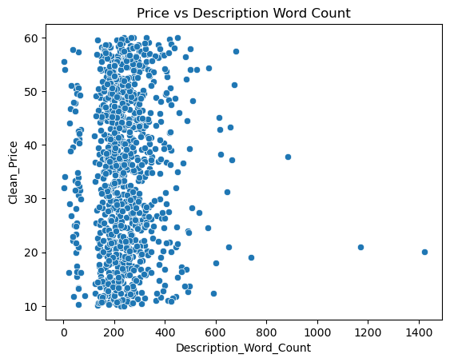
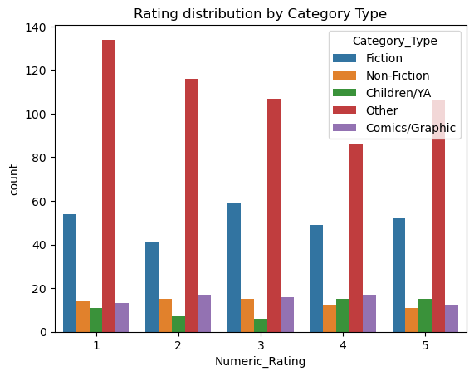
Price vs Description Length
Ratings Across Categories
All categories have books with ratings from 1 to 5, meaning every category has both low-rated and high-rated books.
The "Other" category has the highest number of books across all rating levels.
Fiction and Comics/Graphic books have more higher ratings compared to Children and Non-Fiction.
Books with longer descriptions do not always have higher prices.
Most books fall in the same price range regardless of description length.
Price is not strongly linked to how long the description is — other factors affect price more.

Slide 15
PART 3: MULTIVARIATE ANALYSIS

Slide 16
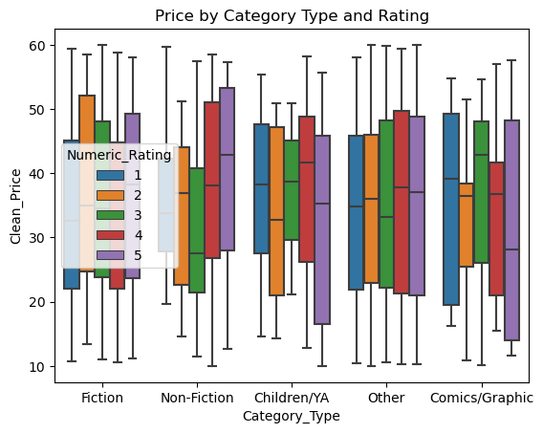
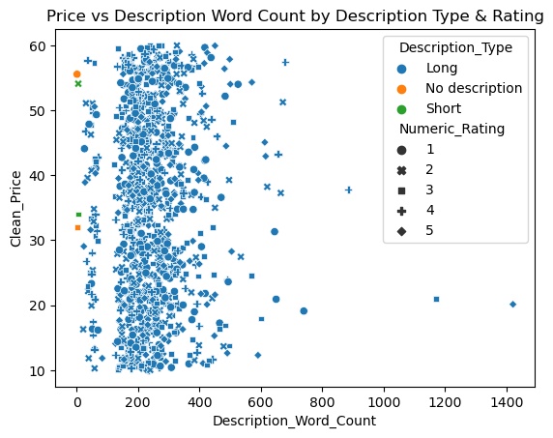
Price by Category and Rating
Price vs Description
Long or short description does not change price much.
Books with any description type appear across all price levels.
Rating and description together still do not strongly decide price.
Higher ratings slightly increase price, but not by much.
Prices vary within each category.
Category and rating do not fully decide price.

Slide 17
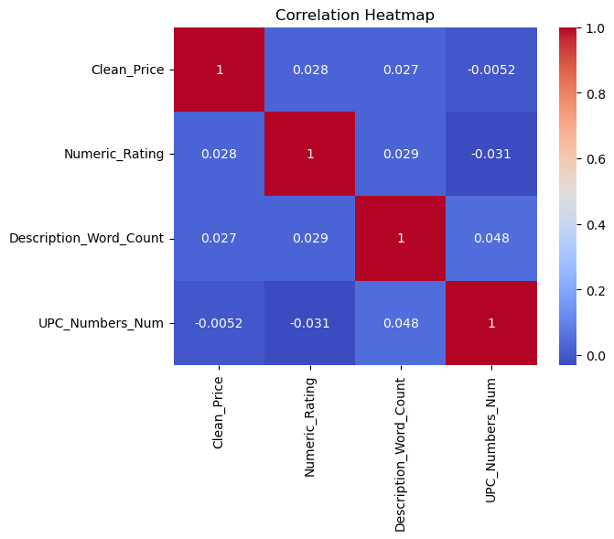
Multivariate Correlation Patterns
Weak Relationships:
Clean_Price has very low correlation with Rating and Description length.
No Strong Patterns:
All feature correlations are close to zero, showing no direct linear link.
Hidden Influencers:
Price is likely affected by external factors (author, edition, popularity, publisher) rather than these numeric features.
Key Understanding:
Pricing is not determined by rating or description length in this dataset.

Slide 18
Key Business Insights & Recommendations
Mid-range pricing dominates — most books cluster in the £20–£50 range, showing a stable and consumer-friendly pricing strategy.
Category variety is wide, but demand concentrates — Fiction and general-interest books lead, while Non-Fiction and Comics remain niche segments.
Star ratings do not strongly drive pricing — rating and description length show near-zero correlation with price, meaning brand/author value outweighs user feedback.
Book value is influenced by intangible factors — reputation, edition quality, and publisher prestige play a stronger role than text content length or category.
Pricing strategy is standardized — consistent price spread across categories reflects a mature catalog with controlled pricing rather than aggressive market positioning.

Slide 19
Conclusion
We successfully scraped and cleaned book data from books.toscrape.com.
New useful features were created (Clean Price, Numeric Rating, Category Type, etc.) to improve analysis.
Most books fall in a mid-range price, showing stable and affordable pricing.
Category and rating have only a small effect on price, meaning price is influenced more by author, edition, or publisher.
The dataset is now organized, insightful, and ready for further use in dashboards or recommendation systems.

Slide 20
Experience – Web Scraping & Data Analysis
Extracted book data from a live website using Requests and BeautifulSoup.
Cleaned and transformed raw data using Pandas (handling missing values, encoding fixes, feature engineering).
Converted text-based ratings and prices into meaningful numerical values for analysis.
Performed Univariate, Bivariate, and Multivariate Analysis to identify patterns and insights.
Created visualizations using Matplotlib and Seaborn to clearly present trends.
Summarized insights to support business understanding and decision-making.

Slide 21
Challenges – Web Scraping & Data Analysis
Irregular HTML structure: Some pages required careful tag selection to extract data correctly.
Encoding issues in Price and Description: Symbols like “Â£” had to be cleaned and converted.
Rating stored as text: Needed conversion to numeric scale (1–5) for analysis.
Missing or very short descriptions: Handled by replacing with "No description" for consistency.
Feature Engineering required extra steps: Extracting Category_Type, Description length, and UPC patterns took careful processing.

Slide 22


