Slide 1

Web Scraping & EDA on
EazyDiner Website

Slide 2
About us
Group member 1:
K. Ramakrishna, B. Tech in ECE
ID: 81010810425, Batch: 448
Group member 2:
G. Srinivas, B. Tech in CSE
ID: 81010815325 , Batch: 448
Group member 3:
K. Shiva Shankar, B. Tech in CSE
ID: 81010816825 , Batch: 448

Slide 3
Business Problem
The main business problem is to analyze restaurant ratings and pricing trends across different cities on EazyDiner and understand whether pricing, city or discounts influence customer ratings.
Objective
We do scrape restaurants over multiple cities followed by cleaning and structuring of data then onto performing EDA and finally deriving business insights.

Slide 4
Flow of Entire Code
Website
↓
Web Scraping (Requests + BS4)
↓
Raw Data (.csv)
↓
Data Cleaning (Pandas + Regex)
↓
EDA (Seaborn + Matplotlib)
↓
Insights & Business Conclusion

Slide 5
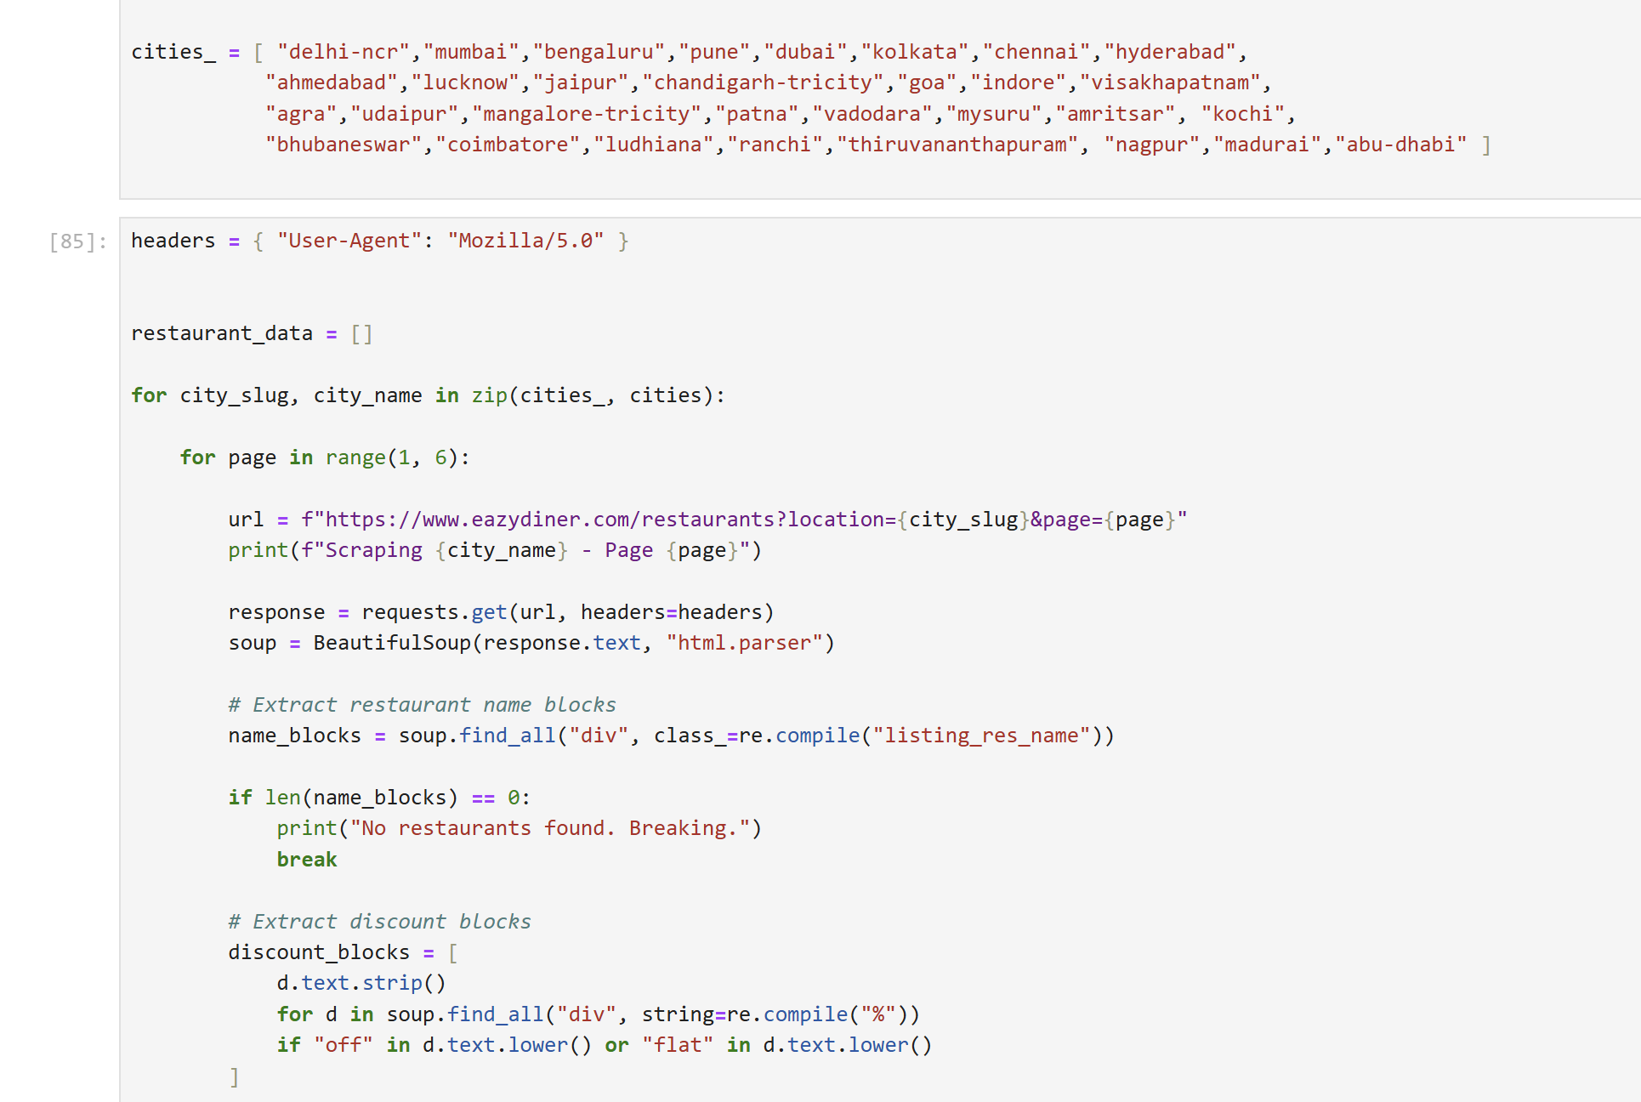
Data Collection Process Snippet

Slide 6
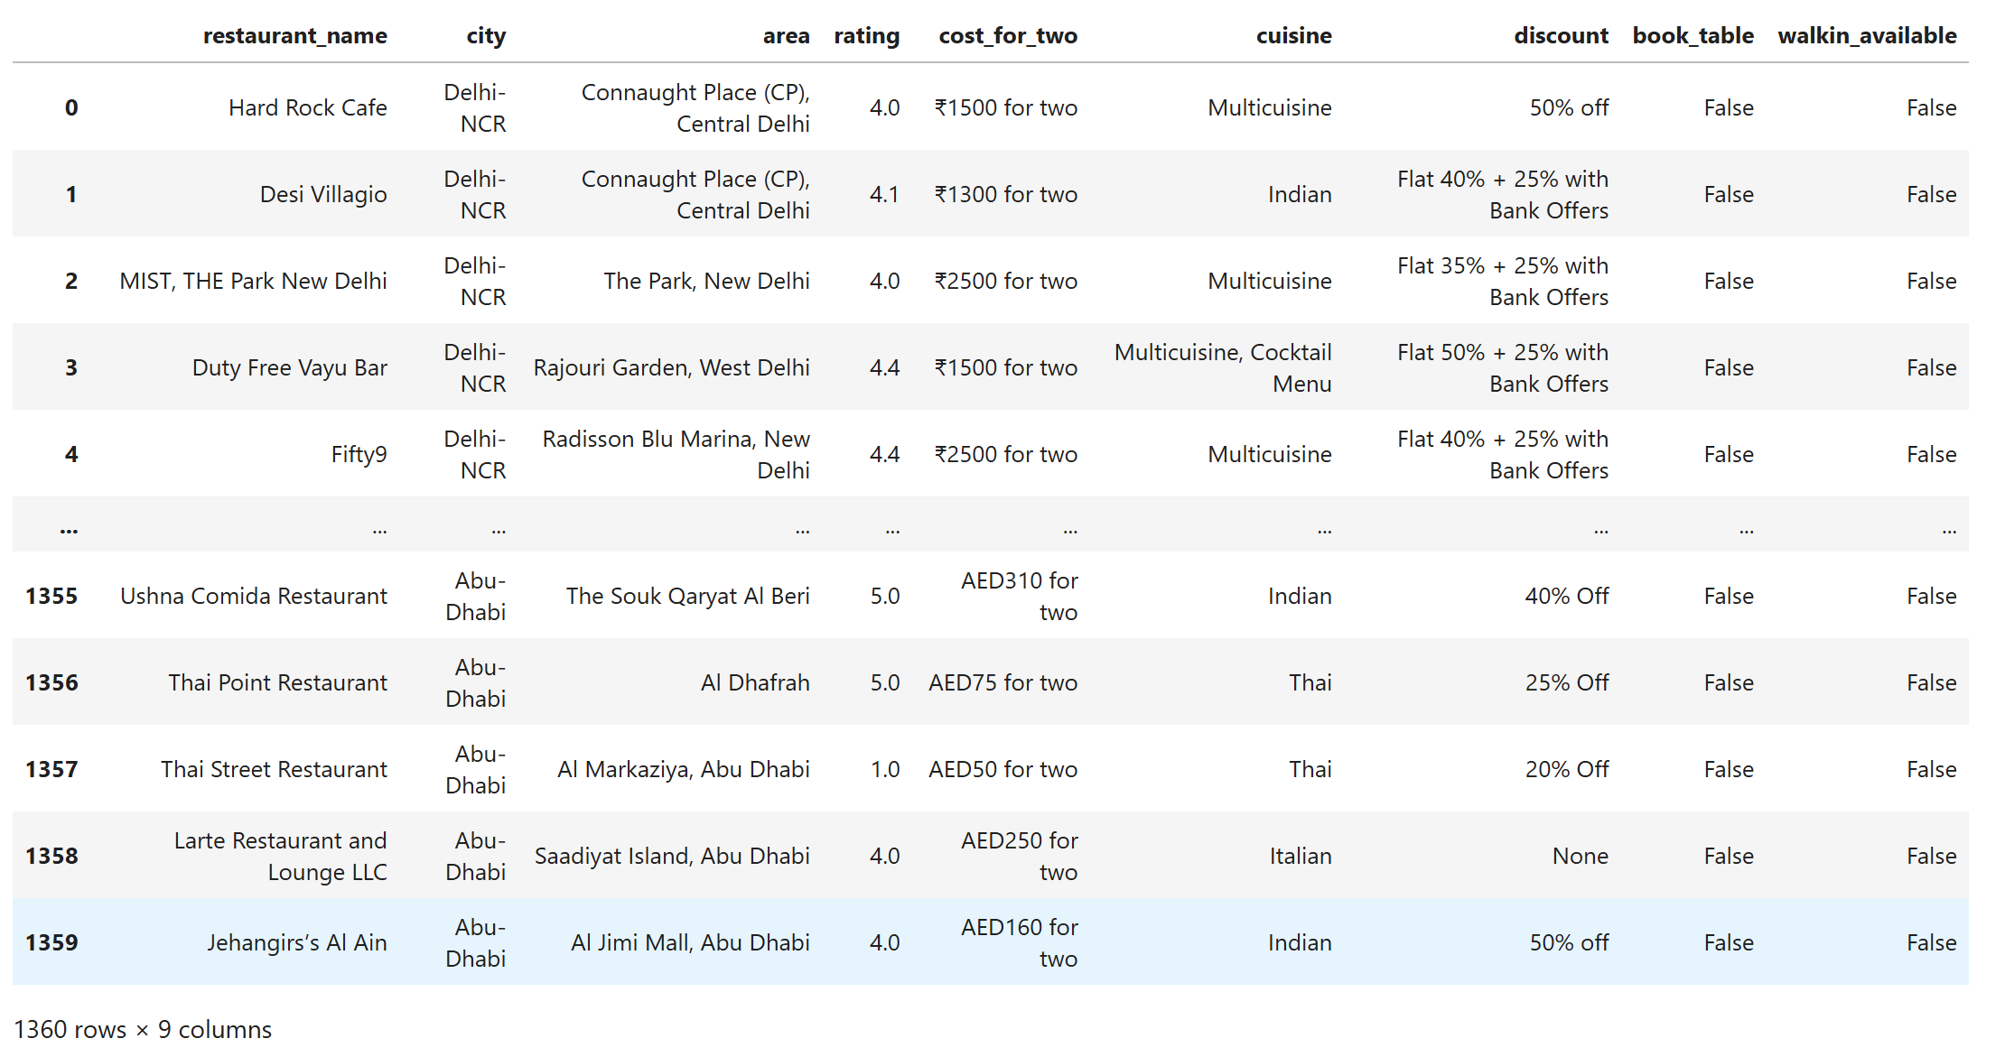
Raw Dataframe

Slide 7
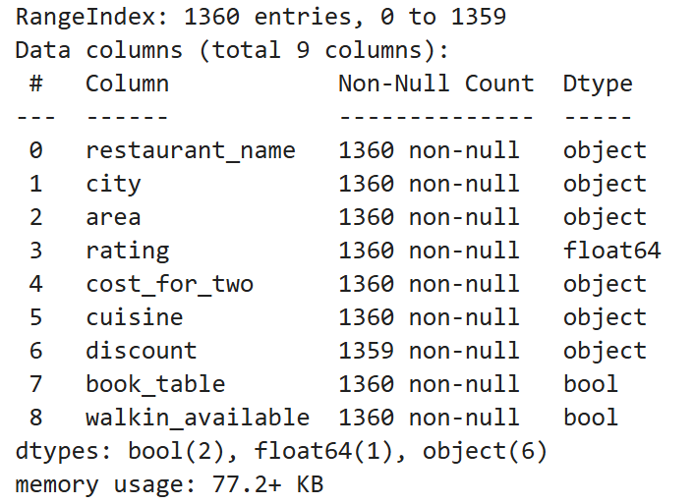
Dataset(Uncleaned) Summary

Slide 8
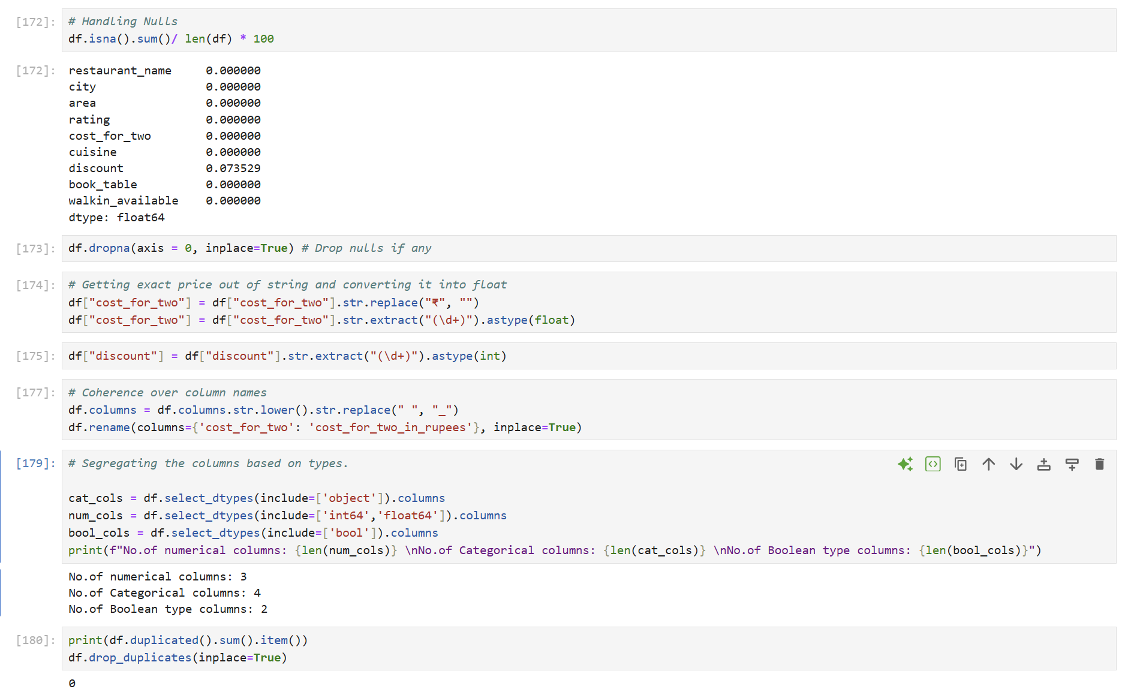
Data Cleaning Code Snippet

Slide 9
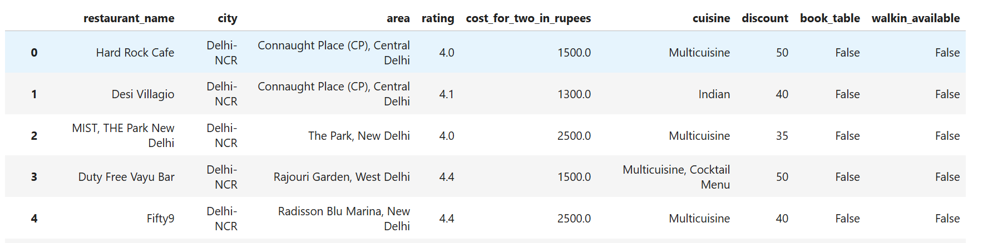
Data Cleaning Steps
Dealt with missing values, NaNs.
Changed column names so they are all in proper format.
Removed duplicates.
Segregated each column based on their datatypes.
Outliers are retained as they represent genuine data during EDA .
Fig: Cleaned Dataframe Head

Slide 10
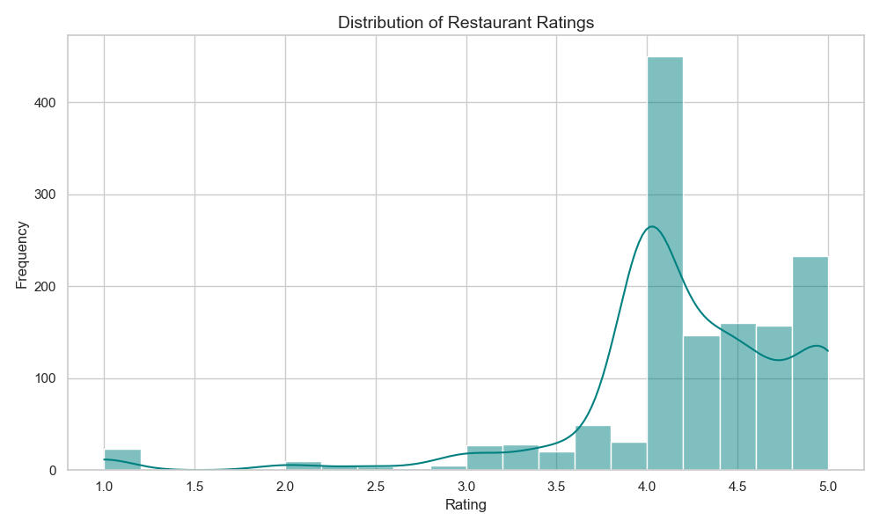
Univariate Analysis: Rating Distribution
Insights:
Most restaurants rated between 4.0–4.5
Very few poor ratings
Overall strong quality presence

Slide 11
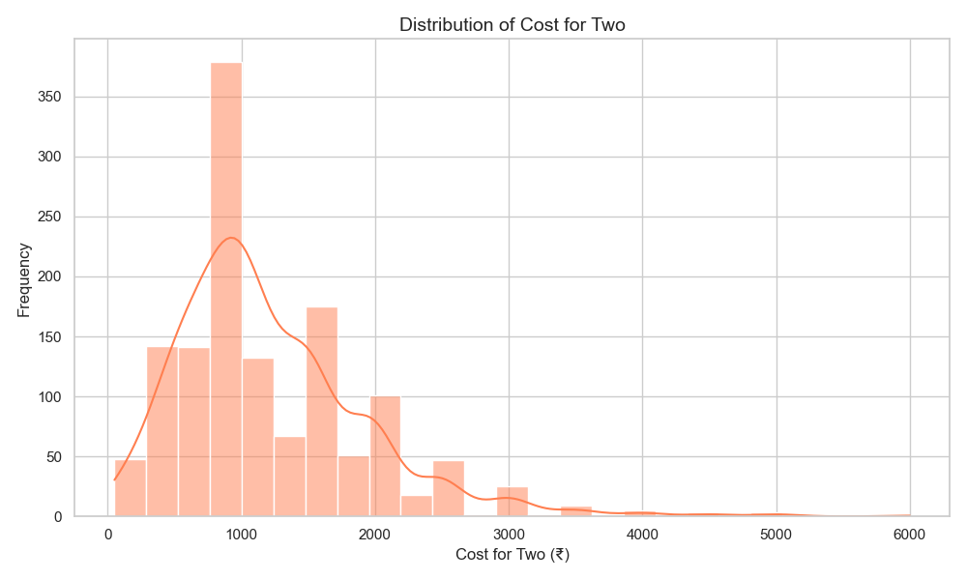
Univariate Analysis: Cost Distribution
Insights:
Majority fall in ₹700–₹1500
Very few premium > ₹3000
Platform focuses on mid-range customers

Slide 12
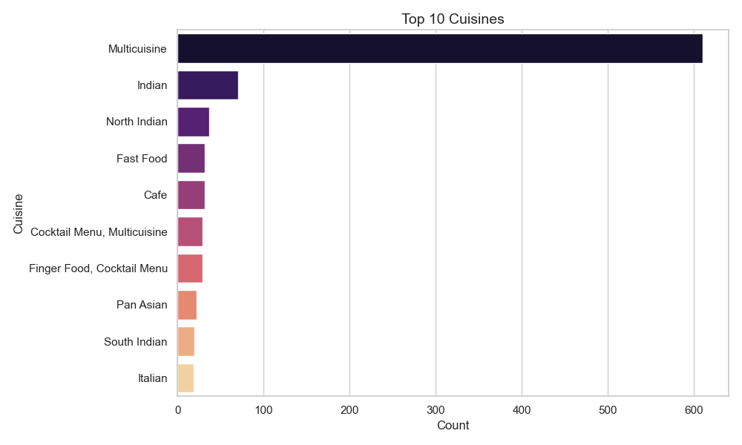
Univariate Analysis: Top Cuisines
Insights:
Multicuisine dominates
Indian & North Indian strong
presence
Customers prefer variety

Slide 13
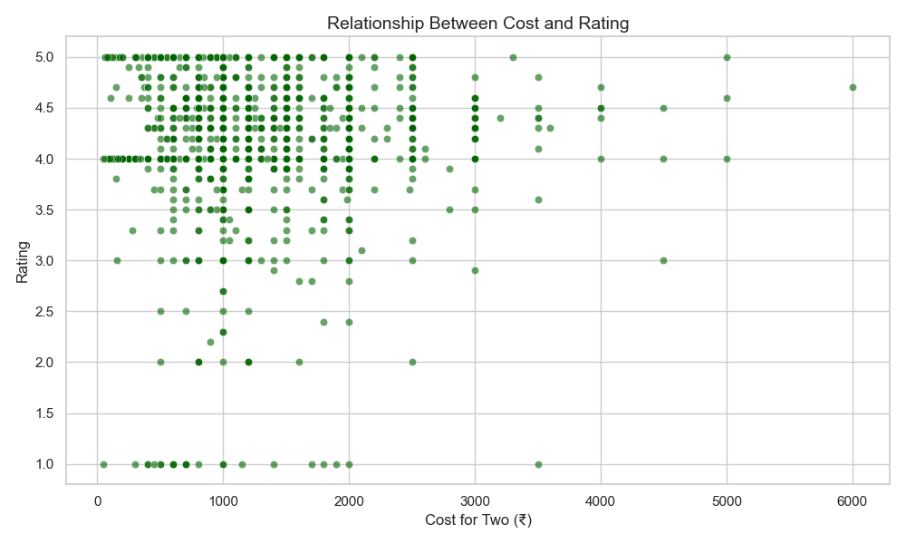
Bivariate Analysis: Rating vs Cost
Insights:
No strong relationship
High Expense doesn’t automatically reflect in Higher Rating
Experience matters more than pricing

Slide 14
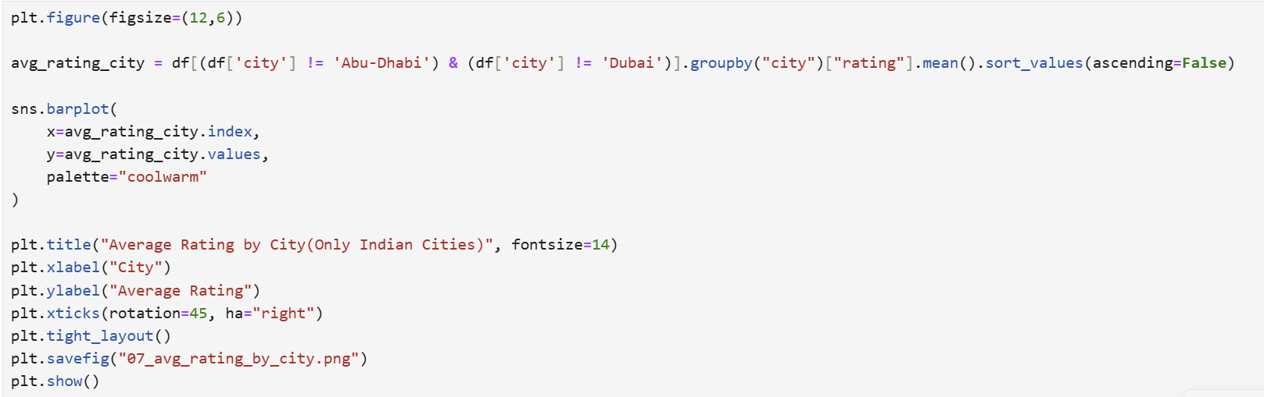
Bivariate Analysis: Average Rating by City Code Snippet
Bar chart to be drawn with only Indian cities while excluding Dubai and Abu-Dhabi.

Slide 15
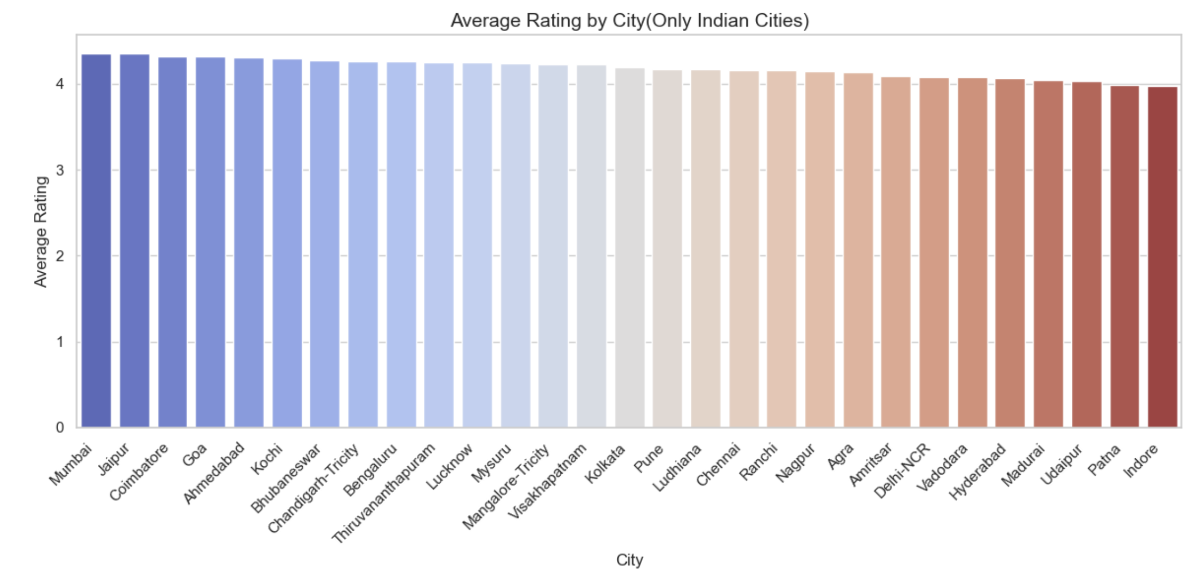
Bivariate Analysis: Average Rating by City
Insights:
1. Most cities have average ratings between 4.0–4.4, meaning quality levels are quite consistent across cities | 2 .No city shows extremely poor average rating.

Slide 16
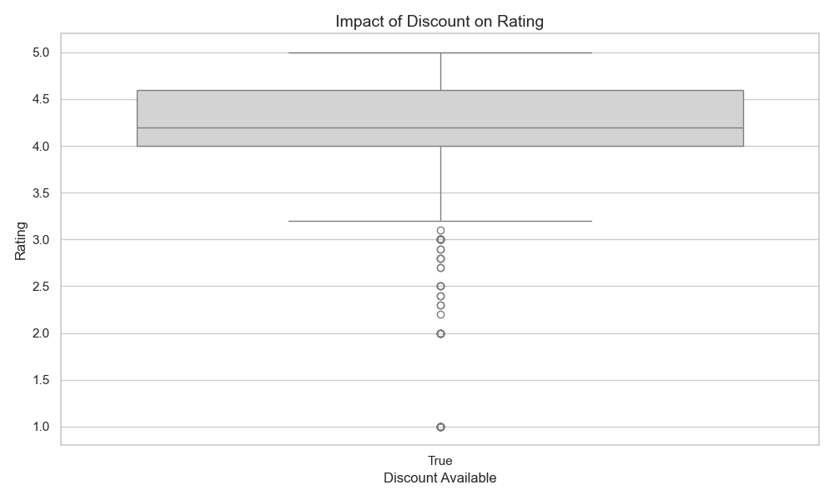
Bivariate Analysis: Discount vs Rating
Insights:
Discount does not significantly increase rating
Ratings driven by service quality
Promotions may not always lead to satisfaction

Slide 17
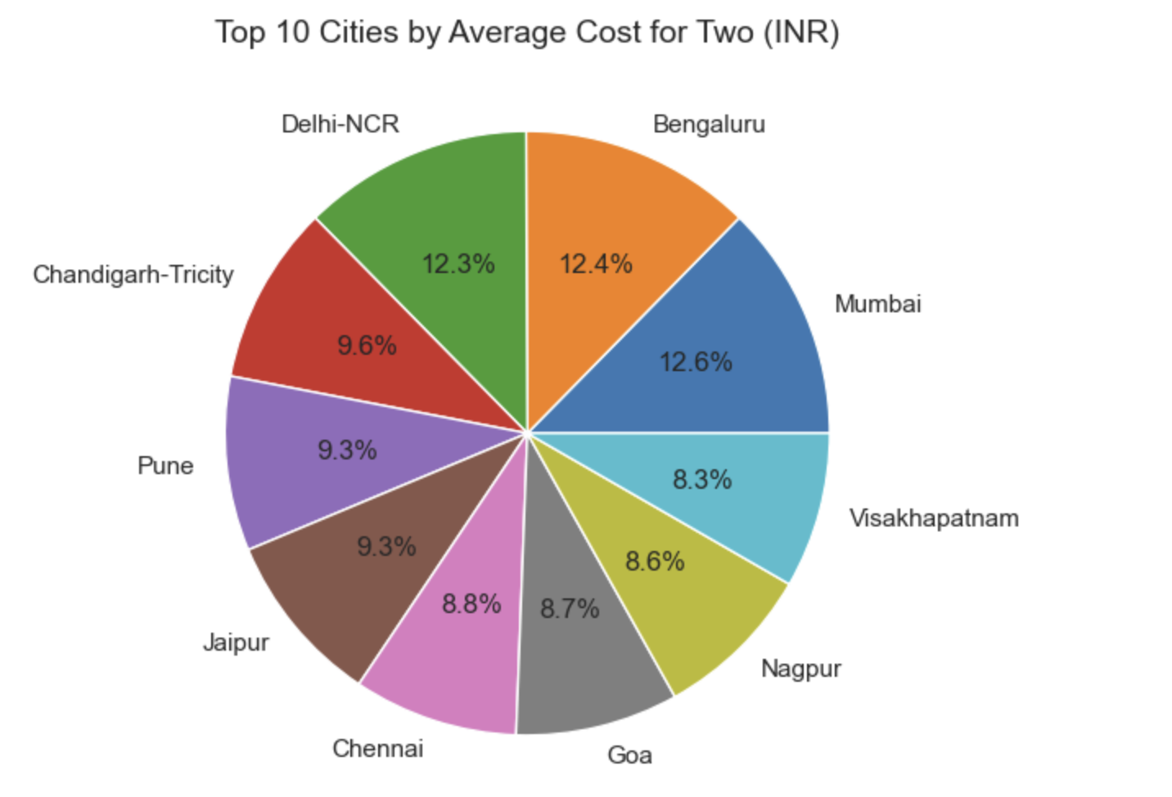
Bivariate Analysis: City vs Cost
Insights:
Cost for two is predominantly high in the cities of Mumbai, Bengaluru, Delhi-NCR.
Goa offers most affordable prices among the top 10 cities.

Slide 18
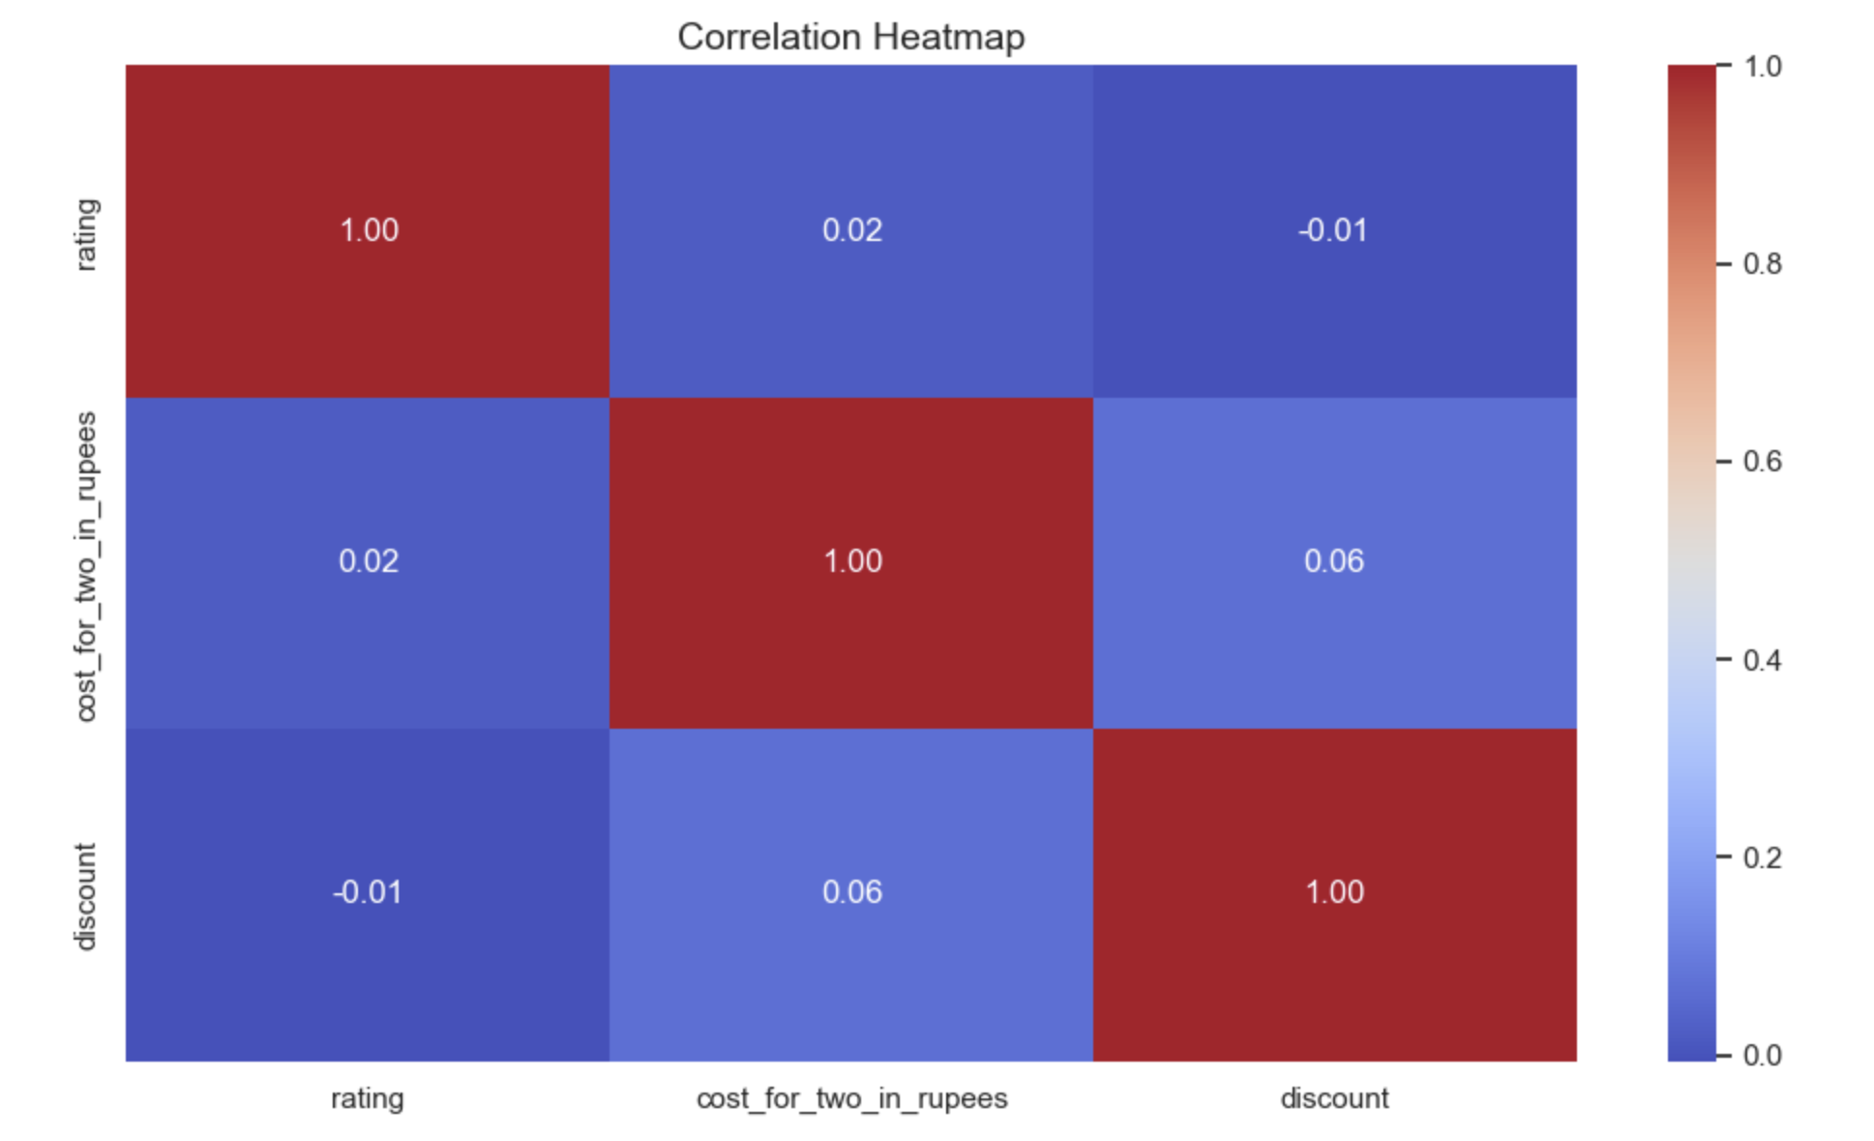
Multivariate Analysis: Correlation Heatmap
Insights:
Correlation between cost, discount and rating is very weak (~0.02 – 0.06)
Therefore, Pricing and discount are not strong predictor of rating.

Slide 19
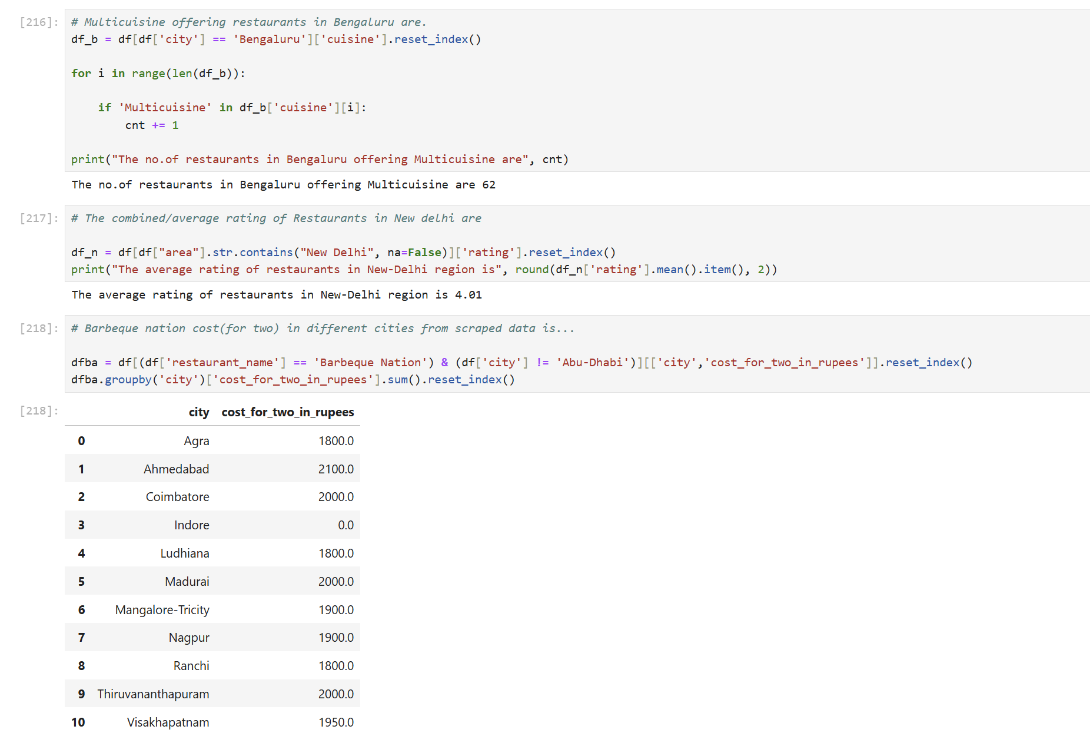
Basic EDA Questions Code Snippet

Slide 20
Business Insights
EazyDiner strongly focused on metropolitan cities.
Multicuisine restaurants dominate platform.
Most restaurants are mid-priced.
Ratings generally high across cities.
Discounts do not significantly impact ratings.
Tier-2 cities offer growth opportunity.

Slide 21
Conclusion
The analysis shows that pricing does not strongly influence ratings.
Customer satisfaction is consistent across cities.
Expansion into Tier-2 cities can increase platform reach.
Focus should be on quality and partner onboarding rather than heavy discounting.

Slide 22
Our Experience/Challenges working on this project
Identifying correct HTML tags was tricky
Discount extraction required separate logic
SVG rating extraction was challenging
Cleaning numeric values needed regex
Correlation interpretation needed care

Slide 23

THANK YOU

