Slide 1
Wireless Network Project
Arduino Wireless Network with Multiple NRF24L01 Modules
Group – 13
T.V.S.Kalyan - S20200020305
K. Balarajaiah - S20200010085
Z.Ram Gopal - S20200010239

Slide 2
Project Statement
Building an Arduino Wireless network, composed of multiple NRF24L01 transceiver modules.
Software Used : Arduino IDE
Components:
Arduino
NRF 24L01 modules
Potentiometer
Servo motor

Slide 3
Block Diagram
TRANSMITTER:
NRF24L01
Arduino
POT

Slide 4
Block Diagram
RECEIVER:
NRF24L01
Arduino
Servo motor

Slide 5
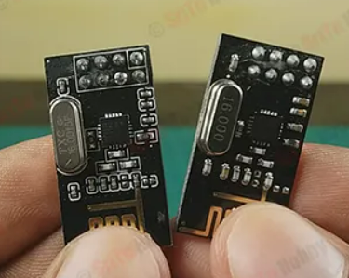
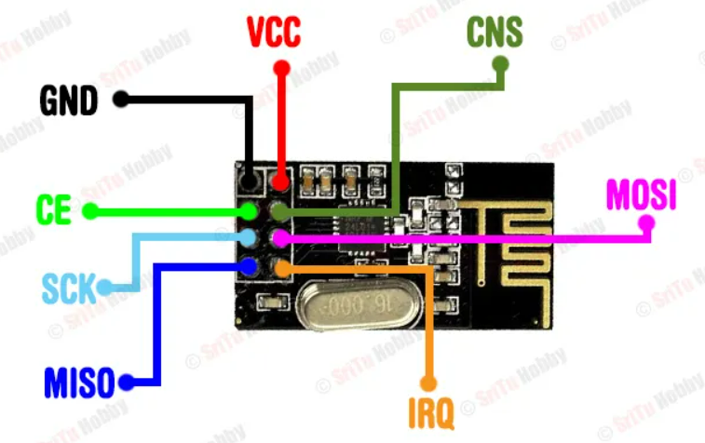
NRF 24L01 MODULE:
NRF: Nordic Radio Frequency
PINS
CE: Chip Enable
SCK: Serial Clock
CSN: Chip Select Not
IRQ: Interrupt Request
The above are the NRF 24L01 Modules we are using and the pin diagram of the module.
It can transmit and receive data within 100 meters of an open area.
2Mbps Data rate,2.4 GHz frequency band
Low interference

Slide 6
PROJECT WORKING:
In this project we going to have two parts. They are:
1) Transmitter
2) Receiver
TRANSMITTER:
At transmitter side we have Arduino UNO, NRF module and Potentiometer.
2) RECEIVER:
At receiver side we have Arduino UNO, NRF module and Servo motor.

Slide 7
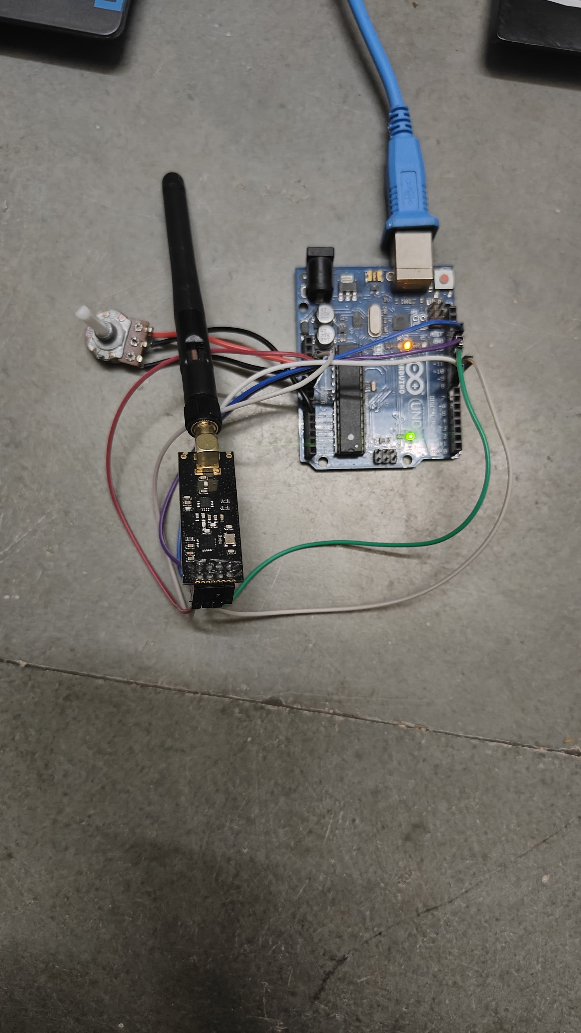
Hardware Connection :
Transmitter Circuit

Slide 8
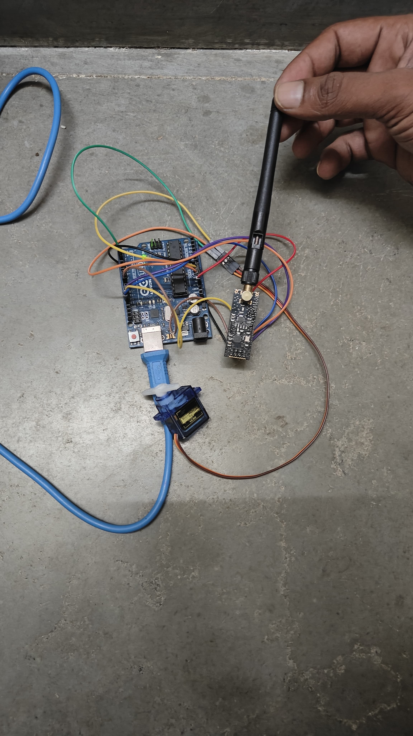
Hardware Connection :
Receiver Circuit

Slide 9
challenges
Working of NRF modules. Checking each nrf module.
Transmission of series of numbers and characters.
Connecting the pins of nrf to Arduino uno.

Slide 10
Thank You

