Slide 1
Budget Manager iOS Application
Presented by:
Kopparthi Satya Sandeep
Srinivas Kummari
Shravya Samavedam
Anudeep Juluru
Rathan Swaroop Potti

Slide 2


Client & Mentor
Client
Dr. Scott Bell
Mentor
Dr. Charles Hoot Jr

Slide 3
Overview
Choice of tools
Incomplete Functionalities
Functionalities for Budget Manager 2.0
Choices of Databases
Reusability on other Interface
Performance during heavy usage
Secured data
Bad inputs
Automating the testing
Redo the project
Lessons Learned

Slide 4
Choice of tools
Cocoa pods:
Advantage: We can directly link third party libraries.
Disadvantage: Only limited support for configurations
Fluid UI:
Advantage: No limitation for the number of objects to be used in a project
Disadvantage: We can create prototypes only for 9 screens without upgrading
PaintCode 2:
Advantage: Automatically create swift code for pickers and symbols.

Slide 5
Choice of tools
Appium :
Advantage:
Helps the tester to think more about the inputs to be given to the user
It supports various frameworks
No need to record the results of the tests manually
Supports cross platform

Slide 6
How to use Appium tool
Every test script is a java class
Navigations for test script are recorded in appium and copied into java class
Run the java class
App gets launched and navigations are provided by the users
Testing is automatically done by the tool

Slide 7
Incomplete Functionalities
Choosing an icon for a category
Adding previous months transactions
View budget for the current month directly without selection.

Slide 8
Functionalities for Budget Manager 2.0
1. Budget Health:
Provide health of the budget for a particular month
Amount saved or over spent for all the categories is also calculated

Slide 9
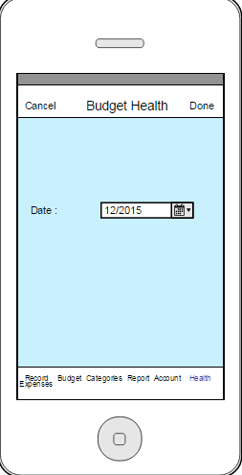
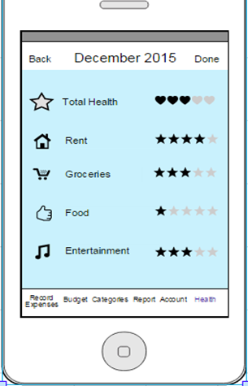

Slide 10
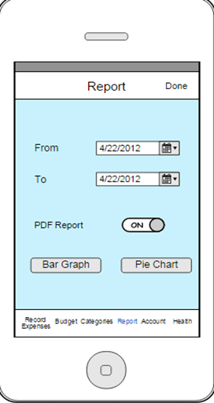
Functionalities for Budget Manager 2.0
2. Monthly expenses report:
Monthly expenses are mailed to the user in the form of a pdf report

Slide 11
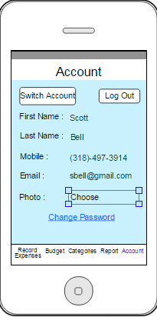
Functionalities for Budget Manager 2.0
3. Choose a profile picture:
Providing the user with the option of selecting a profile picture.

Slide 12
Functionalities for Budget Manager 2.0
4. Reduce Dependency:
Current app is dependent on the web application
We will create our own register, Change password and New User screens
5. Bug Fixes:
Bugs in the present version will be resolved in the next version
Major bugs like viewing the budget for current month should be removed

Slide 13
Choices of Databases
Structured VS Unstructured data
Research firm IDC estimates
World digital data accounts to 4.4 zettabytes
It is expected to grow ten times by 2020
NoSQL contains BSON object
Application stores and retrieves data using JSON object.

Slide 14
Choices of Databases(cont’d…)
NoSQL Tools which can be used
MongoDb
CouchDB
Changes required to implement NoSQL
Major changes have to be done at data layer and business layer
Minimal changes in presentation layer.

Slide 15
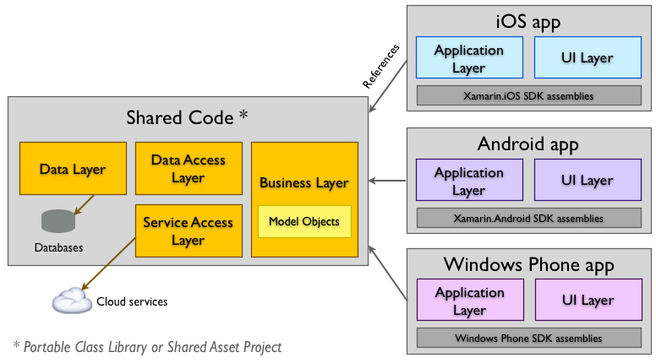
Reusability on Other Interface
Demand Virtual and Augmented reality
Each interface differs in the way they set the user constraints
Changes in Design/Code
Major changes will be in Presentation layer
Once the parameters are set
URL will hit the database with user constraints
Add required libraries for interface

Slide 16
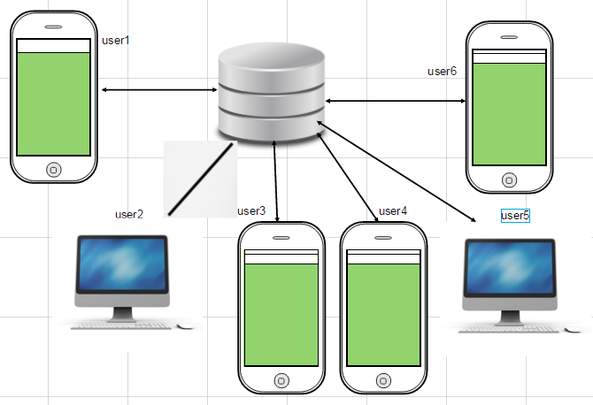
Handles Heavy Usage

Slide 17
Secured Data
Never Impose any URL to the end user
Using get request can be vulnerable
Put request could mitigate the vulnerabilities

Slide 18
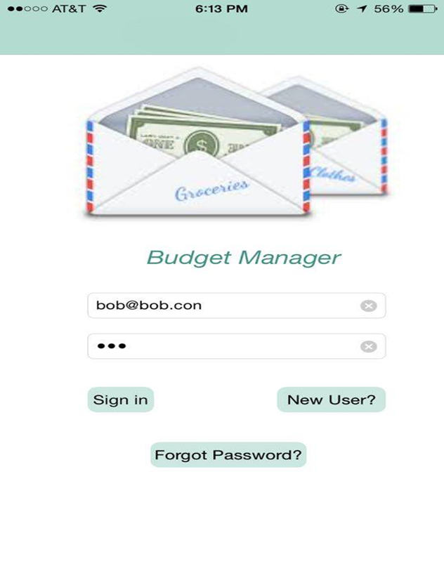
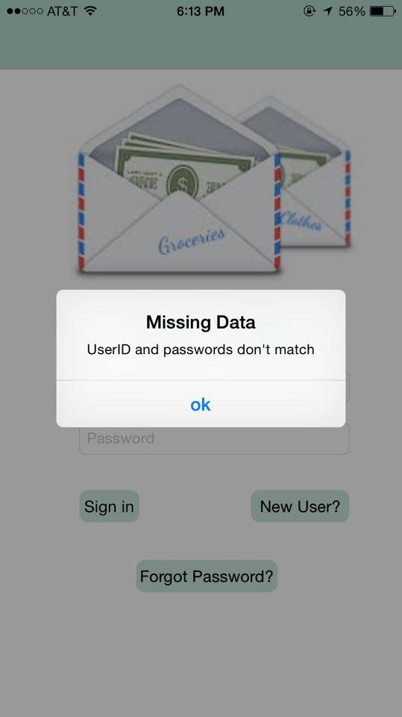
Bad Inputs
Validations are provided for all the input fields
Notes:
Screens to be included

Slide 19
Bad Inputs
Provided validations for numeric inputs where the user is not allowed to enter any special character
No chance of SQL injection

Slide 20
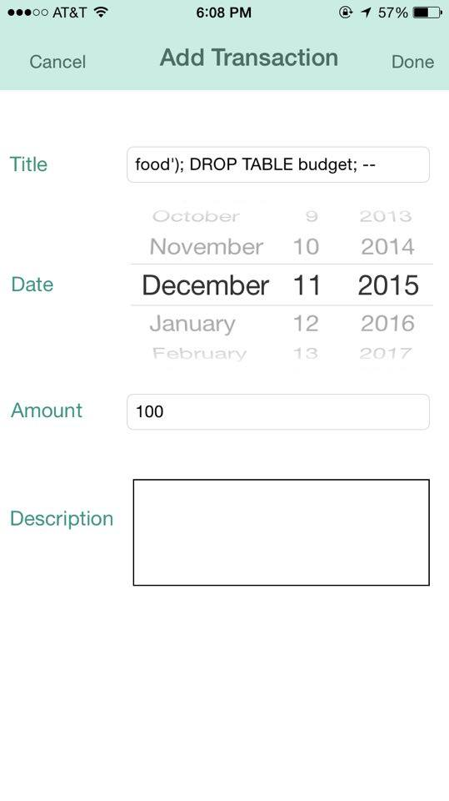
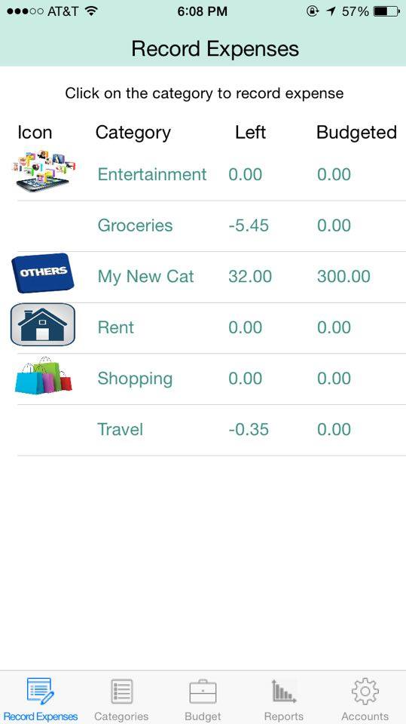
Bad Inputs
Notes:
Screens to be included

Slide 21
Automating the testing
Performed manual testing
Appium can be used to perform automation testing
Testing should be done after the development of every module

Slide 22
Lessons Learned
Understanding the project requirements completely so that we can work on project well
If at all the requirements keep changing, it would be difficult to change the design
Learnt how to update the xcode to latest version
Learnt how to work in team, how to organize meetings and sharing ideas

Slide 23
Lessons Learned (cont’d…)
Learnt how to handle the situation if application crashes
Learnt how to connect app using web service
Setting size constraints for all devices
We went through all the phases of software development life cycle including the test plans
Database design was also one of the major things that we have learnt

Slide 24


Slide 25


