Slide 1
D3OP_EAC
Application Quality Assessment CAST AIP April 2021

Slide 2



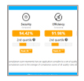



CAST ‘MRI for Software’
Analyses database structures, code components, interdependencies. Delivers accurate, precise, actionable intelligence.
Architecture Blueprints
e2e transactions, dependencies DB access & API call graphs
Critical Flaws | Quality Grades | Benchmarks
Security, Reliability Efficiency, Maintainability
Sizing & Effort Metrics
ISO standardized Automated FPs
Best Resolution – only flaws that matter and no one else can see
Highest Fidelity – context-based scoring that no one else does
Broadest Range – across all quality characteristics and technologies
' CAST is a very sound technology that has been thoroughly vetted ', Jim Duggan, Vice President, Gartner Research

Slide 3
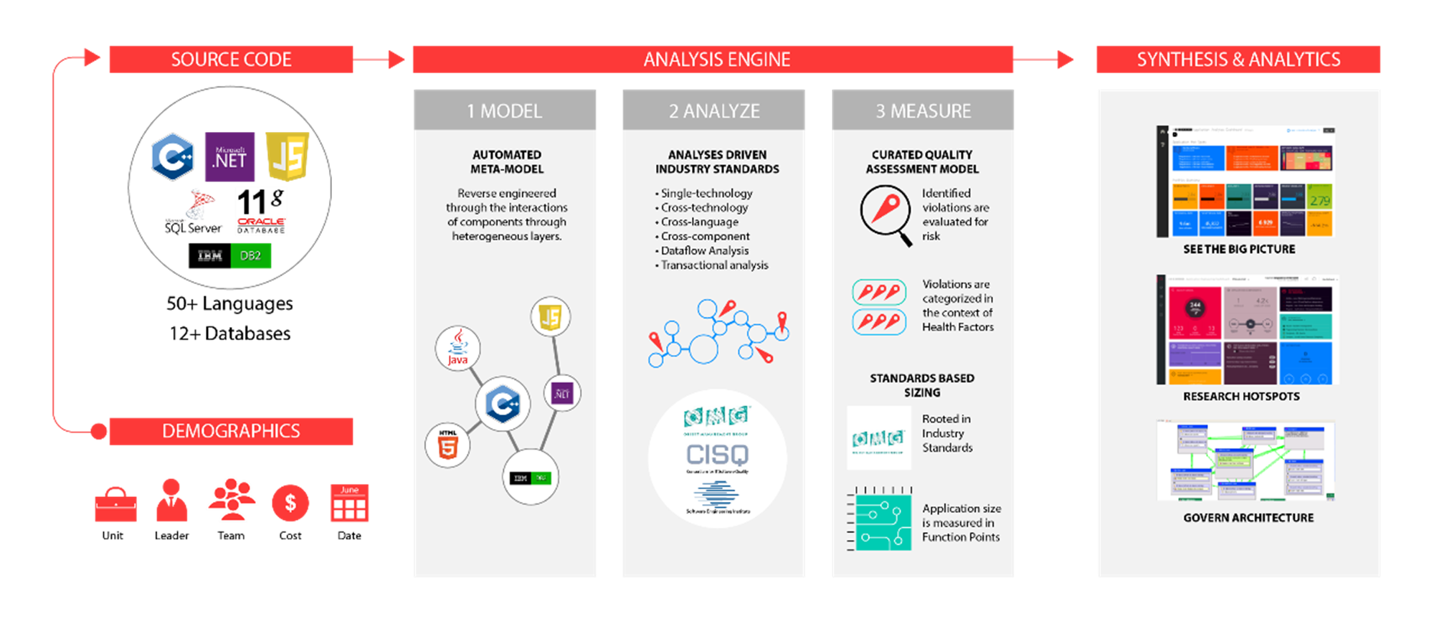
How CAST AIP Works

Slide 4
Context, Objective & Approach
1
Context
2
Objective
3
Approach
D3OP EAC application with PHTML, PHP and SQL is considered for quality assessment
- Understand the applications’ current state of health – how resilient, scalable, secure and maintainable is the source code?
- Identify main risk areas and prioritize them based on their impact
- Create short term and long term action plans, and timeline associated
- Present a holistic analytics output and risk mitigation action plans to the CIO
Source Code Collection
- Source code and DB artifacts are collected for the application
- App owner fills out survey questionnaire
Analysis Engine
1. Model – Architectural Meta Model created by CAST AIP
2. Analyze – Analysis driven by industry standards (CISQ, OMG)
3. Measure – Generates curated quality assessment model
Synthesis & Analytics
- Application Health Dashboard
- Application Engineering Dashboard
- Architecture governance

Slide 5




Scope Under Analysis
D3OP_EAC
Lines of code
Files
Classes
Automated Function Points
Transactional Function Points
1,405,565
10,018
9,303
8,226
6,276
Data tables
SQL artifacts
Technical Size
Functional Size
Data Function Points
421
8
1,950
Lines of code by technology
Size in Million LOCs
Automobile Fuel Injection
Apollo 11
F-22 Raptor fighter jet
Boeing 787
Embedded
Logitech Wireless Mouse
Mars Curiosity Rover
Simple iOS app
Ecommerce Platform
Zalando (2013+)
Facebook
Average iOS app
Zalando (-2011)
Obamacare websites
Web & Mobile
Virus
3D Engine
Skype
Airline Reservation System
Microsoft Office 2013
Super Mario Bros (1985)
Core Banking System US
Heavy clients
PDF Viewer
NYSE Trading System
Photoshop CS6
US Air Traffic Control
Core Banking System EU
Debian 5.0
Computer BIOS
Android OS
Microsoft Windows 7
Mainframe & OS
Source: Capers Jones, The Economist, CAST study

Slide 6
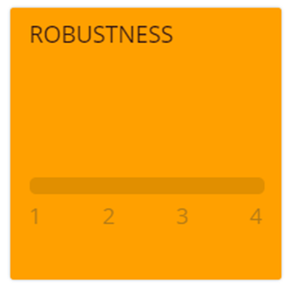
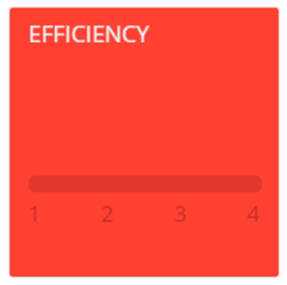

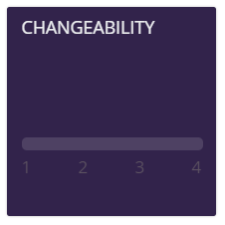
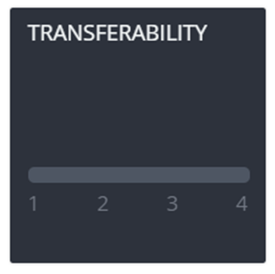
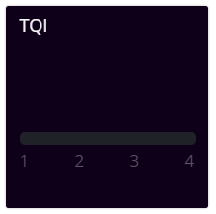
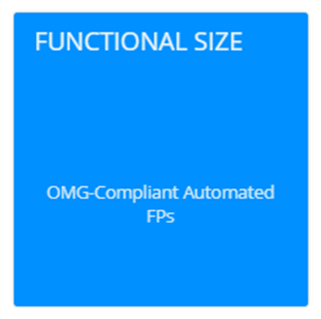
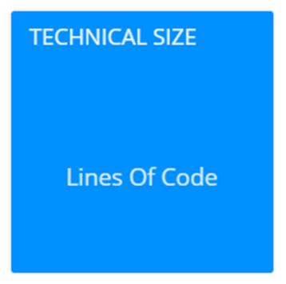
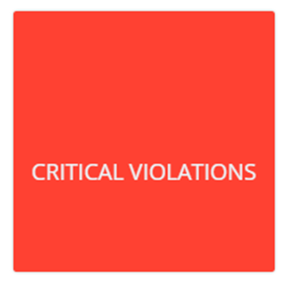

Executive Summary of the Application Health
3.08
3.64
2.74
3.00
3.14
Likelihood of outage, data integrity or reliability issues
Resource consumption, scalability and performance issues
Security vulnerabilities and likelihood of breaches
Adaptability to changing regulations and business needs
Ramp up difficulties for newcomers
SUMMARY
Overall Quality of the application is 3.08 which is at Moderate Risk with 5729 Critical Violations identified.
Application is at High Risk with respect to Security and at Moderate Risk with other health factors
3.08
8,226
1,405,565
5,705
Aggregate score of all the quality rules
Size of the scope under analysis*
Size of the scope under analysis
Hard-to-find structural flaws that may lead to software catastrophes
*Indicative only, the Function Point computation was not calibrated
URL - https://infra-nad.techmahindra.com/CAST-Health-Engineering/portal/index.html

Slide 7
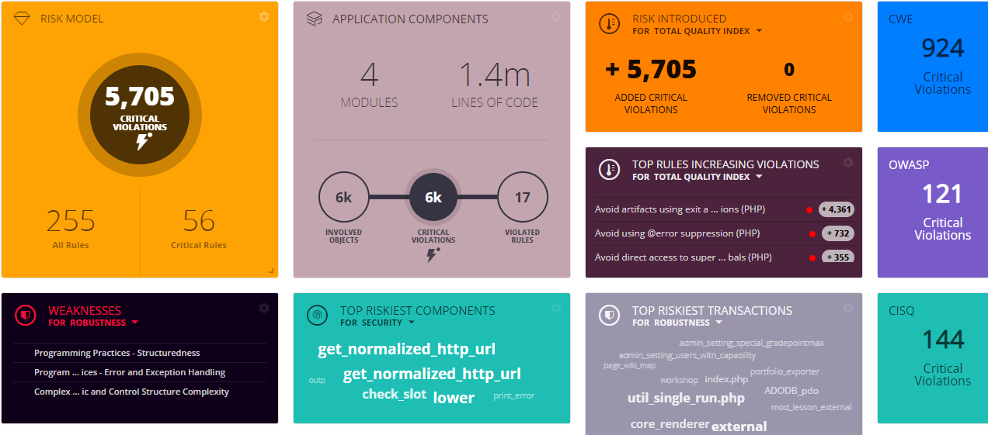
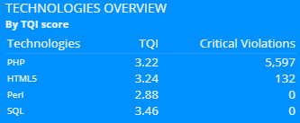
Engineering Dashboard
The Engineering Dashboard gives visibility into the quality rules, critical code violations, riskiest components, riskiest transactions, etc. The developer can drill-down from Health Factors -> Technical Criteria -> Quality Rules -> Violated objects. It also shows the line of code or block of code where the error occurs and the “learn more” feature gives more information such as rule description, rationale, references and remediation details of the quality rule
Critical Violations (CV) 5705
Total Violations 312.9k
CV split across Technologies
URL - https://infra-nad.techmahindra.com/CAST-Health-Engineering/engineering/index.html

Slide 8
S STRENGTHS | W WEAKNESSES | O OPPORTUNITIES | T THREATS
Secure Coding –Handling of API Abuse | Secure Coding - Weak Security Features | Secure Coding - Handling of Input Validation | CWE violations
Architecture –Handling of Multi-Layers and Data Access | Secure Coding - Encapsulation | Efficiency - Memory, Network and Disk Space Management | CISQ violations
Efficiency – Handling of Expensive Calls in Loops | Programming Practices – Handling of Errors and Exceptions | Complexity - Algorithmic and Control Structure Complexity | OWASP Violations
 | Programming Practices - Structuredness | Efficiency - SQL and Data Handling Performance

Slide 9
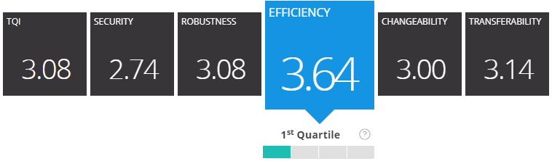
Health Focus - Efficiency
Application Efficiency score is 3.64 and needs to be looked for remediation
Falls under the 1st (in top 25%) quartile against peer applications.

Slide 10

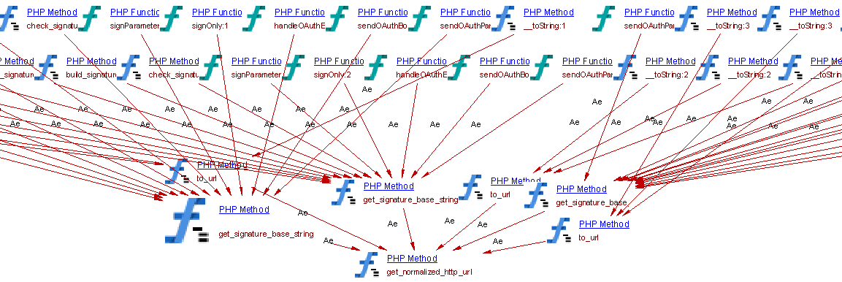

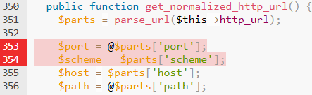
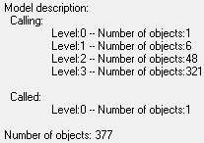
Efficiency - Avoid using @error suppression (PHP)
Violation Count: 732
eac-master\enrol\lti\ims-blti\oauth.php
Recommendation: Try to reduce use of @ and instead provide a mechanism for error handling

Slide 11
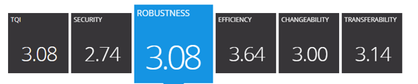
Health Focus - Robustness
Application Robustness score is low and needs to be looked for remediation

Slide 12


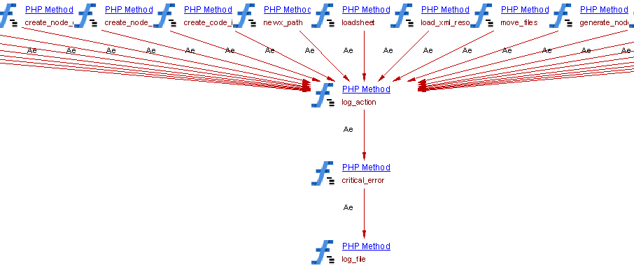
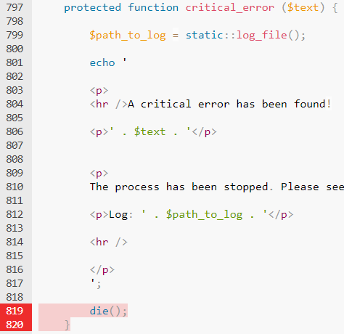
Robustness- Avoid artifacts using exit and die expressions (PHP)
Violation Count: 4361
EAC-master\backup\cc\cc2moodle.php
Recommendation: Instead of exit or die expressions, use exception handling and graceful program exit .

Slide 13

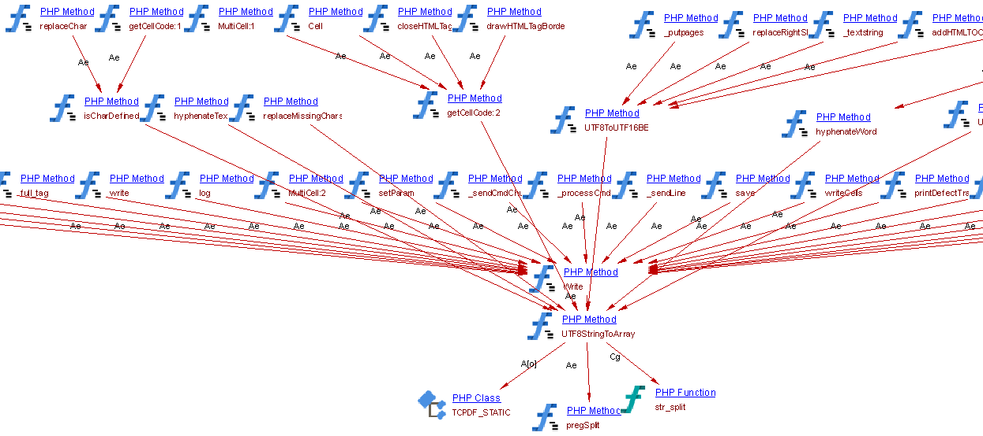

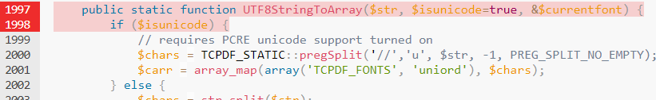
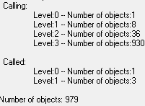
Robustness - Avoid artifacts with optional parameters before required parameters (PHP)
EAC-master\lib\tcpdf\include\tcpdf_fonts.php
Recommendation: Modify the source code and try to reduce number of artifacts with optional parameters before required ones
Violation Count: 66

Slide 14
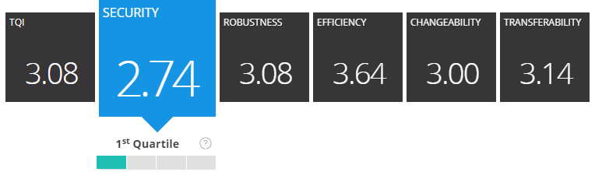
Health Focus - Security
Application Security falls under the 1st (top 25%) quartile against peer applications.
There are CISQ Security and OWASP, CWE vulnerabilities that should be looked into.

Slide 15
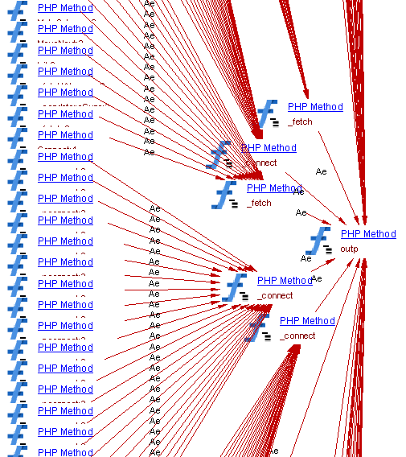

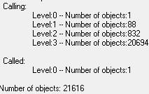
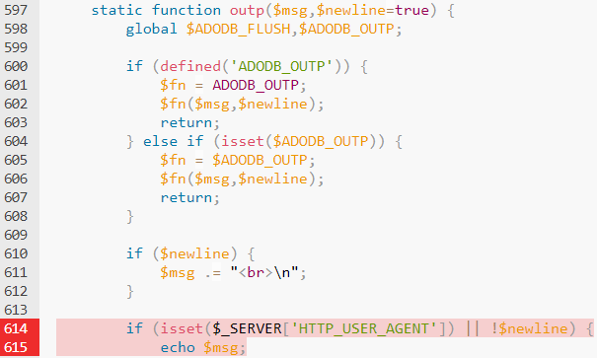
Security-Avoid direct access to superglobals (PHP)
eac-master\lib\adodb\adodb.inc.php
Violation Count: 355
Recommendation: Use PHP filter APIs to access superglobals

Slide 16
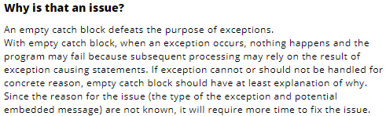
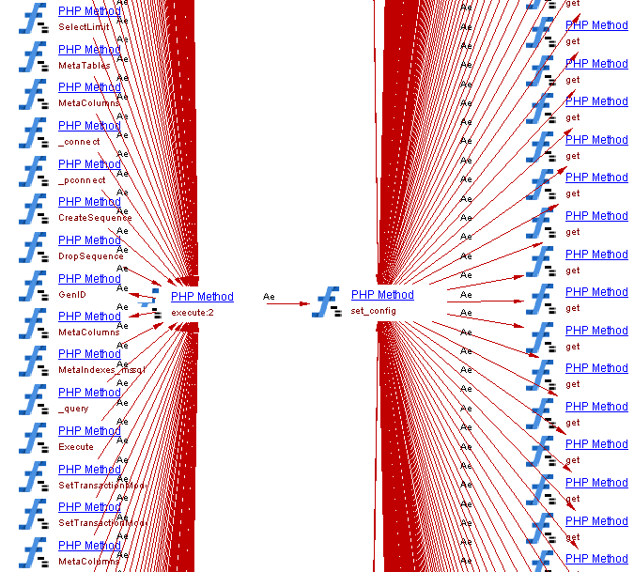

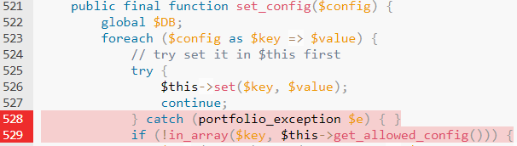
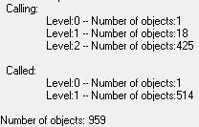
Security - Avoid empty catch blocks (PHP)
Violation Count: 53
EAC-master\lib\portfolio\plugin.php
Recommendation: Exception should be handled or at least contain a comment explaining concrete reason for not handling the exception

Slide 17
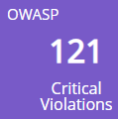
OWASP Top Violations & Report
This assessment used the CAST Application Intelligence Platform (AIP) to automatically scan the implementation of these applications to review the architecture, design, and code against OWASP standards.
CAST AIP adapts the quality rules from best-in-class industry standards (OWASP, CWE, CISQ). With its unique ability to perform dataflow and system-level analysis (From Presentation layer to Database layer), CAST provides the most accurate security findings, reducing a lot of false positives.
OWASP-2017 | Total Vulnerabilities
A1-2017 Injection | 52
A3-2017 Sensitive Data Exposure | 11
A7-2017 Cross-Site Scripting (XSS) | 13
A9-2017 Using Components with Known Vulnerabilities | 1
The OWASP Top 10 focuses on identifying the most serious web application security risks for a broad array of organizations.
Refer to the report for details on findings:

Slide 18
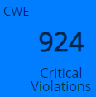
CWE Violations & Report
This section provides a summary of the most severe security vulnerability identified in the structural quality analysis and measurement by CAST AIP against the CWE Top 25 standard.
CWE-LATEST-VERSION | Total Vulnerabilities
CWE-20 Improper Input Validation | 11
CWE-78 Improper Neutralization of Special Elements used in an OS Command ('OS Command Injection') | 17
CWE-79 Improper Neutralization of Input During Web Page Generation ('Cross-site Scripting') | 13
CWE-80 Improper Neutralization of Script-Related HTML Tags in a Web Page (Basic XSS) | 10
CWE-95 Improper Neutralization of Directives in Dynamically Evaluated Code ('Eval Injection') | 48
CWE-98 Improper Control of Filename for Include/Require Statement in PHP Program ('PHP Remote File Inclusion') | 1
CWE-99 Improper Control of Resource Identifiers ('Resource Injection') | 3
CWE-311 Missing Encryption of Sensitive Data | 6
CWE-390 Detection of Error Condition Without Action | 74
CWE-391 Unchecked Error Condition | 146
CWE-392 Missing Report of Error Condition | 740
CWE-478 Missing Default Case in Switch Statement | 147
CWE-489 Active Debug Code | 1
CWE-532 Information Exposure Through Log Files | 1
CWE-561 Dead Code | 37,959
CWE-614 Sensitive Cookie in HTTPS Session Without 'Secure' Attribute | 2
CWE-674 Uncontrolled Recursion | 777
CWE-676 Use of Potentially Dangerous Function | 1
CWE-1004 Sensitive Cookie Without 'HttpOnly' Flag | 2
CWE-1041 Use of Redundant Code | 1,136
CWE-1048 Invokable Control Element with Large Number of Outward Calls | 17,679
CWE-1050 Excessive Platform Resource Consumption within a Loop | 3,074
Refer to the report for details on findings:
CWE-1053 Missing Documentation for Design | 45,877
CWE-1054 Invocation of a Control Element at an Unnecessarily Deep Horizontal Layer | 1,864
CWE-1064 Invokable Control Element with Signature Containing an Excessive Number of Parameters | 108
CWE-1074 Class with Excessively Deep Inheritance | 1
CWE-1075 Unconditional Control Flow Transfer outside of Switch Block | 147
CWE-1080 Source Code File with Excessive Number of Lines of Code | 1,495
CWE-1085 Invokable Control Element with Excessive Volume of Commented-out Code | 3,727
CWE-1086 Class with Excessive Number of Child Classes | 12
CWE-1089 Large Data Table with Excessive Number of Indices | 98
CWE-1099 Inconsistent Naming Conventions for Identifiers | 39,546
CWE-1118 Insufficient Documentation of Error Handling Techniques | 1,824
CWE-1121 Excessive McCabe Cyclomatic Complexity | 2,745

Slide 19
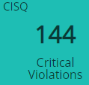
CISQ Violations & Report
CAST AIP applies over 1200 engineering checks based on standards and measurements developed by the Software Engineering Institute (SEI), International Standards Organization (ISO), Consortium for IT Software Quality (CISQ), the Institute of Electrical and Electronics Engineers (IEEE) and the technology provider industry. The resulting analysis identifies specific flaws in the software and aggregates this information into metrics to objectively quantify the structural quality of the application.
CISQ | Total Violations
CISQ-Maintainability | 66,873
CISQ-Performance-Efficiency | 3,172
CISQ-Reliability | 915
CISQ-Security | 33
Refer to the report for details on findings:

Slide 20
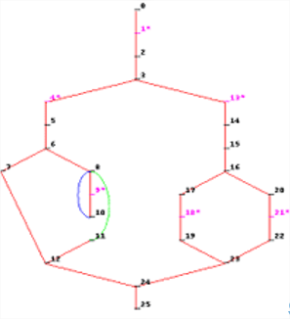
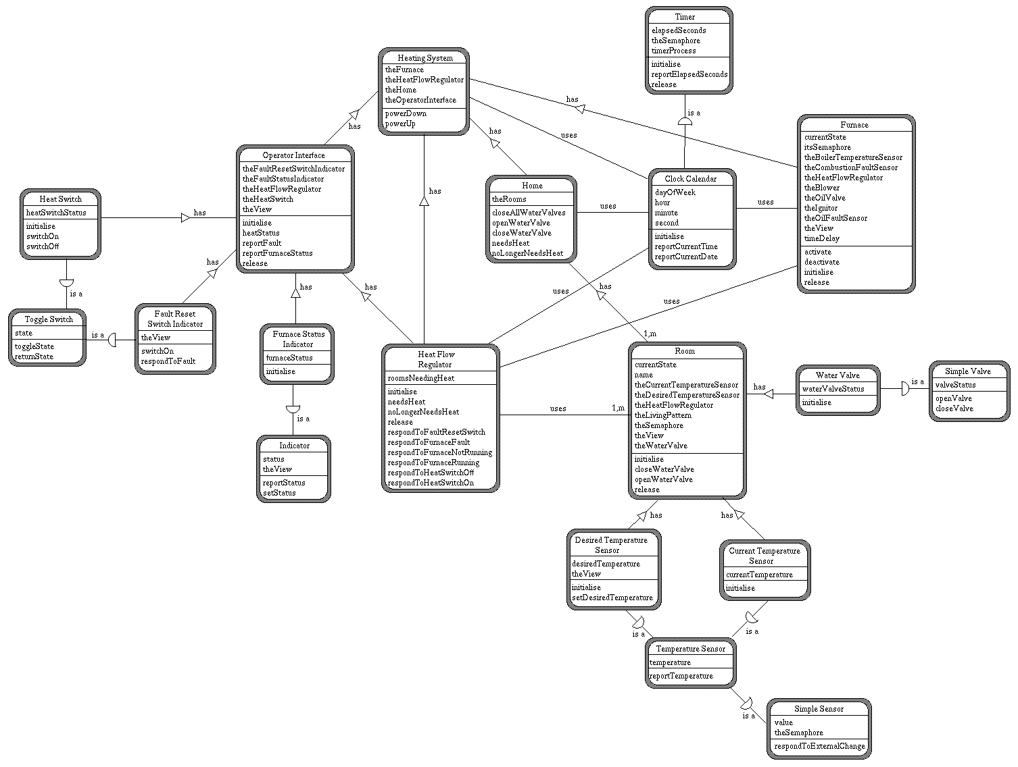

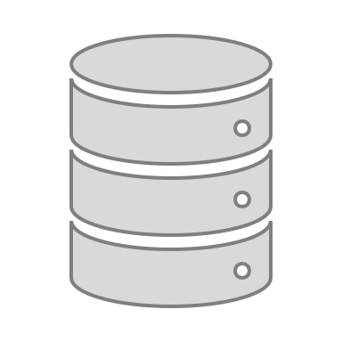
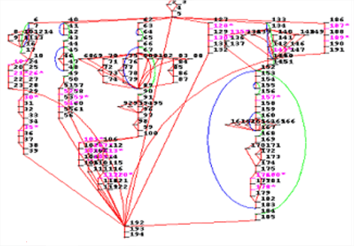

Complexity assessment – Definitions
Cyclomatic Complexity
Object-Oriented Complexity
SQL Complexity
Cyclomatic Complexity is a measure of the complexity of the control structure of an Artifact. It is the number of linearly independent paths and therefore, the minimum number of independent paths when executing the software.
It looks into the number of conditional structures and their nesting / imbrication.
The higher the number of flow paths, the more complex the artifact is.
OO Complexity is based on the classic Object-Oriented metrics defined by Chidamber & Kemerer:
High Cyclomatic Complexity Classes (WMC)
High Depth of Inheritance Classes (DIT)
Low Cohesion Classes (LCOM)
High Length (too many lines of code) or Weight Classes (too many methods / fields)
The more categories the class belongs to, the more complex it is. A class that belongs to at least three of the previous categories is considered Very Complex.
The SQL Complexity Distribution measures the distribution of SQL Complexity of all artifacts using SQL by looking into:
Query on more than 4 tables
Subquery
GROUP BY
Complex SELECT clause
UPDATE statement
Raw SQL Complexity
Each criterion is weighted and the total score gives the complexity.
Why should I care?
Why should I care?
Why should I care?
Ensure testability of the codebase
Reduce the time needed to diagnose issues and fix defects
Promote reuse of existing components by having an easy-to-understand model
Limit over-spend on maintenance
Improve understandability and changeability of the code manipulating the data
Protect your business by ensuring maximum data integrity

Slide 21


Complexity assessment
GOALS
% High + % Very High < 3%
SUMMARY
CAST recommends that artifacts with High and Very High Complexity should be within 3% of total artifacts.
Here we can see for Cyclomatic High & Very high are more than 3% so it will be difficult to maintain & transfer the application. Also it will be difficult for new member induction.
However for OO and SQL High and Very High are less than 3% which is good.

Slide 22
Long-Term Risks Changeability/Transferability

Slide 23
Top Violations in Changeability/Transferability Health Factor
Rule Name | Description | # Violations | Impact
Avoid incrementer jumbling in loops (PHP) | The jumbling incrementer detects use of an outer incrementer in an inner loop and vice versa | 3 | For maintainability and readability reasons, it is preferable to avoid incrementer jumbling in loops
Avoid Tables not using referential integrity | This diag is a clone of the old diag called "Avoid tables not involved in a Foreign key" listing all tables not involved in a Foreign Key (FK). | 421 | A foreign key is an integral part of a relational database design and contributes to the database's consistency. The use of Foreign Keys between Tables must be applied to manage referential integrity only.
Avoid unconditional "if" and "else if\elseif" statements (PHP) | This rule searches for all artifacts containing unconditional "if" and "else if\elseif" statements. Artifacts considered for this quality rule are PHP Section, function, method and constructors | 4 | Unconditional "if" and "else if\elseif" statements are not necessary
Avoid artifacts directly accessing database tables (PHP) | This rule searches for all artifacts that direct access database Table. The artifacts checked are php section, function, method and constructors. | 1864 | For security reasons, directly accessing database tables is not advised
Avoid using a break statement in 'for' loops | This rule searches for functions that contain a 'break' statement in a 'for' loop. 'break' statements located in nested loops will also be reported as a violation to this rule | 107 | A 'for' loop must be straightforward to read. Using too many 'break' statements in 'for' loops makes them more difficult to read.
Avoid Methods and Functions with High Fan-In (PHP) | This rule searches for all Functions and Methods with High Fan-In. The Fan-in of Method or Function is the number of other artifacts that are referencing it | 17328 | If an artifact is referenced by large number of artifacts, maintenance and evolution becomes difficult. This is because all the referencing artifacts need to be updated and\or retested
Avoid Artifacts with High Essential Complexity | Avoid Artifacts with High Essential Complexity (EC greater than X). Essential Complexity measures the number of non-structured independent paths. Non-structured paths are paths of the control flow graph in which an instruction that interrupts the flow is present. The threshold is a parameter and can be changed at will. | 5 | Review the design of the Artifact to reduce the number of non-structured independent paths. E.g.: Reduce the number of BREAK or GOTO statements
Avoid Too Many Copy Pasted Artifacts | This metric measures the ratio between the number of duplicated, copy/pasted artifacts and the total number of artifacts | 1136 | A program with a lot of duplication is hard to change. It might be required to change every copy of a copy/pasted code while it is very difficult to locate these copy/pasted code elements

Slide 24
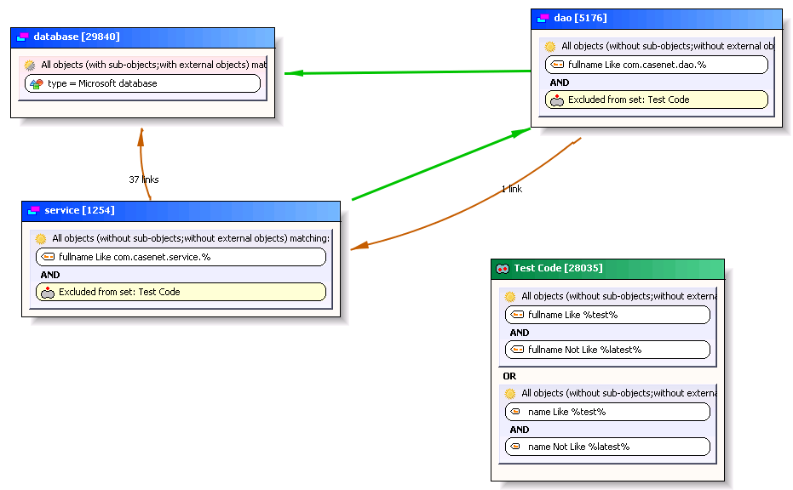
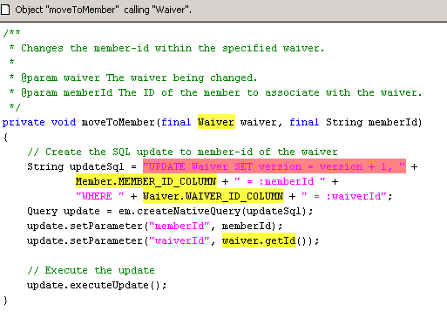
Architecture Checker
What is Architecture Checker? It is a tool used to check the architecture compliance of the application in a automated manner.
Establish architectural rules specific to your environment
Measure and enforce development adherence to architectural rules
Find violations immediately, or during regular in-cycle scans by developers
Steps
1.) Set up layers with a few clicks
2.) Populate those layers by dragging and dropping components
3.) Setup allowed links by dragging the green arrows
4.) Calculate violations immediately along with root-causes
5.) Save this as a custom rule that will be flagged in dashboards going forward

Slide 25
Remediation plans built for D3OP EAC Quick-wins amounts to 00 man-days; Mid-term plan yields massive results
Criteria | Current Score | New Score | Gain
TQI | 3.08 | 3.38 | 9.74%
Robustness | 3.08 | 3.41 | 10.71%
Efficiency | 3.64 | 3.64 | 0.00
Security | 2.74 | 3.71 | 35.40%
Changeability | 3 | 3.09 | 3.00%
Transferability | 3.14 | 3.23 | 2.87%
Short-term Plan
$225+ implementation cost
0.45 man-days implementation effort
Short-term Plan
Impact on Quality
Daily rate of $600
Mid-term Plan
Complexity of Implementation
Daily rate of $600

Slide 26




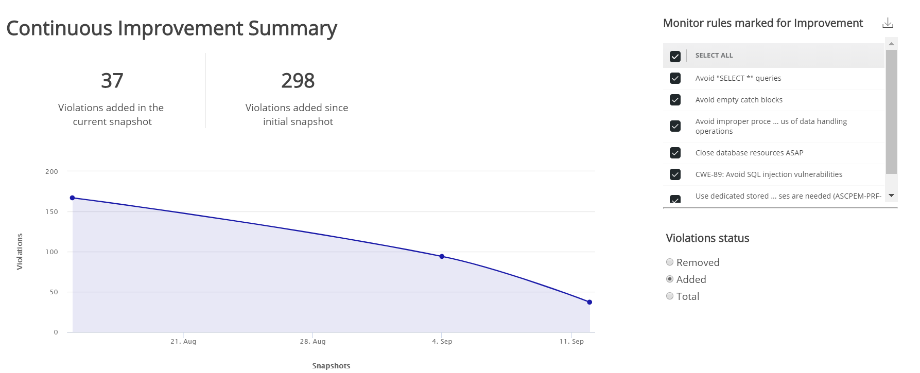


Next steps – For Discussion
Create Education Plans in Engineering Dashboard for continuous improvement
Identify and correlate the trends between the releases to improve time to market(reduce rework)
Track SIT, UAT functional and non functional defects for the release in CAST and rework.
Establish External KPIs to measure post CAST Scans
Record SIT and UAT defects (functional and non functional)
Record Rework post SIT and UAT
Rework
UAT
Defects
Rework
PRDO
CAST Scan previous version N-1
SIT
CAST Scan N
SIT
Defects
Shift Left using CAST in Development/Unit Test
Establish Education plan for Continuous Improvement
CAST Data Points :
Added, Removed Critical Violations
TQI, CVD
External Data Points:
SIT & UAT defects with functional/non functional break up
Rework post SIT and UAT

Slide 27


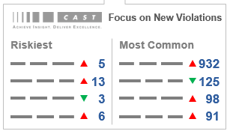



Shift Left: Scrum Retrospectives example
CAST Output focusing on deltas, release over release
Educate Which Non-Functional Defects to Avoid
Drive Quality Improvement
POSITIVE FEEDBACK LOOP with management empowerement
CAST outputs will be leveraged by the application lead (PM, AO, Manager, Scrum Master) to focus on deltas.
Each scan results are presented to the team for education purposes and in order to avoid introducing same defects over and over again.
A positive feedback loop is introduced and management is empowered to coach the team and improve performance.
Can be leveraged in Waterfall, Agile and Devops.
SCRUM MASTER or PROJECT LEAD
Tracks sizing, Quality, and Complexity trends. Manages app quality through behavior change
OR
Trending is good: less non-functional defects are being introduced, team is improving code quality and containing technical debt. Continuous improvement is here to stay and we can prove it.
Trending is bad: same non-functional defects are introduced again and again, technical debt is increasing despite time spent by the team. Management must act accordingly*, supported with facts.
(*) with a Reward / Penalty mechanism

Slide 28
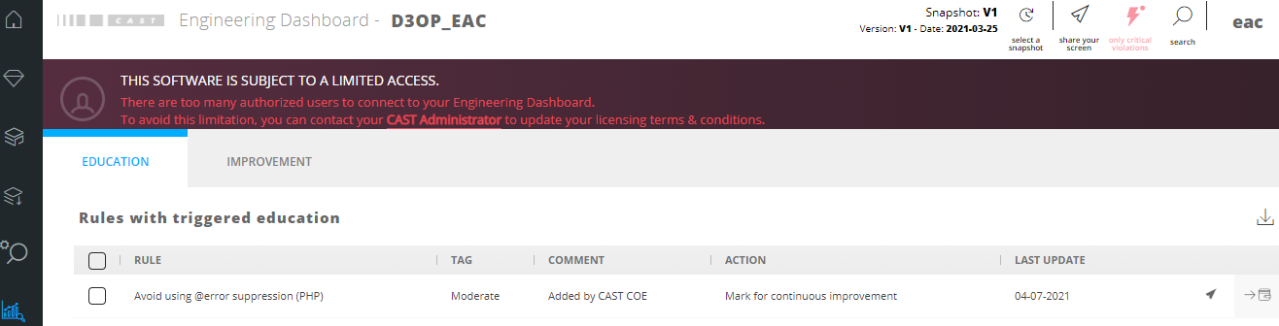
Suggested Education plan
CAST provides the Risk level of each artifact in CAST Engineering Dashboard as a guideline for developing education plan within each best practices, an example. Request App team to work with COE to finalize the Education plan
For continuous improvement, recommend app team to creates education plan and monitor the trending as shown in the Sample graph

Slide 29
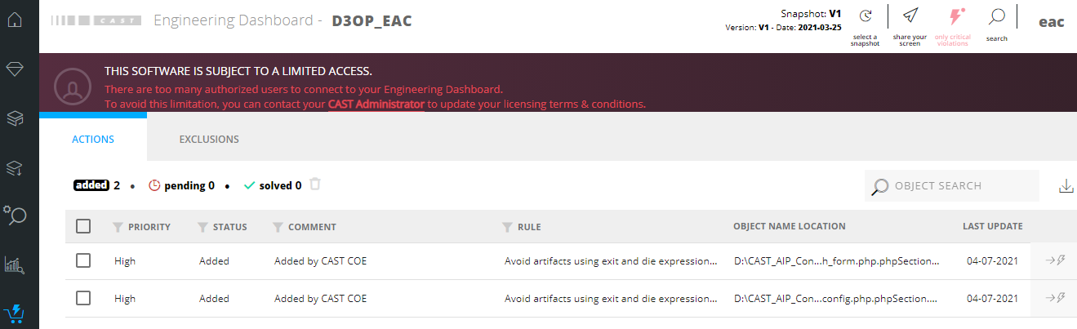
Focus on Pain Areas
Focus on top critical rules for Efficiency
Focus on the module with lowest scores, then the health factors with lowest score and then the rules with higher weightages i.e. 6 to 9.
Focus on critically important artefacts (from a business perspective) and plan to fix violations if there is an associated pain area
For each critical rule focus on objects/flows with highest PRI/TRI
Any action plan should focus on remediating the critical and high weightage rules
An Indicative action plan is created . This can be modified/enhanced by application team

Slide 30
Limitations
Moodle framework used in the application is not supported, hence majority of the transactions is not complete.
Maximum of the quality rules for PHP are not link based so the impact on the over all quality computation should be minimum

