Slide 1
Introduction
This project focuses to build a reliable classification model for predicting the rating class for the musical instruments based on the reviews
Reliable Predictions help the business understand customer satisfaction and concentrate on areas of improvement
Ensemble models like Random Forest and probabilistic model like Multinomial Naïve Bayes are investigated, implemented, evaluated and the results are analyzed

Slide 2
AIM – THE BUSINESS QUESTIONS
Can we lower the False Positives decently?
Can the huge data imbalance in ratings be addressed or sufficiently modelled?
To predict the rating class based on customer reviews

Slide 3
DATA
10k+ records available
Sourced from json file provided
Customer ID, Product ID, Review Text, Summary, Review Time, Overall Rating are the Attributes
Review Text and Summary concatenated to Review
Identifier Attributes and Time Attributes dropped from data

Slide 4
Text Data Cleaning
Reviews converted to lower case
Tokenized
Contractions expanded (e.g., You’re -> You are, I’m->I am)
Stop Words & Special Chars Removed
Words lemmatized to base forms (e.g., best->good, working->work)

Slide 5
EDA Insights
Data heavily skewed – less information available on low rated products
AVG length of negative reviews higher than Positive Reviews – Customer Dis-satisfaction

Slide 6
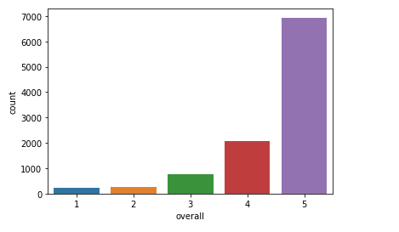
Data Skew Before Grouping
Higher ratings – predominant in the data
1 Star & 2 Star ratings - minimal

Slide 7
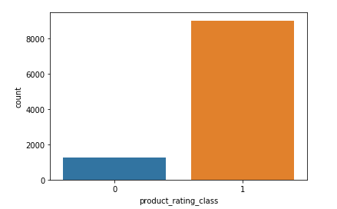
Data Skew After Grouping
Data Imbalance Persists Even After Grouping
Imbalance Needs To Be Handled

Slide 8
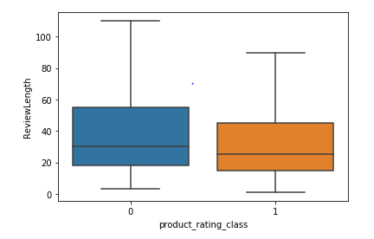
Review Length
Bad Reviews - more length in general
Possible Customer Dis-satisfaction

Slide 9

Word Cloud – Good Reviews
Words like ‘work great’, ‘sound great’ frequently used

Slide 10
Solution Approach - Workflow
Data
Text Cleaning
Stratified Train/Test Split (70:30)
TF-IDF Vectorizer on Train with Cross Validation and hyperparameter tuning
Fit Model on Train
Evaluate best model on Test

Slide 11
Model Design – Handling Data Imbalance
Random Forest Classifier – Give Class Weights – More Weight to Minority Class
Oversampling with SMOTE and fit Multinomial Naive Bayes with 10-Fold Stratified CV

Slide 12
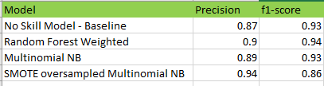
Outcomes
The SMOTE oversampling cross validated with stratified 10-fold and trained on Multinomial NB gives a generalized increase in precision score

Slide 13
Proposed Next Steps
Minimum Viable Solutions – implemented in this project
Boosting Algorithms and Advanced Deep Neural Network models – Proven Predictive Performance in Text Analytics – RNN, LSTM RNN – can be adapted and analyzed

