Slide 1
HTML5

Slide 2
HTML5
HTML is an acronym which stands for Hyper Text Markup Language which is used for creating web pages and web applications.
Hyper Text: HyperText simply means "Text within Text." A text has a link within it, is a hypertext.
Markup language: A markup language is a computer language that is used to apply layout and formatting conventions to a text document.
Building blocks of HTML
Tags: An HTML tag surrounds the content and apply meaning to it. It is written between < and > brackets.
Attribute: An attribute in HTML provides extra information about the element, and it is applied within the start tag. An HTML attribute contains two fields: name & value.
Syntax
<tag name attribute_name= " attr_value"> content </ tag name>

Slide 3
HTML5
Example:
<!DOCTYPE html>
<html>
<head>
<title>The basic building blocks of HTML</title>
</head>
<body>
<h2>The building blocks</h2>
<p>This is a paragraph tag</p>
<p style="color: red">The style is attribute of paragraph tag</p>
<span>The element contains tag, attribute and content</span>
</body>
</html>
HTML Elements:
An HTML file is made of elements. These elements are responsible for creating web pages and define content in that webpage. An element in HTML usually consist of a start tag <tag name>, close tag </tag name> and content inserted between them. Technically, an element is a collection of start tag, attributes, end tag, content between them.

Slide 4
Example
<!DOCTYPE html>
<html>
<head>
<title>WebPage</title>
</head>
<body>
<h1>This is my first web page</h1>
<h2> How it looks?</h2>
<p>It looks Nice!!!!!</p>
</body>
</html>
HTML Formatting
HTML Formatting is a process of formatting text for better look and feel. HTML provides us ability to format text without using CSS. There are many formatting tags in HTML. These tags are used to make text bold, italicized, or underlined. There are almost 14 options available that how text appears in HTML and XHTML.
In HTML the formatting tags are divided into two categories:
https://www.javatpoint.com/html-formatting

Slide 5
CSS3
CSS, or Cascading Style Sheets, is the language used to style and enhance HTML documents. It defines the presentation of HTML elements on a web page, enabling changes to fonts, colors, sizes, spacing, column layouts, and animations.
A CSS Syntax rule consists of a selector, property, and its value. The selector points to the HTML element where the CSS style is to be applied. The CSS property is separated by semicolons. It is a combination of the selector name followed by the property: value pair that is defined for the specific selector.
Syntax:
selector { Property: value; }
<!DOCTYPE html>
<html>
<head>
<!-- Style on h1 elements -->
<style>
h1 {
color: green;
text-align: center;
}
</style>
</head>
<body>
<h1>Welcome to CSS world</h1>
</body>
</html>
https://www.geeksforgeeks.org/css-tutorial/?ref=lbp

Slide 6
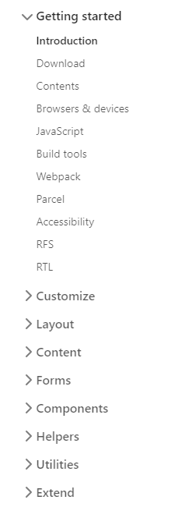
Bootstrap
https://getbootstrap.com/docs/5.0/getting-started/introduction/
Powerful, extensible, and feature-packed frontend toolkit. Build and customize with Sass, utilize prebuilt grid system and components, and bring projects to life with powerful JavaScript plugins.

Slide 7
Thank you

