Slide 1


CS209:Artificial Intelligence
Course Project Title: Air Quality Classification
Submitted by:
Preksha MC23BT029
Srinivas MC23BT004
Deepthi MC23BT008
Sricharan MC23BT031
Course Instructor: Prof. Dileep. A.D
Mentor Name: Neha Mam

Slide 2
Outline
Date:15/05/2025
Introduction
Methodology
Results
Conclusion
2

Slide 3
Date:15/05/2025
Introduction
Air quality plays a vital role in public health.
With growing concerns over pollution and its health impacts, predicting air quality can help inform timely actions and raise public awareness.
This project aims to utilize Artificial Intelligence and Machine Learning techniques to classify and predict air quality levels based on pollutant concentrations and environmental data.
Our model uses data features such as Temperature, Humidity, PM2.5, PM10, NO₂, SO₂, CO, and Demographical/Geographical features like Proximity to Industrial Areas and Population Density to estimate Air Quality and categorize them into standard health-related classes like Good, Moderate, Poor and Hazardous.
3

Slide 4
Date:15/05/2025
Methodology
Checked for missing values, handled outliers/inconsistencies, and visualized data using box plots, histograms, and KDE curves.
Handling class imbalance using SMOTE after splitting the data.
Standardized the data and trained multiple classification models to identify the best-performing model.
Determined feature importance, compared models based on accuracy, and printed confusion matrices for validation data.
Evaluating the best model on test data.
4

Slide 5
Date:15/05/2025
Handling Outliers
→ Checked the distribution of each attribute and observed no null values.
→ Handled outliers in the data in the following manner:
Replaced negative values in PM10 and SO2 with 0 using clipping.
Clipped humidity values(%) greater than 100 to 100.
Applied log transformation to right-skewed attributes for normalization.
Replaced remaining outliers (values outside 1.5*(Interquartile range)) with the mean of the respective attribute.
Visualised using box plots ( before and after cleaning), histograms and kde curve.
→ The data is now more reliable and consistent.

Slide 6
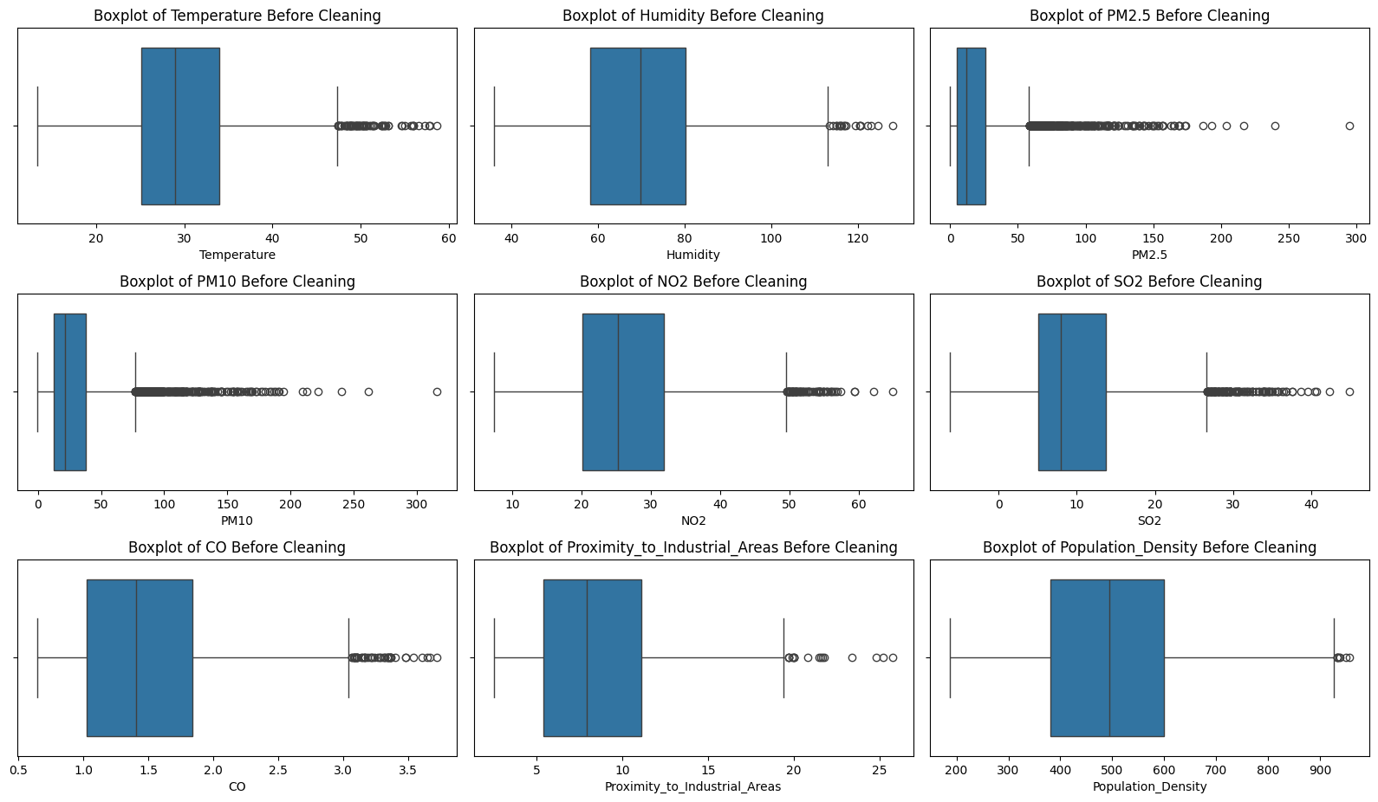
Date:15/05/2025
Box Plots Before Cleaning

Slide 7
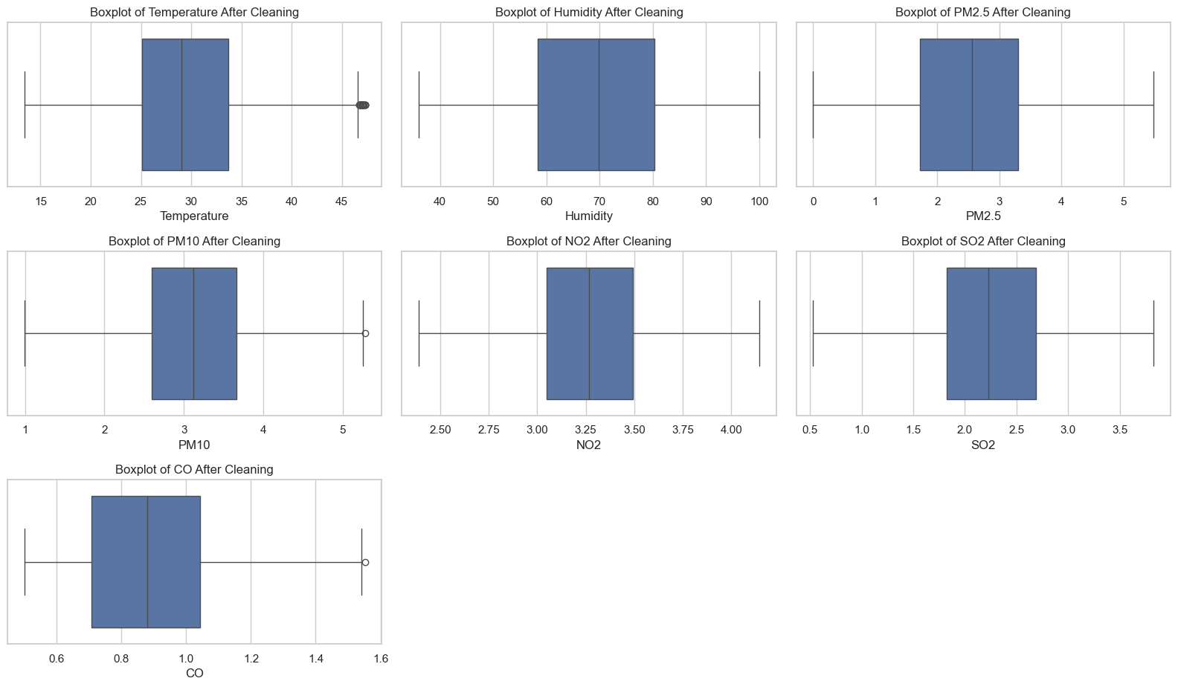
Date:15/05/2025
Box Plots After Cleaning

Slide 8
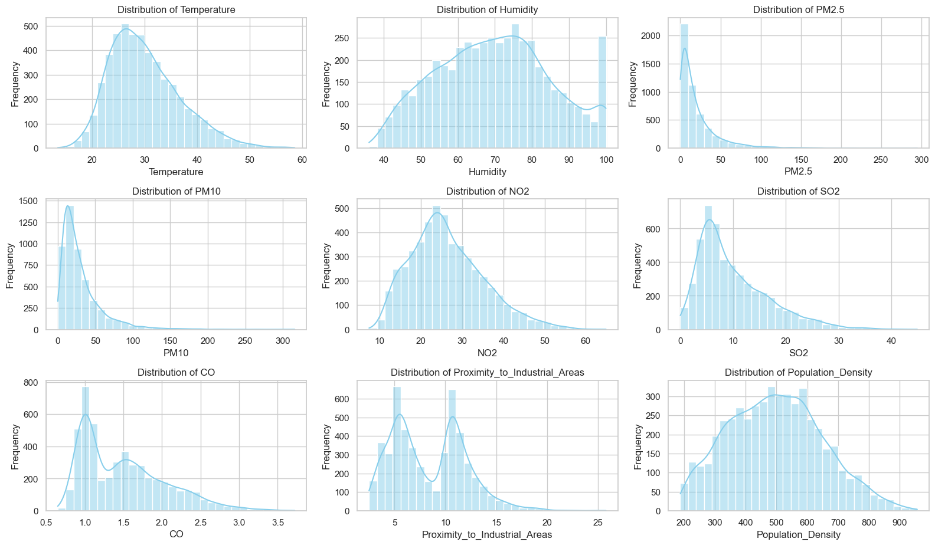
Date:15/05/2025
Kde Distribution Curves

Slide 9
Date:15/05/2025
Log Transformation
→ The KDE curve before transformation shows a right-skewed distribution, where most data points are concentrated towards the lower values, and a long tail extends to the right. This kind of skewness can negatively impact model performance, especially for algorithms that assume normally distributed input features.
→ To address this, we applied a log transformation, which:
Compresses the range of high values, Spreads out lower values and
Helps in making the distribution more symmetric and closer to a normal (bell-shaped) curve.
→ After the log transformation, the KDE curve becomes noticeably less skewed, indicating a more balanced distribution. This improves the reliability of statistical analyses and enhances model learning by reducing the effect of extreme values.

Slide 10
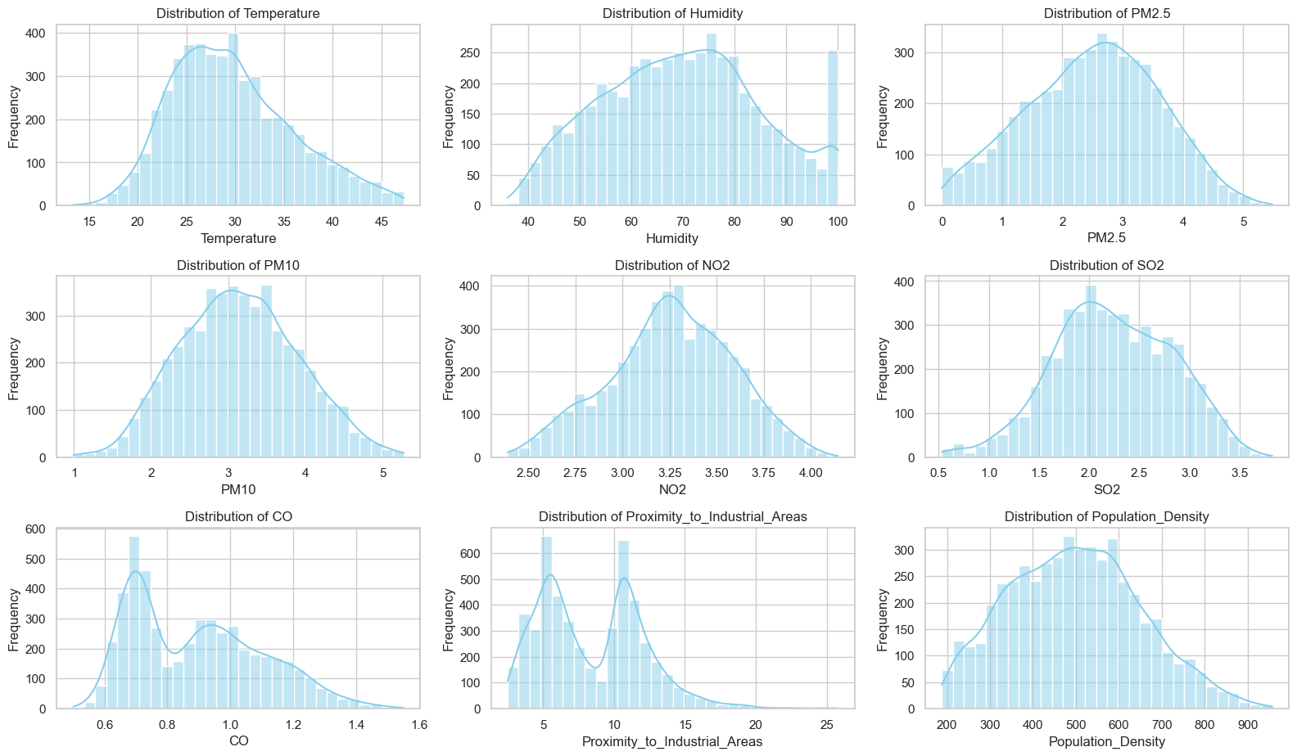
Date:15/05/2025
Kde Distribution Curves After Transforming

Slide 11
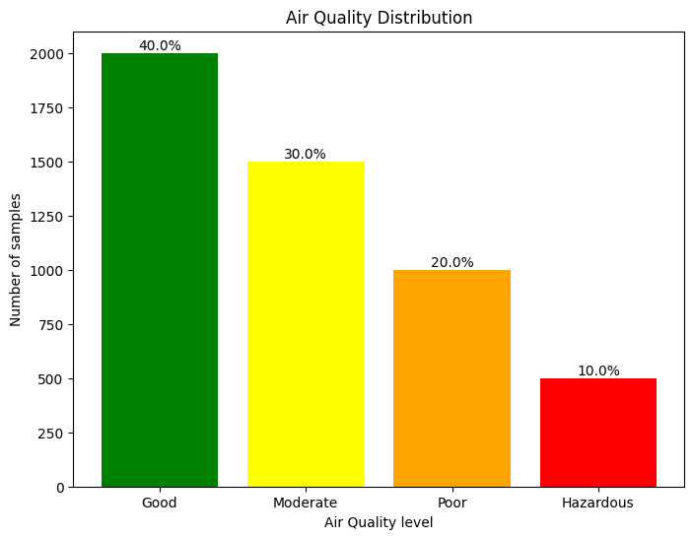
Date:15/05/2025
Class Imbalance
→ The bar graph shows a clear imbalance in class distribution, where one class significantly outnumbers the others.
→ Models trained on imbalanced data tend to be biased toward the majority class, leading to poor performance on the minority class.
→ To address this, we used SMOTE (Synthetic Minority Over-sampling Technique) after splitting the data.

Slide 12
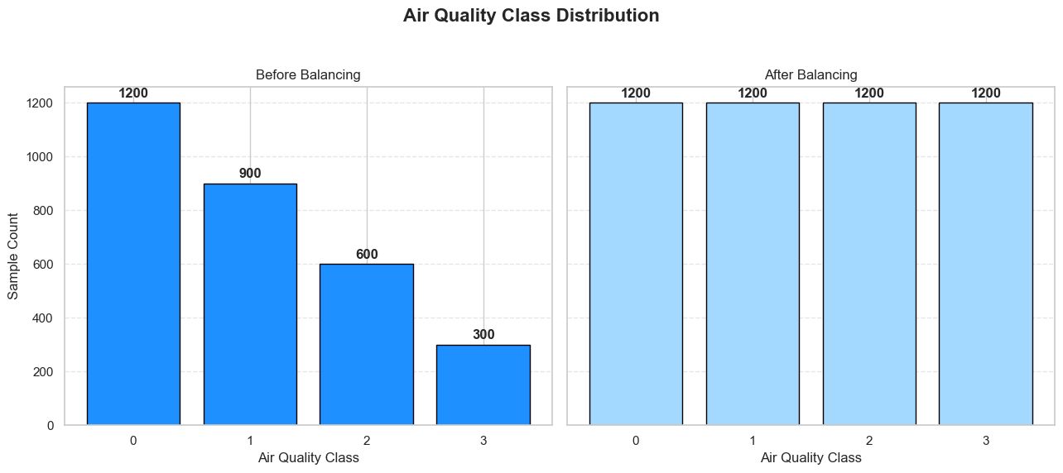
Date:15/05/2025
SMOTE
→ Applied SMOTE (Synthetic Minority Over-sampling Technique) only on the training set to prevent data leakage.
→ The bar graph shows that the class distribution is now balanced, with equal representation for all classes.
→ This ensures that the model can learn patterns from all classes effectively, improving prediction accuracy and reducing bias toward the majority class.
→ Standardized the data and now the data is ready to be given for training the model.

Slide 13
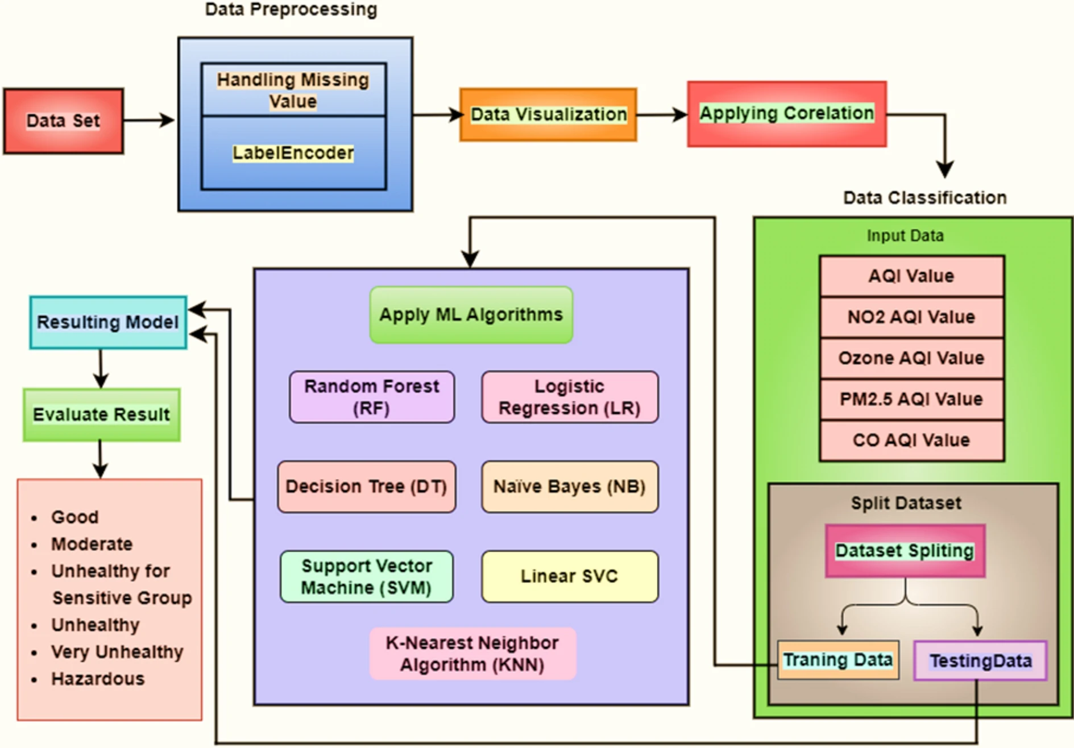
Date:15/05/2025
Model Building and Performance Comparison

Slide 14
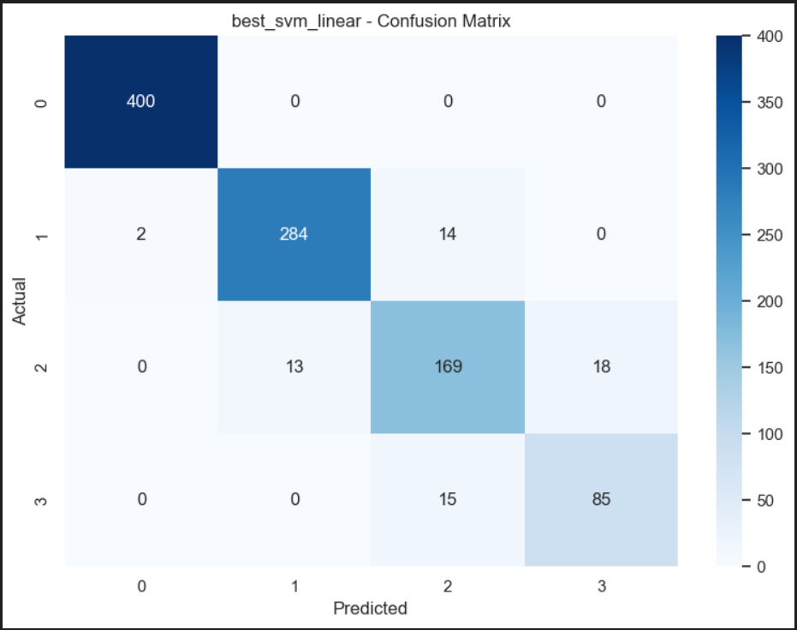

Date:15/05/2025
Support Vector Machine (SVM)
Linear SVM:
In this dataset, even though the data points are dense, they still follow a linear pattern that the SVM can learn.
The model uses a soft margin to allow a few misclassified points, which helps it generalize well.
Implemented with C=1.0, demonstrating robust performance for linearly separable components of the data

Slide 15
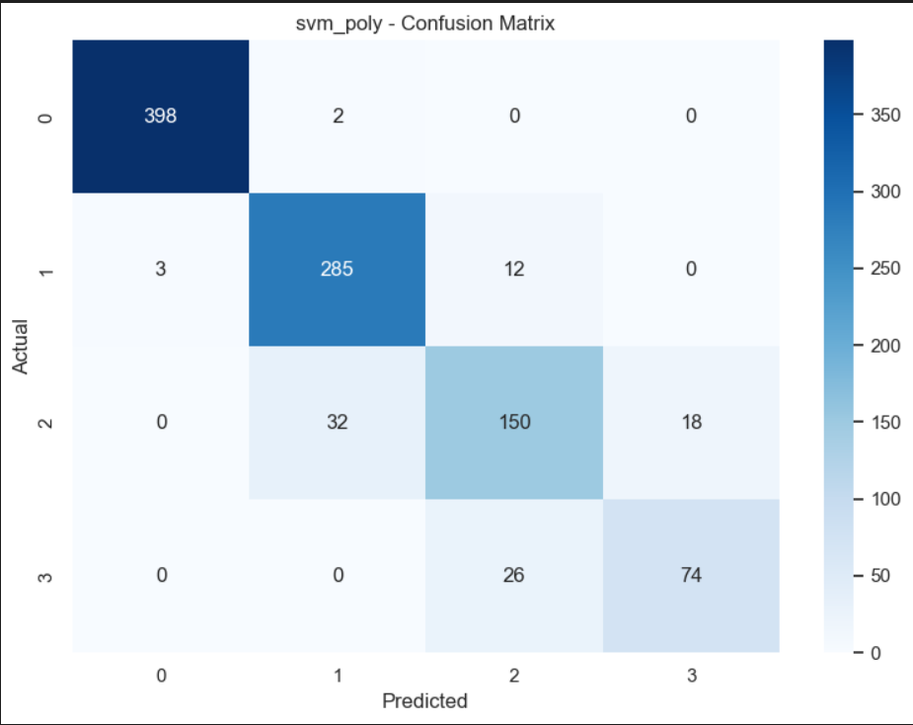

Date:15/05/2025
Support Vector Machine (SVM)
2. Polynomial SVM:
Captures non-linear relationships through polynomial interactions between features. It offered more flexibility but is computationally more expensive.
It performed worse than Linear kernel because it can create overly complex decision boundaries, causing the model to overfit and not generalize well.
Polynomial kernels are better suited for complex, nonlinear data, but not all datasets require this complexity.

Slide 16
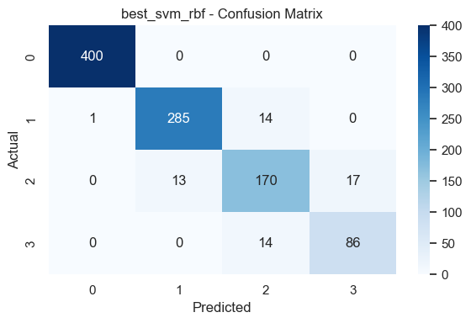

Date:15/05/2025
Support Vector Machine (SVM)
3. RBF(Radial Basis Function):
The RBF Kernel maps data into a high-dimensional space to capture complex, nonlinear patterns using a Gaussian function.
Focuses more on nearby data points, less on distant ones
It achieved the highest accuracy of 93.9% among all kernels tested by capturing subtle nonlinear relationships missed by the linear and polynomial kernels.

Slide 17


Date:15/05/2025
Logistic Regression
Learns a separate set of weights for each class. Maximizes the log-likelihood across all classes to find the best decision boundaries.
Followed one-vs-rest approach since our data consists of 4 classes.
Achieved an accuracy of 93.6%, showing strong generalization despite class complexity.

Slide 18
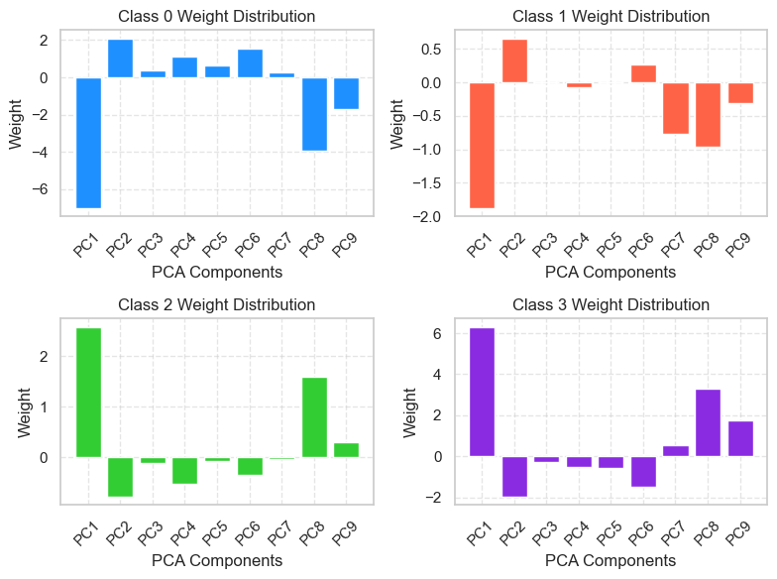
Date:15/05/2025
Logistic Regression
Since we are using the one-vs-rest approach, we obtain separate weight vectors for each class. As a result, there are four different plots corresponding to the four classes.
Chosen for its simplicity and interpretability

Slide 19
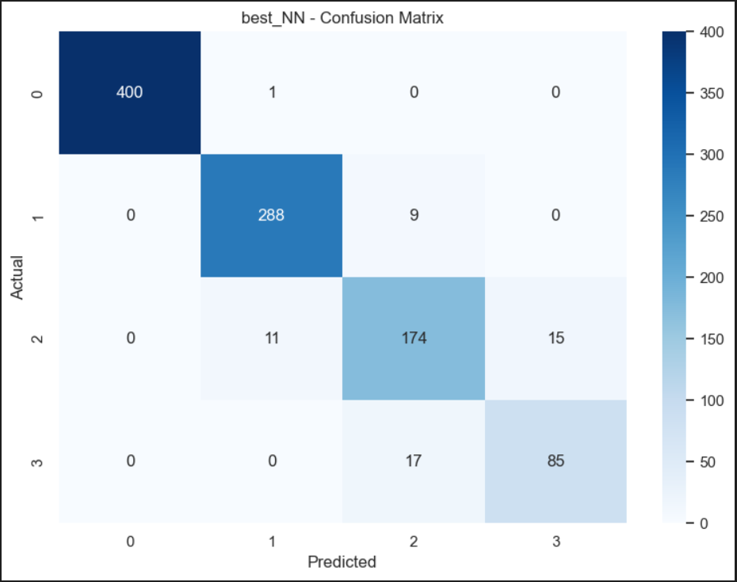

Date:15/05/2025
Neural Networks
It consists of an input layer, one or more hidden layers, and an output layer. Each neuron performs a weighted sum of inputs followed by a non-linear activation function to capture complex feature interactions.
The neural network performed comparably to SVM and Decision Trees, but slightly below Random Forest in terms of accuracy and F1-score

Slide 20
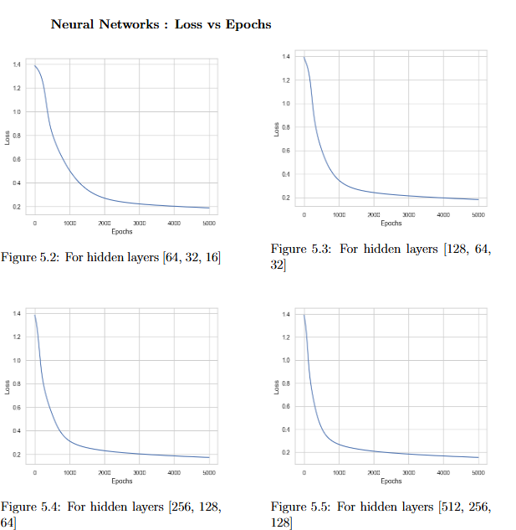
Date:15/05/2025
Neural Networks
All configurations show steady decrease in loss over epochs, indicating effective learning.
Deeper networks (like [512,256,128]) converge faster and achieve lower final loss, suggesting better learning capacity.
Simpler architectures (like [64,32,16]) also converge but may plateau at a higher loss..
Increasing the number of neurons in each layer improves convergence speed and final performance.

Slide 21
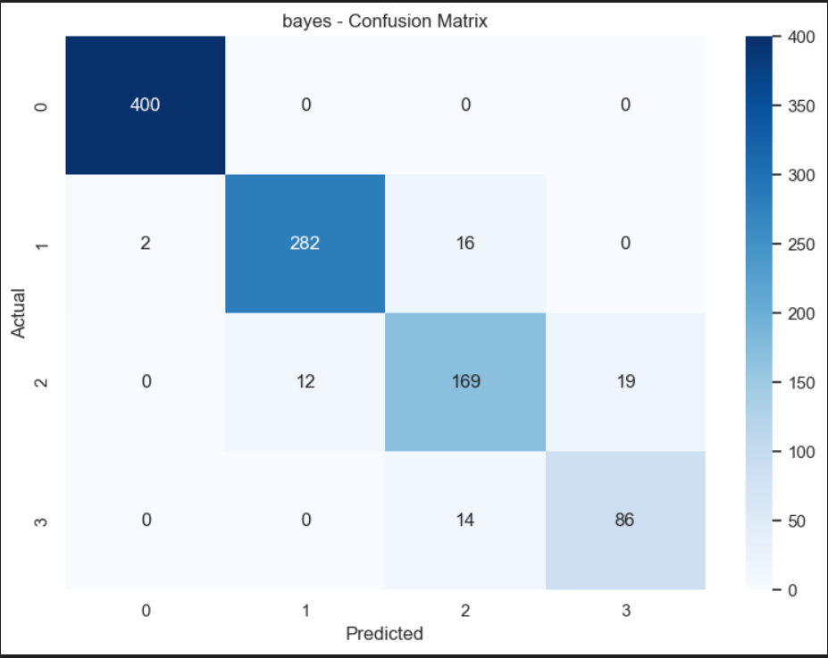

Date:15/05/2025
Bayes Classifier
Learns a separate set of weights for each class. Maximizes the log-likelihood across all classes to find the best decision boundaries.
The accuracy observed demonstrates that Bayes-based classification can perform well even with relatively simple probabilistic assumptions.
The closeness of precision and recall suggests the classifier is treating all classes fairly, with no significant bias or skew in predictions.

Slide 22


Date:15/05/2025
Naive Bayes Classifier
The Gaussian Naive Bayes classifier assumes each feature dimension is normally distributed and conditionally independent given the class.
Works well with high-dimensional data,fast and efficient.
Naive Bayes shows slightly lower performance, which is expected due to its strong independence assumption.

Slide 23


Date:15/05/2025
KNeighborsClassifier
Instance-based learning method
KNN is a distance-based classifier that predicts a class by looking at the majority class among the K closest data points.
At k = 3, the model achieved the highest accuracy, suggesting this is the optimal value for k.
KNN is sensitive to outliers and noisy data
because it looks at the k nearest neighbors for classification. Even a small amount
of noise can impact predictions.

Slide 24
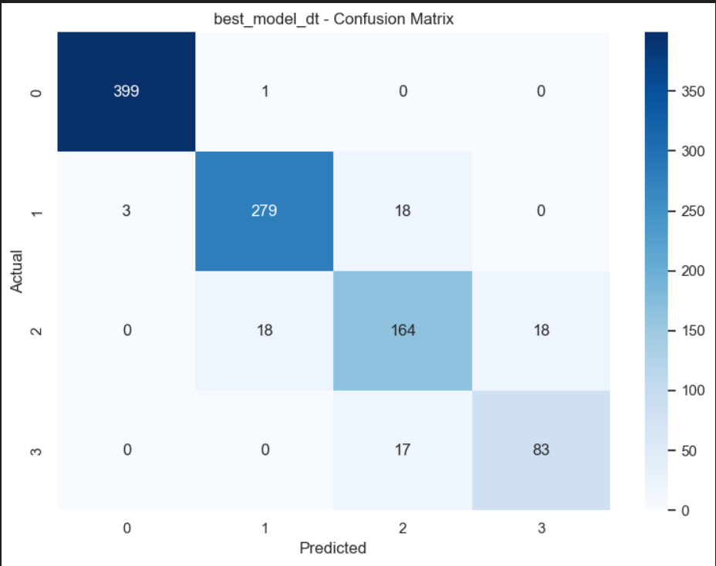
Date:15/05/2025
Decision Trees
It works by recursively splitting the dataset into subsets based on feature values that best separate the target classes.
The advantage is no need for feature scaling.
Handles both numerical and categorical data.
Prone to overfitting on noisy data.

Slide 25
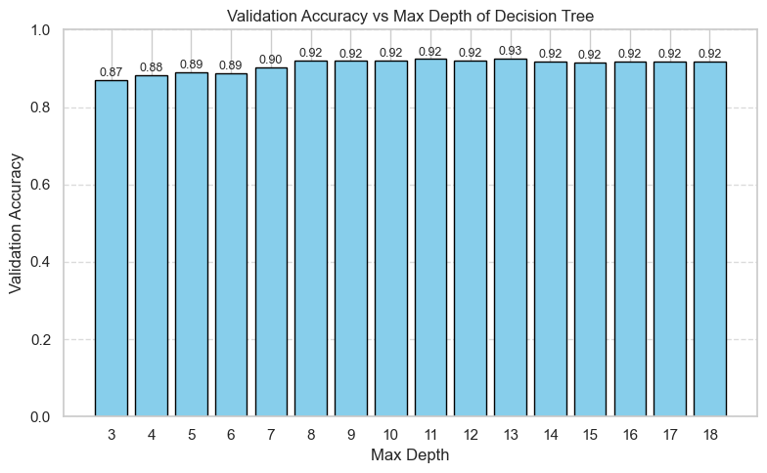
Date:15/05/2025
Decision Trees
Validation accuracy increases with depth and plateaus around depth 8–10.
The highest accuracy achieved is 0.93 at depth 13.
Shallow trees (depth < 7) underfit the data and yield lower accuracy.
Depth 8–10 is a good trade-off between performance and complexity.

Slide 26


Date:15/05/2025
Random Forest
Random Forest is an ensemble learning algorithm that builds multiple decision trees on random subsets of the data and features, and aggregates their outputs to improve overall prediction accuracy.
This bagging approach helps reduces overfitting improve, generalization, and enhance accuracy.

Slide 27
Date:15/05/2025
Random Forest
Observations:
Highest Accuracy so far with 94.9% accuracy, Random Forest outperforms all other models, indicating superior predictive power on the validation set.
Excellent Precision and F1-Score: A precision of 95% and F1-score of 94.9% show that the model makes accurate and reliable predictions, minimizing both false positives and false negatives.
Environmental data (like pollutant levels vs AQI) often have complex, non-linear interactions which the Random Forest model, being an ensemble of decision trees, can model effectively.
Random Forest is robust to noise and outliers. Random Forest, with its bagging approach, learns from both real and synthetic samples efficiently, boosting minority class performance.
By combining multiple decision trees and averaging outputs, it reduces variance and improves generalization.

Slide 28
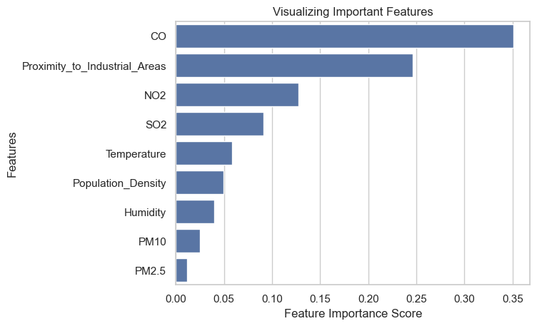
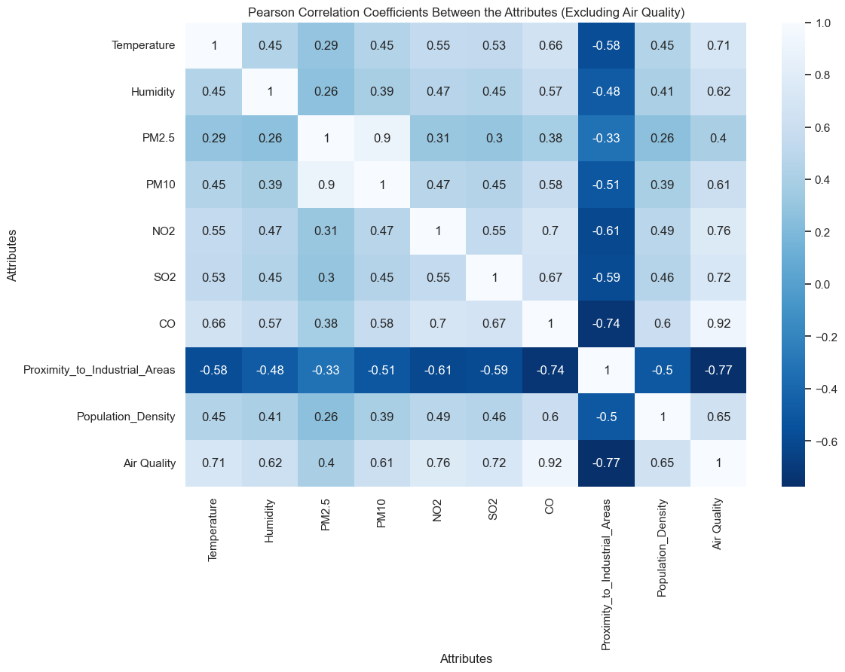
Date:15/05/2025
Feature Importance
We observed that the feature importance graph that we printed from random forest aligns with the correlations observed in the correlation matrix with the target.

Slide 29
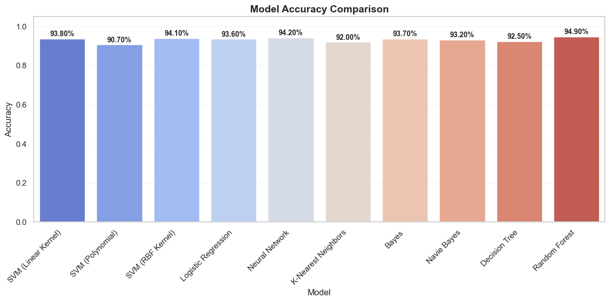
Date:15/05/2025
Comparison of Models

Slide 30
Date:15/05/2025
Best Model Performance
Overall the Random Forest model achieved the highest scores across all metrics, indicating its superior classification performance.
Random Forest’s feature importance analysis revealed that CO, Proximity to Industrial Areas, NO2, and SO2 were the most influential in determining air quality levels.
Interestingly, PM2.5 was found to be the least important and was removed in a refined model. After removal, the model’s accuracy increased, confirming the benefit of excluding irrelevant or noisy features.

Slide 31
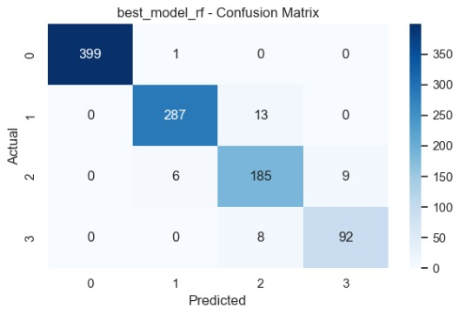
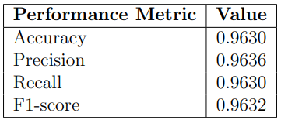
Date:15/05/2025
Best Model Performance

Slide 32
Date:15/05/2025
Observations
Balanced Dataset: After training on balanced data( using SMOTE) ,Accuracy and Recall can often align closely, since the model doesn’t benefit from class imbalance.
High True Positive Rates: Models are consistently making correct predictions for each class, so the true positives (used in Recall) dominate the confusion matrix mirroring overall accuracy.
No Major Class Bias: When there’s no significant class imbalance and no model is biased toward specific classes, performance measures like Accuracy, Recall, and F1 tend to converge.

Slide 33
Date:15/05/2025
Conclusion
In this work, we focus on the early detection of air quality, crucial for safeguarding public health and the environment, with the potential to save millions of lives globally.
We introduced an advanced air quality prediction system that integrates various machine learning techniques, including K-Nearest Neighbors, Bayes, Naive Bayes, Random Forest, Support Vector Machine, Logistic Regression, Decision Tree, and SVC achieving a remarkable 96% accuracy with Random Forest.
The model’s limitations include its reliance on historical data, challenges in real-time data integration, and the need for further validation across diverse conditions In addition, our findings highlight the importance of feature engineering, data preprocessing, and model selection in achieving reliable and interpretable predictions.
The high accuracy of the Random Forest classifier underscores its robustness and suitability for complex, nonlinear relationships among pollutant variables. This research sets the foundation for deploying intelligent monitoring systems in urban areas to enable timely alerts.

Slide 34
Date:15/05/2025
Further Improvements
Future directions may involve incorporating real-time sensor data, improving generalizability with larger datasets from multiple regions, and exploring deep learning models for temporal pattern recognition.
By enhancing predictive accuracy and deployment feasibility, such systems can play a pivotal role in environmental management and public health strategies.
API Integration: Build an API to serve your model predictions and integrate it into applications that can use air quality predictions.

Slide 35
Date:15/05/2025
References
https://link.springer.com/article/10.1023/A:1010933404324 :- A foundational paper on the Random Forest algorithm.
https://environmentalsystemsresearch.springeropen.com/articles/10.1186/s40068-024-00378-z#:~:text=The%20proposed%20research%20uses%20various,Multinomial%20Na%C3%AFve%20Bayes%20(52%25)
DataFlair. Predicting Air Quality Index using Python. https://medium.com/dataflair/predicting-air-quality-index-using-python-4381b64904f1

Slide 36
Date:15/05/2025
Thank You
-Team 20

