Slide 1
Customer Segmentation using Data science

Slide 2
Determining Optimal Clusters
Methods
Elbow method
Silhouette method
Gap statistic
While working with clusters, you need to specify the number of clusters to use. You would like to utilize the optimal number of clusters. To help you in determining the optimal clusters, there are three popular methods.

Slide 3
Elbow Method
The main goal behind cluster partitioning methods like k-means is to define the clusters such that the intra-cluster variation stays minimum.
minimize(sum W(Ck)), k=1…k
Where Ck represents the kth cluster and W(Ck) denotes the intra-cluster variation. With the measurement of the total intra-cluster variation, one can evaluate the compactness of the clustering boundary. We can then proceed to define the optimal clusters as follows –
First, we calculate the clustering algorithm for several values of k. This can be done by creating a variation within k from 1 to 10 clusters. We then calculate the total intra-cluster sum of square (iss). Then, we proceed to plot iss based on the number of k clusters. This plot denotes the appropriate number of clusters required in our model. In the plot, the location of a bend or a knee is the indication of the optimum number of clusters. Let us implement this in R as follows

Slide 4
CODE
library(purrr)
set.seed(123)
# function to calculate total intra-cluster sum of square
iss <- function(k) {
kmeans(customer_data[,3:5],k,iter.max=100,nstart=100,algorithm="Lloyd" )$tot.withinss
}
k.values <- 1:10
iss_values <- map_dbl(k.values, iss)
plot(k.values, iss_values,
type="b", pch = 19, frame = FALSE,
xlab="Number of clusters K",
ylab="Total intra-clusters sum of squares")

Slide 5
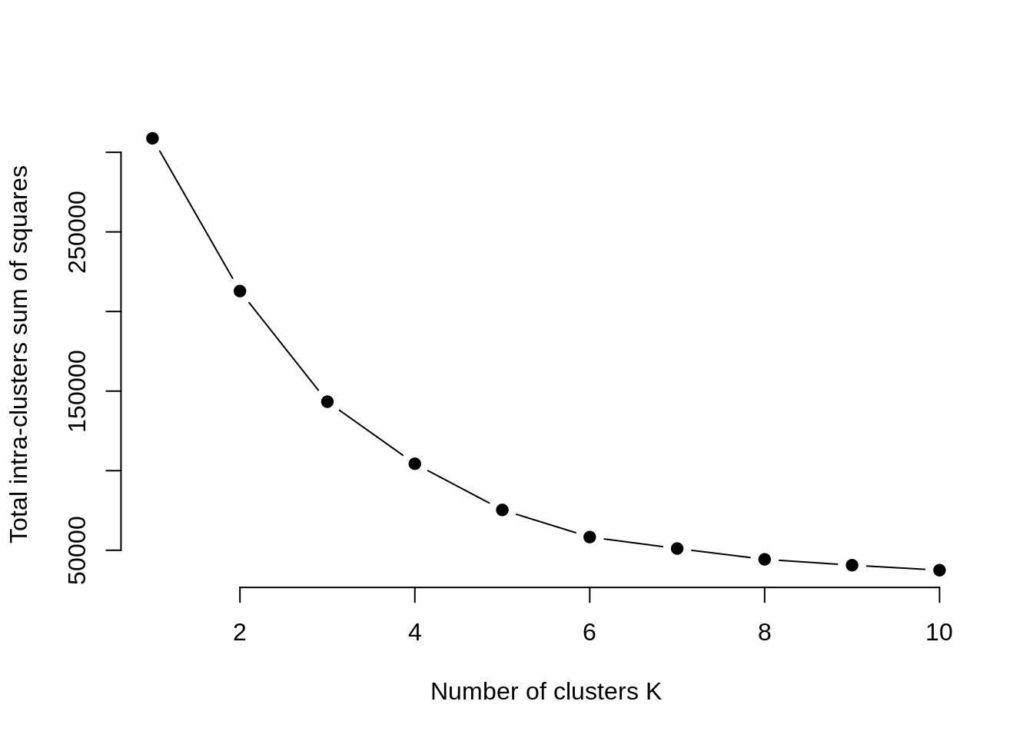
OUTPUT

Slide 6
Average Silhouette Method
With the help of the average silhouette method, we can measure the quality of our clustering operation. With this, we can determine how well within the cluster is the data object. If we obtain a high average silhouette width, it means that we have good clustering. The average silhouette method calculates the mean of silhouette observations for different k values. With the optimal number of k clusters, one can maximize the average silhouette over significant values for k clusters.
Using the silhouette function in the cluster package, we can compute the average silhouette width using the kmean function. Here, the optimal cluster will possess highest average.

Slide 7
CODE
library(cluster)
library(gridExtra)
library(grid)
k2<-kmeans(customer_data[,3:5],2,iter.max=100,nstart=50,algorithm="Lloyd")
s2<-plot(silhouette(k2$cluster,dist(customer_data[,3:5],"euclidean")))

Slide 8
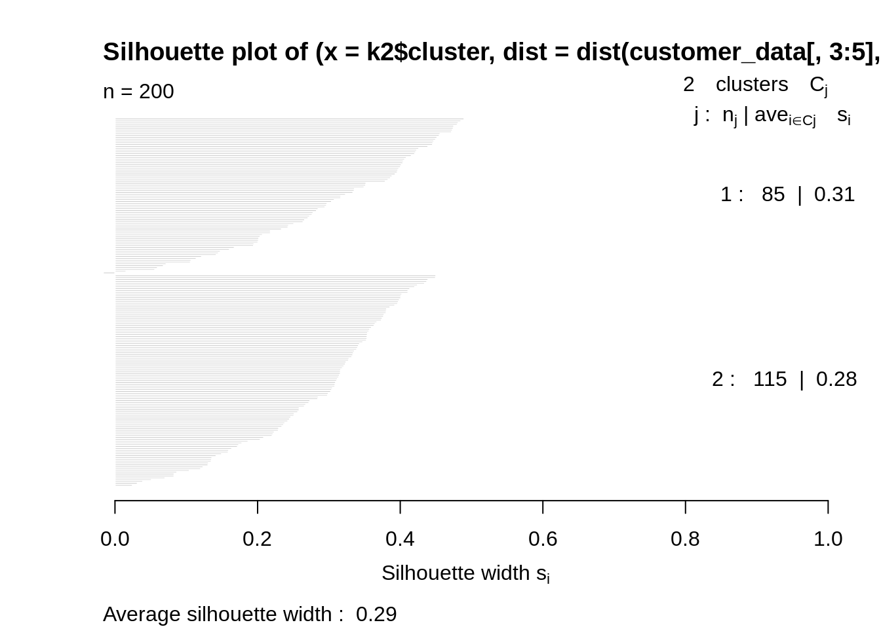
OUTPUT

Slide 9
Gap Statistic Method
In 2001, researchers at Stanford University – R. Tibshirani, G.Walther and T. Hastie published the Gap Statistic Method. We can use this method to any of the clustering method like K-means, hierarchical clustering etc. Using the gap statistic, one can compare the total intracluster variation for different values of k along with their expected values under the null reference distribution of data. With the help of Monte Carlo simulations, one can produce the sample dataset. For each variable in the dataset, we can calculate the range between min(xi) and max (xj) through which we can produce values uniformly from interval lower bound to upper bound.
For computing the gap statistics method we can utilize the clusGap function for providing gap statistic as well as standard error for a given output.

Slide 10
CODE
set.seed(125)
stat_gap <- clusGap(customer_data[,3:5], FUN = kmeans, nstart = 25,
K.max = 10, B = 50)
fviz_gap_stat(stat_gap)

Slide 11
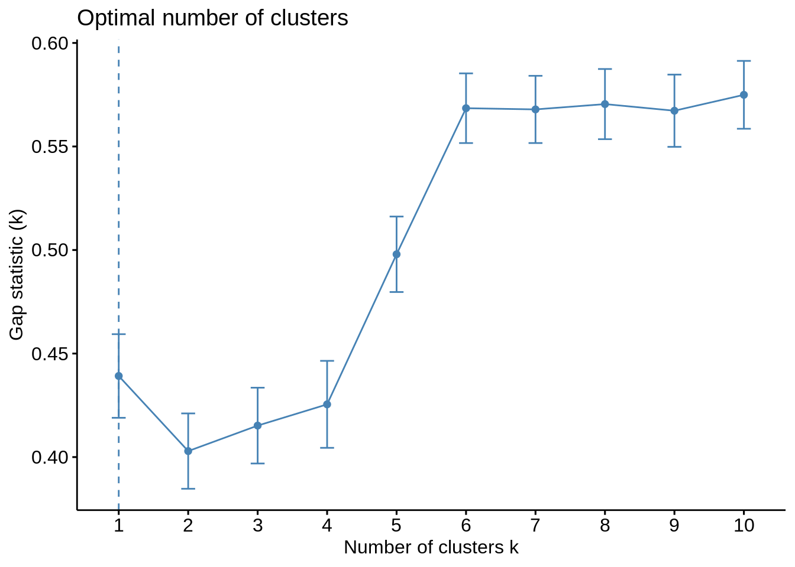
OUTPUT

Slide 12
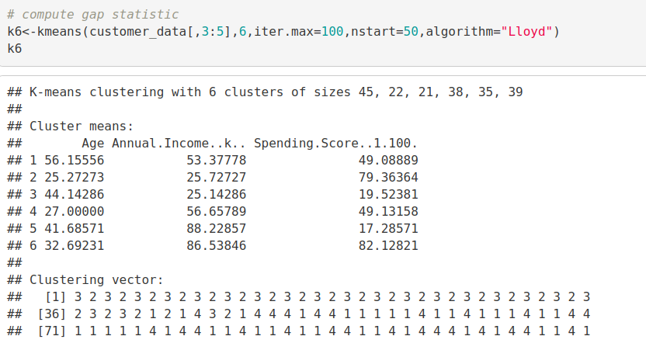
Now, let us take k = 6 as our optimal cluster
CODE:
k6<-kmeans(customer_data[,3:5],6,iter.max=100,nstart=50,algorithm="Lloyd")
k6
output

Slide 13
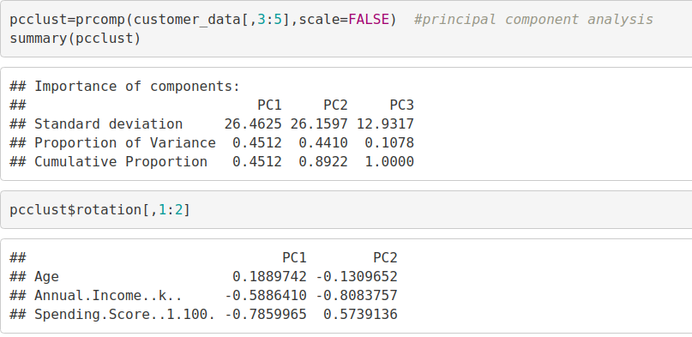
Visualizing the Clustering Results using the First Two Principle Components
Code:
pcclust=prcomp(customer_data[,3:5],scale=FALSE) #principal component analysis
summary(pcclust)
pcclust$rotation[,1:2]
output

Slide 14
Code:
set.seed(1)
ggplot(customer_data, aes(x =Annual.Income..k.., y = Spending.Score..1.100.)) +
geom_point(stat = "identity", aes(color = as.factor(k6$cluster))) +
scale_color_discrete(name=" ",
breaks=c("1", "2", "3", "4", "5","6"),
labels=c("Cluster 1", "Cluster 2", "Cluster 3", "Cluster 4", "Cluster 5","Cluster 6")) +
ggtitle("Segments of Mall Customers", subtitle = "Using K-means Clustering")

Slide 15
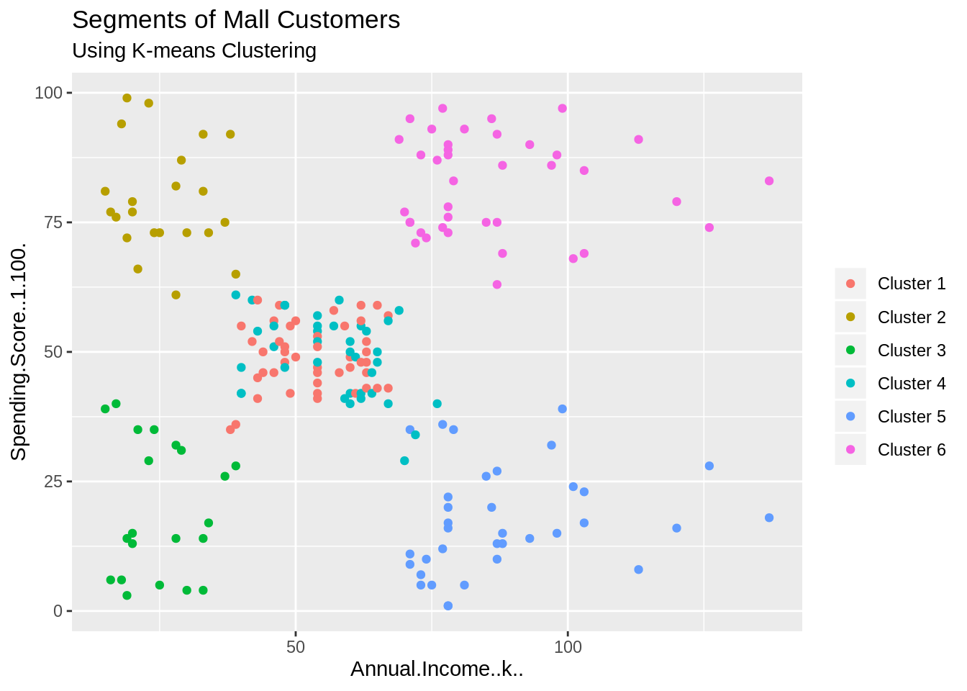
OUTPUT:

Slide 16
CODE:
geom_point(stat = "identity", aes(color = as.factor(k6$cluster))) +
scale_color_discrete(name=" ",
ggplot(customer_data, aes(x =Spending.Score..1.100., y =Age)) +
breaks=c("1", "2", "3", "4", "5","6"),
labels=c("Cluster 1", "Cluster 2", "Cluster 3", "Cluster 4", "Cluster 5","Cluster 6")) +
ggtitle("Segments of Mall Customers", subtitle = "Using K-means Clustering")

Slide 17

OUTPUT:

