Slide 1
Corporate Analytics & Legal-Reasoning Engine(CORAL)
University College of Engineering Nagercoil
Project Supervisor:
Dr. M. Muthuselvi
Assistant Professor (SG)
Department of Computer Science and Engineering.
University College of Engineering Nagercoil.
Team Members :
K. Manikandan
9628220104034
B.E. Computer Science and Engineering
Final year.
S, Antro Vasanth
9628220104033
B.E. Computer Science and Engineering
Final year.
S. Srinivasan
9628220104026
B.E. Computer Science and Engineering
Final year.

Slide 2
Abstract
CORAL is an AI-driven legal compliance platform that translates natural-language queries into verifiable legal decisions without losing statutory precision. It combines semantic retrieval, knowledge-graph enforcement, and intent-grounded reasoning to deliver explainable, audit-ready compliance outcomes.
Preserves exact user-provided legal keywords while converting queries into structured legal intent.
Retrieves relevant statutory provisions using semantic vector search with contextual accuracy.
Enforces legal hierarchies and cross-law dependencies exclusively through a knowledge graph.
Applies intent-anchored LLM reasoning to produce deterministic, explainable compliance decisions.
Generates audit-ready, machine-readable outputs within a scalable, jurisdiction-extensible architecture.

Slide 3
Problem Motivation/Statement
Increasing Regulatory Complexity: Corporate laws and regulations are continuously expanding and frequently amended.
Manual Legal Processes: Current compliance and legal analysis rely heavily on time-consuming human review.
High Cost and Risk: Compliance failures result in financial penalties and reputational damage.
Lack of Legal Reasoning Tools: Existing legal platforms retrieve documents but do not provide legal reasoning or conclusions.
Poor Explainability: AI-based legal tools lack transparent and auditable reasoning mechanisms.
Scalability Challenges: Manual and search-based systems do not scale for fast-growing enterprises.
Fragmented Legal Intelligence: Legal research, compliance, and advisory tools operate in isolated systems.
Need for Structured Legal Intelligence: Organizations require an automated, accurate, and explainable legal decision-support system.

Slide 4
Scope of the Project
Covers corporate law compliance and governance scenarios
Handles legal areas like:
Company formation & registration
Director appointments & board resolutions
Statutory filings & approvals
Regulatory obligations and deadlines
Supports query-based legal decision analysis
Provides compliance status, risk detection, and legal requirements
Designed for corporate teams, legal departments, and compliance officers.

Slide 5
Project System Specification
Hardware Requirements
Processor: Intel Core i5 or higher
RAM: Minimum 8 GB
Storage: Minimum 256 GB available space
Network: Stable Internet connection
Software Requirements
Operating System: Windows 10 / Linux
Backend Technologies: Python, Node.js
Frontend Technology: React
Database: Qdrant (Vector Database), Neo4j (Graph Database)
Frameworks / APIs: FastAPI, REST APIs
Programming Languages: Python, JavaScript
Web Browser: Google Chrome / Microsoft Edge / Firefox

Slide 6
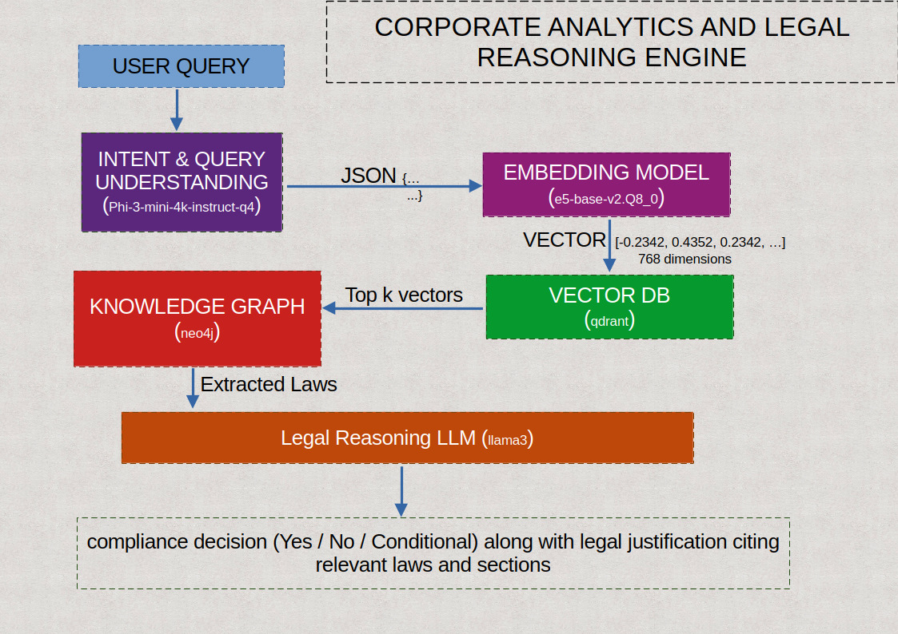
Architecture for Proposed Solution

Slide 7
Tools and Techniques used
Tools / Technologies :
Large Language Model (LLM): phi3, llama3, e5-base-v2
Vector Database: Qdrant
Graph Database: Neo4j
Backend Framework: Python, Node.js
Frontend Framework: React
Graph Query Language: Cypher
APIs: RESTful APIs, FAST API

Slide 8
Module-wise Implementation Status
MODULE | Status
CORAL Information Website Module | Completed
Signup Module | Completed
Login Module | Completed
Chat box & Query Interface Module | Completed
Intent Understanding & Query Normalization Module | Completed
Legal Knowledge Representation Module | Pending
Semantic Retrieval & Orchestration Module | In Progress
Compliance Reasoning & Decision Engine | Completed
Explainability, Validation & System Interface Module | Completed

Slide 9
Proposed Timeline/ Work Plan(Gantt chart)
 | Month 1 |  |  |  | Month 2 |  |  |  | Month 3
 | Week 1 | Week 2 | Week 3 | Week 4 | Week 5 | Week 6 | Week 7 | Week 8 | Week 9 | Week 10 | Week 11 | Week 12
Module 1
Module 2
Module 3
Module 4
Module 5

Slide 10
Expected Outcome
A Knowledge Graph–driven framework for auditing and ensuring transparency of AI systems.
Automated extraction and structuring of legal obligations (e.g., from the EU AI Act).
Improved explainability, traceability, and compliance verification of AI decisions.
Effective integration of LLMs with symbolic knowledge to reduce hallucinations and legal risk.
A scalable and regulator-friendly system supporting AI governance and accountability.

Slide 11
References
Linna, E., & Linna, T. (2026). Challenges for Generative AI in Legal Reasoning. Discover Artificial Intelligence.
Gallia, F., Dal Ponta, T. R., Sartor, G., & Contissa, G. (2025). Approaching the AI Act… with AI: LLMs and Knowledge Graphs to Extract and Analyse Obligations. Legal Informatics & AI Compliance.
Waltersdorfer, L., & Sabou, M. (2024). Leveraging Knowledge Graphs for AI System Auditing and Transparency.
Hannah, G., Sousa, R. T., Dasoulas, I., & d’Amato, C. (2024). On the Legal Implications of Large Language Model Answers: A Prompt Engineering Approach and a View Beyond by Exploiting Knowledge Graphs. Journal of AI and Law.
Moreno-Schneider, J., Rehm, G., Montiel-Ponsoda, (2021). Lynx: A Knowledge-Based AI Service Platform for Content Processing, Enrichment and Analysis for the Legal Domain. Semantic Web Journal.

