Slide 1
The UML is a language for
· Visualizing
· Specifying
· Constructing
· Documenting
the artifacts of a software-intensive system.

Slide 2
The vocabulary of the UML encompasses three kinds of building blocks:
1. Things
2. Relationships
3. Diagrams
There are four kinds of things in the UML:
1. Structural things
2. Behavioral things
3. Grouping things
4. Annotational things

Slide 3
In all, there are seven kinds of structural things:
Classes
Interfaces
Collaborations
Use cases
Active classes
Components
Nodes

Slide 4
In all, there are two primary kinds of behavioral things:
Interaction
state machine
In all, there is one primary kind of grouping thing:
Package
There is one primary kind of annotational thing:
note

Slide 5
There are four kinds of relationships in the UML:
1. Dependency
2. Association
3. Generalization
4. Realization
the UML includes nine diagrams:
1. Class diagram
2. Object diagram
3. Use case diagram
4. Sequence diagram
5. Collaboration diagram
6. Statechart diagram
7. Activity diagram
8. Component diagram
9. Deployment diagram

Slide 6
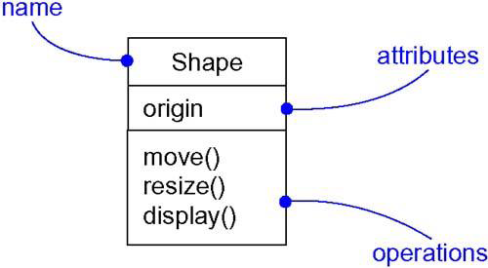
Classes

Slide 7
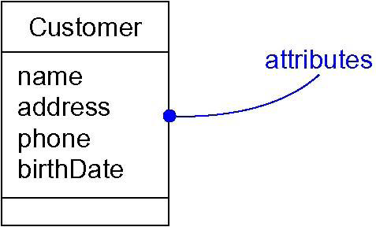
Attributes

Slide 8
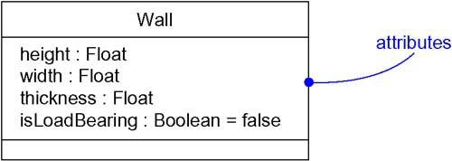
Attributes and Their Class

Slide 9
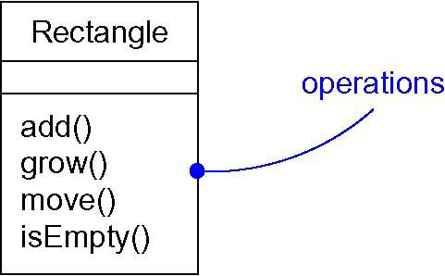
Operations

Slide 10
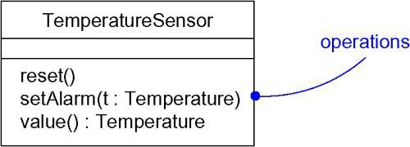
Operations and Their Signatures

Slide 11
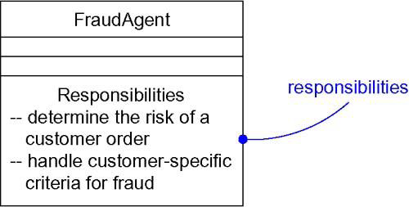
Responsibilities

Slide 12
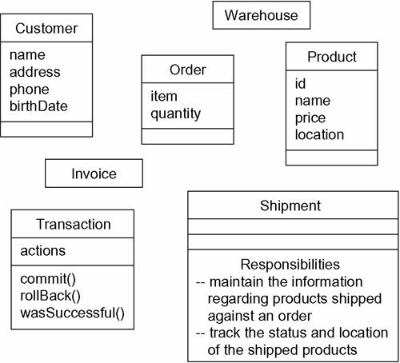
Modeling the Vocabulary of a System

Slide 13
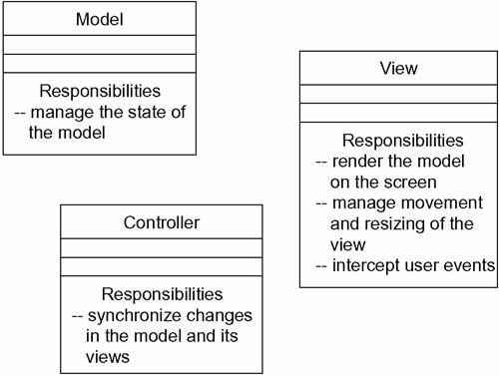
Modeling the Distribution of Responsibilities in a System

Slide 14
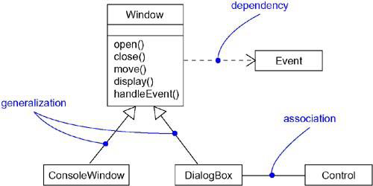
Relationships
Notes:
Dependency Dependency is defined as a relation between two classes, where one class depends on another class but another class may or not may depend on the first class.So any change in one of the classes may affect the functionality of the other class, that depends on the first one.
Generalization All of us know about the concept of inheritance. It is nothing but a kind of generalization. We define it simply with a base class having some properties, functions and so on. A new class will be derived from this base class and the child class will have access to all the functionality of the base or parent class (of course depending on the access modifiers defined on the base class members).
Association Association is defined as a structural relationship, that conceptually means that the two components are linked to each other. This kind of relation is also referred to as a using relationship, where one class instance uses the other class instance or vice-versa, or both may be using each other. But the main point is, the lifetime of the instances of the two classes are independent of each other and there is no ownership between two classes. For example, consider the same example of a Student-Teacher relationship. Conceptually speaking, each student can be associated with multiple teachers and each teacher can be associated with multiple students.
Aggregation: Aggregation is the same as association but with an additional point that there is an ownership of the instances, unlike association where there was no ownership of the instances. To understand it better, let's add another class named Department to our example explained above.
If we talk about the relation between Teacher and Department then conceptually, a Department can have multiple Teachers associated with it but each Teacher can belong to only one Department at a time.
Multiplicity defines how many objects participate in a relationship and it is the number of instances of one class related to one instance of the other class.

Slide 15
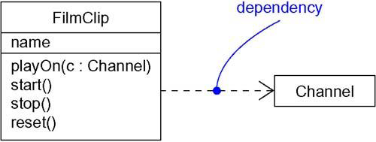
Dependencies
Notes:
Dependency Dependency is defined as a relation between two classes, where one class depends on another class but another class may or not may depend on the first class.So any change in one of the classes may affect the functionality of the other class, that depends on the first one.

Slide 16
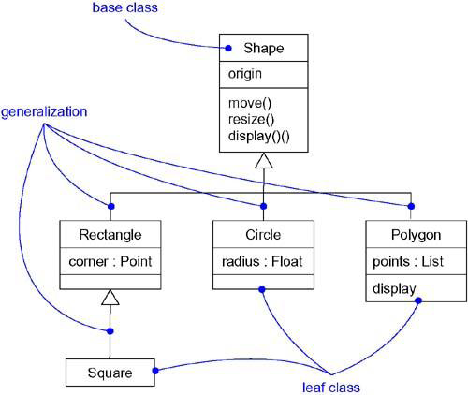
Generalization
Notes:
Generalization All of us know about the concept of inheritance. It is nothing but a kind of generalization. We define it simply with a base class having some properties, functions and so on. A new class will be derived from this base class and the child class will have access to all the functionality of the base or parent class (of course depending on the access modifiers defined on the base class members).

Slide 17
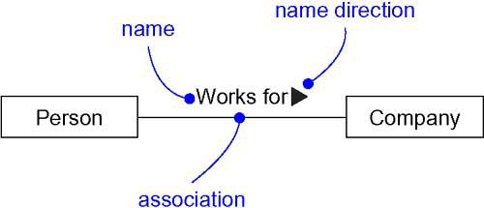
Association Names
Notes:
Association Association is defined as a structural relationship, that conceptually means that the two components are linked to each other. This kind of relation is also referred to as a using relationship, where one class instance uses the other class instance or vice-versa, or both may be using each other. But the main point is, the lifetime of the instances of the two classes are independent of each other and there is no ownership between two classes. For example, consider the same example of a Student-Teacher relationship. Conceptually speaking, each student can be associated with multiple teachers and each teacher can be associated with multiple students.

Slide 18
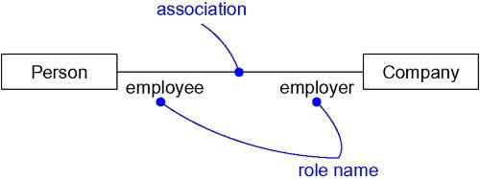
Roles
Notes:
Multiplicity defines how many objects participate in a relationship and it is the number of instances of one class related to one instance of the other class.

Slide 19
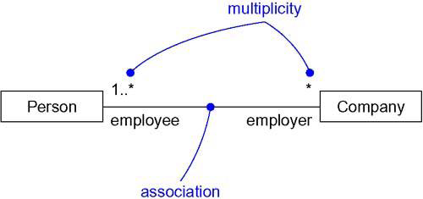
Multiplicity

Slide 20
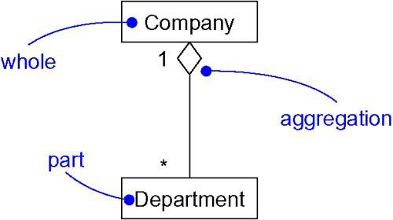
Aggregation
Notes:
Aggregation: Aggregation is the same as association but with an additional point that there is an ownership of the instances, unlike association where there was no ownership of the instances. To understand it better, let's add another class named Department to our example explained above.
If we talk about the relation between Teacher and Department then conceptually, a Department can have multiple Teachers associated with it but each Teacher can belong to only one Department at a time.

Slide 21
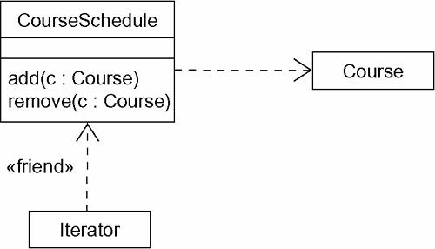
Dependency Relationships

Slide 22
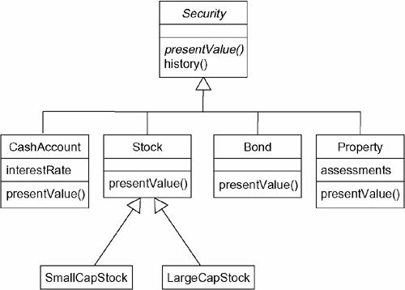
Inheritance Relationships

Slide 23
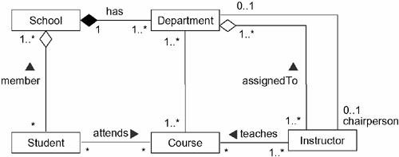
Structural Relationships

Slide 24
Typically, we'll view the static parts of a system using one of the four following diagrams:
1. Class diagram
2. Object diagram
3. Component diagram
4. Deployment diagram

Slide 25
We'll often use five additional diagrams to view the dynamic parts of a system:
1. Use case diagram
2. Sequence diagram
3. Collaboration diagram
4. Statechart diagram
5. Activity diagram

Slide 26
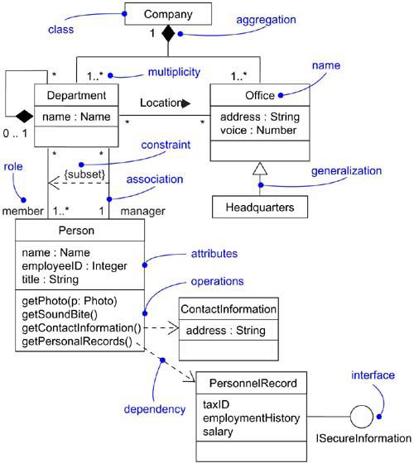
A Class Diagram

Slide 27
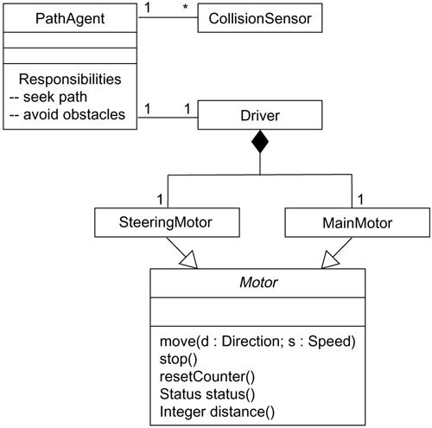
Modeling Simple Collaborations

Slide 28
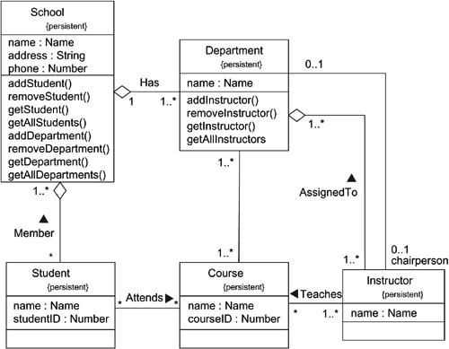
Modeling a Schema

Slide 29
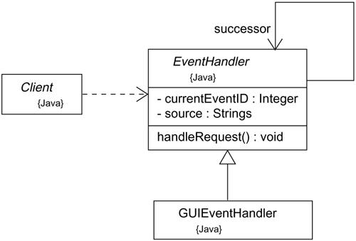
Forward Engineering

Slide 30
Forward engineering the class EventHandler yields the following code:
public abstract class EventHandler {
EventHandler successor;
private Integer currentEventID;
private String source;
EventHandler() {}
public void handleRequest() {}
}

Slide 31
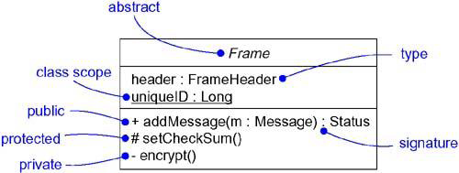
Advanced Classes

Slide 32
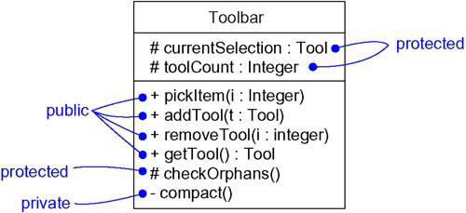
Visibility

Slide 33
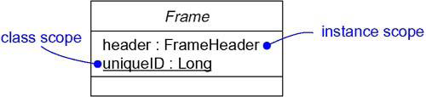
Owner Scope

Slide 34
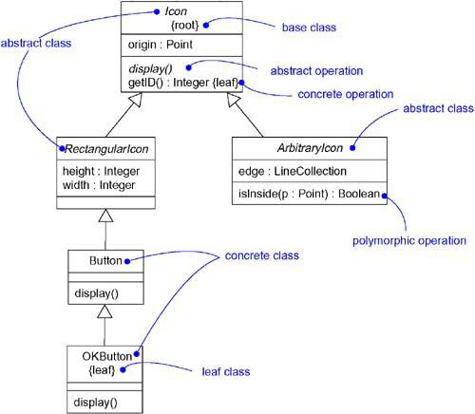
Abstract and Concrete Classes and Operations

Slide 35
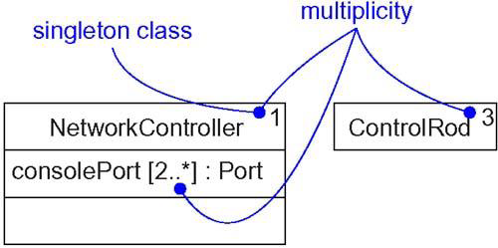
Multiplicity

