Slide 1



An Introduction to
Django
Web development team -APSSDC
By
Matampalli satheesh

Slide 2

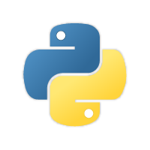
Why Django Framework ?
What is Django ?
Architecture : MVC – MVT Pattern
Get Started With Django

Slide 3
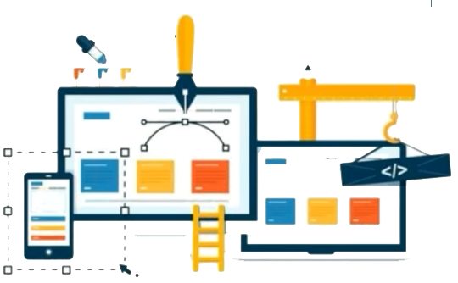
Why Django Framework :
Django is a Python web framework
A Framework provides a structure and common methods to make the life of a web application developer much easier for building flexible, scalable and maintainable web applications.

Slide 4
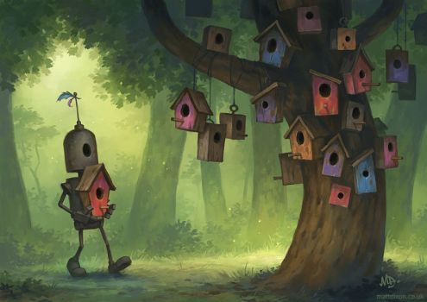


What is Django :
A Python web framework is a code library that provide tools and libraries to simplify common web development operations.

Slide 5
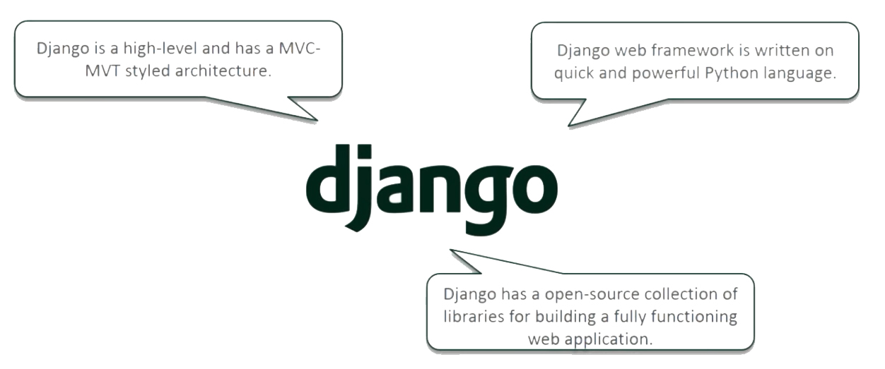
What is Django :

Slide 6
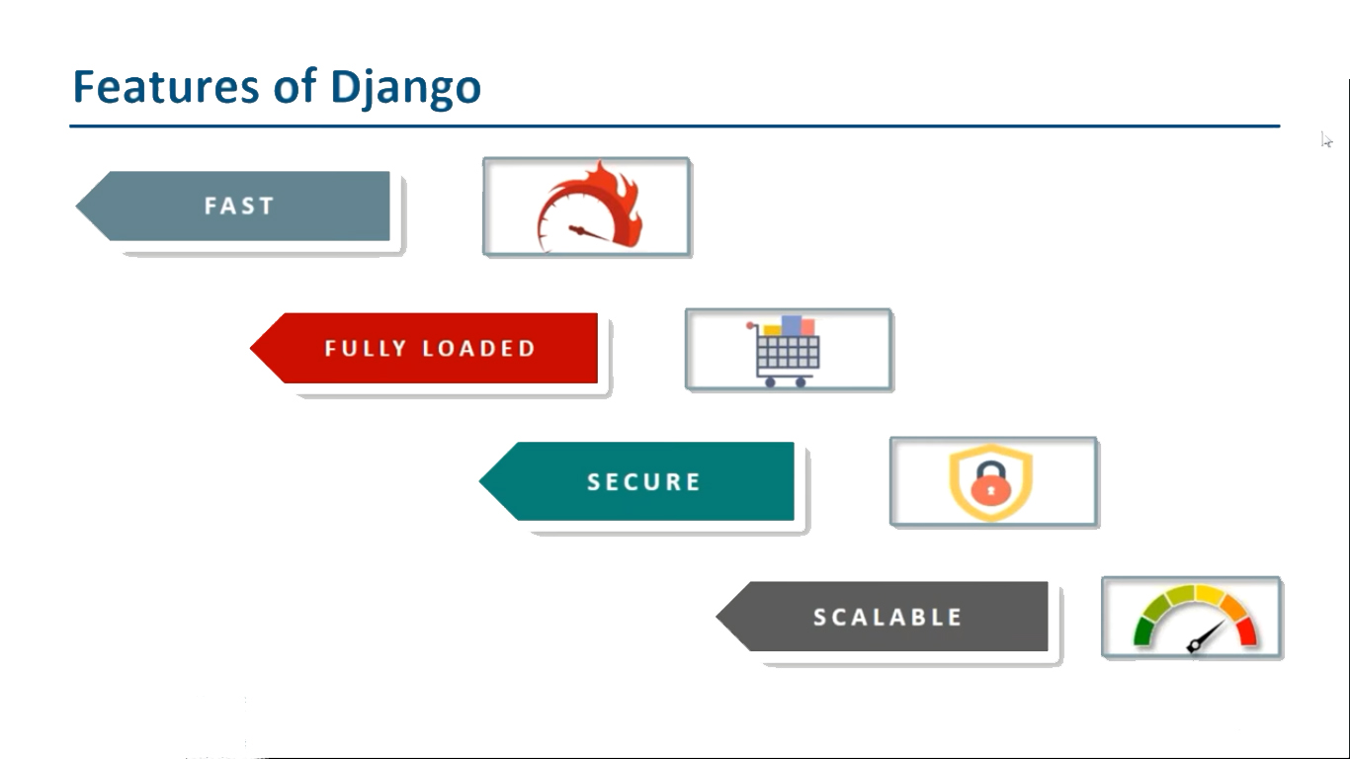

Slide 7
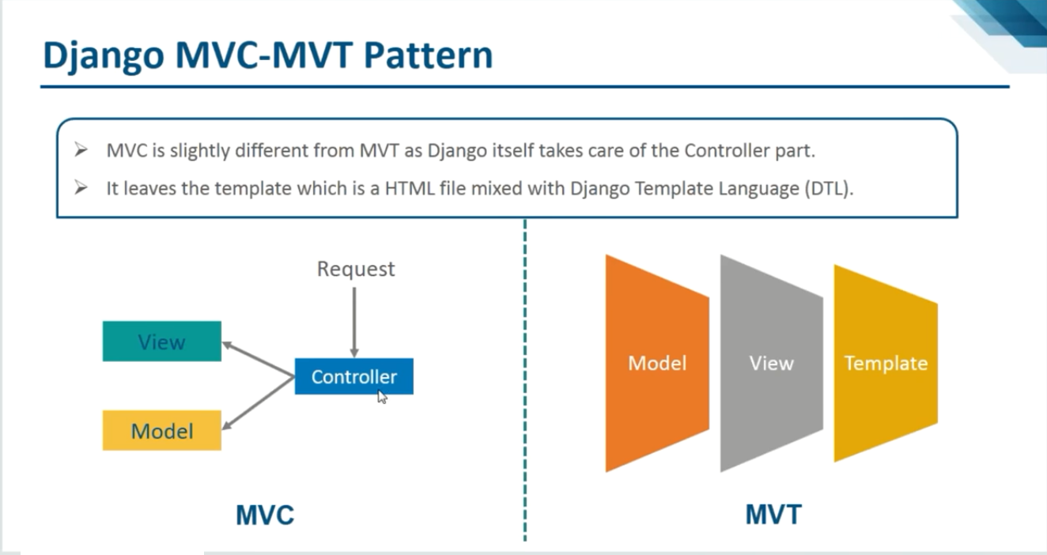

Slide 8
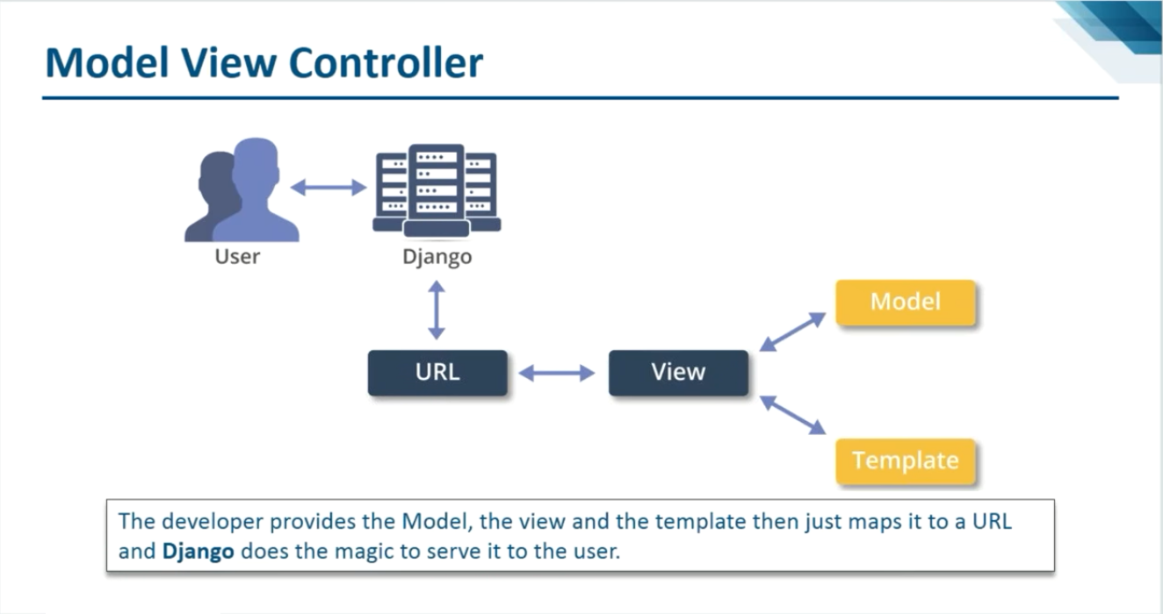

Slide 9
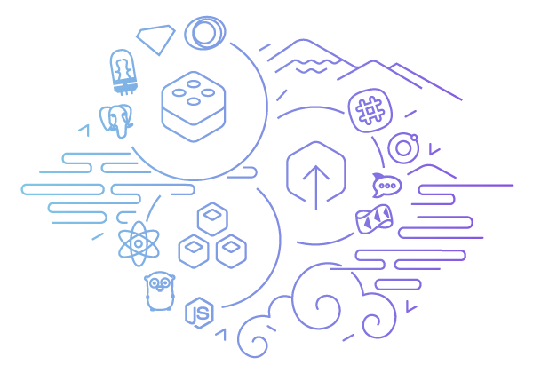
Installation & Version Check :
Installation :
pip install django
Check Version :
django-admin --version

Slide 10

Technologies Used :
HTML
Django
CSS
SQLite3
JS
Admin Auth
Bootstrap
Django Auth
jQuery
Flash Msgs & …

Slide 11
Let’s Get Started…

Slide 12
Create a new project :
python manage.py startproject projectname
Move into that project.

Slide 13
Create a new app :
python manage.py startapp appname
Add app name into settings.py in installed apps
Create templates folder in users app
> users/templates/users

Slide 14
URL mapping:
Urls Mapping to the main urls.py will be done by two ways
By including them “from django.urls import path,include”
path('app/', include('app.urls')),
By importing views from the app the app we created,
“from .app import views as v1“
path('home/', v1.home, name="home"),

Slide 15
Interfacing between controller:
(main) urls.py → (app ) urls.py → views.py → templates(html files)
Here controller is views.py we need to link-up project urls and app urls to the views and to the html files this will follows above pattern

Slide 16
HTTP Request and Responses:
Http Request:
Get (request from url)
Post(request from html)
Http Responses:
Based on request it responds
from django.http import HttpResponse
return HttpResponse(“Welcome to Django”)

Slide 17
Working with 1st project:
Create a new project by using cmd prompt
django-admin startproject myproject (myproject is project name)
Now create an app by moving in project directory
python manage.py startapp myapp (myapp is app name)
Register that app in settings.py
Now make all url mappings and then design whatever you want by editing views.py creating html files
Once all the requirements are satisfied open command prompt and run the project by using
python manage.py runserver

Slide 18

Thank you
Slides created, maintained and distributed by Web development Team - Andhra Pradesh State Skill Development Corporation (All these Slides are open source)

