Slide 1
TUPLES

Slide 2
Agenda
Introduction
Creating a tuple
Accessing Elements in a tuple
Packing and unpacking
Comparing tuples
Using tuples as keys in dictionary
Deleting tuples
Python Tuple methods
Built-in functions with Tuple
Advantages of tuple over list

Slide 3
Introduction
A tuple is just like a list of a sequence of immutable python objects.
The difference between list and tuple is that list are declared in square brackets and can be changed while tuple is declared in parentheses and cannot be changed.
However, you can take portions of existing tuples to make new tuples.

Slide 4
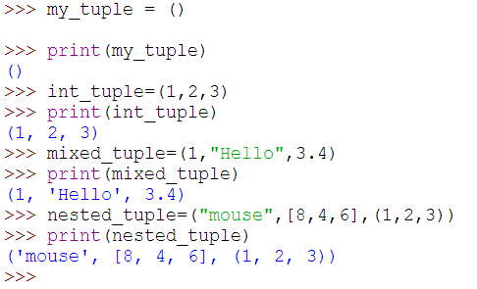

Creating a Tuple
A tuple is created by placing all the items (elements) inside a parentheses (), separated by comma. The parentheses are optional but is a good practice to write it.
A tuple can have any number of items and they may be of different types (integer, float, list, string etc.).

Slide 5
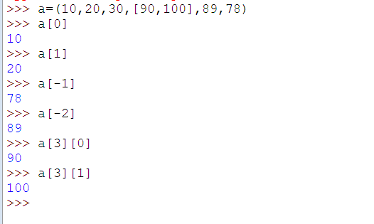
Accessing Elements in a Tuple
Forward and backward Indexing:We can use the index operator [] to access an item in a tuple where the forward index starts from 0 and backward index starts from -1 ,-2 and so on

Slide 6
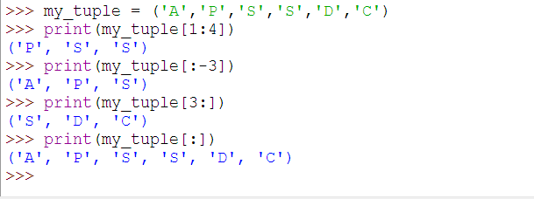
Accessing Elements in a Tuple
Slicing:We can access a range of items in a tuple by using the slicing operator - colon ":”

Slide 7
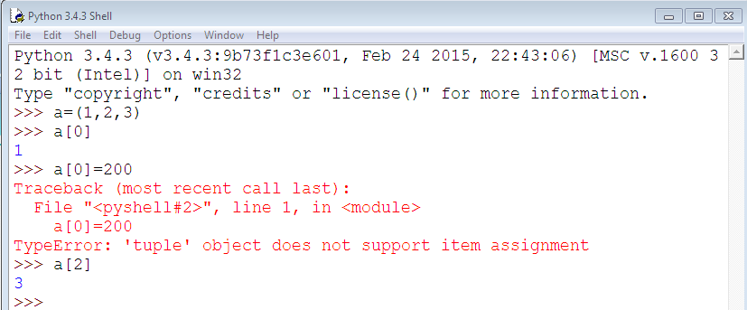
Continue….
Tuples are immutable; you can't change which variables they contain after construction. However, you can concatenate or slice them to form new tuples:

Slide 8
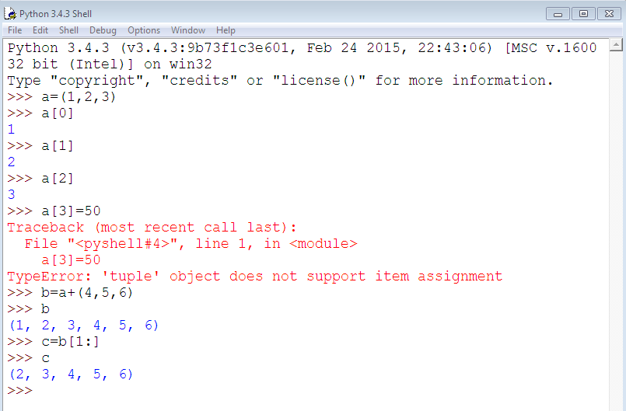
Continue…

Slide 9
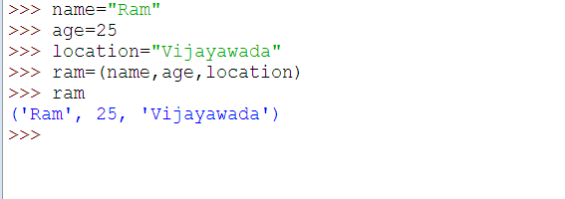
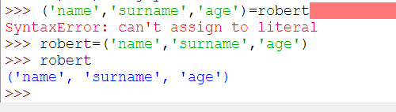
Continue….
Python has tuple assignment feature which enables you to assign more than one variable at a time.

Slide 10
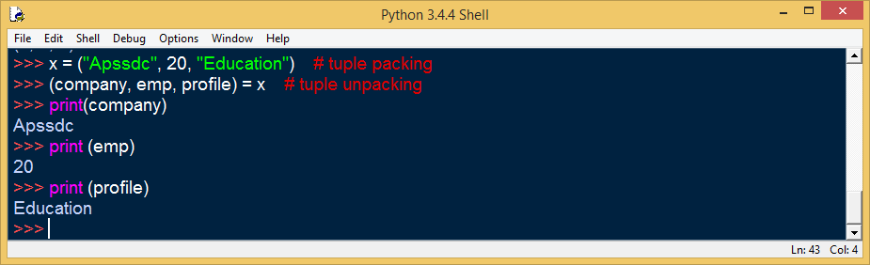
Packing and Unpacking
In packing, we place value into a new tuple while in unpacking we extract those values back into variables

Slide 11
Comparing Tuples
A comparison operator in Python can work with tuples.
The comparison starts with a first element of each tuple. If they do not compare to =, < or > then it proceed to the second element and so on.
It starts with comparing the first element from each of the tuples

Slide 12
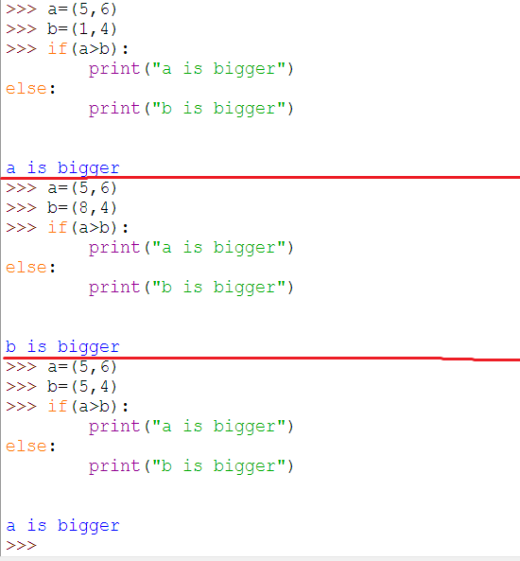
Example

Slide 13
Using Tuples as Keys in Dictionaries
Since tuples are hashable, and list is not, we must use tuple as the key if we need to create a composite key to use in a dictionary.

Slide 14
Example
suppose I have quantities of fruits of different colors, e.g., 24 blue bananas, 12 green apples, 0 blue strawberries and so on. I'd like to organize them in a data structure in Python that allows for easy selection and sorting. My idea was to put them into a dictionary with tuples as keys, e.g.,

Slide 15

Tuples and Dictionary
Dictionary can return the list of tuples by calling items, where each tuple is a key value pair.

Slide 16
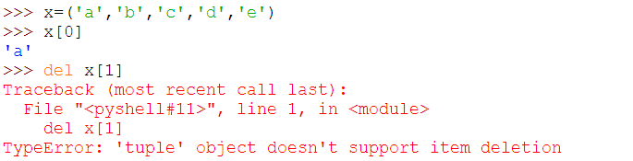
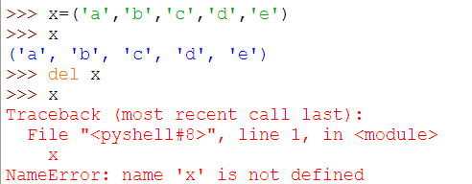
Deleting Tuples
Tuples are immutable and cannot be deleted, but deleting tuple entirely is possible by using the keyword "del."

Slide 17
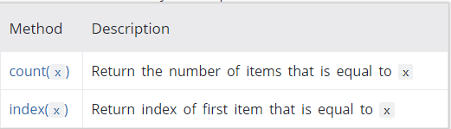
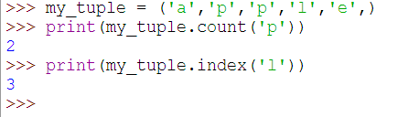
Python Tuple Methods
Methods that add items or remove items are not available with tuple. Only the following two methods are available.

Slide 18
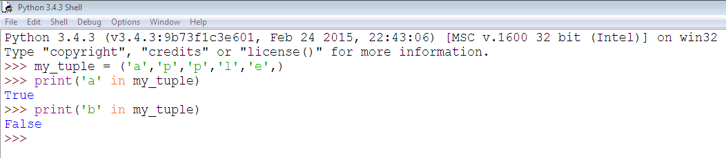
Tuple Membership Test
We can test if an item exists in a tuple or not, using the keyword “in”

Slide 19
Built in Functions with Tuples
To perform different task, tuple allows you to use many built-in functions like all (), any (), enumerate (), max (), min (), sorted (), len (), tuple (), etc

Slide 20
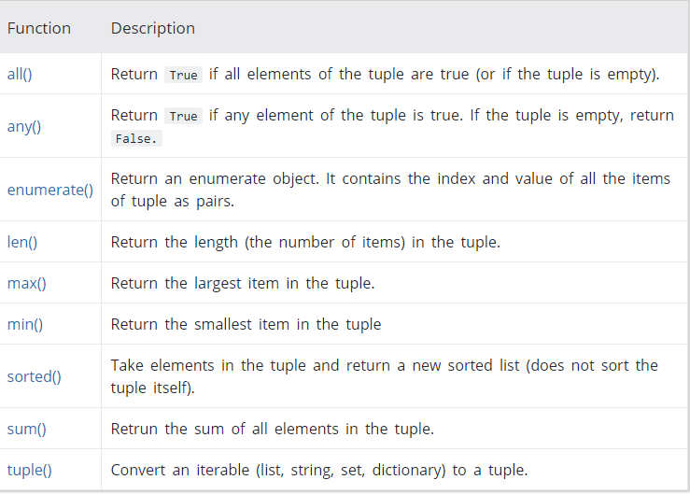
Built in Functions with Tuples

Slide 21
Advantages of tuple over list
Iterating through tuple is faster than with list, since tuples are immutable.
Tuples that consist of immutable elements can be used as key for dictionary, which is not possible with list
If you have data that is immutable, implementing it as tuple will guarantee that it remains write-protected

