Slide 1
VARIABLES, EXPRESSIONS AND STATEMENTS

Slide 2
Agenda
What is variable, How to declare and use a variable
Re-declare a variable
Concatenate variable
Delete a variable
Global and local variable
Keywords,statements,Expressions
Python Operators
Identifiers
Literals

Slide 3
Variable
Variables are nothing but reserved memory locations to store values. This means that when you create a variable you reserve some space in memory.
Based on the data type of a variable, the interpreter allocates memory and decides what can be stored in the reserved memory

Slide 4
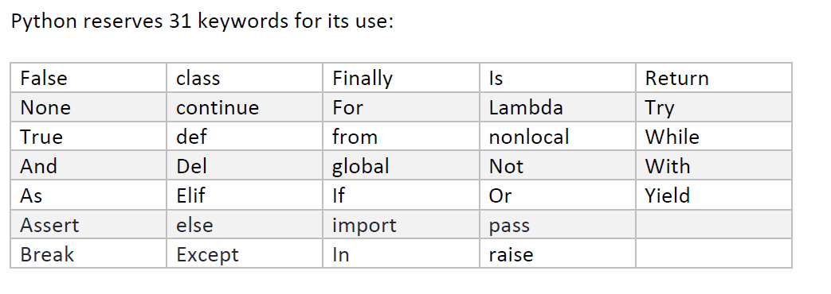
Variables and Keywords
Variables names can start with letters or underscore , but not with numbers.
Keywords cannot be used as variables

Slide 5
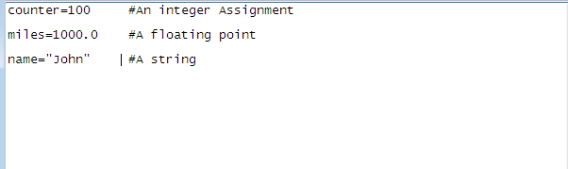
Assigning Values to Variables
The declaration happens automatically when you assign a value to a variable. The equal sign (=) is used to assign values to variables

Slide 6
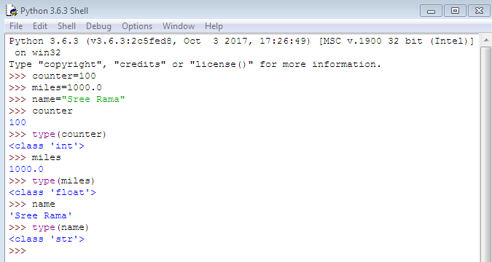
Type of a variable

Slide 7
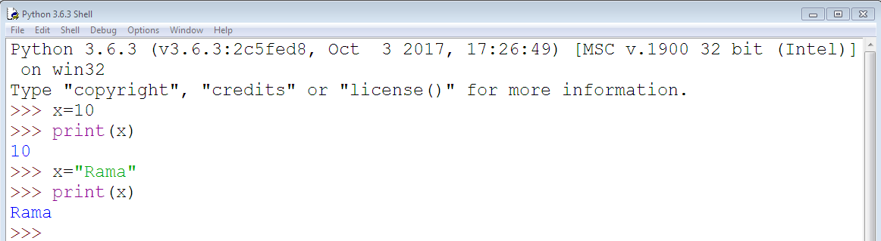
Re-declare a variable
You can re-declare the variable even after you have declared it once.

Slide 8
Concatenate Variable
Let's see whether you can concatenate different data types like string and number together
For example, we will concatenate “Focus" with number “40".
Unlike Java, which concatenates number with string without declaring number as string, Python requires declaring the number as string otherwise it will show a TypeError

Slide 9
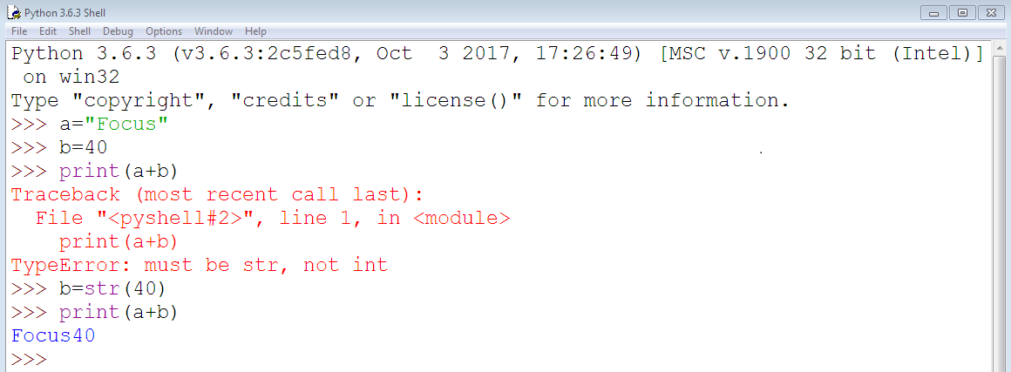
Example

Slide 10
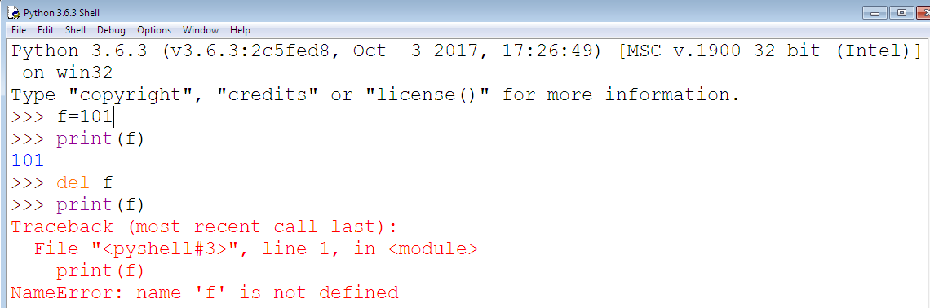
Delete a variable
You can also delete variable using the command del "variable name"

Slide 11
Global and Local Variable
Global Variable:- when you want to use the same variable for rest of your program or module you declare it global variable
Local Variable:- while if you want to use the variable in a specific function or method you use local variable.

Slide 12
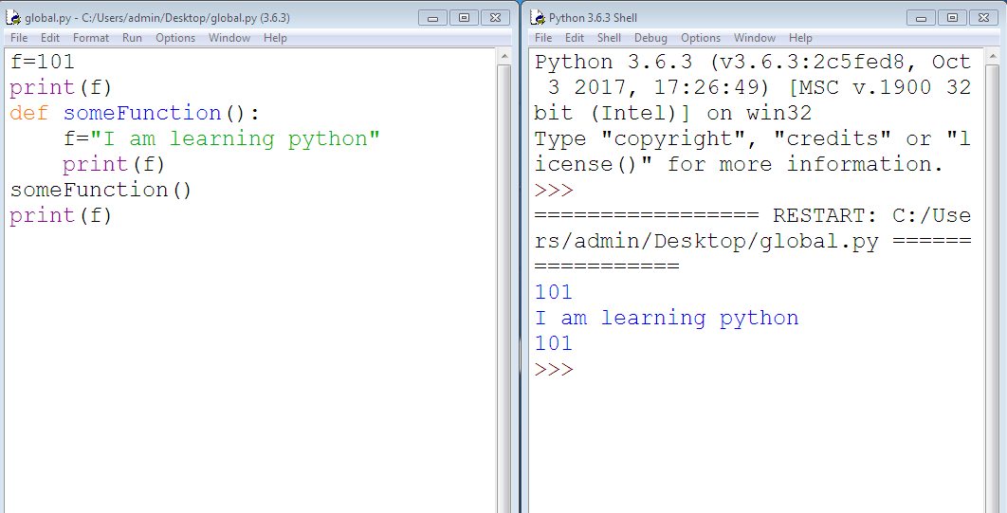
Example

Slide 13
Explanation
Variable "f" is global in scope and is assigned value 101 which is printed in output
Variable f is again declared in function and assumes local scope. It is assigned value "I am learning Python." which is printed out as an output. This variable is different from the global variable "f" define earlier
Once the function call is over, the local variable f is destroyed. At line 12, when we again, print the value of "f" is it displays the value of global variable f=101

Slide 14
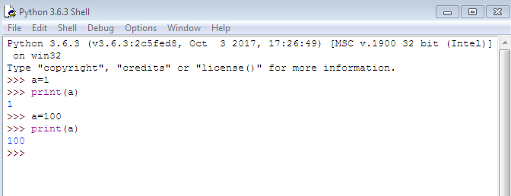
Statements
A statement is an instruction that the Python interpreter can execute. We have seen two kinds of statements: print and assignment

Slide 15
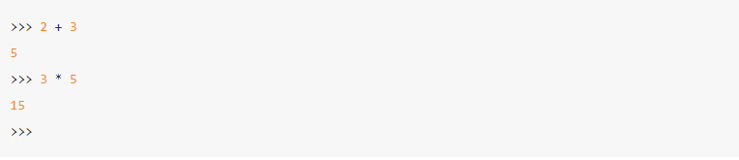
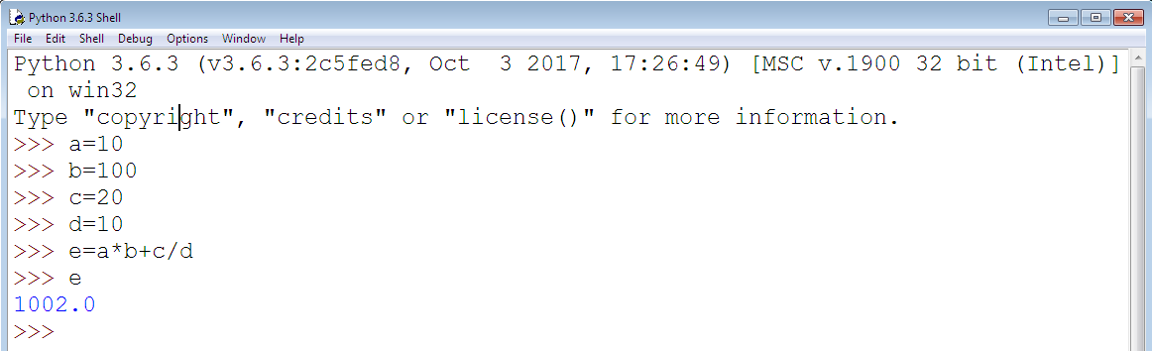
Expressions
An expression is a combination of values, variables, and operators

Slide 16
Operators and operands
Operators are special symbols that represent computations like addition and multiplication etc
The values the operator uses are called operands.
Example: C=A+B
The operators +, -, *, / and ** perform addition, subtraction, multiplication, division and exponentiation
Here A ,B, C are Operands

Slide 17
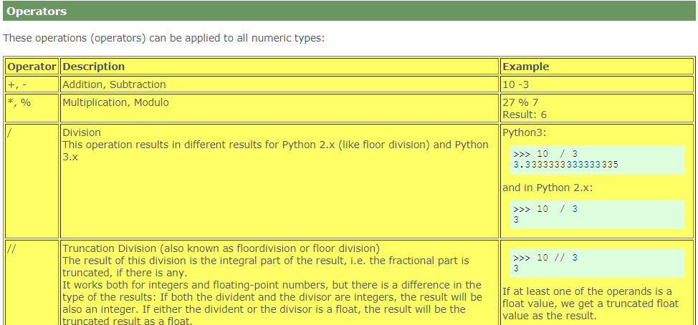
Operators

Slide 18
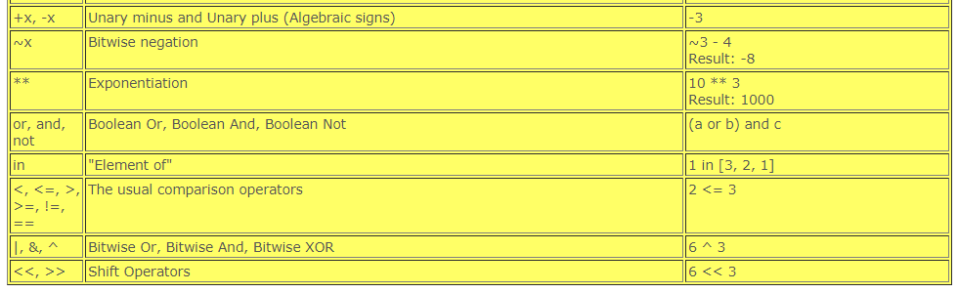
Continue…

Slide 19
Order of precedence
When more than one operator appears in an expression, the order of evaluation depends on the rules of precedence. For mathematical operators, Python follows mathematical convention. The acronym PEMDAS is a useful way to remember the rules:
Paranthesis, Exponentiation,Multiplication,Division, Addition,Subtraction

Slide 20
Identifiers
Identifier is the name given to entities like class, functions, variables etc. in Python.
It helps differentiating one entity from another.

Slide 21
Rules For writing Identifiers
Identifiers can be a combination of letters in lowercase (a to z) or uppercase (A to Z) or digits (0 to 9) or an underscore (_). Names like myClass, var_1 and print_this_to_screen, all are valid example.
An identifier cannot start with a digit. 1 Variable is invalid, but variable1 is perfectly fine.
Keywords cannot be used as identifiers.
We cannot use special symbols like !, @, #, $, % etc. in our identifier.

Slide 22
Python Literals
Literals can be defined as a data that is given in a variable or constant
String literals:String literals can be formed by enclosing a text in the quotes. We can use both single as well as double quotes for a String.
Eg:"Aman" , '12345‘
Numeric literals:Numeric Literals are immutable.

Slide 23
Types of Strings
There are two types of Strings supported in Python:
a)Single line String- Strings that are terminated within a single line are known as Single line Strings.
Ex: a=’apssdc’
b)Multi line String- A piece of text that is spread along multiple lines is known as Multiple line String.

Slide 24
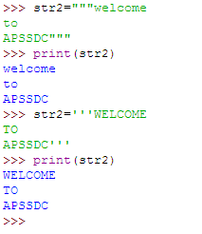
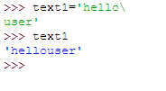
Continue…
There are two ways to create Multiline Strings:
1) Adding black slash at the end of each line
2)Using triple quotation marks

Slide 25
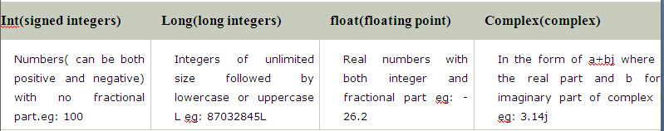
Numeric literals
Numeric Literals are immutable. Numeric literals can belong to following four different numerical types.

Slide 26
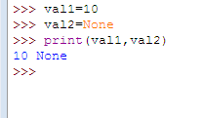
Boolean and Special literals
Boolean literals:A Boolean literal can have any of the two values: True or False
Special literals:Python contains one special literal i.e., None.None is used to specify to that field that is not created. It is also used for end of lists in Python.

Slide 27
Literal Collections
Literal Collections:Collections such as tuples, lists and Dictionary are used in Python.
List:List contain items of different data types. Lists are mutable i.e., modifiable.
Tuple: A tuple is a sequence of immutable python objects
Dictionary: Python dictionary is an unordered collection of items. While other compound data types have only value as an element, a dictionary has a key: value pair.

Slide 28
Lists
List contain items of different data types. Lists are mutable i.e., modifiable.
The values stored in List are separated by commas(,) and enclosed within a square brackets([]). We can store different type of data in a List.
Value stored in a List can be retrieved using the slice operator([] and [:]).
The plus sign (+) is the list concatenation and asterisk(*) is the repetition operator.

Slide 29
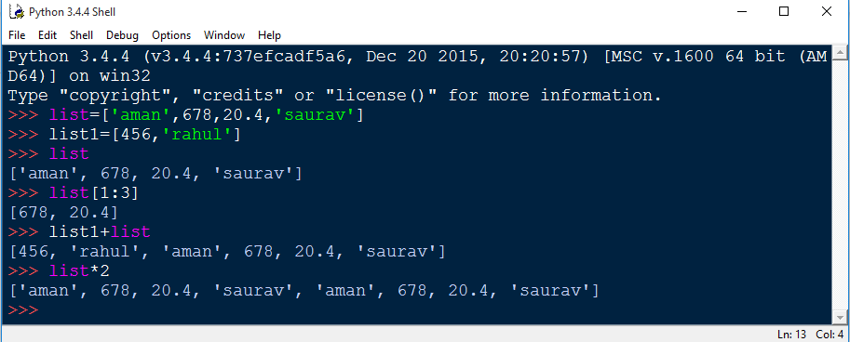
Continue…

Slide 30
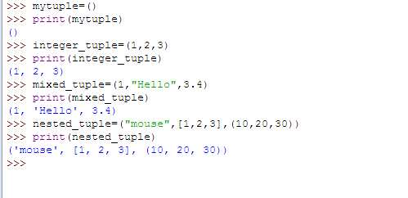
Tuple
A tuple is a sequence of immutable python objects

Slide 31
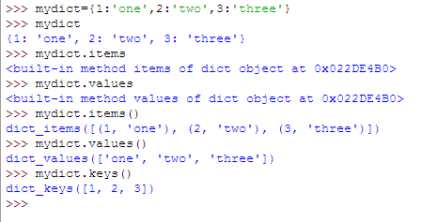
Dictionaries
Python dictionary is an unordered collection of items.

Slide 32
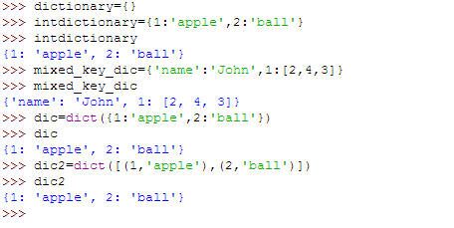
Continue…..

