Slide 1
FUNCTIONS

Slide 2
Agenda
What is Function and types of functions
Call a function
Significance of indentation
How to function return a value
Arguments in functions

Slide 3
Functions
In Python, function is a group of related statements that perform a specific task.
Functions help break our program into smaller and modular chunks. As our program grows larger and larger, functions make it more organized and manageable

Slide 4
Types of functions
Built-in Functions:The Python interpreter has a number of functions that are always available for use. These functions are called built-in functions.
example: print() function prints the given object to the standard output device (screen) or to the text stream file
User defined Functions:Functions that we define ourselves to do certain specific task are referred as user-defined functions.

Slide 5
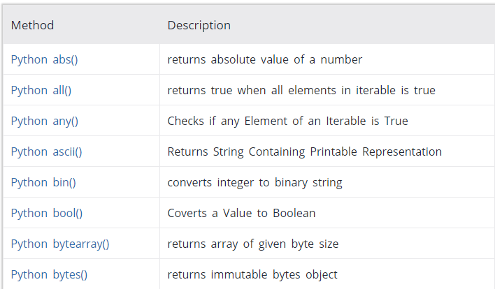
Some Built in Functions

Slide 6
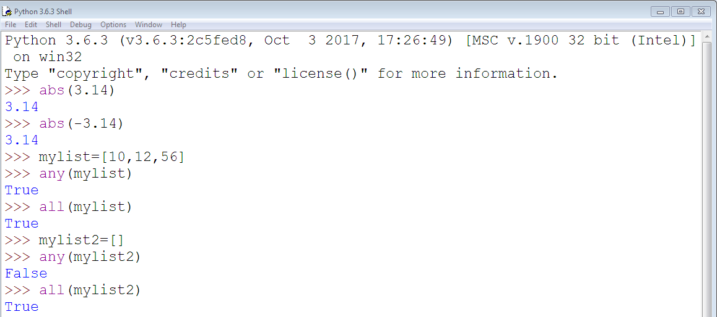
Continue….

Slide 7
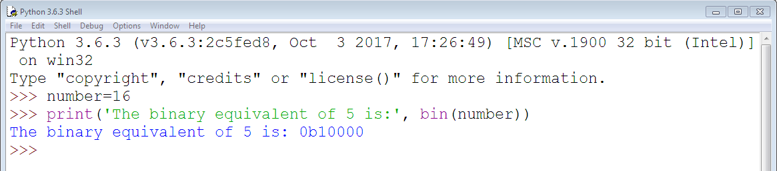
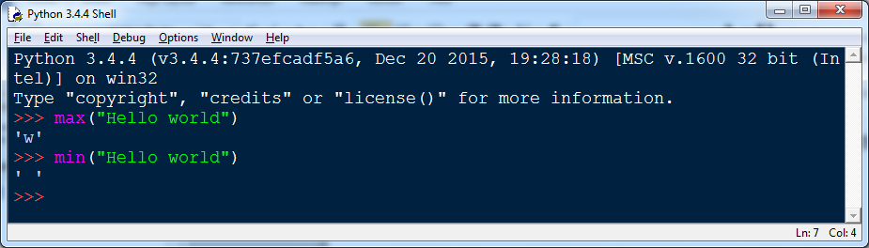
Continue…

Slide 8
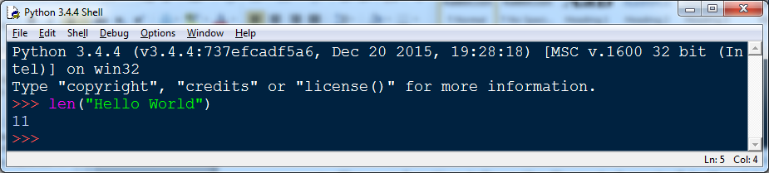
Continue….
len:Return the length (the number of items) of an object. The argument may be a sequence (such as a string, bytes, tuple, list, or range) or a collection (such as a dictionary, set, or frozen set).

Slide 9
Continue….
Round:Return number rounded to ndigits precision after the decimal point. If ndigits is omitted or is None, it returns the nearest integer to its input.
Sorted:Return a new sorted list from the items in iterable
Power:The pow() method returns x to the power of y
Sum:sum(iterable) sums the numeric values in an iterable such as a list, tuple, or set. sum(iterable) does not work with strings because you can't do math on strings (when you add two strings you are really using an operation called concatenation).

Slide 10
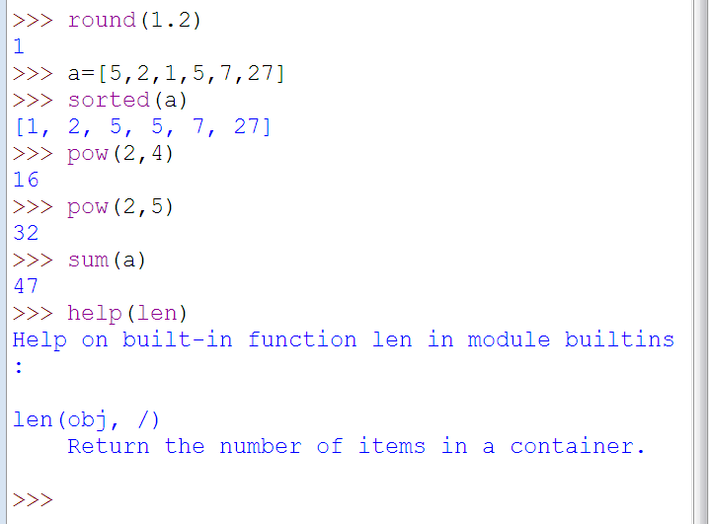
Continue…….
Help:The help() function is your new best friend. Invoke the built-in help system on any object and it will return usage information on the object.

Slide 11
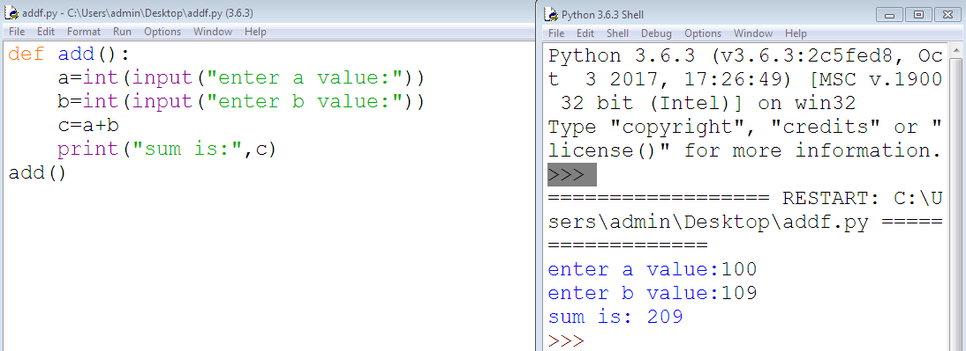
User defined Functions
Syntax:
def function_name(parameters):
statement(s)

Slide 12
Advantages of user defined functions
User-defined functions help to decompose a large program into small segments which makes program easy to understand, maintain and debug.
If repeated code occurs in a program,function can be used to include those codes and execute when needed by calling that function.
Programmars working on large project can divide the workload by making different functions.

Slide 13
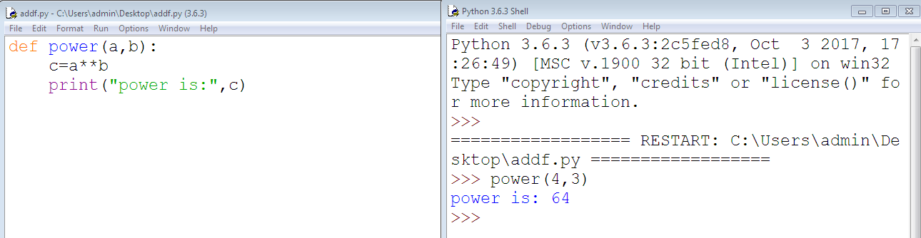
Call a function
Once we have defined a function, we can call it from another function, program or even the Python prompt.
To call a function we simply type the function name with appropriate parameters.

Slide 14
Significance of Indentation
Indentation in a writing context typically describes the space between the page border and the start of the text.
In a programming context, it describes the space between the edge of the editor and the start of the code.
Python is unusual among programming languages by having what is sometimes called "significant whitespace", Where the amount of space before the code starts affects the structure of the program.

Slide 15
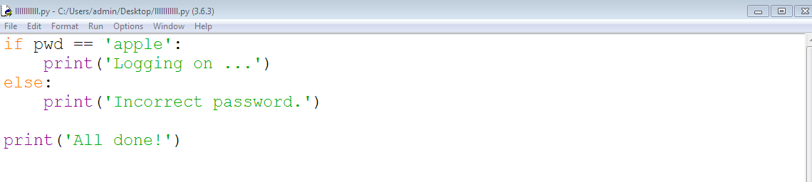
Code Blocks and Indentation
Consider the if-statement from our simple password-checking program:

Slide 16
Continue…..
The lines print('Logging on ...') and print('Incorrect password.') are two separate code blocks.
To indicate a block of code in Python, you must indent each line of the block by the same amount.
The two blocks of code in our example if-statement are both indented four spaces, which is a typical amount of indentation for Python.
In Python, it is required for indicating what block of code a statement belongs to. For instance, the final print('All done!') is not indented, and so is not part of the else-block.

Slide 17
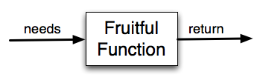
How to function return a value
Functions that return values are sometimes called fruitful functions.
In many other languages, a function that doesn’t return a value is called a procedure.
But we will stick here with the Python way of also calling it a function, or if we want to stress it, a non-fruitful function.

Slide 18
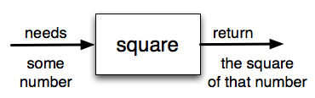
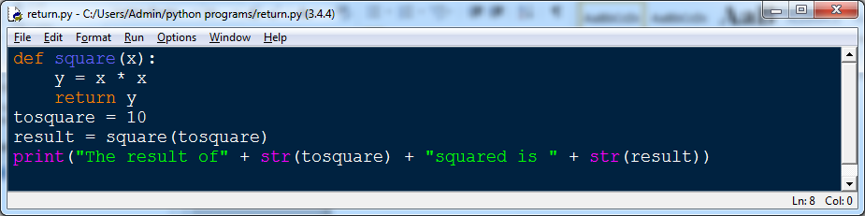
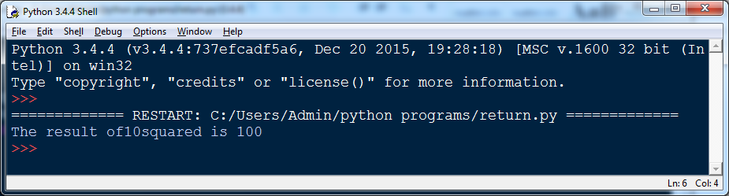
Example
The square function will take one number as a parameter and return the result of squaring that number

Slide 19
Arguments in Functions
You can call a function by using the following types of formal arguments:
1.Required arguments
2. Keyword arguments
3.Default arguments
4.Variable-length arguments

Slide 20
Required arguments
Required arguments are the arguments passed to a function in correct positional order.
Here, the number of arguments in the function call should match exactly with the function definition.
To call the function printme(), you definitely need to pass one argument, otherwise it gives a syntax error as follows

Slide 21
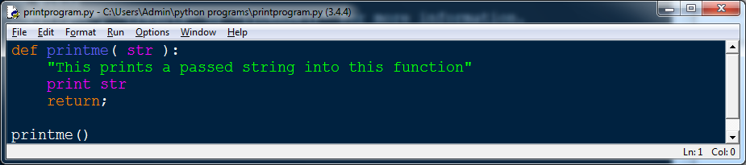
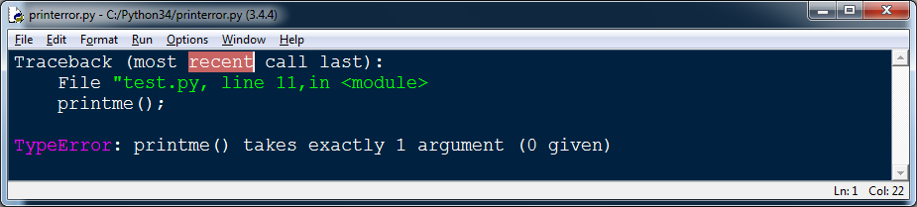
Required arguments

Slide 22
Keyword arguments
Keyword arguments are related to the function calls. When you use keyword arguments in a function call, the caller identifies the arguments by the parameter name.
This allows you to skip arguments or place them out of order because the Python interpreter is able to use the keywords provided to match the values with parameters.

Slide 23
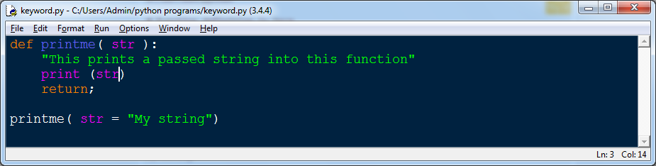
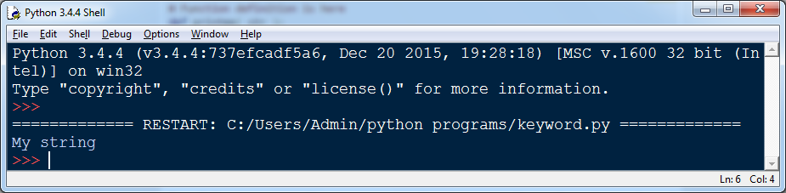
Continue….
You can also make keyword calls to the printme() function in the following ways –

Slide 24
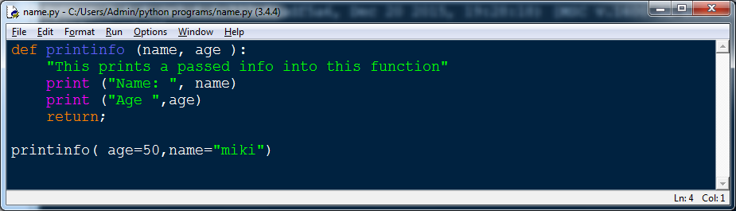
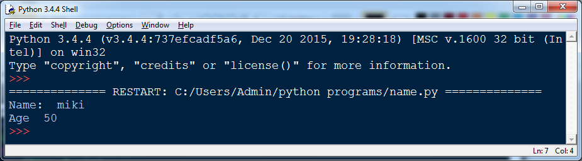
Continue…
The following example gives more clear picture. Note that the order of parameters does not matter

Slide 25
Default arguments
A default argument is an argument that assumes a default value if a value is not provided in the function call for that argument.
The following example gives an idea on default arguments, it prints default age if it is not passed

Slide 26
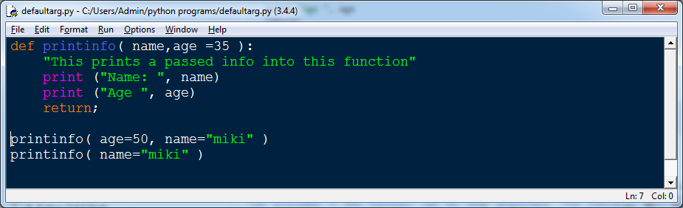
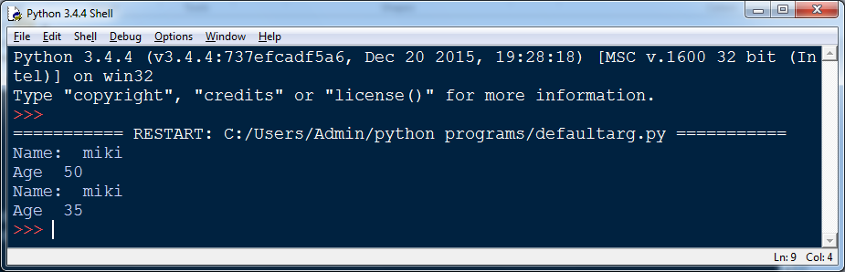
Continue…

Slide 27
Variable length arguments
You may need to process a function for more arguments than you specified while defining the function
These arguments are called variable-length arguments and are not named in the function definition,unlike required and default arguments.

Slide 28
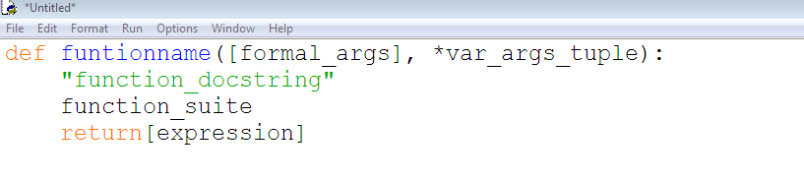
Continue….
Syntax for a function with non-keyword variable arguments
An asterisk (*) is placed before the variable name that holds the values of all no keyword variable arguments.
This tuple remains empty if no additional arguments are specified during the function call

Slide 29
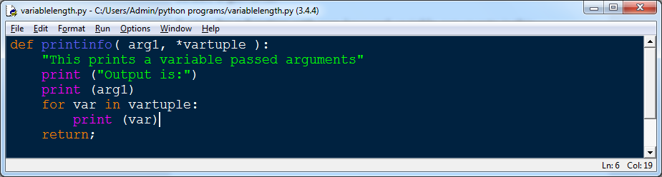
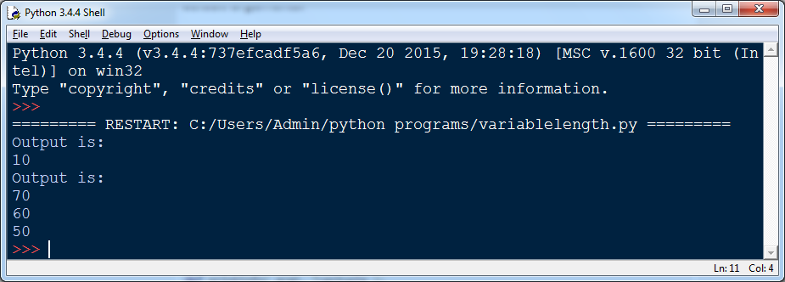
Continue…..

