Slide 1
ITERATIONS

Slide 2
Agenda
How to use “while loop, for loop”
Break and Continue statements in for loop
Enumerate function for “for loop”
Loop repeat the same statement over and again

Slide 3
Loop
A loop statement allows us to execute a statement or group of statements multiple times.
Python programming language provides following types of loops to handle looping requirements
While loop
For loop
While loop with else
Break
Continue

Slide 4
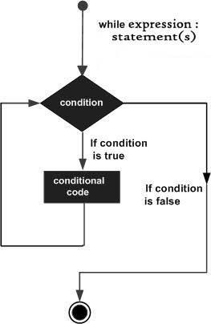
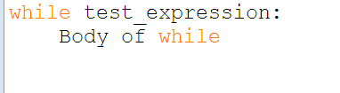
While loop
Repeats a statement or group of statements while a given condition is TRUE. It tests the condition before executing the loop body
Look at Syntax and Flowchart given below

Slide 5
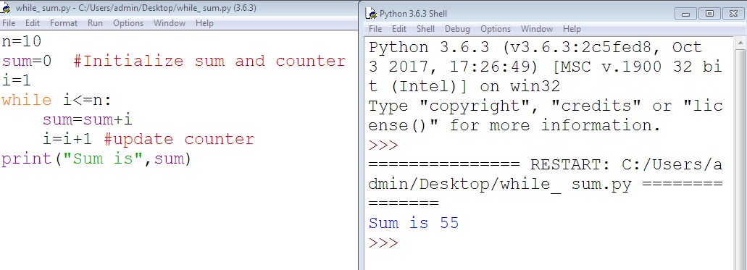
Program to print sum of 10 natural numbers using while

Slide 6
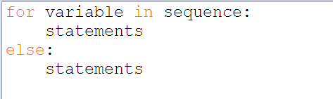
For loop
Executes a sequence of statements multiple times and abbreviates the code that manages the loop variable.
Loop continues until we reach the last item in the sequence. The body of for loop is separated from the rest of the code using indentation.
Look at syntax given below

Slide 7
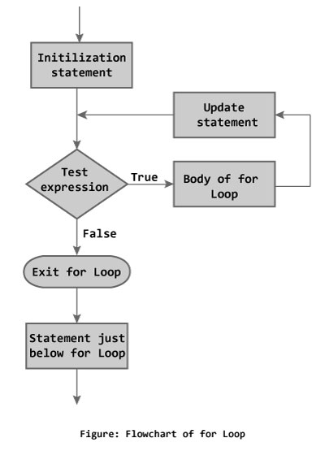
Flow chart

Slide 8
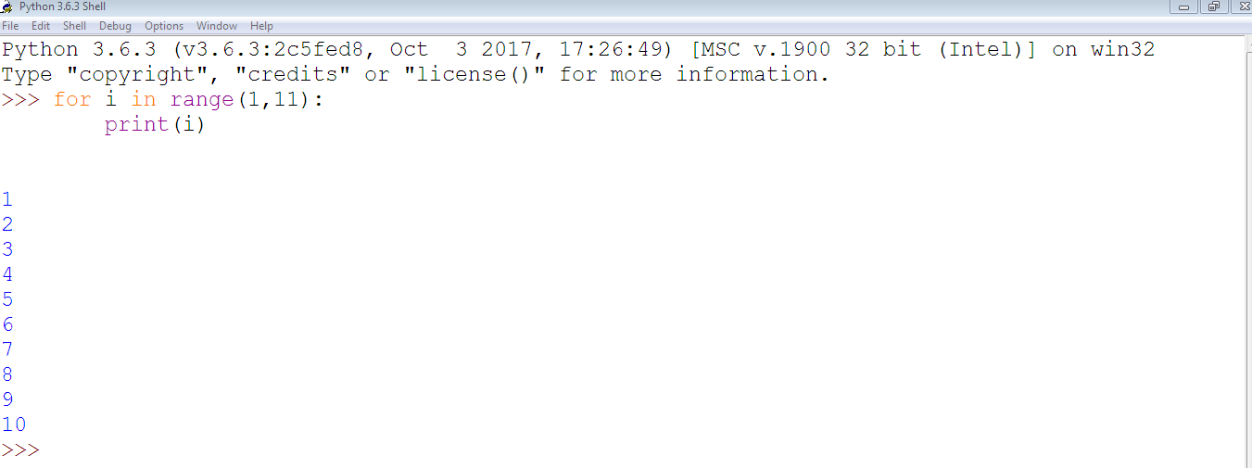
Print 1 to 10 numbers using for

Slide 9
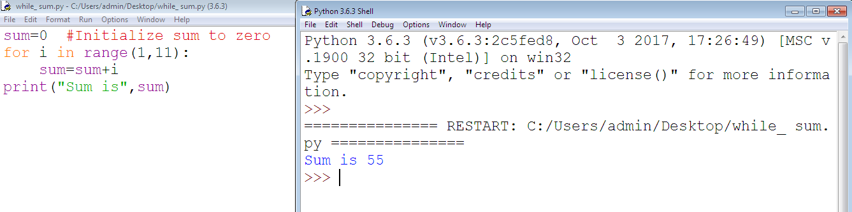
Sum of 10 numbers using for loop

Slide 10
While loop with else
Same as that of for loop, we can have an optional else block with while loop as well.
The else part is executed if the condition in the while loop evaluates to False.
The while loop can be terminated with a break statement. In such case, the else part is ignored. Hence, a while loop's else part runs if no break occurs and the condition is false.

Slide 11
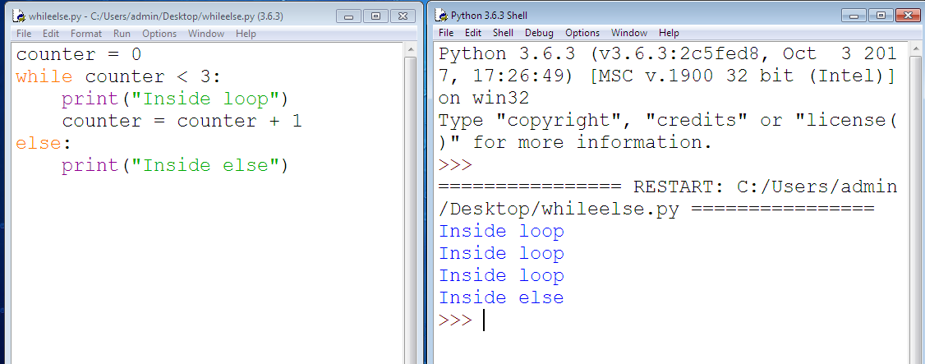
Example

Slide 12
Break Statement
The break statement terminates the loop containing it. Control of the program flows to the statement immediately after the body of the loop.
If break statement is inside a nested loop (loop inside another loop), break will terminate the innermost loop.

Slide 13
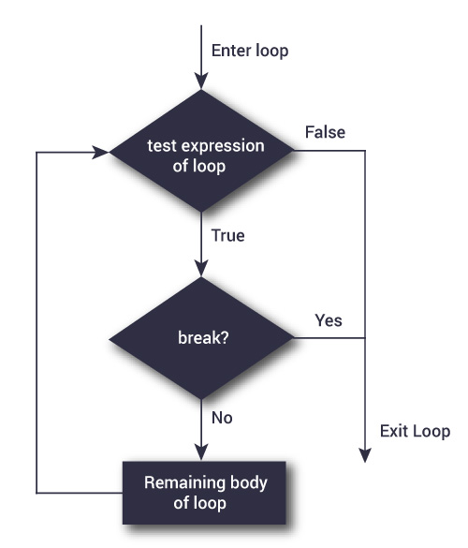
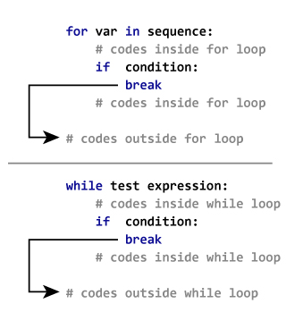
Syntax and flow chart

Slide 14
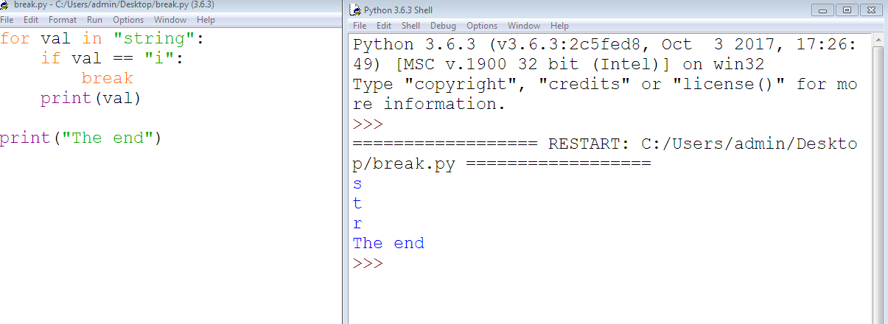
Program

Slide 15
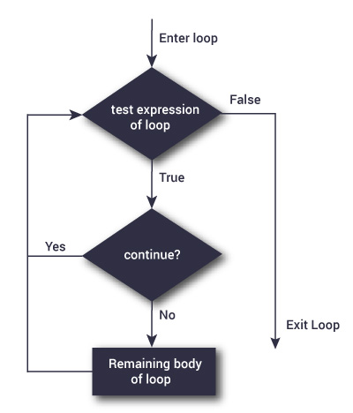
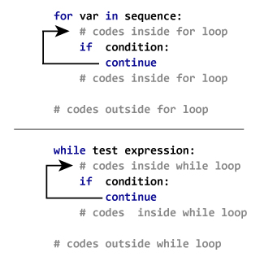
Continue statement
The continue statement is used to skip the rest of the code inside a loop for the current iteration only. Loop does not terminate but continues on with the next iteration.

Slide 16
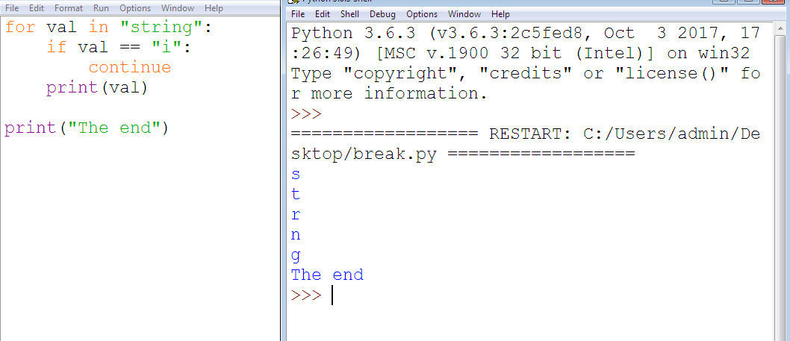
Program

Slide 17
Enumerate function for “for loop”
Python’s built-in enumerate function allows us to loop over a list and retrieve both the index and the value of each item in the list
NOTE: The enumerate function gives us an iterable where each element is a tuple that contains the index of the item and the original item value.

Slide 18
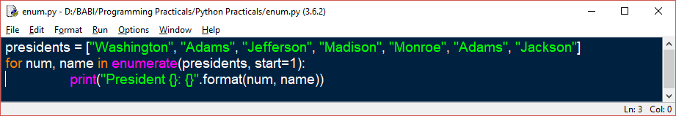
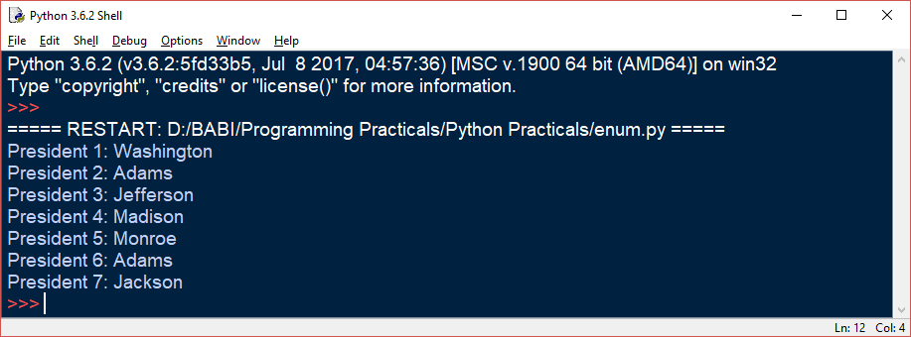
Continue…..

Slide 19
Loop repeat the same statement over and again:
A repeat loop is used to iterate over a block of code multiple number of times. There is no condition check in repeat loop to exit the loop. We must ourselves put a condition explicitly inside the body of the loop and use the break statement to exit the loop. Failing to do so will result into an infinite loop.

Slide 20
Syntax of repeat loop
repeat{
Statement
}
In the statement block, we must use the break statement to exit the loop.

Slide 21
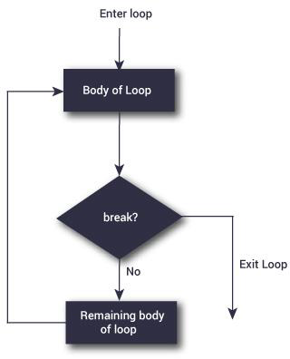
Flowchart of repeat loop:

