Slide 1
STRINGS

Slide 2
Agenda
How to create a string
Accessing values in strings
Updating Strings
How to change or delete a string?
String operations
String methods
String Formatting operators

Slide 3
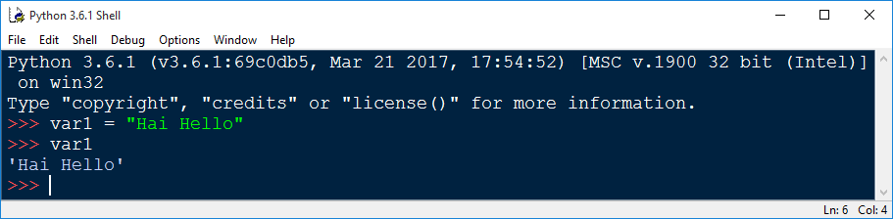
How to create a string
We can create them simply by enclosing characters in quotes.
Python treats single quotes same as double quotes.
Creating strings is as simple as assigning a value to a variable.

Slide 4
Accessing values in strings
Python does not support a character type; these are treated as strings of length one, thus also considered a substring.
To access substrings, use the square brackets for slicing along with the index or indices to obtain your substring.

Slide 5
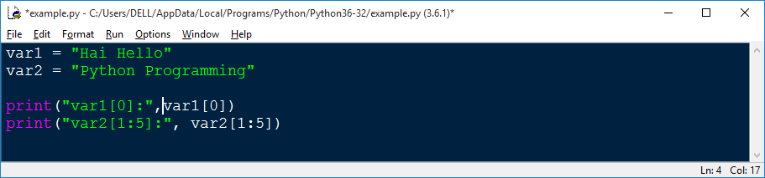
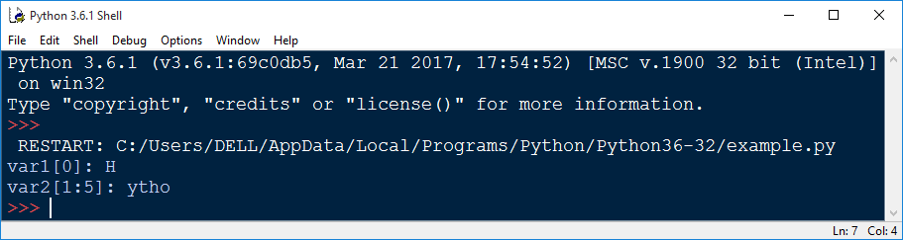
Continue…..
When the above code is executed, it produces the following result

Slide 6
Updating Strings
You can "update" an existing string by (re)assigning a variable to another string. The new value can be related to its previous value or to a completely different string altogether.

Slide 7
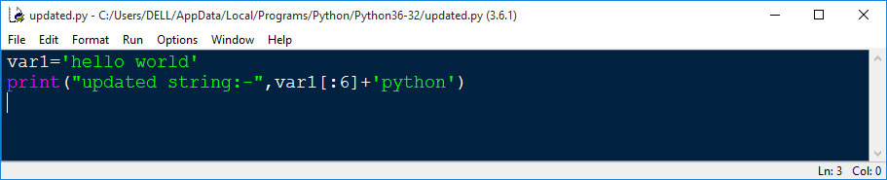
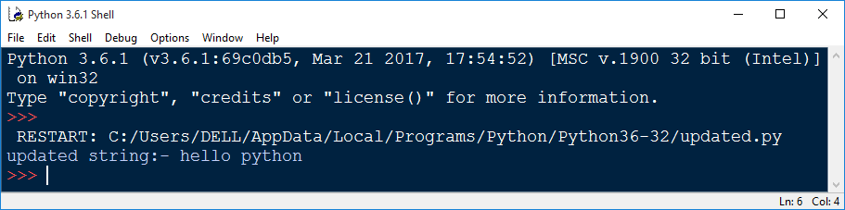
Continue….
When the above code is executed, it produces the following result

Slide 8
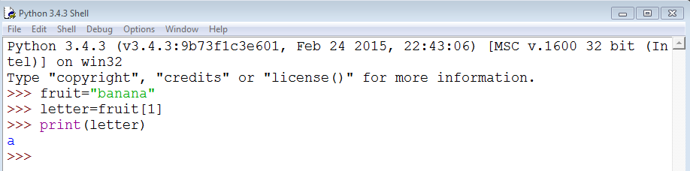
Continue….
A string is a sequence of characters. You can access the characters one at a time with the bracket operator

Slide 9
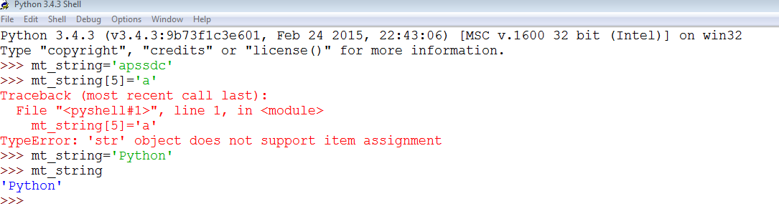
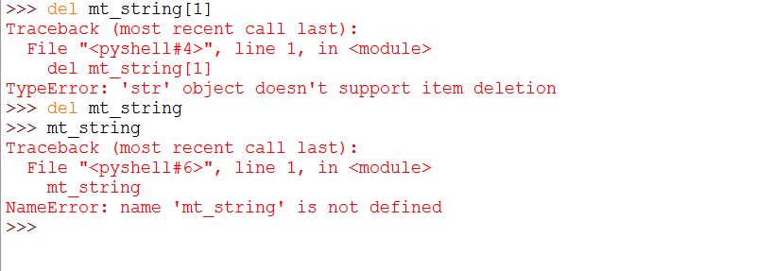
How to change or delete a string?

Slide 10
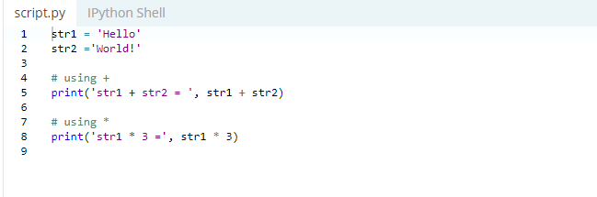

String Operations
Concatenation of Two or More Strings:Joining of two or more strings into a single one is called concatenation.
The + operator does this in Python. Simply writing two string literals together also concatenates them.
The * operator can be used to repeat the string for a given number of times.

Slide 11
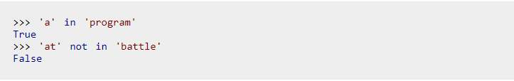
String Membership Test
We can test if a sub string exists within a string or not, using the keyword in

Slide 12
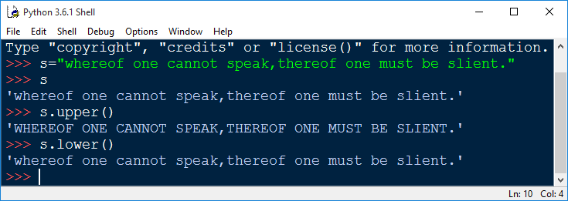
String Methods
S.lower() and S.lower(): Returns the lowercase and upper case version of the string. The .upper() and .lower() string methods are self-explanatory.
Performing the .upper() method on a string converts all of the characters to uppercase, whereas the lower() method converts all of the characters to lowercase.

Slide 13
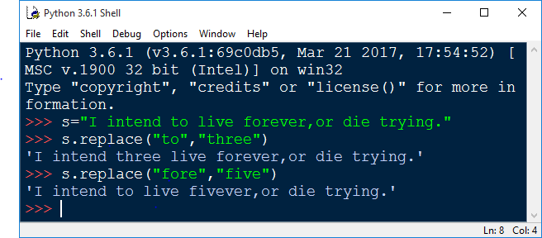
Replace
S.replace('old', 'new'): Returns a string where all occurrences of 'old' have been replaced by 'new'

Slide 14
Split
At some point, you may need to break a large string down into smaller chunks, or strings. This is the opposite of concatenation which merges or combines strings into one. To do this, you use the split function.
S.split('delim') : Split() splits or breakup a string and add the data to a string array using a defined separator.
If no separator is defined when you call upon the function, whitespace will be by default. In simpler terms, the separator is a defined character that will be placed between each variable.

Slide 15
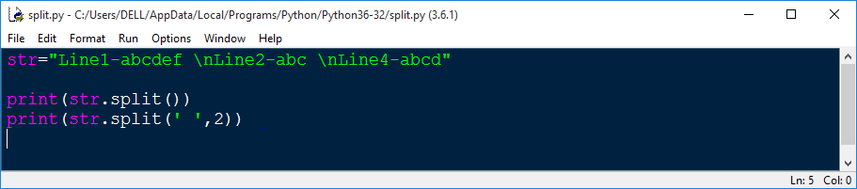
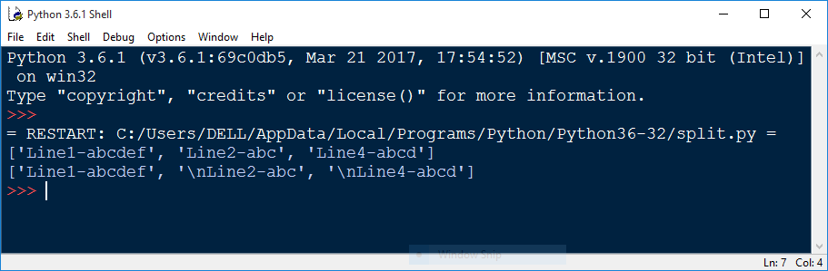
Example
When the above code is executed, it produces the following result

Slide 16

JION
s.join(list): The method join () returns a string in which the string elements of sequence have been joined by str separator. Opposite of split(),joins the elements in the given list together using the string as the delimiter.
Syntax

Slide 17
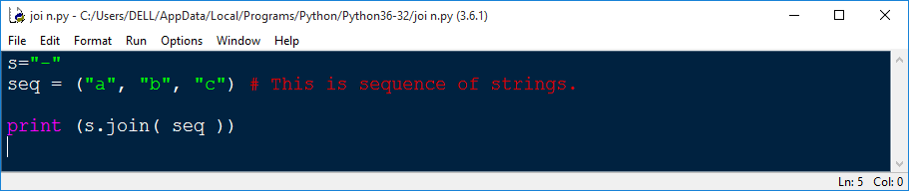
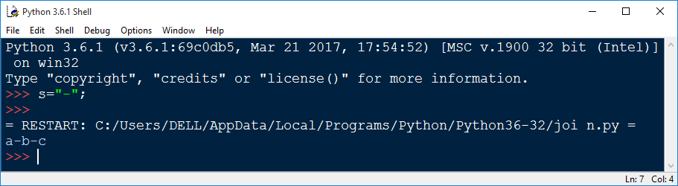
Example
When the above code is executed, it produces the following result

Slide 18

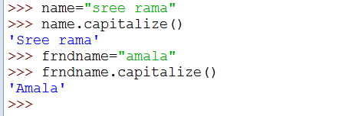
String capitalize() Method
It returns a copy of the string with only its first character capitalized.

Slide 19
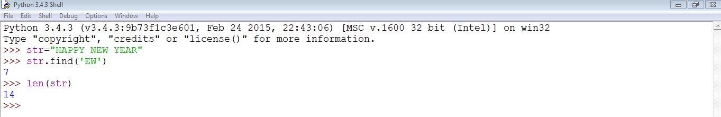
Find and len()

Slide 20
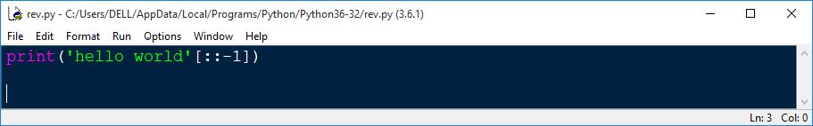
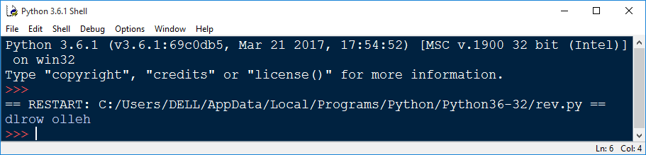
Reversing String
By using the reverse function, you can reverse the string. For example, if we have string "selenium" and then if you apply the code for the reverse function as shown below.
When the above code is executed, it produces the following result

Slide 21
String Slices
Slice Operator is used to extract part of a string or a list. The syntax is simple.
Actually it looks a little bit like accessing a single element with an index, but instead of just one number we have more, separated with a colon ":".
We have a start and an end index, one or both of them may be missing. It's best to study the mode of operation of slice by having a look at

Slide 22
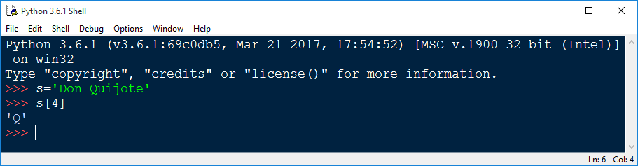
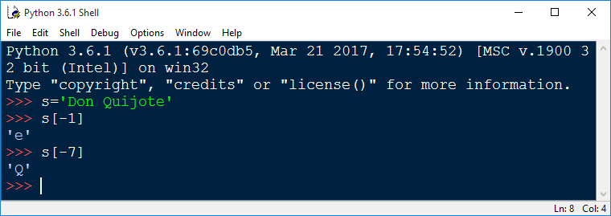
Example
If you want to start counting from the end of the string, instead of the beginning, use a negative index. For example, an index of -1 refers to the right-most character of the string

Slide 23
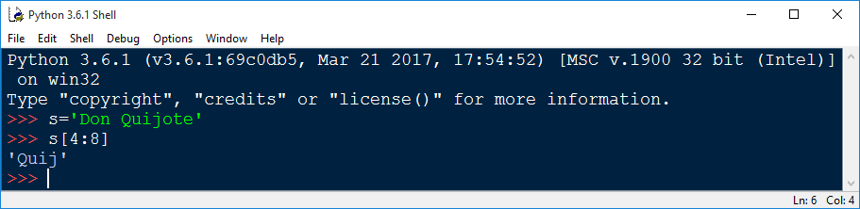
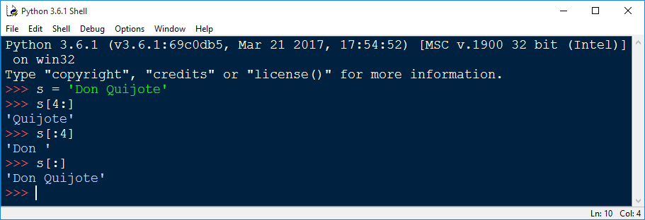
Continue…

Slide 24
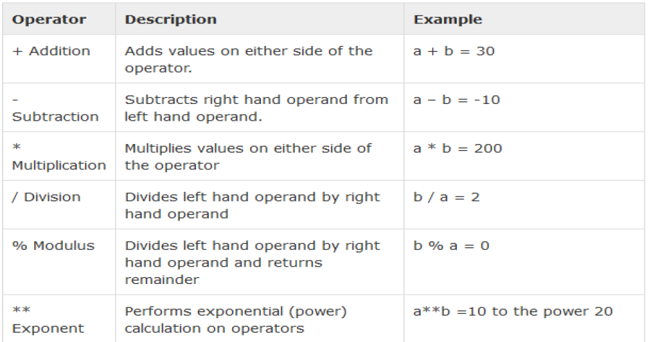
String Operators
Assume string variable a =10 and b=20, then

Slide 25
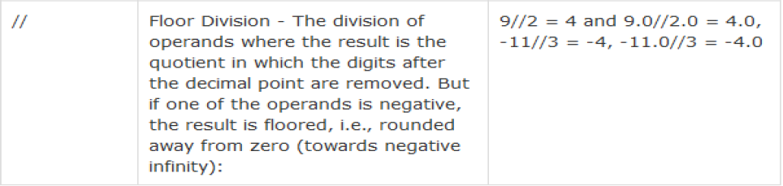
Continue…..

Slide 26
String Formatting Operator
Python uses C-style string formatting to create new, formatted strings. The "%" operator is used to format a set of variables enclosed in a "tuple" (a fixed size list), together with a format string, which contains normal text together with "argument specifiers", special symbols like "%s" and "%d"

Slide 27
