Slide 1
Perceptron

Slide 2
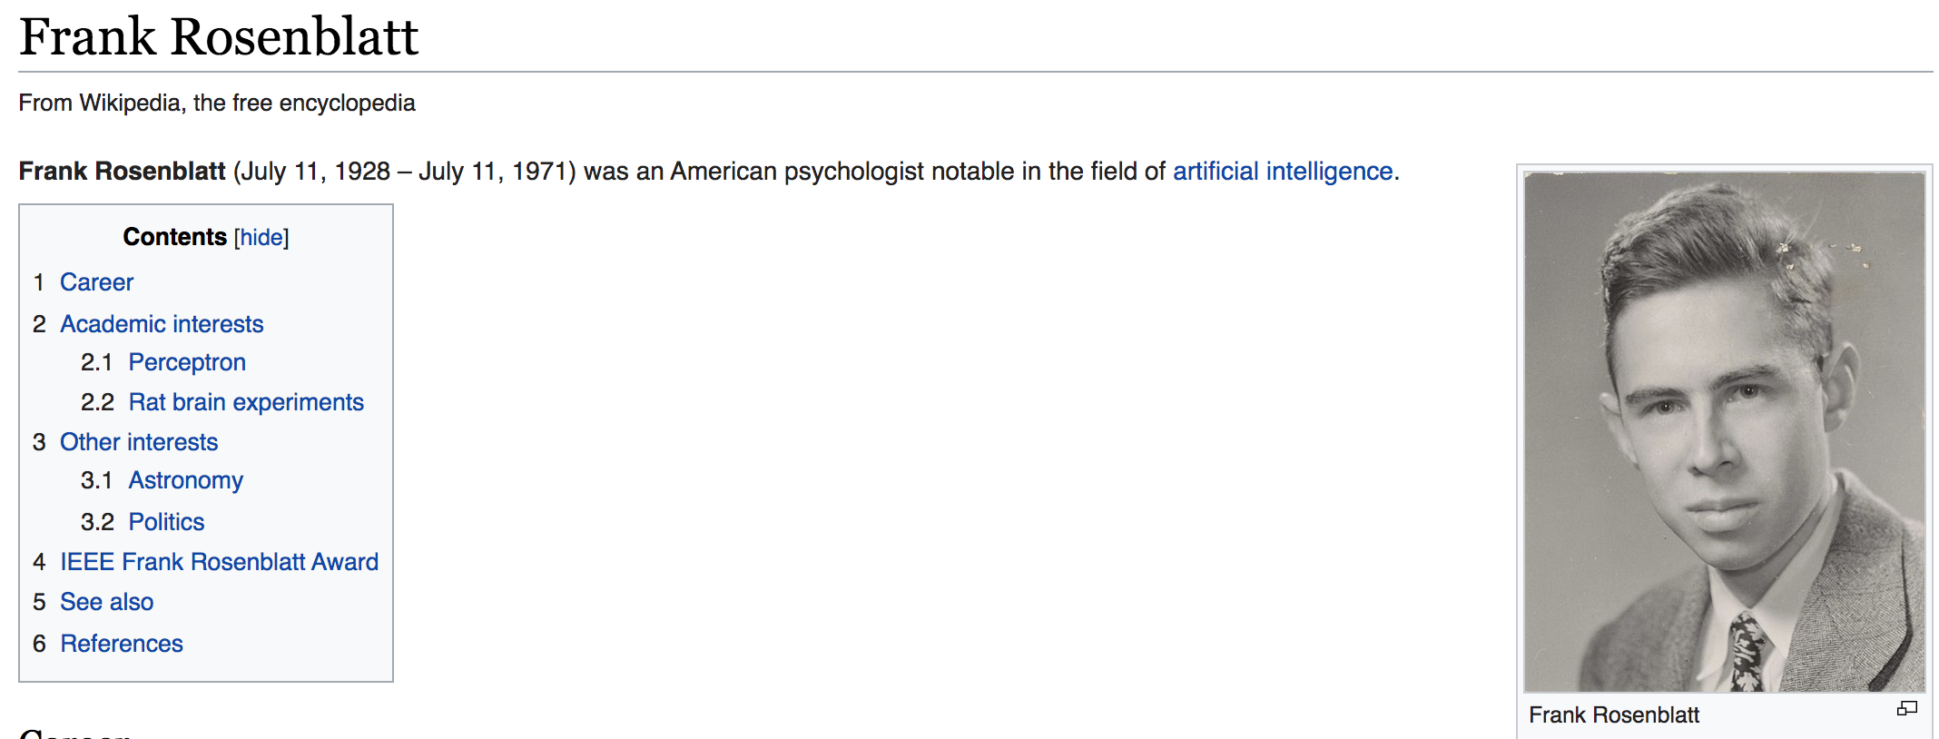
Who Invented

Slide 3
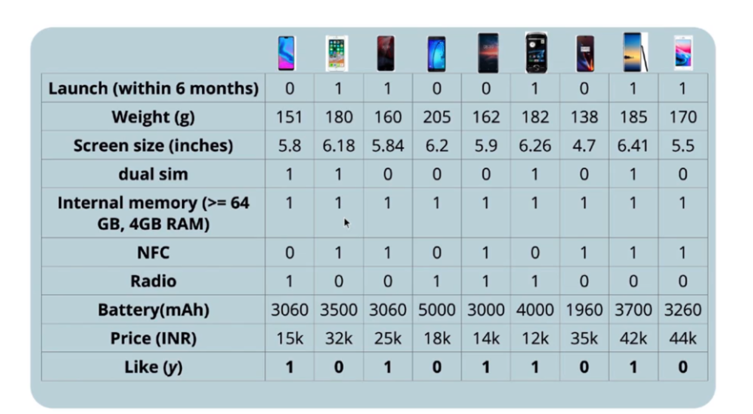
Perceptron Data
In perceptron model inputs can be real numbers unlike the boolean inputs in MP Neuron Model
Introduces the concept of weights and also a learning algorithm
The output from the model is still a Boolean Output

Slide 4
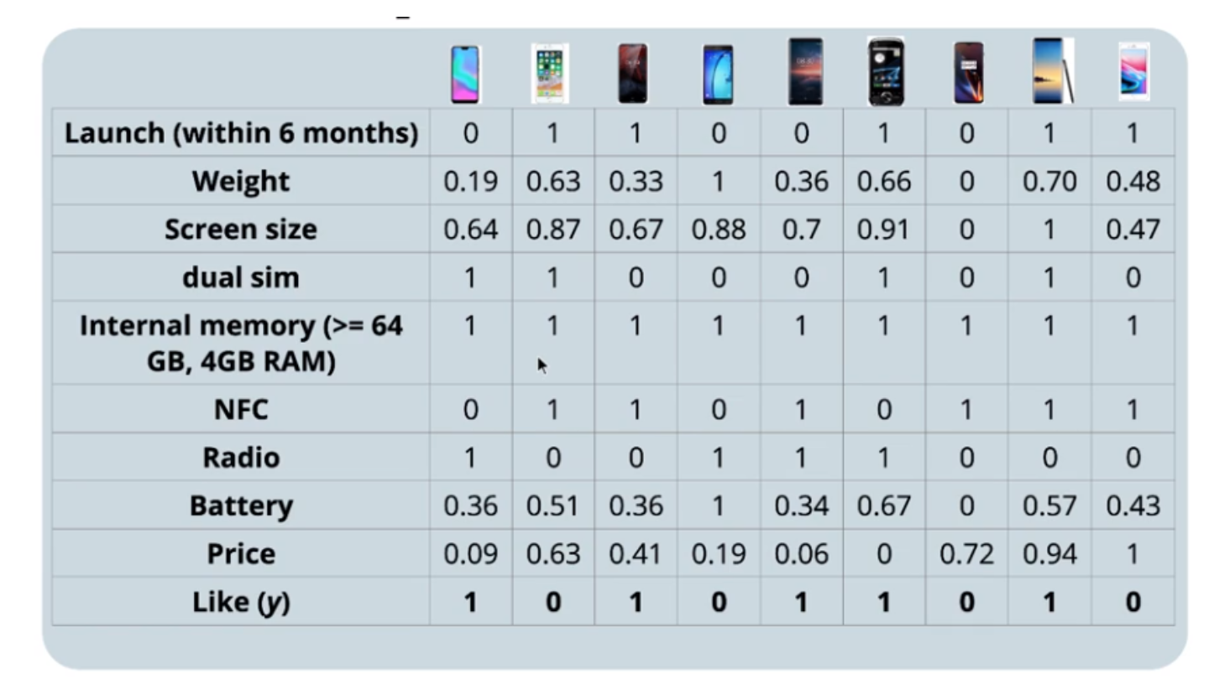

Input Data - Standardization
It is very important to have all the features present in the data to be on the same scale and so that these features will have the same importance, at least in the initial stage of iteration. In order to bring all the features to the same scale. We will perform min-max standardization to bring all the values to a range 0–1.

Slide 5
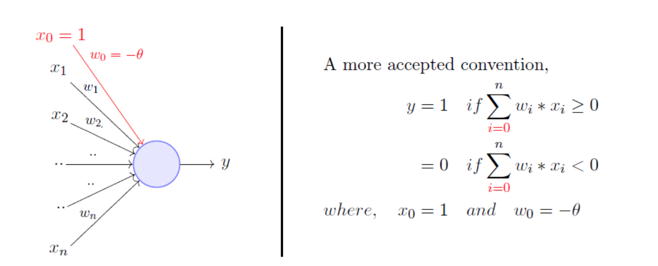
Model
The model is a function which may have multiple parameters(weights). The model works as a addition of the multiplication of input and the parameters(weights). The weights can be positive or negative based on its positive influence or negative influence towards the final prediction
Here, w_0 is called the bias because it represents the prior

Slide 6
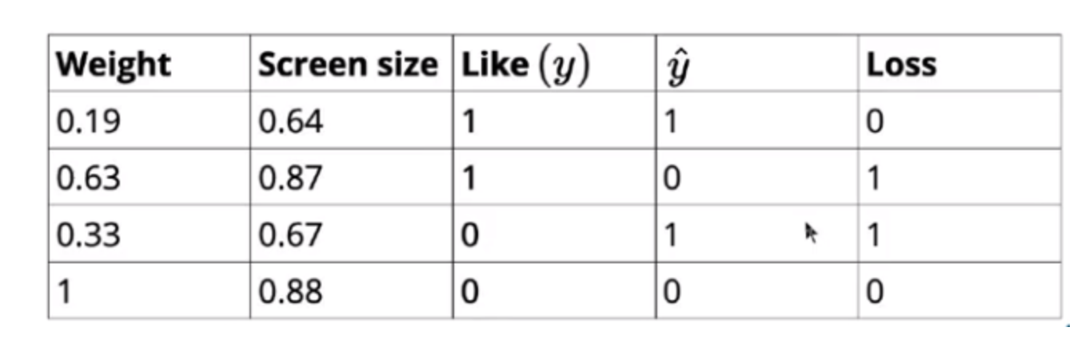
Loss
If there is a deviation from the true output, the loss value is 1. If it is the same as the actual output, loss value is zero. The loss value tells the model that some correction needs to be done. For the correction the weights or the thresholds are adjusted.
Let’s consider that we are making a decision based on only two features, Weight and Screen size

Slide 7
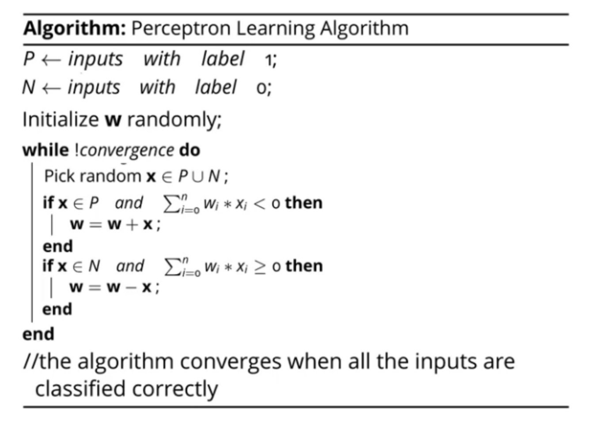
Perceptron Learning Algorithm
We initialize the weights randomly, then pick a random observation x from the entire data. If the x belongs to the positive class and the dot product w.x < 0 it means that the model is making an error (we need the output to be w.x ≥ 0 for positive class refer) and the weights need to be updated (w = w + x). Similarly, if the x belongs to the negative class and the dot product w.x ≥ 0 (we need the output to be w.x < 0 for negative class) again in this case the model made an error, so the weights need to be updated (w = w — x). We will continue this operation till we reach convergence, convergence in our case means that our model is able to classify all the inputs correctly.

Slide 8
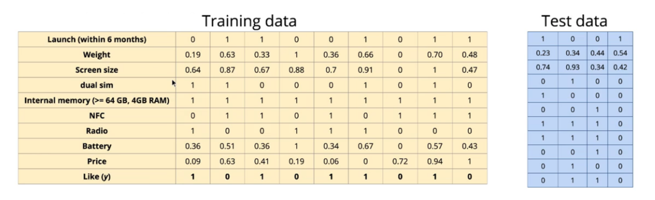
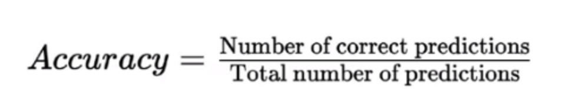
Model Evaluation
Once we got the best weights w from the learning algorithm, we can evaluate the model on the test data by comparing the actual class of observation and the predicted class of the observation

Slide 9
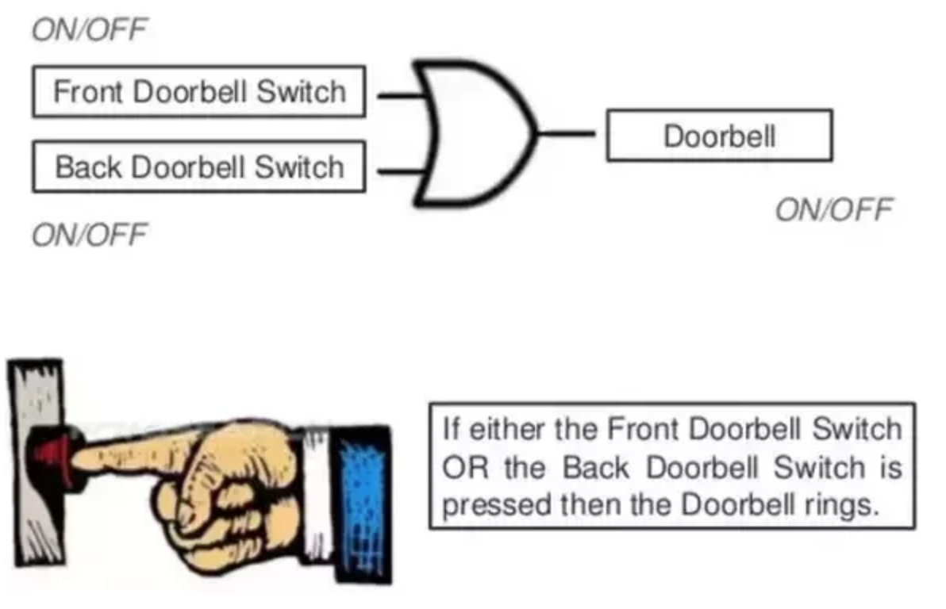
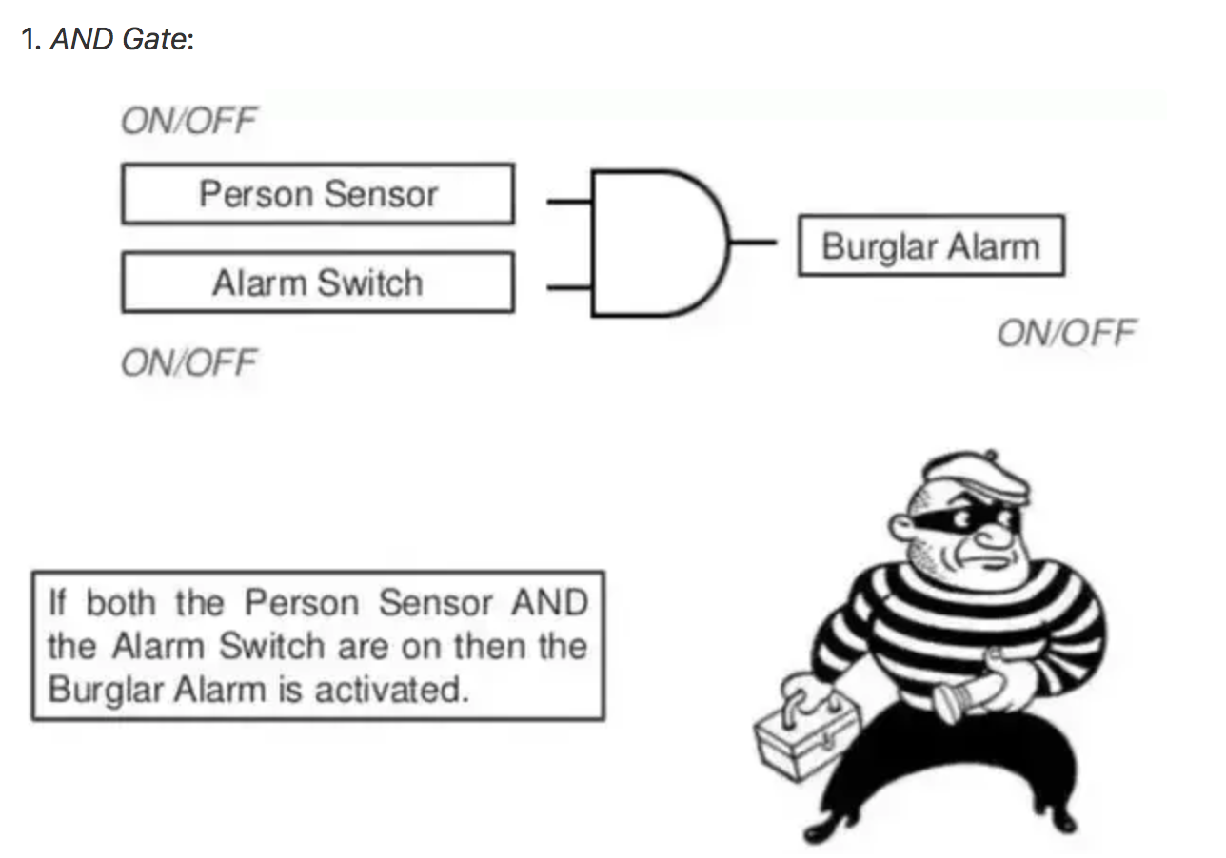
AND GATE - OR GATE

Slide 10
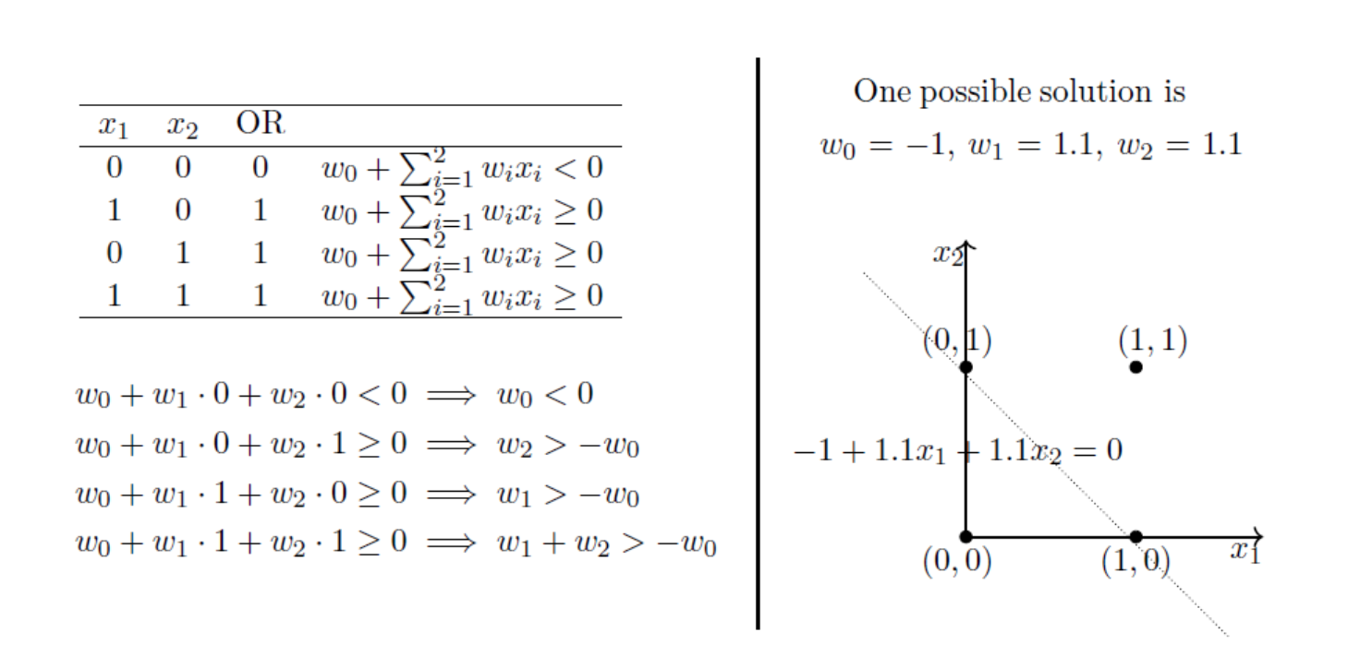
Perceptron Limitation - OR Function
The above ‘possible solution’ was obtained by solving the linear system of equations on the left. It is clear that the solution separates the input space into two spaces, negative and positive half spaces

Slide 11
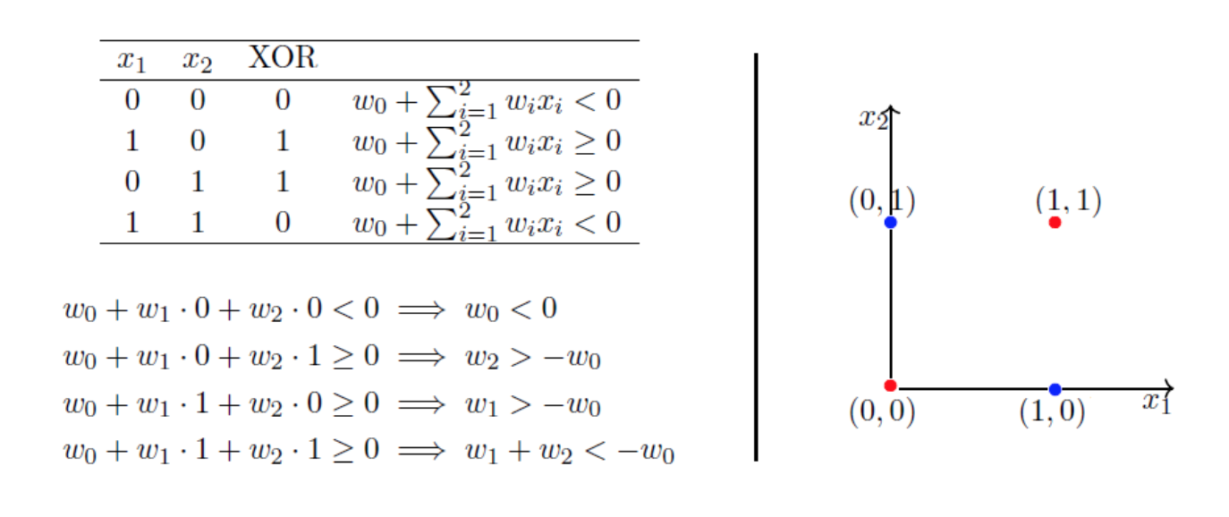
Perceptron Limitation - XOR Function
Notice that the fourth equation contradicts the second and the third equation. Point is, there are no perceptron solutions for non-linearly separated data. So the key take away is that a single perceptron cannot learn to separate the data that are non-linear in nature

