Slide 1
Sigmoid Neuron

Slide 2
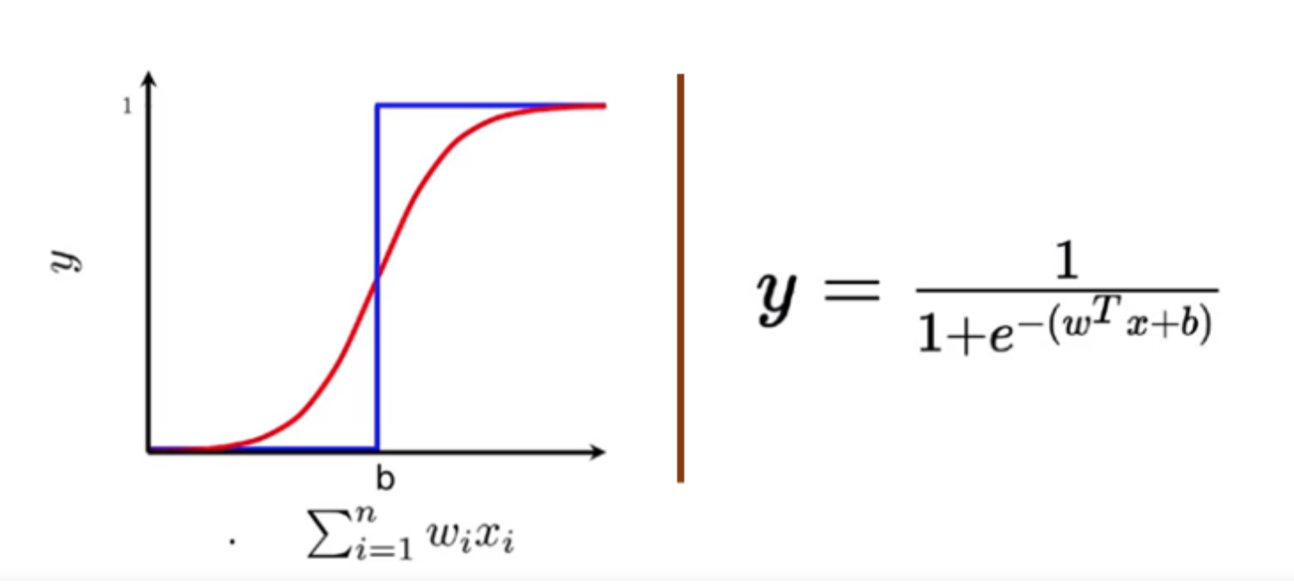
Sigmoid Neuron
The output from the sigmoid is not 0 or 1 like the perceptron model instead it is a real value between 0–1 which can be interpreted as a probability. The most commonly used sigmoid function is the logistic function, which has a characteristic of an “S” shaped curve.

Slide 3
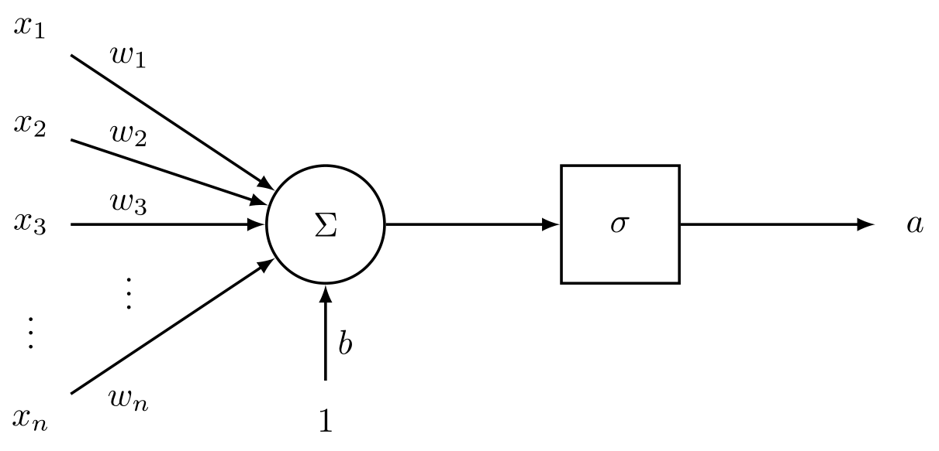
Sigmoid Neuron

Slide 4
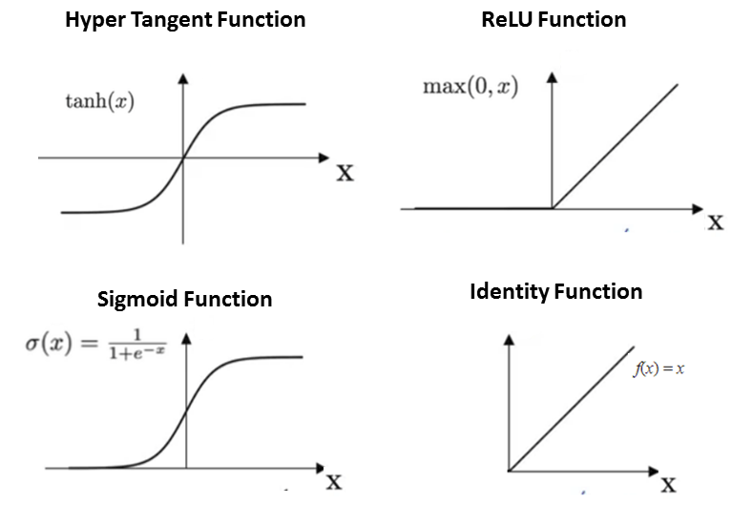
Activation Function

Slide 5
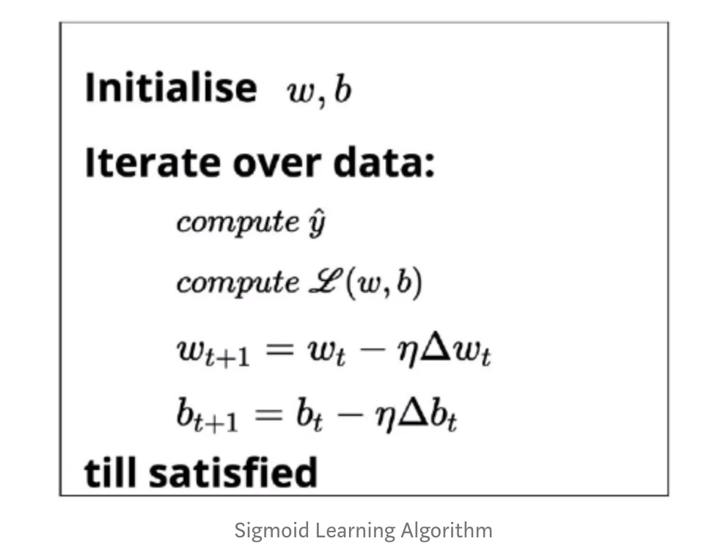
Learning Algorithm
learning the parameters w and b of the sigmoid neuron model by using the gradient descent algorithm.
The objective of the learning algorithm is to determine the best possible values for the parameters, such that the overall loss (squared error loss) of the model is minimized as much as possible. Here goes the learning algorithm:

Slide 6
Loss Optimization
We initialize w and b randomly. We then iterate over all the observations in the data, for each observation find the corresponding predicted outcome using the sigmoid function and compute the squared error loss. Based on the loss value, we will update the weights such that the overall loss of the model at the new parameters will be less than the current loss of the model.
The overall loss of the model becomes zero.
The overall loss of the model becomes a very small value closer to zero.
Iterating for a fixed number of passes based on computational capacity.

Slide 7
Relu Activation
It’s not always the case that our activation function is going to transform between 0 and 1
Relu activation that transforms the input to maximum of either 0 or input itself
// pseudocode
function relu(x) {
if (x <= 0) {
return 0;
} else {
return x;
}
}

