Slide 1
Stock Market Value Prediction
AISECT Regional Office,Indore

Slide 2
Agenda
Problem Statement
Introduction to Team
Responses to the Questions
Response to Questionnaire

Slide 3
Problem Statement
Predicting how the stock market will perform is one of the most difficult things to do. In the stock market, analysis is divided into two parts –
Fundamental Analysis and
Technical Analysis.
Question : Can we use machine learning as a game changer in this domain?
Answer : Definately YES!!!
Advantages :
Accurate Results in the Stock Market with the time saving process.
Good Decision Making for the traders and investors.

Slide 4

Team
Mrs. Arpana Jaiswal Rai Qualification : BE(CSe),M.Tech(CSe) Designation: IT Faculty |  | Ms. Ankan Sharma Qualification : BCA,MCA Designation : Project Coordinatior(IT)

Slide 5
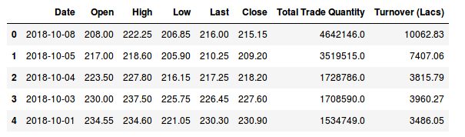
Responses to questionnaire
There are multiple variables in the dataset – date, open, high, low, last, close, total_trade_quantity, and turnover.

Slide 6
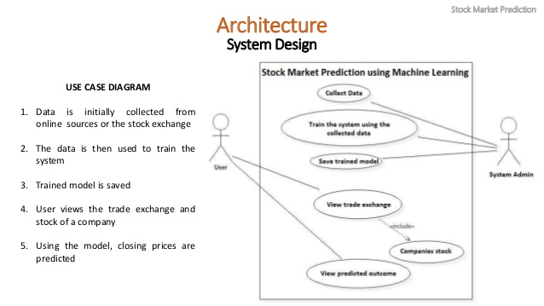
Responses to questionnaire (Algorithms)
we will work with historical data about the stock prices of a publicly listed company. We will implement a mix of machine learning algorithms to predict the future stock price of this company, with simple algorithms like linear regression, KNN and LSTM.

Slide 7
Thank you

