Slide 1

AJAX Tutorial
For Beginners & Professionals

Slide 2
What is AJAX
Asynchronous JavaScript & XML
Not a Technology
Sends and Receives data from Client & Server Asynchronously
Different than regular HTTP Requests
Uses XmlHTTPRequest Object
Carries data in xml , plain text & JSON format
Does not refresh the browser to receive data from server

Slide 3
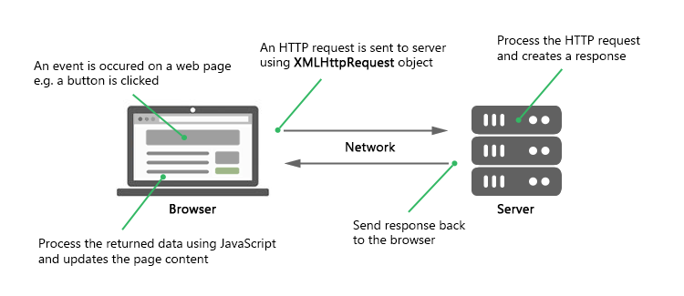
How AJAX Works

Slide 4
Ways of AJAX
Regular AJAX Requests
Fetch API
Axios Library
Jquery Library
Node JS HTTP Module

Slide 5
Regular AJAX with JS
Basic AJAX Requests Flow
Custom API with AJAX for GET , POST , PUT & DELETE
Example App for CRUD Operations
Employee Portal App Using Custom AJAX API

Slide 6
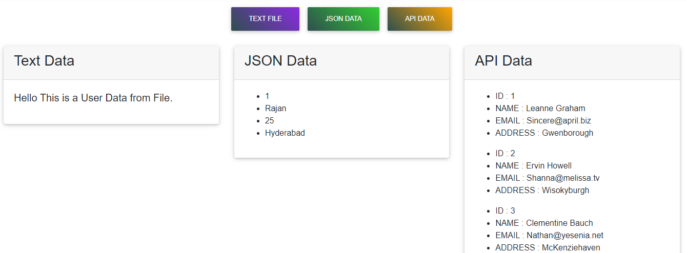
AJAX Basics

Slide 7
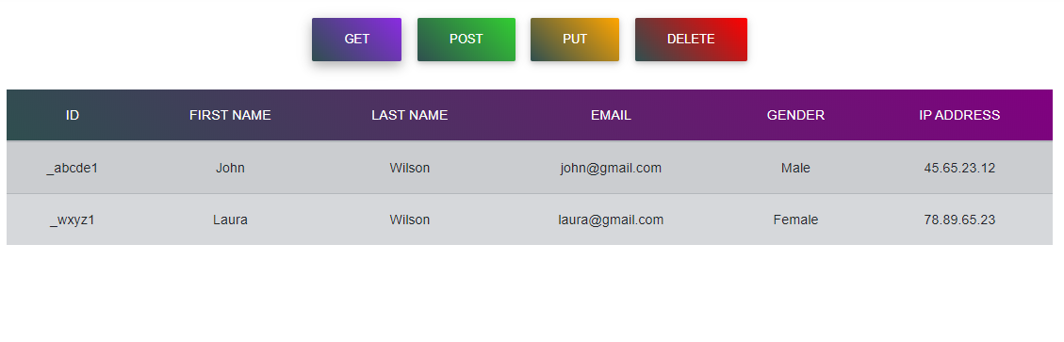
Fetch API with REST API

Slide 8
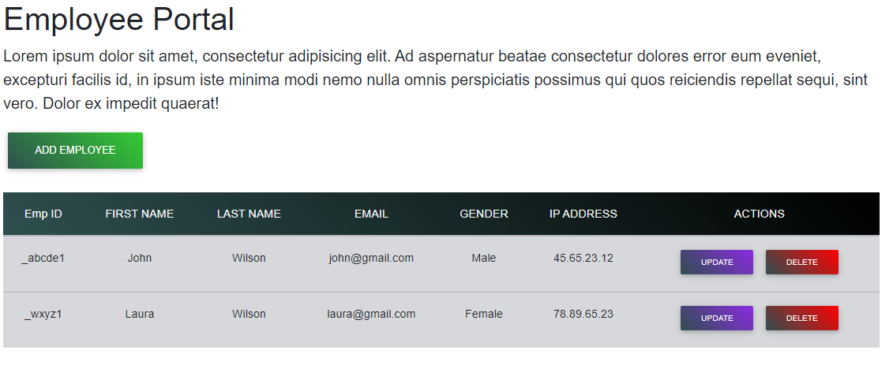
Employee Portal with AJAX

Slide 9
Fetch API Basics

Slide 10
Fetch with REST API

Slide 11
Employee Portal with Fetch API

Slide 12
Axios Library Basics

Slide 13
Axios Library with REST API

Slide 14
Employee Portal with Axios Library

Slide 15
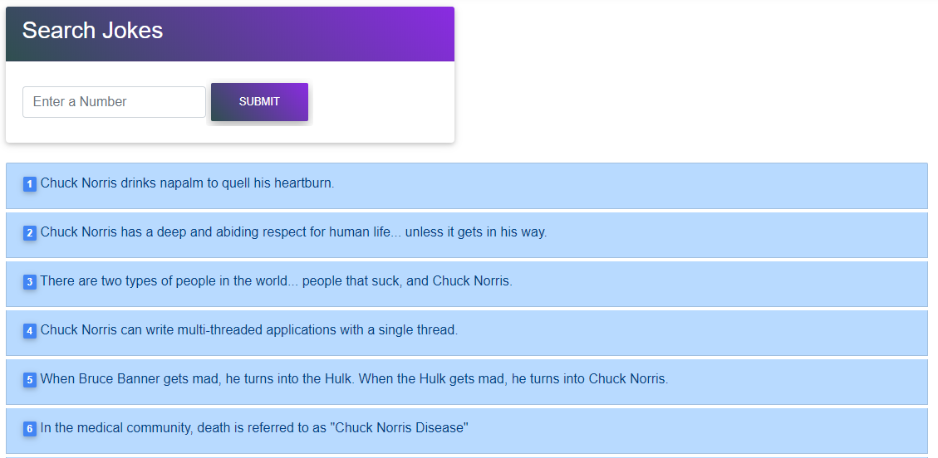
Chuck Norris Database - AJAX

Slide 16
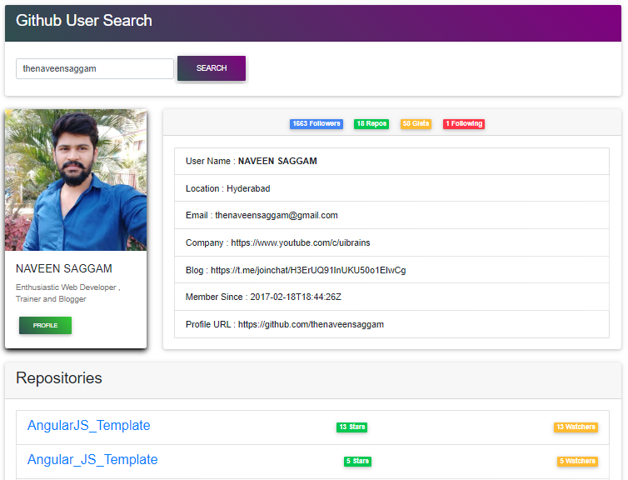
GitHub Profile Search - AJAX

Slide 17
Many More…..
For Online Classes, Please Contact :
+91 – 98 44 80 45 33

