Slide 1
Angular 10 Online Training 2020
By NAVEEN SAGGAM
UiBrains Technologies
UiBrains

Slide 2
What is Angular
Angular is an open source framework to build Rich Client Side Applications
Developed & Maintained by Google
Released in Sep,2016
Current Version is 10.0.3
One of the Best Framework to Build Client Side Apps along with React JS
Average Salary in India around 838k (INR). (payscale.com)
Average Salary in USA around $73k (payscale.com).
UiBrains

Slide 3
Features of Angular
Developed by Google
Works on Microsoft TypeScript
Component based development
Two-way data binding
Both for Web & Mobile Development
Dependency Injection
Used MVC Design Pattern
Advantage of Modularity
Easy to Test Angular Applications
Can Integrate with Any Back End Technology.
UiBrains

Slide 4
Pre Requisites
Basic Knowledge on HTML
Basic Concepts on CSS
Good Understanding of JavaScript with Functions
Experience on TypeScript Language
Bootstrap knowledge is added advantage
Visit : UiBrains Technologies YouTube Channel for above tech Stack.
UiBrains

Slide 5
Angular Learning Plan
Angular Fundamentals
TypeScript
NGRx
Node
Express MongoDB
Angular Material
Prime NG Angular
Final Project
UiBrains

Slide 6

TypeScript
Introduction to TypeScript
Installation and Apps Creation using TypeScript
Variables Declaration , Data Types , Conditional , Looping Statements
Objects , Arrays , Functions / Methods
OOPS Concepts Classes , Objects , Interfaces , Inheritance
Collections in TypeScript
Exception Handling in TypeScript
Dependency Injection in TypeScript
Modules Pattern in TypeScript.
UiBrains

Slide 7

Angular Fundamentals
Introduction to Angular CLI & commands
Angular Architecture & Folder Structure
Angular Components & Modules Creation
Styles Configuration , Bootstrap Integration
Databinding , Interpolation , Events Binding, Template ref variables
Angular structural directives, pipes
Angular with HTTP Modules
Angular Routing
Angular Form Validation (Template Driven & Reactive)
Authorization & Authentication in Angular.
UiBrains

Slide 8

NgRx with Angular
What is NgRx
Introduction State Management
Advantages of NgRx with Angular
Configuration of NgRx with Angular Applications
NgRx Store Creation
Actions & Entities
Selectors & Side Effects
Example Apps using NgRx with Angular.
UiBrains

Slide 9




Server Side Integration
Implementation of Node JS Server with Routing
Implementation of Express JS with Routing
Introduction to REST API and Development
Password Encryption
JSON Web Token based Authentication
Form Validations
Integration of Mongo DB with local & Cloud
Developing Models with Mongoose Library
Deployment of Server Side Apps to Heroku.
UiBrains

Slide 10

Angular Material
Introduction to Material Design by Google
Introduction to Angular Material
Integration of Angular Material with Angular Applications
Form Components (Buttons , Checkbox , Date Picker)
Data Components (Cards , Chips , Tables)
Progress bars , Spinners
Snack bars for Alerts
Steppers for Rich Forms.
UiBrains

Slide 11

Prime NG
Introduction to Prime NG
Integration of Prime NG with Angular Applications
Form Components (Buttons , Checkbox , Date Picker)
Data Components (Cards , Chips , Tables)
Progress bars , Spinners
Menus , Charts.
UiBrains

Slide 12

Final Project (E-Commerce)
Bootstrap Layout with Responsive side nav with Full Page landing page
Implementation of Angular Routing & Navigation for various links
JSON Web Token (JWT) based Authentication
Image upload functionality for products
Server side with Node , Express JS with Mongo DB integration
Backend Data modeling with Mongoose
Stripe Payments integration for products purchase
Final Application Deployment to Heroku App
Future implementations of the projects.
UiBrains

Slide 13

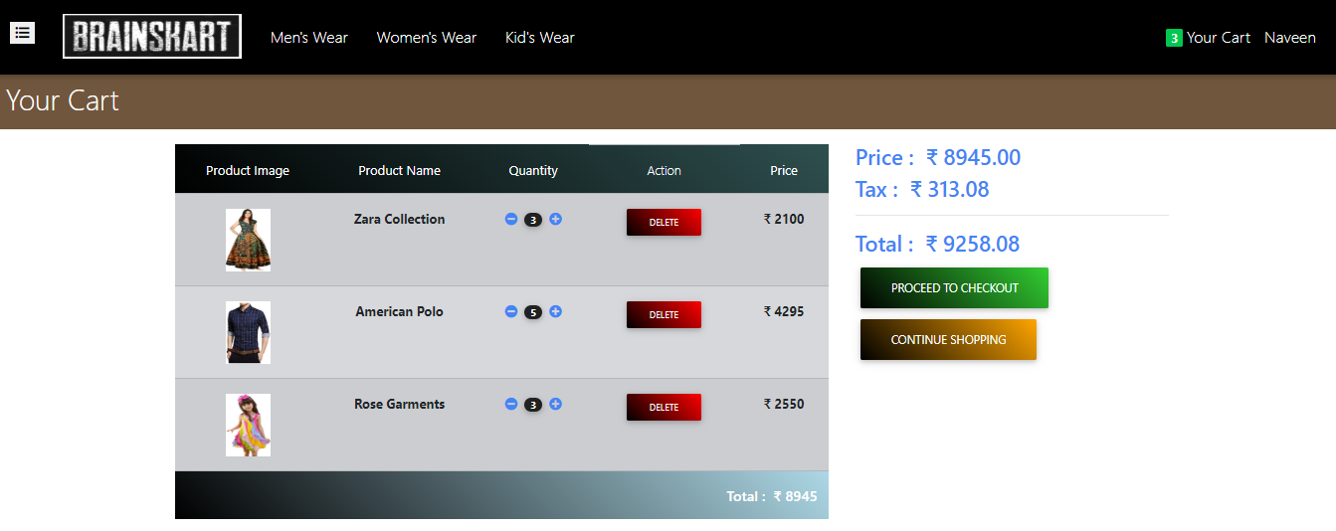
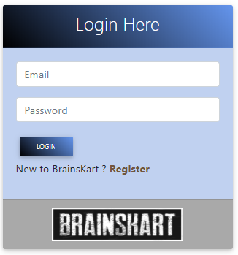
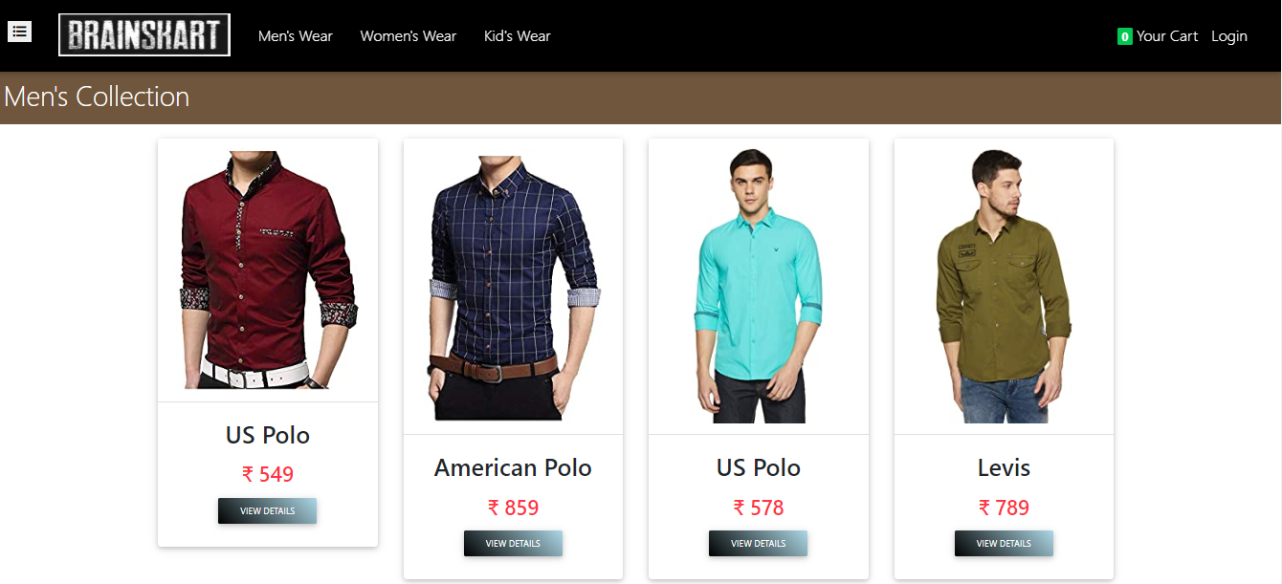
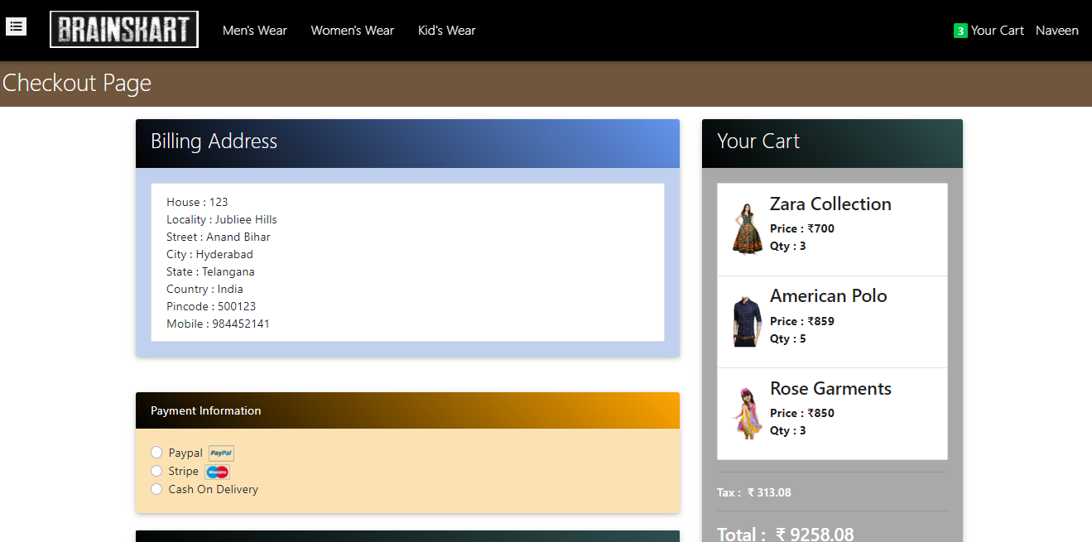
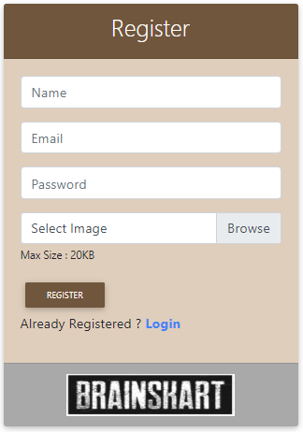
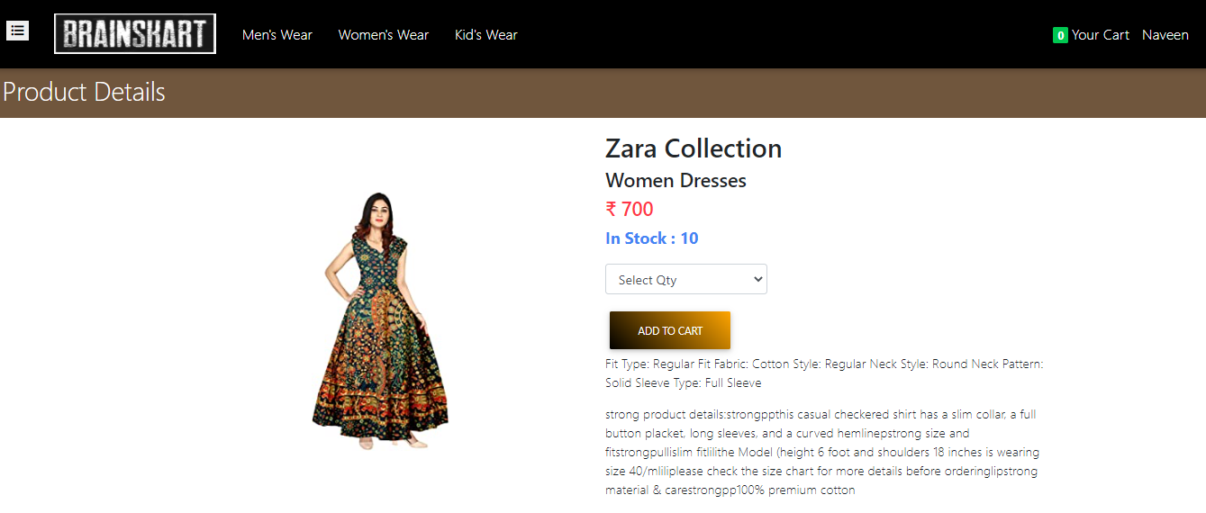
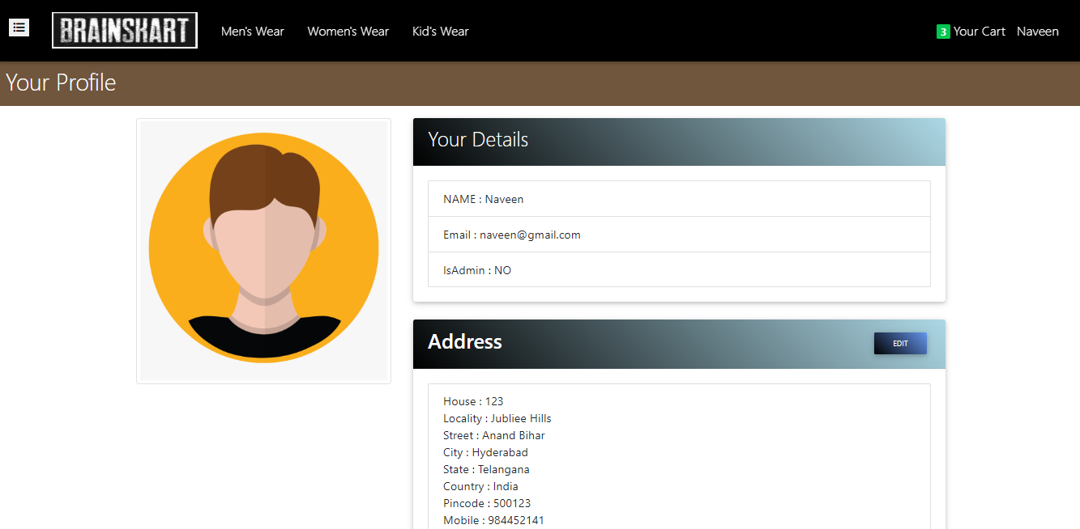
Real
Images
UiBrains

Slide 14
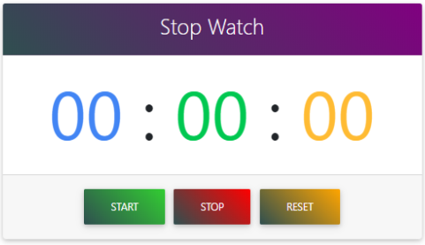
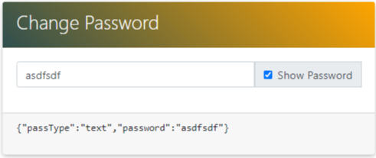
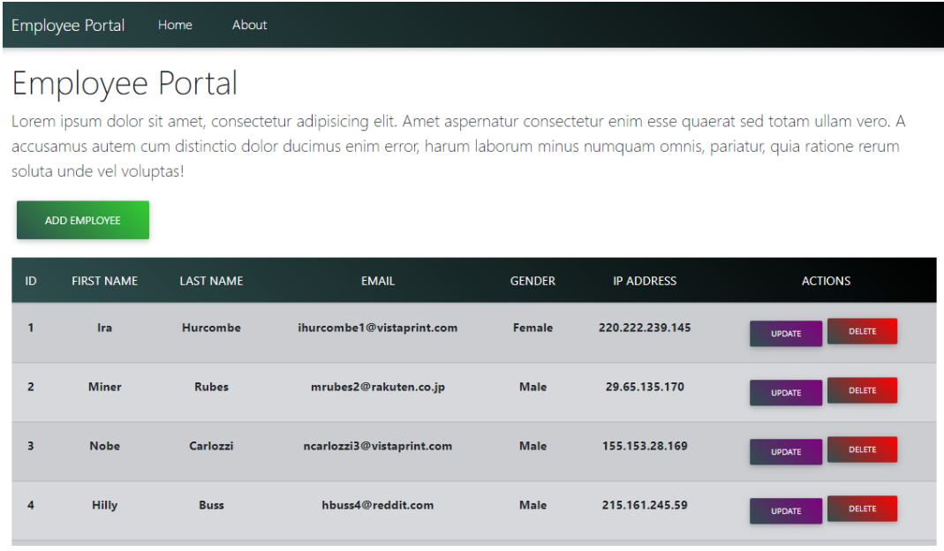
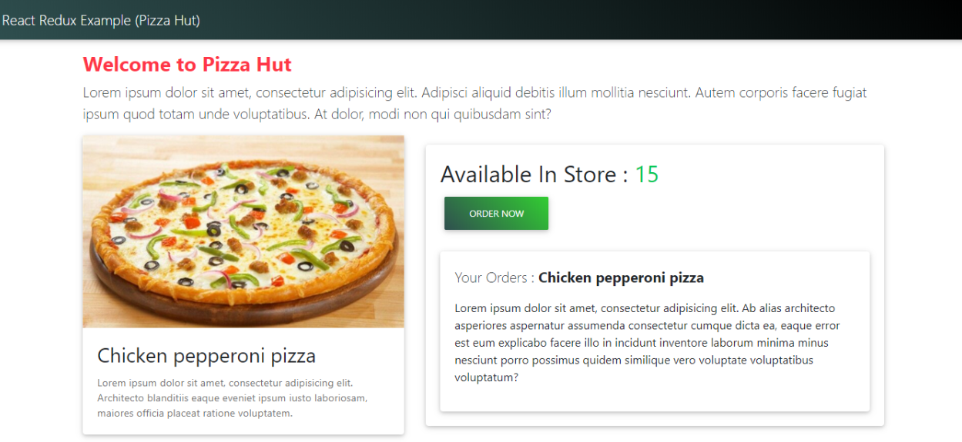
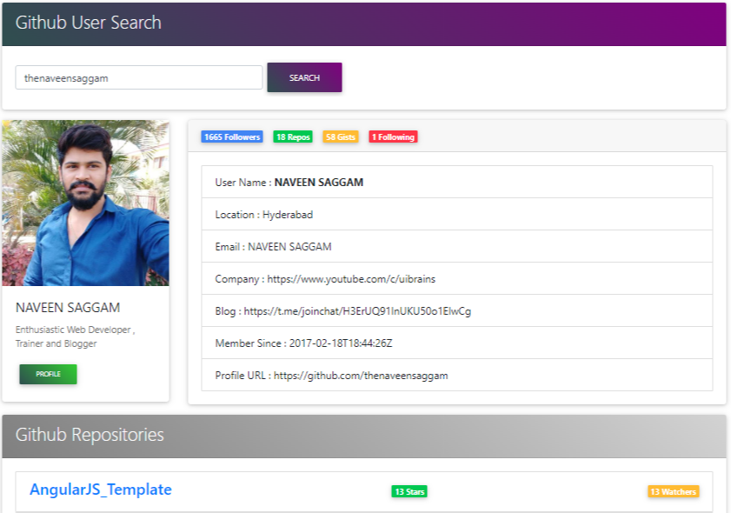
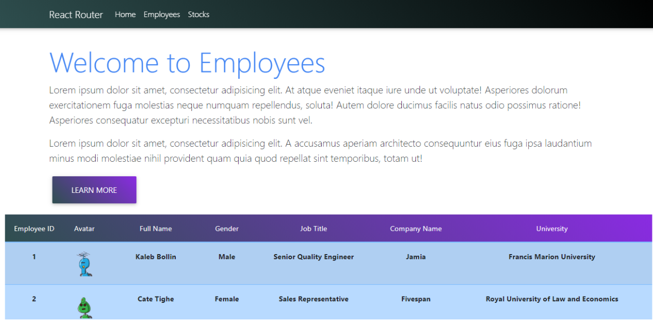
Other Applications

Slide 15

Course Information
Total Duration 50days (100 hrs.)
Live & Hands-on Training on Each Concept
Covers Basics to Advanced level with App Development
Daily videos , Files , Slides Sharing for Practice
Life Time Access
Class Timings 6PM – 8PM IST(Daily 2hrs)
Monday - Saturday (Sunday Holiday)
Fees : 6000 INR / $85 US Dollars
Google pay / Phone Pay to 9844804533
Website : uibrains.com
Email id : naveen.uibrains@gmail.com
Average Salary in India around 838k (INR). (payscale.com)
Average Salary in USA around $73k (payscale.com)
UiBrains

Slide 16




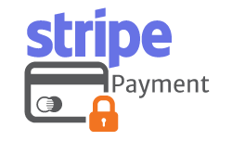

Bonus Concepts
UiBrains

Slide 17

Any Queries ?
UiBrains

Slide 18














Software Installation
Notepad++
Node JS
Mongo DB
Insomnia / Postman
Heroku
Git
Angular CLI
TypeScript
Editors (WebStorm / Visual Studio Code)
UiBrains

Slide 19
Angular Architecture
Angular Application
Root Module (appModule)
Root Comp (app Component)
User Module
card
Home
User List
User Details

Slide 20
Single Page
Navbar
Sidebar 1
Main Content
Sidebar 2

Slide 21
Navbar Component
navbar.html
navbar.css
navbar.ts
Design
Styles
Logic

