Slide 1

ITCS 5102 - SURVEY OF PROGRAMMING LANGUAGES
Sales Tracker
Group 7
Nikhita Bharat Upadhye (801337745)
Rakesh Moramreddy (801337430)
Srinivasulu Padigay (801330017)
Vachanshree Mugappa Chabbi (801306456)

Slide 2

Contents
○ What is the language paradigm?
○ How does it fit into the historical evolution of programming languages?
○ What did you find different about the language from other languages in the same paradigm?
○ What features did you find helpful?
○ What does this language offer to the programmer that makes it a language you would want to use?
○ Is the language best suited for one particular type of application? If so, what

Slide 3

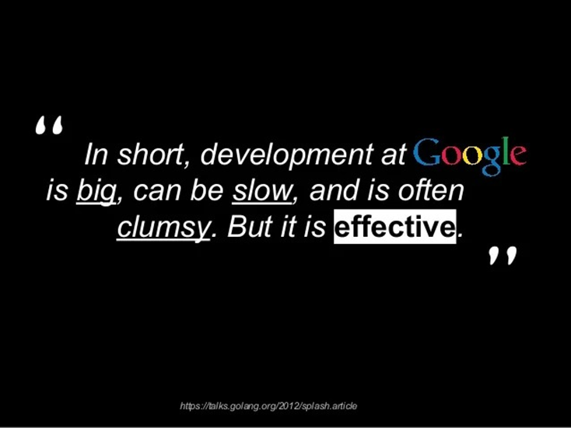
Language paradigm
Language Paradigm: Go is an imperative and procedural language with aspects of object-oriented programming.
Historical Account: Developed by Google in 2007 to address challenges in large-scale software development.

Slide 4
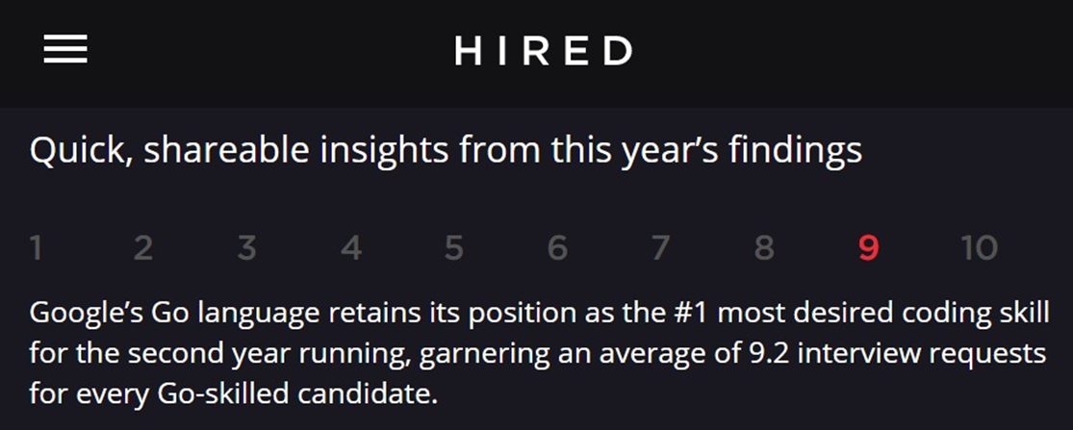
Elements of the Language: Includes reserved words, primitive data types, and structured types.
Syntax: C-like syntax prioritizing readability with optional semicolons and curly braces.
Control Abstractions: Provides standard control structures like loops, conditional statements, and defer statements.

Slide 5

Fit into evolution of programming languages
Go addresses contemporary challenges in large-scale software development while drawing inspiration from its predecessors.
Developed by Google engineers in 2007, it aims to overcome limitations of existing languages.
Incorporates elements from languages like C and Pascal while introducing modern features.
Prioritizes simplicity, efficiency, and ease of use, catering to demands of modern software development.
Focuses on concurrency and scalability, aligning with the need for high-performance, distributed systems.

Slide 6
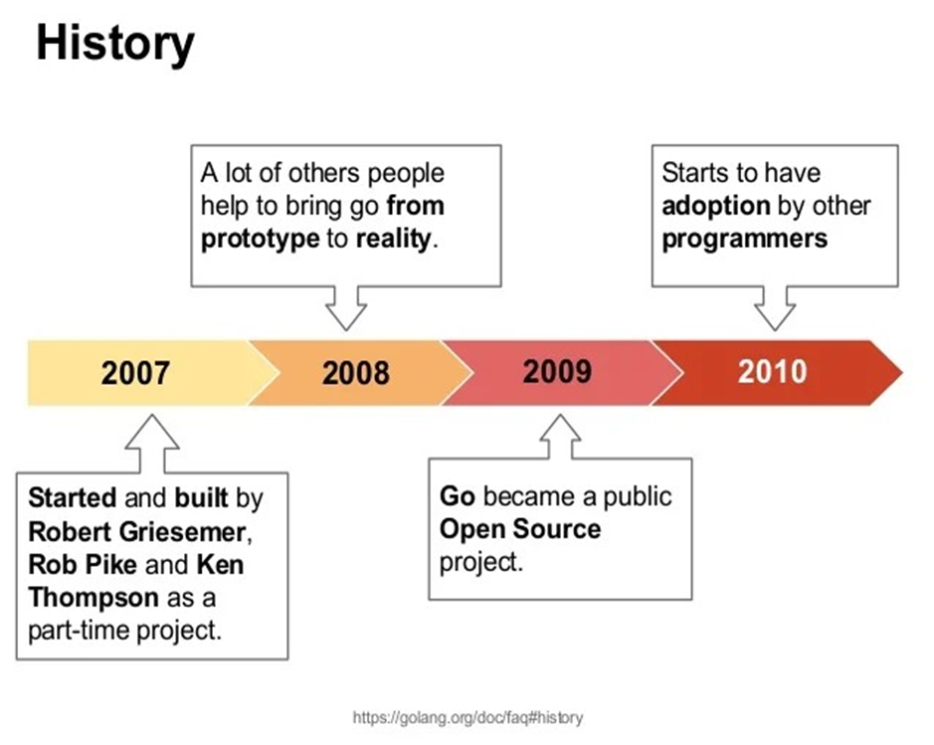
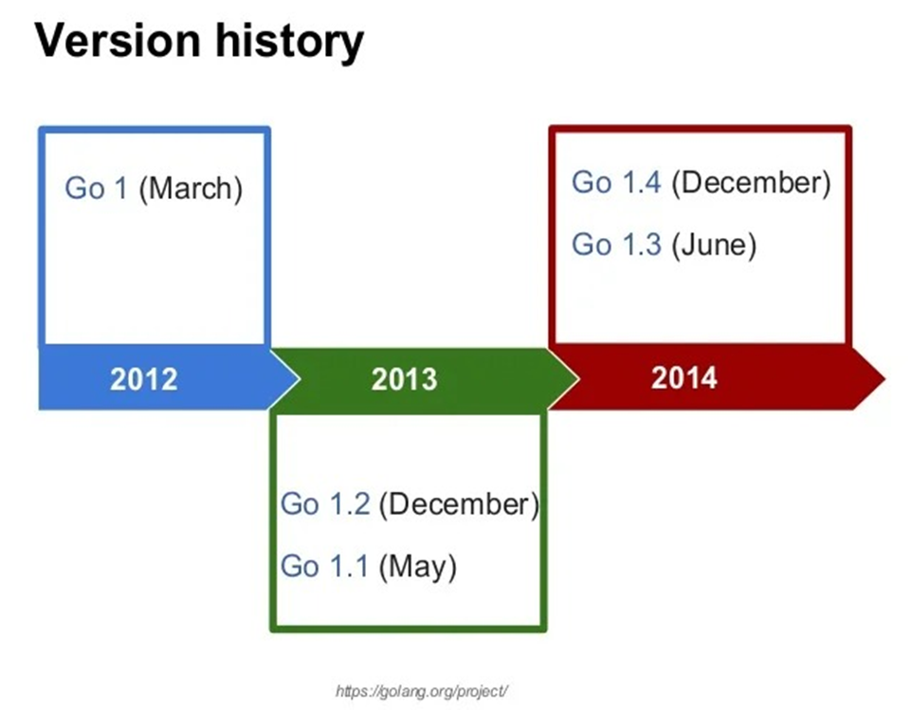
Fit into evolution of programming languages

Slide 7

What’s different about Go?
Go stands out due to its unique blend of simplicity and concurrency within the statically typed, compiled language paradigm.
While it follows the imperative and procedural programming paradigms like many other languages, Go emphasizes ease of use and efficiency.
Unlike some languages in the same paradigm, Go prioritizes concurrency through its goroutines and channels, facilitating the development of concurrent systems.
It introduces modern features while retaining a minimalist syntax, distinguishing itself from languages that may prioritize feature-richness over simplicity.

Slide 8
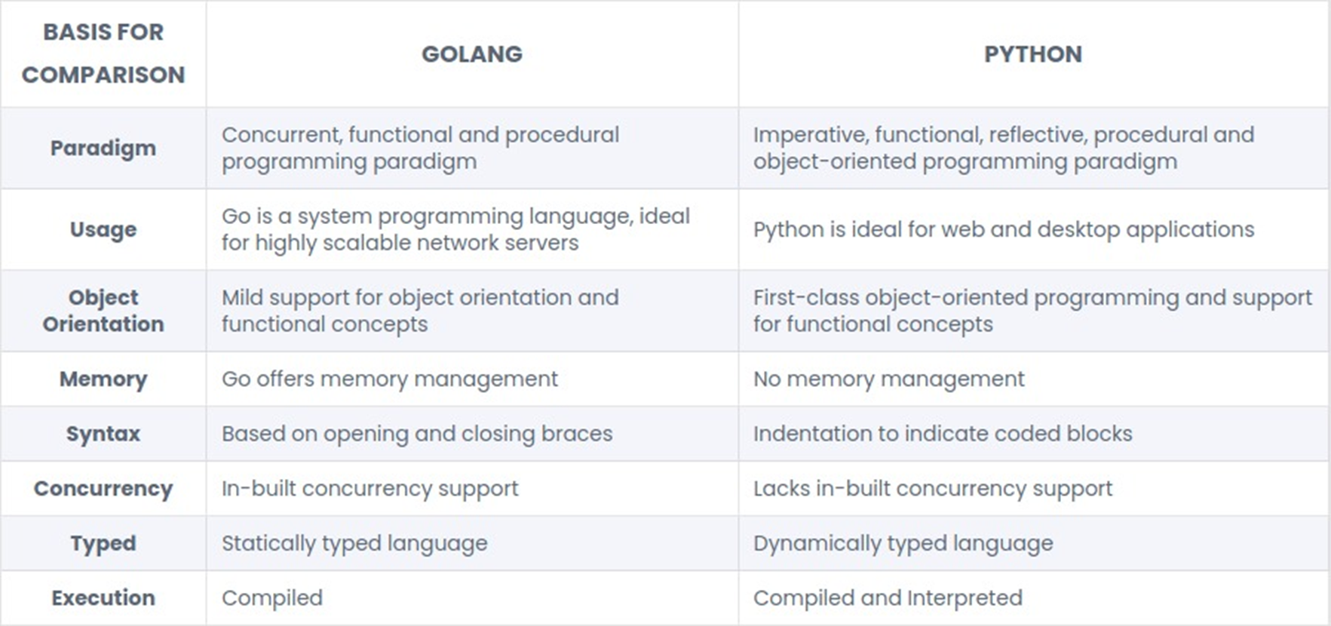
What’s different about Go?

Slide 9
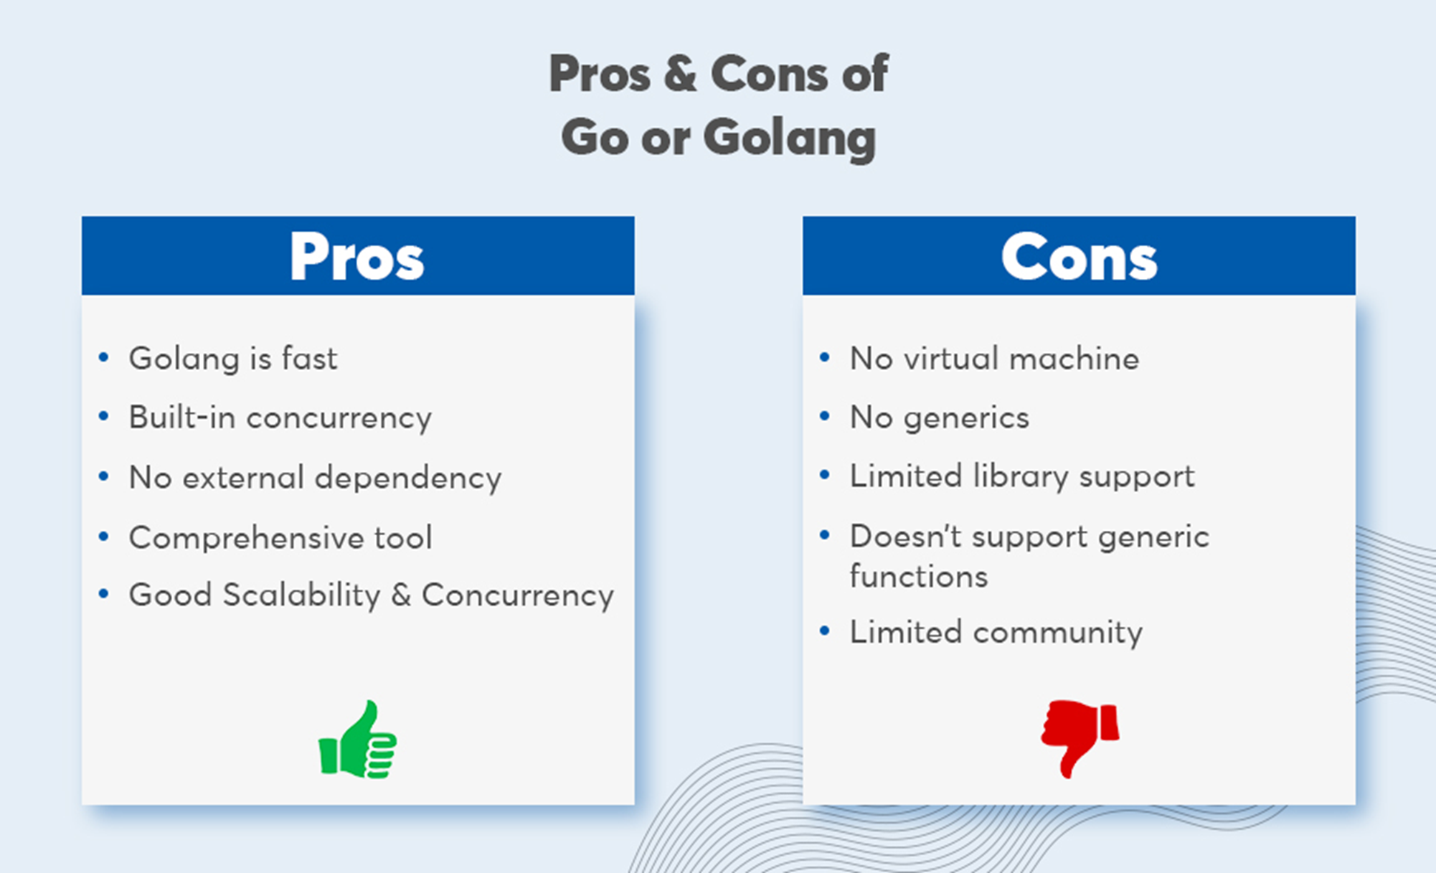
Advantages of Using Go Programming Language

Slide 10
Helpful features
Concurrency support through goroutines and channels, enabling efficient handling of concurrent tasks without excessive resource consumption.
Simplicity in syntax and design, making code easy to read, write, and maintain, thus reducing development time and effort.
Strong standard library offering a wide range of functionalities, reducing the need for third-party dependencies and ensuring consistency across projects.
Fast compilation speed, allowing for quick iteration and deployment of applications, especially in large-scale software development projects.
Built-in testing support, facilitating the development of reliable and robust software through comprehensive testing suites.

Slide 11
Versatility and Application Suitability of Go Language
Go is not inherently tailored to one specific type of application. Instead, it offers versatility, making it suitable for a wide range of applications, including web development, network programming, system-level programming, and concurrent applications. Its concurrency support, simplicity, and strong standard library make it particularly well-suited for building scalable and efficient distributed systems and microservices architectures.

Slide 12
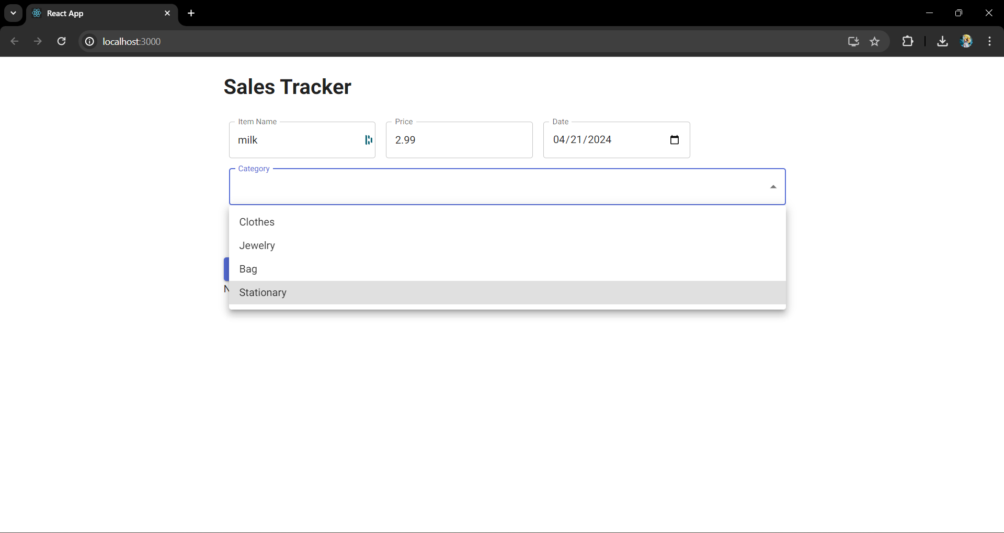
Demo of our application

Slide 13
Thank You!

