Slide 1

Self-Improving-AI-Week_01
Robot Room Search Using MDPs

Slide 2
Robot Room Search Using Markov Decision Processes
This project models a mobile robot searching rooms in a building to locate a target while minimizing expected total search cost.
The robot does not know the target’s location and maintains a probabilistic belief over all rooms, updating this belief after each search.
The problem is formulated as a Markover Decision Process (MDP) and solved using policy iteration to compute an optimal search strategy under uncertainty.

Slide 3
Test Data:
Room | Prior Probability (pᵢ) | Search Cost (cᵢ)
Living Room | 0.30 | 3
Bedroom | 0.25 | 4
Kitchen | 0.15 | 2
Office | 0.15 | 3
Bathroom | 0.10 | 2
Storage | 0.05 | 1

Slide 4
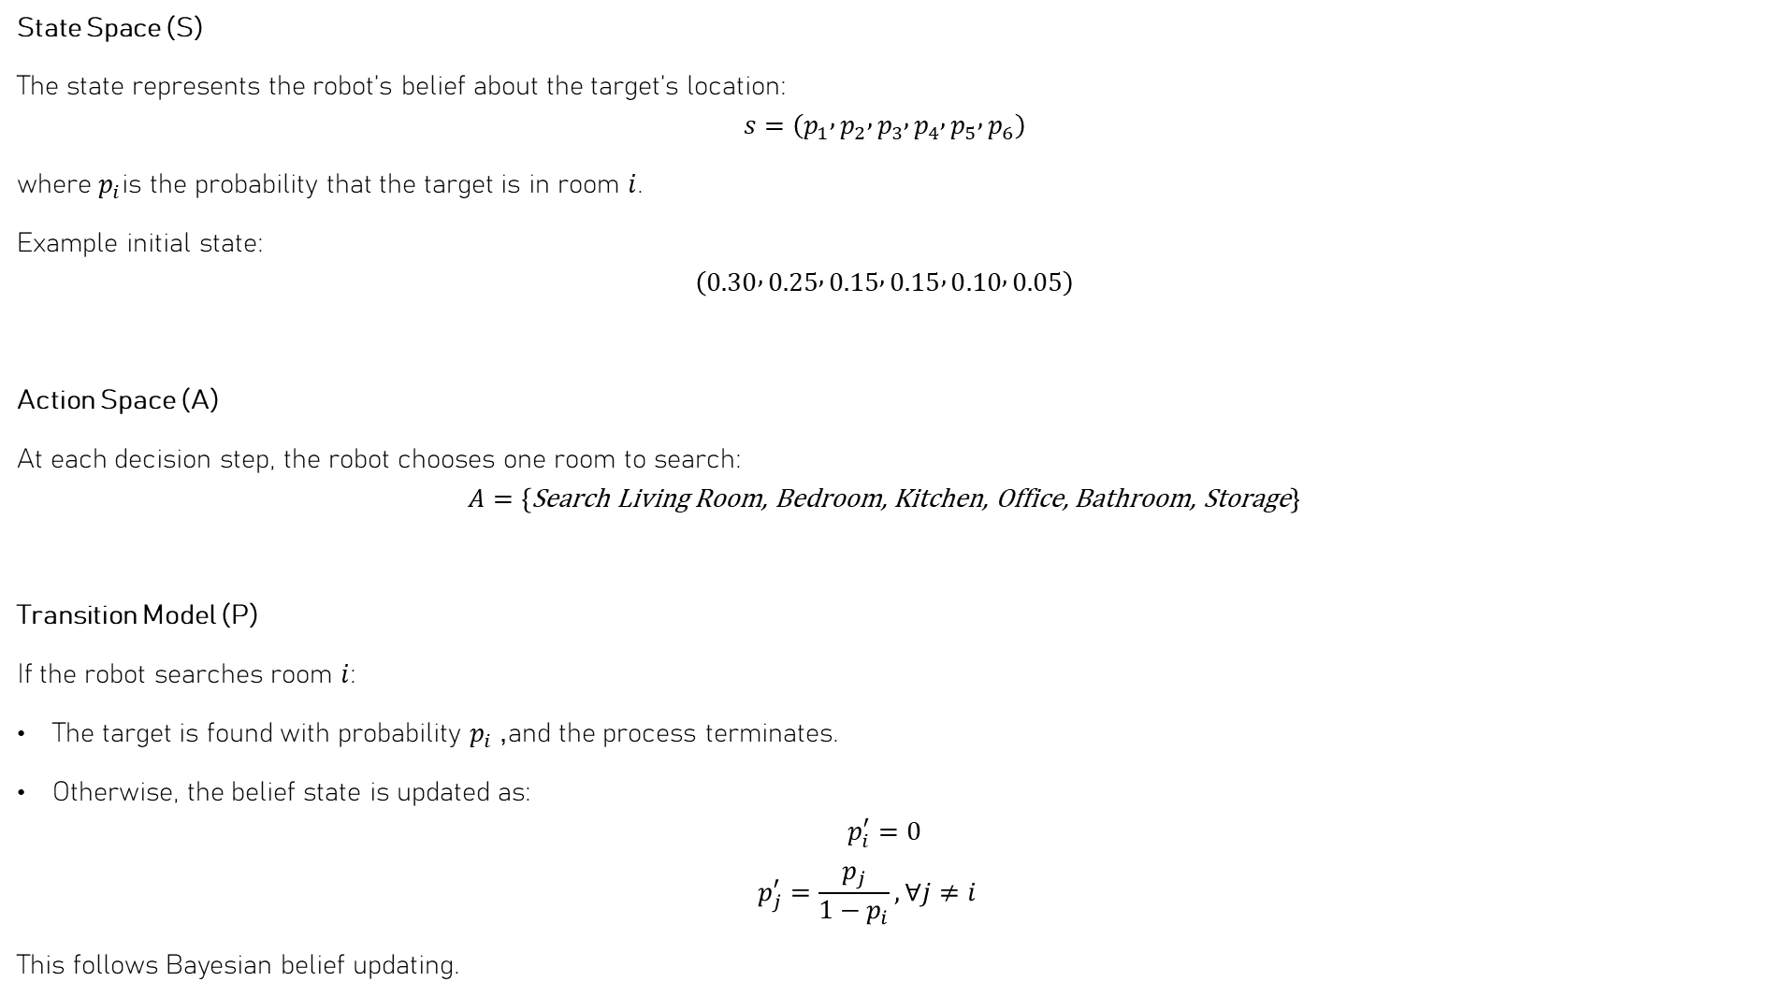
MDP Formulation
State Space (S)
The state represents the robot’s belief about the target’s location:
$$s=\left(p_{1} , p_{2} , p_{3} , p_{4} , p_{5} , p_{6}\right)$$
where $p_{i}$is the probability that the target is in room $i$.
Example initial state:
$$\left(0.30 , 0.25 , 0.15 , 0.15 , 0.10 , 0.05\right)$$
Action Space (A)
At each decision step, the robot chooses one room to search:
$$A=\left\{\text{Search} \text{Living} \text{Room}\text{, }\text{Bedroom}\text{, }\text{Kitchen}\text{, }\text{Office}\text{, }\text{Bathroom}\text{, }\text{Storage}\right\}$$
Transition Model (P)
If the robot searches room $i$:
The target is found with probability $p_{i}$, and the process terminates.
Otherwise, the belief state is updated as:
$$p_{i}^{′}=0$$
$$p_{j}^{′}=\frac{p_{j}}{1−p_{i}}, ∀j≠i$$
This follows Bayesian belief updating.

Slide 5

Continue..
Reward / Cost Function (R)
Each search action incurs a cost based on the room searched:
$$R\left(s , a=i\right)=−c_{i}$$
where $c_{i}$is the search cost for room $i$.
Discount Factor (γ)
$$γ=1$$
since this is a finite, absorbing search problem.
Terminal State
The process terminates when the target is found.

Slide 6
EXPERIMENTAL RESULTS
Experimental Setup
Number of rooms: 6
Belief discretization step size: 0.1
Total belief states: 3003
Discount factor: γ = 1
Solution method: Policy Iteration
Policy Iteration Convergence
Iteration 1: 2525 belief states updated
Iteration 2: 0 policy changes
Result: Policy converged in 2 iterations
This indicates fast and stable convergence due to the finite belief space.
Optimal Policy Results
Optimal first room to search: Storage
Expected total search cost: 1.0
Despite having a lower probability, Storage is searched first due to its minimal search cost.

Slide 7
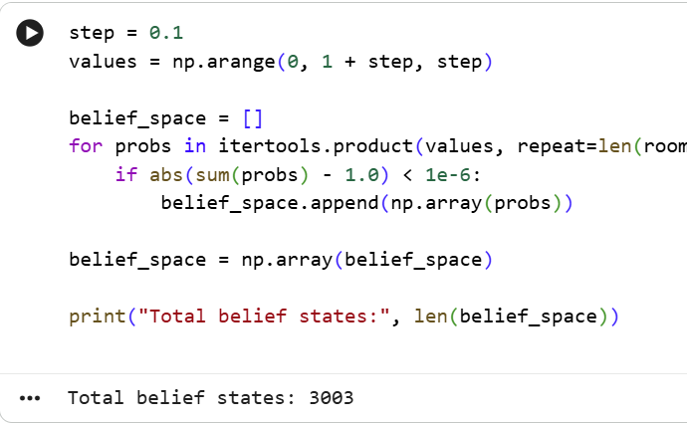
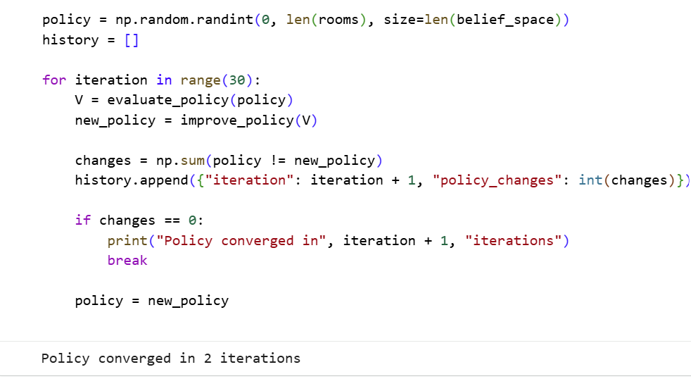
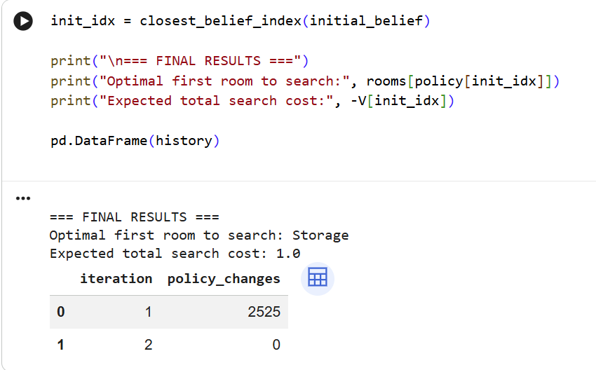
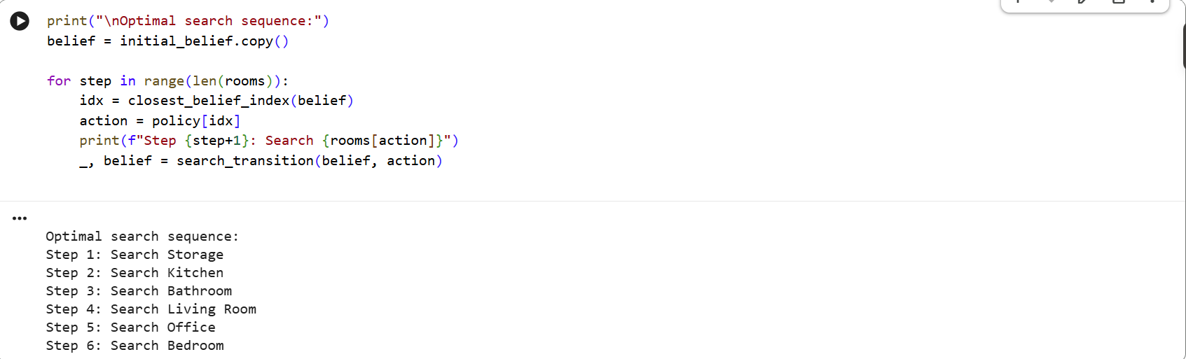
EXPERIMENTAL RESULTS
Optimal Search Sequence
Storage
Kitchen
Bathroom
Living Room
Office
Bedroom
The policy prioritizes low-cost rooms first, minimizing total expected cost.

