Slide 1
Secure Data Hiding In Images Using Steganography
CAPSTONE PROJECT
Presented By: Srinjoy Bhattacharjee
Student Name :Srinjoy Bhattacharjee
College Name & Department : Heritage Institute Of Technology
Computer Science & Engineering

Slide 2
OUTLINE
Problem Statement
Technology used
Wow factor
End users
Result
Conclusion
Git-hub Link
Future scope

Slide 3
Problem Statement
Develop a simple image-based encryption and decryption system using Python and OpenCV. The program should allow users to hide a secret message inside an image by modifying pixel values and later retrieve the hidden message using a correct passcode. The encryption process should store the modified image, while the decryption process should extract the message only if the correct passcode is entered. The system should be implemented in two separate scripts: one for encryption and another for decryption.

Slide 4
Technology used
Programming Language: Python 3.x
Image Processing Library: OpenCV (cv2) – For reading, modifying, and saving images
File Handling & OS Interaction: Python os module – For managing files and opening images
Encryption Technique: Pixel-value modification to encode the message inside an image
Authentication: Passcode-based security for decryption
IDE/Editor: Visual Studio Code (VS Code) for writing and running the scripts
Platform Compatibility: Works on Windows, macOS , and Linux

Slide 5
Wow factors
Image-Based Steganography
Passcode-Protected Decryption
No External Storage of Message
Lightweight & Fast Execution
Cross-Platform Compatibility
Separation of Encryption & Decryption

Slide 6
End users
Cybersecurity Enthusiasts
Students & Researchers
Privacy-Conscious Users
Forensic Experts
Developers & Programmers

Slide 7


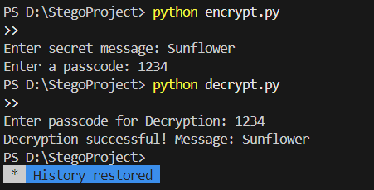
Results
Input Image
Output Image
Output Terminal

Slide 8
Conclusion
This project successfully implements a simple image-based encryption and decryption system using Python and OpenCV. By modifying pixel values, it securely hides a secret message inside an image, ensuring that only users with the correct passcode can retrieve it. The separation of encryption and decryption into two scripts enhances modularity and usability. This approach provides a lightweight and effective steganography technique, making it useful for privacy-conscious users, students, and cybersecurity enthusiasts

Slide 9
GitHub Link
https://github.com/Srinjoy100/SteganoGraphyProje

Slide 10
Future scope(optional)
Enhanced Security – Implement advanced encryption algorithms for stronger protection.
Support for Larger Messages – Optimize storage to hide longer texts efficiently.
Multiple File Formats – Extend support to PNG, BMP, and other image formats.
Graphical User Interface (GUI) – Develop a user-friendly interface for non-programmers.
AI-Based Detection Prevention – Improve resistance against steganalysis techniques

Slide 11
THANK YOU

