Slide 1
Stealthy Computational Delay Attacks
on Control Systems
Talitha Nauta, Henrik Sandberg and Martina Maggio · ACM/IEEE ICCPS 2025
PRESENTED BY
Shubham Tyagi
Swarali
Madhavi Singh
Abhishek Sharma
Srinjoy
Embedded and Cyber-Physical Systems
Notes:
Good morning everyone. We are presenting the paper "Stealthy Computational Delay Attacks on Control Systems" by Nauta, Sandberg and Maggio, from ICCPS 2025. I'm Shubham, and I'll start us off.

Slide 2
Presentation Roadmap
we start here
1
2
3
4
5
6
7
Introduction
& Brief
Problem
Formulation
Author
Setup
Results
Novelty
Our
Extension
Conclusion
Why timing matters, how the attack works, key takeaways
Plant, controller, switched model, detectors
Requirements, assumptions, code and pipelines
The paper's findings and our reproduction
What is new in the authors' work
The defender's view: choosing safe settings
Summary and references
The question that runs through the whole talk
How much damage can an attacker cause only by delaying the controller, while staying completely undetected?
Notes:
[Sweep left to right.] Here is our plan. I'll give the introduction, a brief of the paper and the key takeaways. Then my teammates cover the problem formulation, the authors' setup, the results with our reproduction, the novelty, our own extension, and the conclusion. [Point to the red box.] One question connects it all: how much damage can an attacker do only by delaying the controller, without being detected?

Slide 3
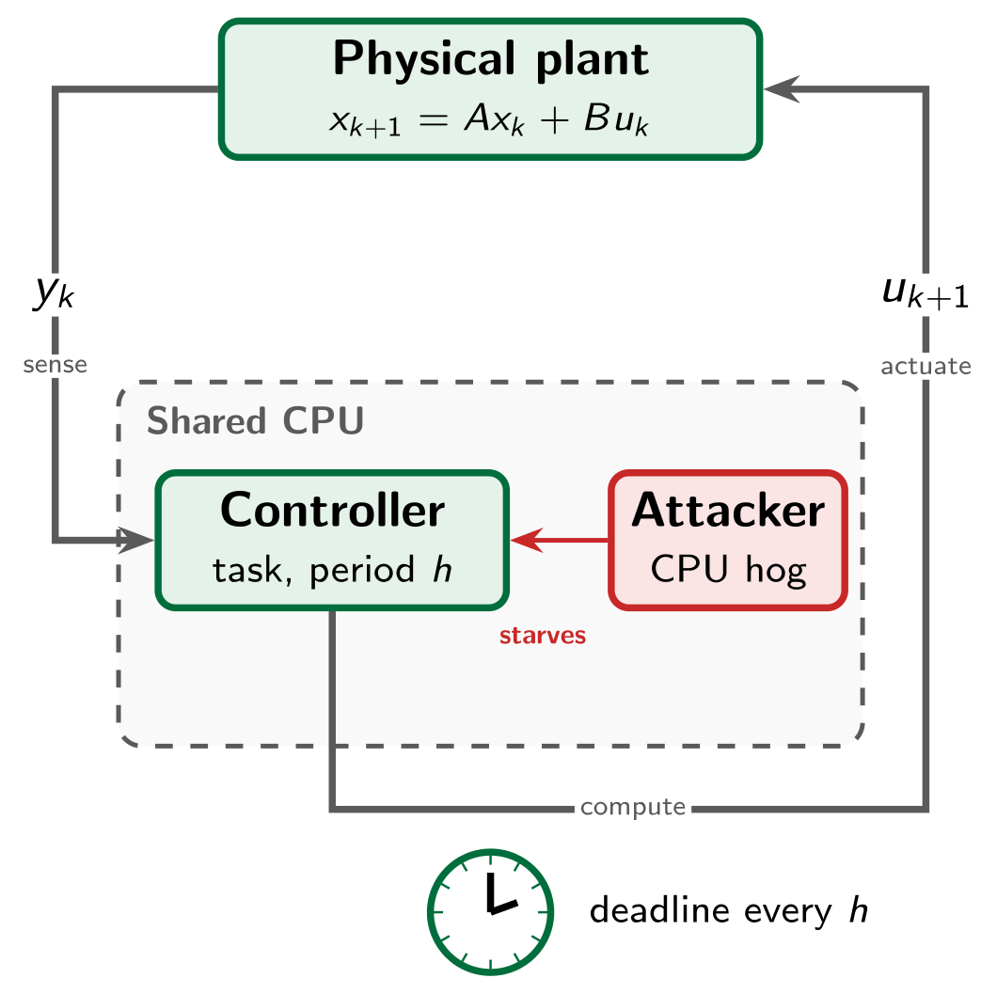
Introduction: Control Loops Run on a Clock
A cyber-physical system couples computation with a physical process: power grids, factories, vehicles, medical devices.
The controller is a periodic task. Every period h it reads yₖ, computes uₖ₊₁, and must finish before the deadline.
Famous attacks such as Stuxnet (2010) and the German steel mill (2014) manipulated the data: sensor readings or control signals.
Defences followed: physics-based detectors check whether y and u agree with the system model.
The question this paper asks
What if the attacker never touches the data, and only delays when the control signal is computed?
Notes:
A cyber-physical system joins computation with a physical process, like a power grid or a factory. [Point to the loop.] The controller runs as a periodic task. Every period it senses y, computes the next control signal u, and must finish before a deadline.
Famous attacks like Stuxnet and the German steel mill attack changed the data itself, the sensor readings or control commands. So defences check whether that data matches the physical model.
This paper asks something different. What if the attacker never touches the data, and only delays when the control signal is computed?

Slide 4
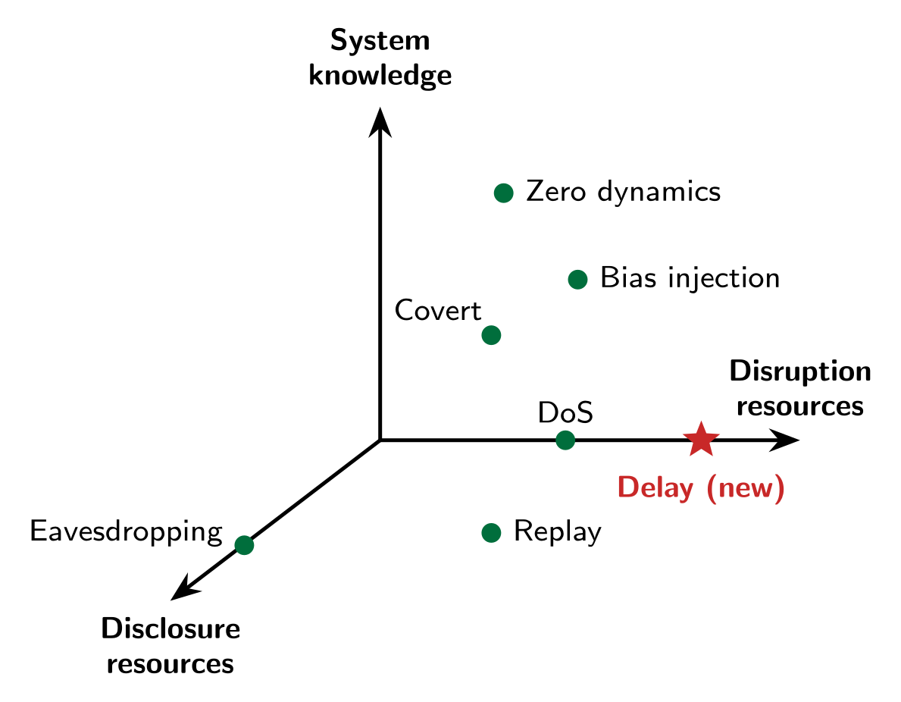
Introduction: Where Delay Attacks Fit
Taxonomy of CPS attacks (Teixeira et al.)
 | False data injection | Denial of service | Computational delay
What it changes | sensor or actuator values | availability | timing of the control job
Needs to read data? | yes | no | no
How it looks | model mismatch | large and obvious | like normal timing jitter
Physics detector catches it? | often | yes | no: y and u stay consistent
Contributions of the paper
Extends the attack taxonomy with computational delay attacks.
Finds the worst-case stealthy attack as an optimisation problem.
Tests it on a stable and an unstable plant against realistic detectors.
The paper adds the delay attack: it needs only disruption resources, no access to the data.
Notes:
[Point to the taxonomy.] CPS attacks are classified by three resources: knowledge of the system, the ability to read data, and the ability to disrupt. The authors add a new point, the delay attack, which needs only disruption.
[Point to the table.] Unlike false data injection, it reads no data. Unlike denial of service, it isn't loud. It hides inside normal timing jitter, and because y and u stay consistent with the model, physics-based detectors can't see it.
So the paper adds this attack class, computes its worst stealthy form, and tests it on two plants.

Slide 5
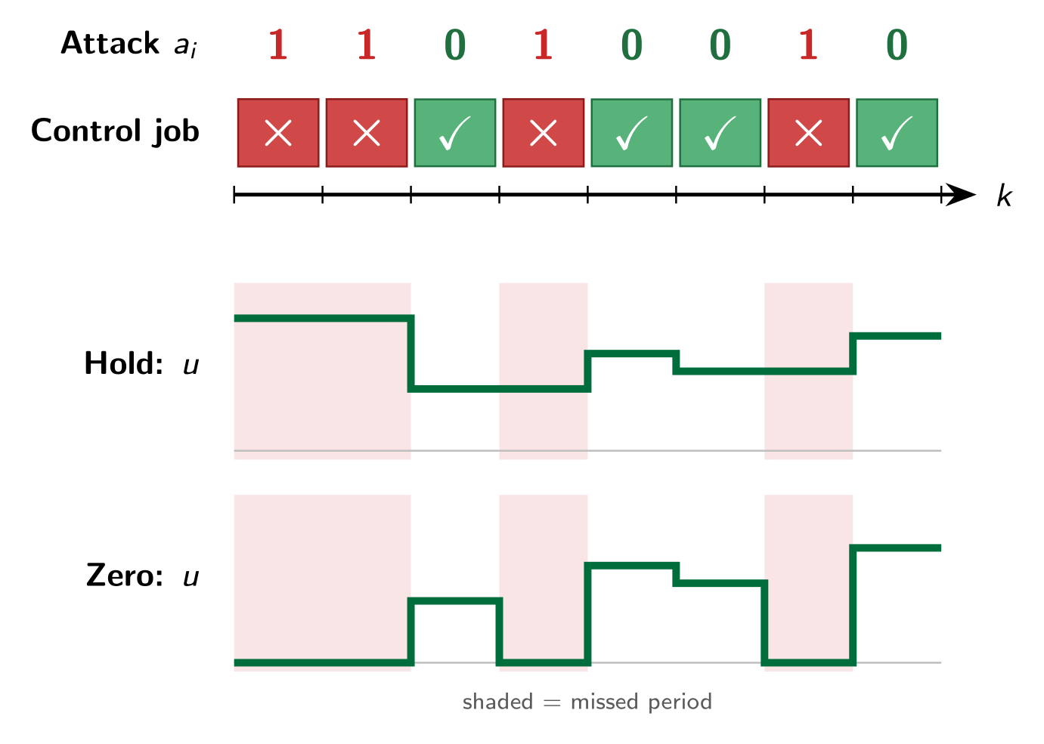
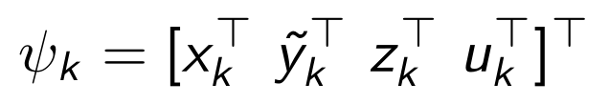
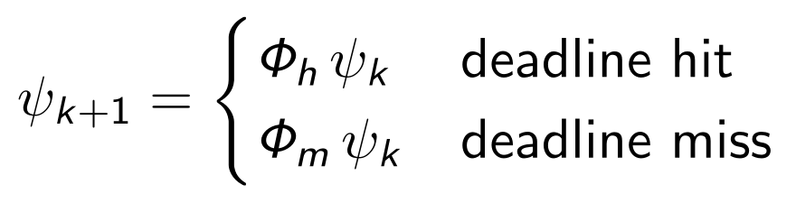
Brief of the Paper: How the Attack Works
CPU starvation: when a control job starts, the attacker may launch a task that holds the processor, so the job misses its deadline.
Each period the attacker picks aᵢ ∈ {0, 1}: 0 = deadline hit, 1 = forced miss.
During a miss
No new control signal is computed.
Hold: keep the old u. Zero: set u = 0.
The late job then uses the stale measurement ỹₖ.
Closed-loop model
With
Notes:
The attack is CPU starvation. When the control job starts, the attacker runs a task that holds the processor, so the job misses its deadline. [Point to the row of ones and zeros.] Each period the attacker chooses: zero is a hit, one is a forced miss.
During a miss, no new control signal is computed. [Point to the two plots.] With hold, the old value is kept. With zero, the signal is set to zero. When the late job finishes, it uses a stale measurement. Mathematically, the closed loop switches between two matrices, one for a hit and one for a miss.

Slide 6
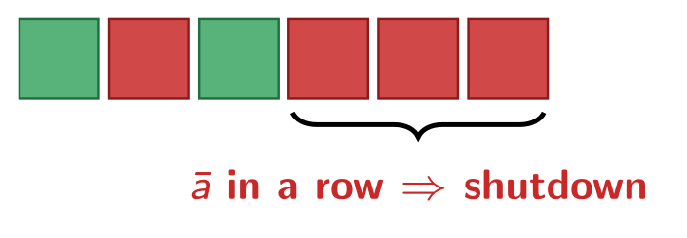
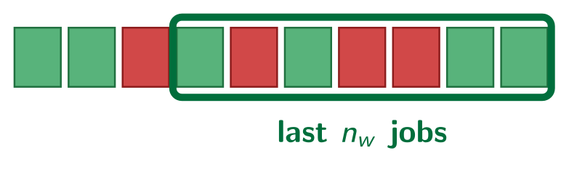
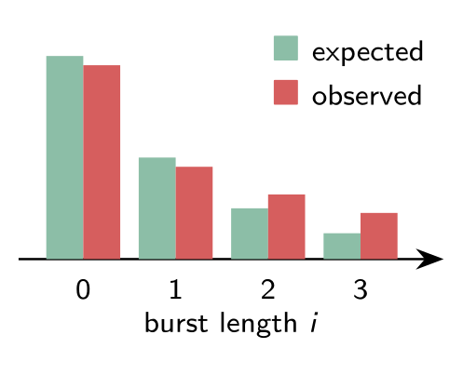
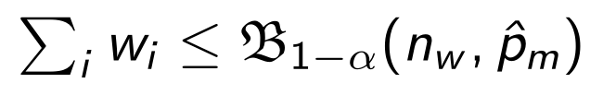
Brief of the Paper: What the Defender Watches
The defender cannot see a data change, so it watches the timing of the control task with three checks.
1. Watchdog
2. Sliding window test
3. Long-term history test
Shuts the plant down after ā consecutive misses. In industry ā is usually 3 to 10.
Binomial test: alarm if the misses in the window exceed what the normal miss rate p̂ₘ allows:
Counters mᵢ record bursts of i misses since start-up. A χ² test checks they follow the geometric law Eᵢ = p̂ₘⁱ(1 − p̂ₘ)N.
Stealth requirement
The attack is stealthy only if none of these checks can reject “the system is behaving normally” at significance level α (the paper uses α = 0.01).
Notes:
The defender can't see a data change, so it watches timing with three checks. First, a watchdog shuts the plant down after a fixed number of consecutive misses, usually three to ten in industry. Second, a sliding window uses a binomial test to raise an alarm if recent misses exceed the normal miss rate. Third, long-term counters record bursts of misses, and a chi-squared test checks they follow a geometric distribution.
The attack is stealthy only if none of these tests can say the system is behaving abnormally.

Slide 7
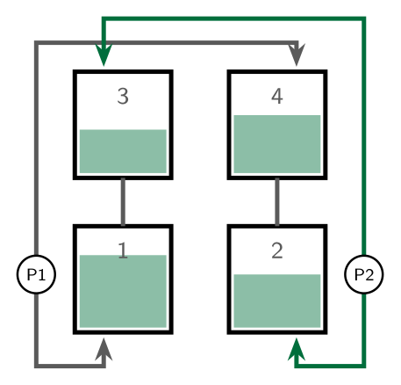
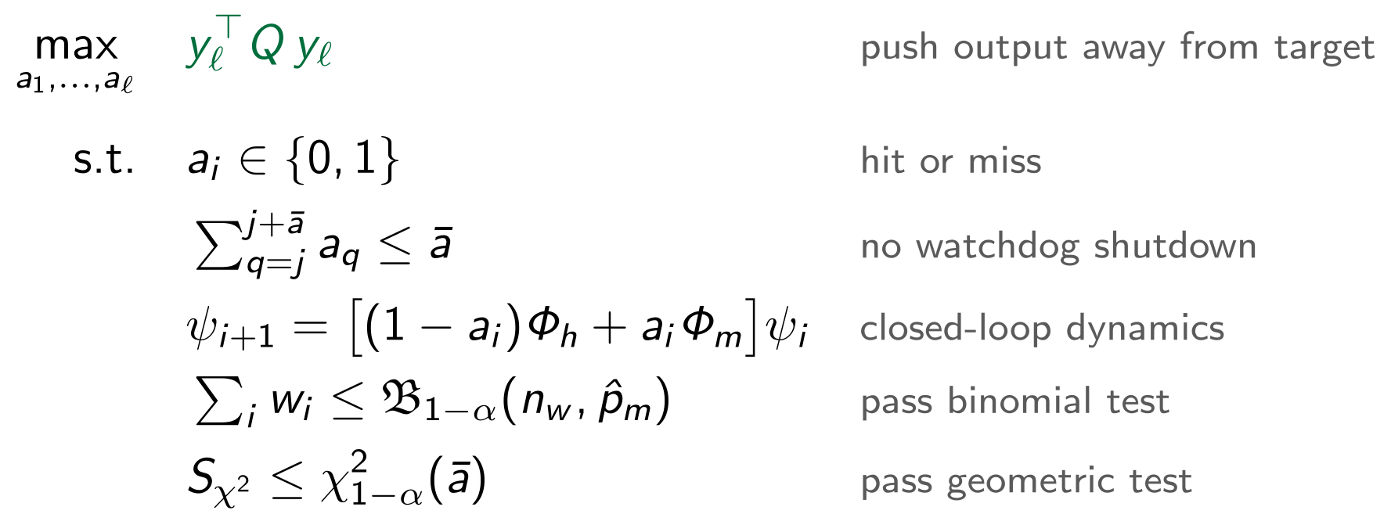
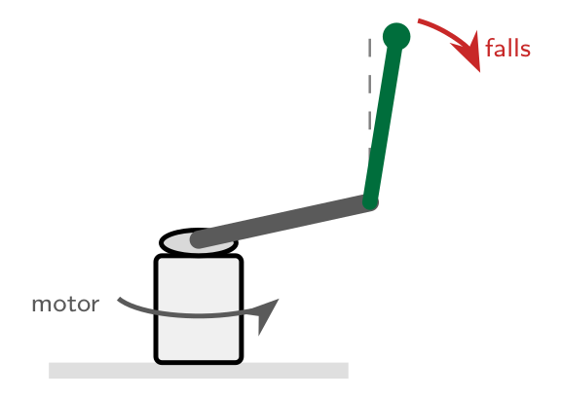
Brief of the Paper: The Optimal Stealthy Attack
Attacker’s problem (MIQCP)
Two test plants
Quadruple tank: stable, simulated, LQG, h = 0.1 s, hold
Binary choices plus quadratic terms: a Mixed Integer Quadratically Constrained Program, solved with Gurobi.
The answer is a schedule of misses, e.g. 101011011101000
Furuta pendulum: unstable, real hardware, LQR, h = 5 ms, hold and zero
Notes:
[Point to the objective.] The attacker chooses the pattern of misses that pushes the output as far as possible from its target. The constraints say the watchdog must never fire, the system follows its real dynamics, and both statistical tests must pass.
This is a mixed integer quadratically constrained program, solved with Gurobi, and the answer is a schedule of misses like this one. [Point to the drawings.] They test it on a quadruple-tank process, which is stable, and on a real Furuta pendulum, which is unstable.

Slide 8
Key Takeaways
1
Timing is an attack surface
No data is altered, so physics-based detectors stay silent. The attacker needs no access to sensor values.
What defenders should do
1
Monitor long-term timing statistics
2
Watchdogs give little protection
They only help if the plant shuts down after 1 or 2 misses. From ā ≥ 3 the attack is almost as strong.
2
Prefer zeroing over holding on unstable plants
3
Long memory beats short memory
The χ² test on long-term counters limits the attacker far more than the sliding-window binomial test.
3
Tune the detection window to the plant
4
Treat timing anomalies as possible attacks
4
The actuation policy matters
For the Furuta pendulum, zero is the safer choice. Under hold, a stealthy attack can destabilise it.
Bottom line
Real-time scheduling is part of security: timing must be monitored over the long term, not only in the last few periods.
5
Well-timed beats more
Optimal attacks interleave misses with hits, and around 10 periods is already enough for peak damage.
Notes:
Five takeaways. One: timing itself is an attack surface. No data changes, so data-based detectors stay silent.
Two: watchdogs give little protection. They only help if the system shuts down after one or two misses.
Three: long memory beats short memory. The long-term chi-squared test limits the attacker far more than the window test.
Four: the actuation policy matters. For the pendulum, zero is safer, while under hold a stealthy attack can destabilise it.
Five: well-timed beats more. Misses are spread between hits, and about ten periods is enough.
[Point to the green box.] So defenders should monitor timing over the long term and pick the actuation policy to suit the plant. Real-time scheduling is part of security. Thank you, and I'll hand over to my teammate for the problem formulation.

