Slide 1

Music Store Data Analysis using SQL
Name: Tippaluri Srinu

Slide 2
About me
B.E graduate in Computer Science Engineering
Currently learning Data Analytics to build strong analytical skills
Interested in data-driven decision making
Completed SQL module with hands-on project experience
LinkedIn: www.linkedin.com/in/tippaluri-srinu-435425291
GitHub: https://github.com/Srinu-333

Slide 3
Agenda
Objective of the Project
ER Diagram and schema explanation
Key analysis questions (use cases)
SQL query results with screenshots or summaries
Final business insights and recommendations
Conclusion (Key finding overall)
Q&A Slide
Your Experience/Challenges working on SQL – Data Analysis Project.

Slide 4
Objective of the Project
To analyze a Music Store database using SQL
To understand customer behavior and sales performance
To identify:
  Best customers
  Top-selling artists & genres
  Revenue trends by country and city
To practice:
  Joins, Subqueries, Aggregations
  CTEs and Window Functions
To convert raw data into business insights

Slide 5
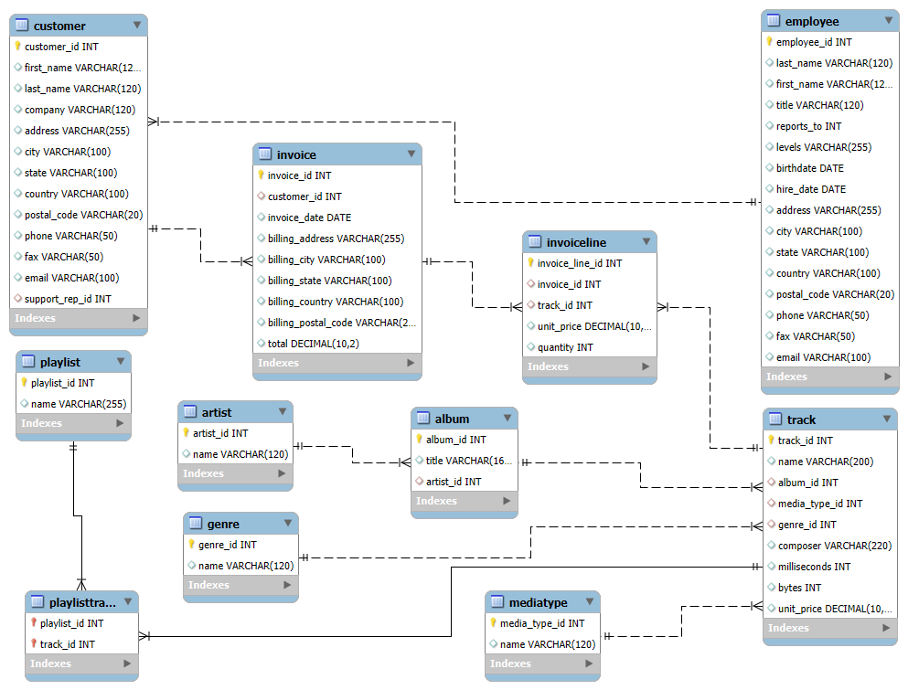
ER Diagram & Schema Explanation

Slide 6
The database follows a relational model
Core entities:
  Customer, Invoice, InvoiceLine
  Track, Album, Artist, Genre
  Employee, Playlist
Relationships:
  One customer → many invoices
  One invoice → many invoice lines
  Tracks linked to albums, artists, genres
  Playlist and Track have many-to-many relationship
Proper primary keys and foreign keys ensure data integrity

Slide 7
Key Analysis Questions
Who is the senior most employee?
Which countries generate the most invoices?
Who is the best customer by total spending?
Which city generates the highest revenue?
What is the most popular music genre by country?
Which artists and tracks perform best?
How much does each customer spend on different artists?

Slide 8
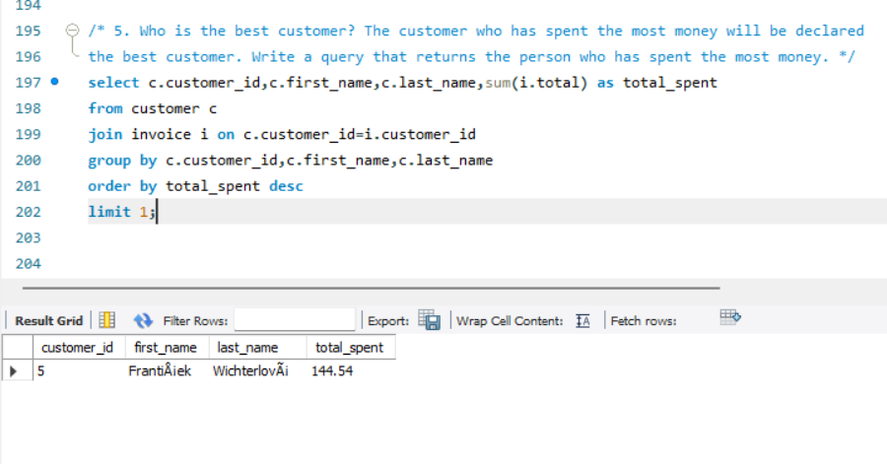
SQL Query Results
1.Best Customer
Identified the customer with the highest total spending.
High-value customer suitable for loyalty and retention programs.

Slide 9
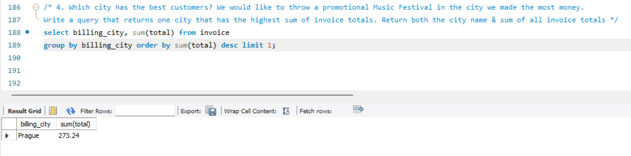
2. Top Revenue Generating City
One city contributed the highest overall revenue.
Ideal location for promotional events and marketing campaigns.

Slide 10
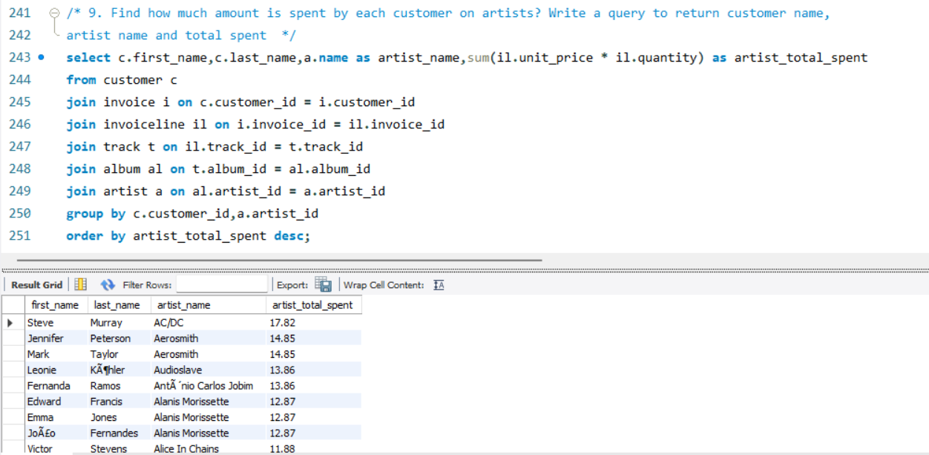
3. Customer Spending by Artist
Calculated accurate spending per customer for each artist.
Enables personalized recommendations and targeted promotions.

Slide 11
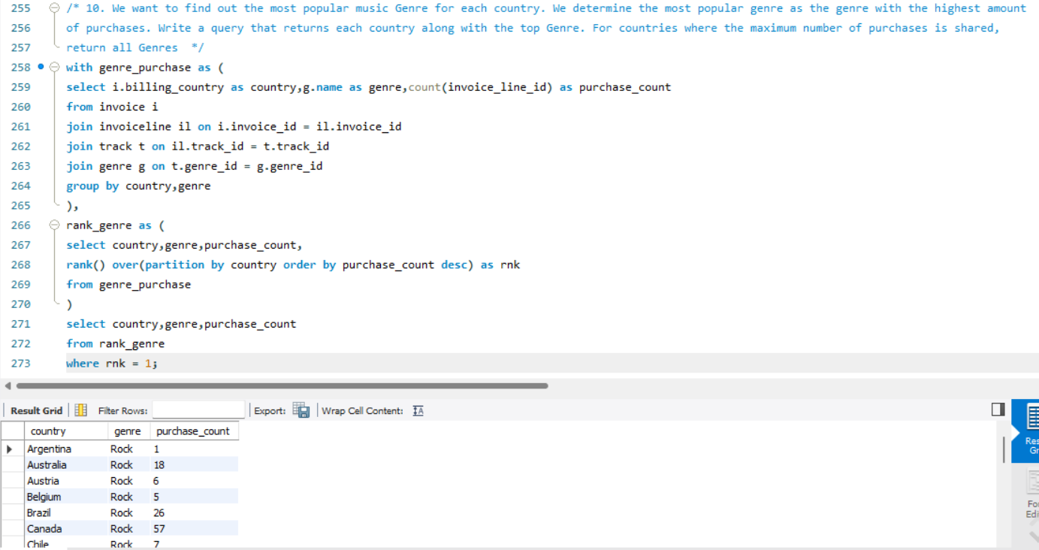
4. Most Popular Genre by Country
Identified the most purchased genre for each country.
Helps align music catalog and promotions with regional preferences.

Slide 12
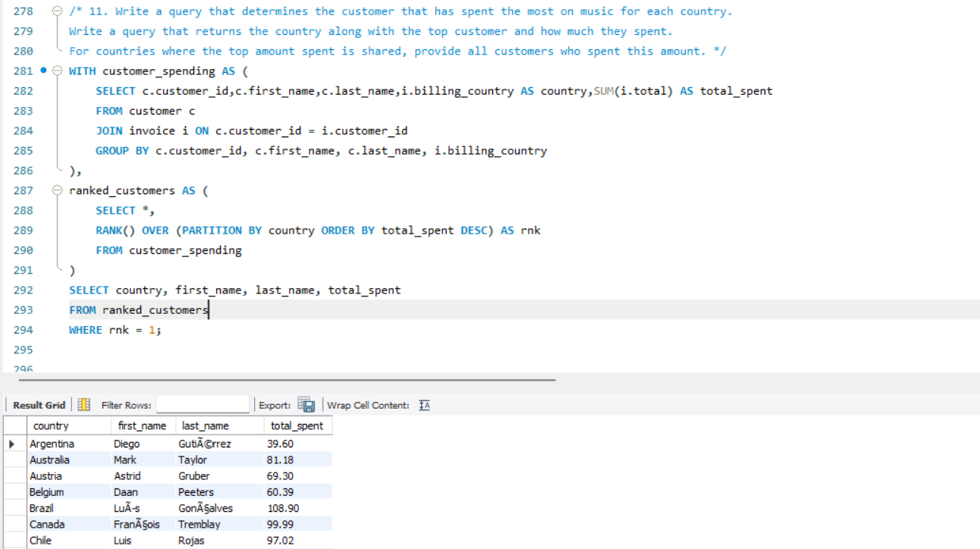
5. Top Customer by Country
Identified highest-spending customers in each country.
Useful for country-wise customer segmentation and premium offers.

Slide 13
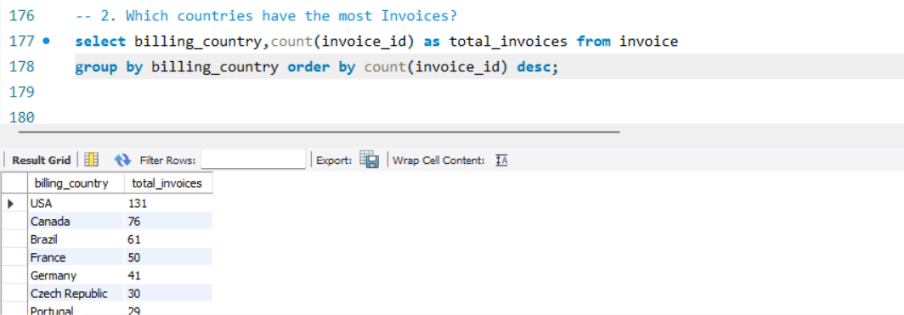
6. Countries with the Highest Number of Invoices
Identified countries with the highest customer transaction volume.
Countries with more invoices indicate strong customer demand.

Slide 14
Final Business Insights & Recommendations
Key Business Insights
  A small number of countries and cities contribute the majority of revenue
  High-value customers play a critical role in overall sales
  The Rock genre is one of the most popular and consistently purchased genres
  Certain artists and tracks drive repeated customer purchases
  Customer music preferences vary by country, indicating regional trends
Business Recommendations
  Focus marketing efforts on top-performing countries and cities
  Introduce loyalty programs for high-spending customers
  Promote popular genres and top artists to increase sales
  Use customer–artist spending data for personalized recommendations
  Align music catalog and promotions with country-wise preferences

Slide 15
Conclusion
This project demonstrated how SQL can be effectively used for real-world data analysis
Proper database design and relationships enabled accurate and meaningful insights
Advanced SQL concepts such as joins, subqueries, CTEs, and window functions were successfully applied
The analysis helped convert raw transactional data into actionable business insights
Overall, the project strengthened my analytical thinking and SQL problem-solving skills

Slide 16
Challenges & Learning Experience
Faced challenges in writing complex JOIN queries across multiple tables
Handling GROUP BY with aggregations required careful column selection
Implementing CTEs and window functions improved query readability and performance
Understood the importance of proper database design and relationships
Gained hands-on experience in converting business questions into SQL queries

Slide 17


Slide 18

THANK YOU

