Slide 1

Department of Information Technology
Safe Path Recommendation
Roll No: 22BD1A1230
22BD1A1212
22BD1A1220
22BD1A1236
SECTION: IT - A
GROUP NO: 14

Slide 2
Abstract
Index
Abstract
Introduction
Literature survey
Implementation
Conclusion
Future Enhancement
References

Slide 3
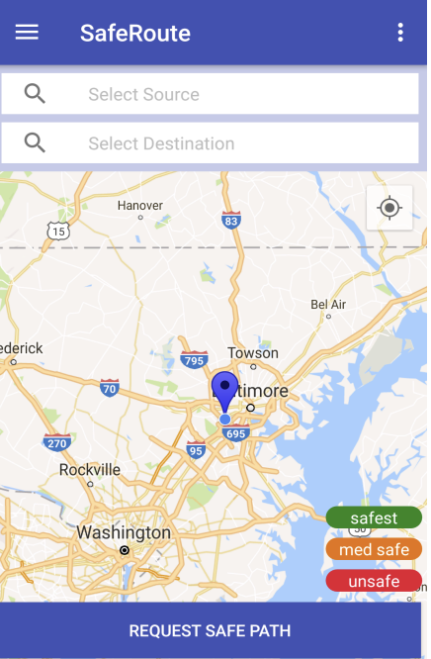
Introduction
Recommends safest route instead of shortest
Uses crime data + Google Maps APIs
Calculates Danger Index for each route
Applies K-means clustering for risk analysis
Visual indicators for safe → dangerous zones
Supports multiple travel modes (walk, drive, transit)

Slide 4
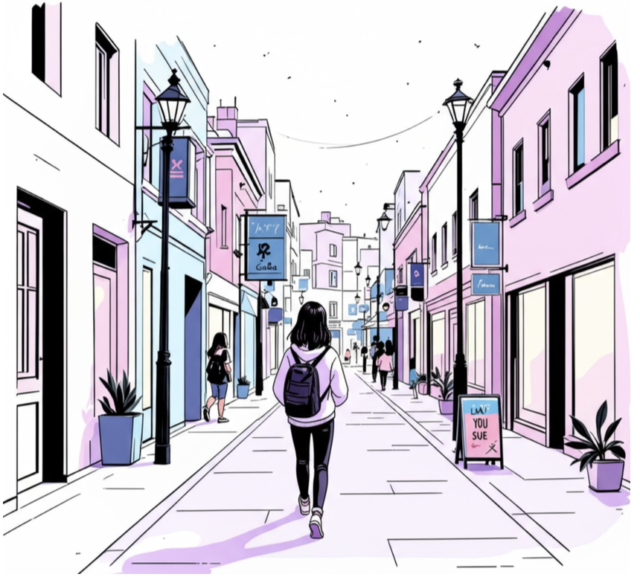
ABSTRACT:
1. Urban navigation apps prioritize shortest/fastest routes, ignoring safety
2. Our system introduces safety-aware route recommendation
3. Integrates crime datasets + geospatial mapping
4. Uses K-means clustering to identify high-risk zones
5. Computes a Danger Index for route evaluation
6. Compares multiple routes and suggests the safest option
7. Visualizes routes with risk-level indicators
8. Designed especially for women, night travel & unfamiliar areas

Slide 5
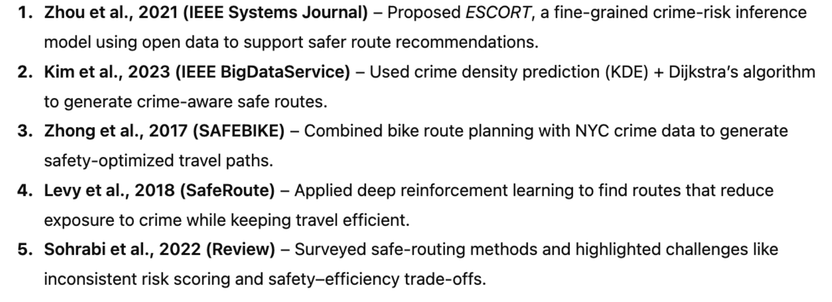

Literature Survey

Slide 6
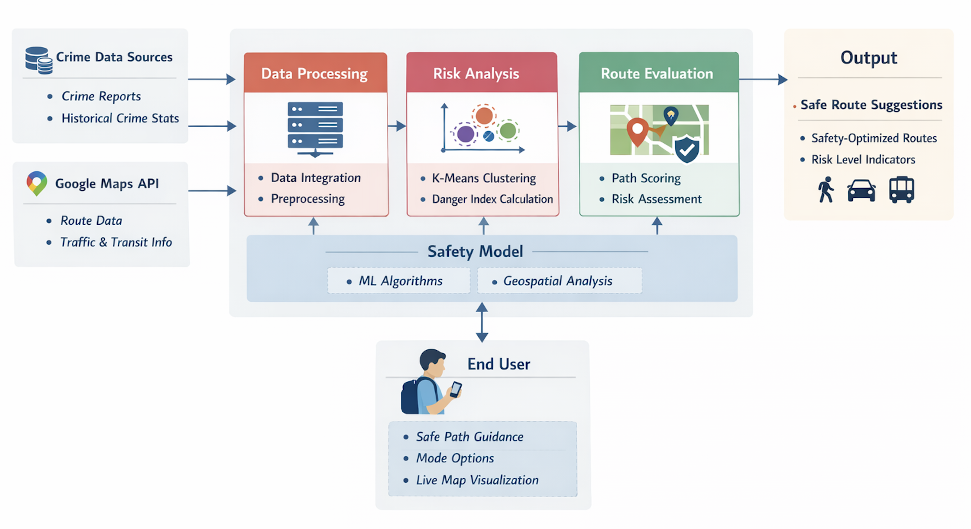
ARCHITECTURE DIAGRAM:

Slide 7
IMPLEMENTATION

Slide 10


