Slide 1

Online Food-Delivery Time Reliability Analysis Using Normal and Exponential Distributions
Capstone Project Presentation
UBA0904 – Probability and Statistics
Presented By
P. Sravanthi (192311272)
B. Satya Hyndavi(192311178)
K. Harshitha(192311309)
Under The Guidance of
V. SelvaKumar

Slide 2


Introduction
Overview of the Project
Online food delivery has become an important part of modern life, where customers expect their orders to arrive quickly and reliably. However, delivery times can vary due to factors such as traffic, distance, weather, restaurant preparation time, and delivery delays.
Purpose of the Project
To analyze online food-delivery times using statistical probability distributions.
To apply Normal Distribution to understand the variation in delivery times.
To apply Exponential Distribution to analyze waiting and delay times.
To calculate the probability of on-time and delayed deliveries.
To evaluate the reliability and performance of food-delivery services.
To identify delivery-time patterns and support better delivery planning and customer satisfaction.

Slide 3
Objectives
Goals
To study the distribution of food-delivery times.
To estimate the probability of on-time and delayed deliveries.
To apply Normal and Exponential Distributions to real-world delivery data.
To measure the reliability of delivery times.
Problem Statement
Online food deliveries may be delayed due to traffic, distance, and preparation time. These variations can affect customer satisfaction.
This project analyzes delivery times using Normal and Exponential Distributions to predict delays and measure delivery reliability.
Expected Outcomes
To determine the average food-delivery time and its variation.
To understand delivery-time patterns using Normal Distribution.
To analyze waiting and delay times using Exponential Distribution.

Slide 4
Literature Review
S.NO | RESEARCH PAPER | AUTHOR | ADVANTAGES | DISADVANTAGES | TECHNOLOGIES USED
1 | Statistical Analysis of Food Delivery Times | S. Kumar et al. | Helps identify delivery-time patterns and variations. | Requires reliable delivery-time data. | Statistical Analysis, Python
2 | Modeling Delivery Times Using Probability Distributions | R. Sharma, A. Singh | Useful for predicting delivery-time probabilities. | Accuracy depends on the selected distribution. | Probability Distribution, Python
3 | Application of Normal Distribution in Delivery Time Analysis | P. Patel et al. | Effectively analyzes average delivery times and variations. | May not accurately represent extreme delays. | Normal Distribution, Statistics
4 | Exponential Distribution for Waiting Time Analysis | M. Das, K. Roy | Suitable for analyzing waiting and delay times. | Assumes a constant event rate. | Exponential Distribution, Statistics
5 | Reliability Analysis of Online Delivery Services | A. Gupta, R. Verma | Helps measure service reliability and identify delays. | Results depend on the quality and size of the dataset. | Python, Pandas, Matplotlib, Statistical Analysis

Slide 5
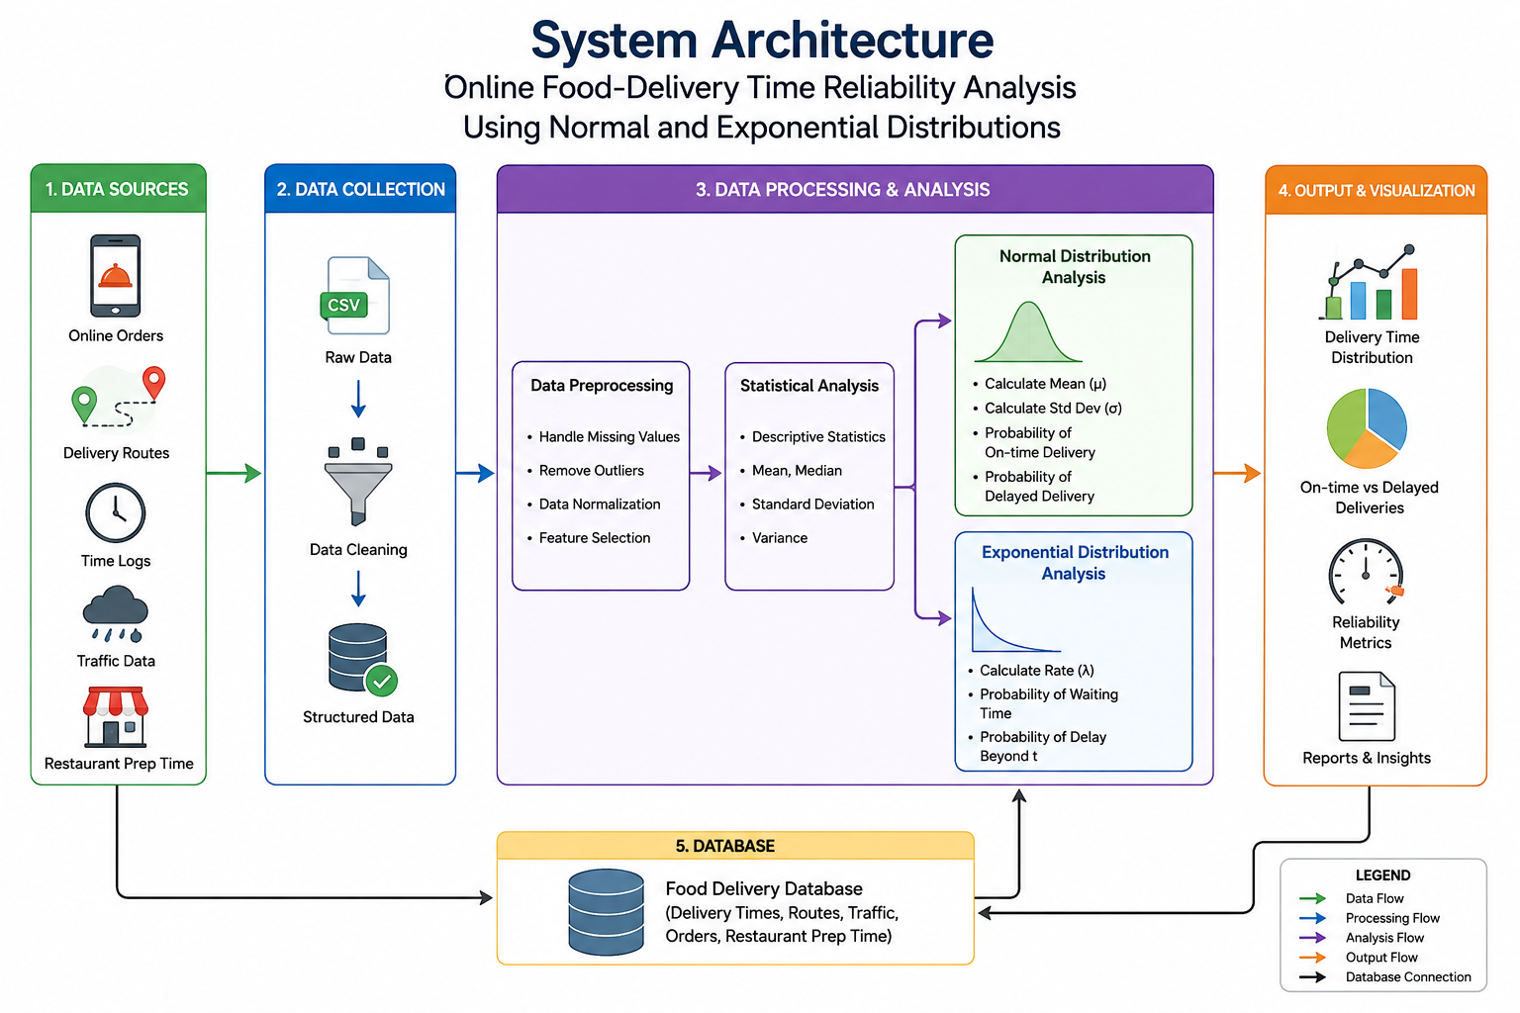
System Architecture

Slide 6
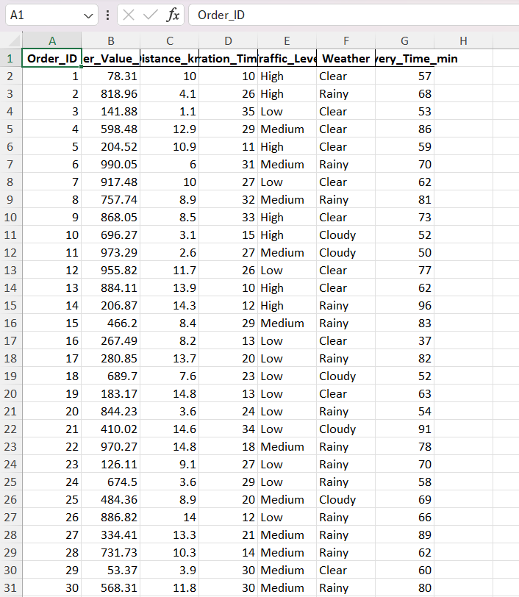
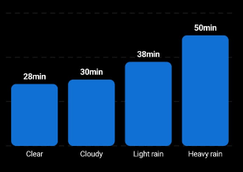
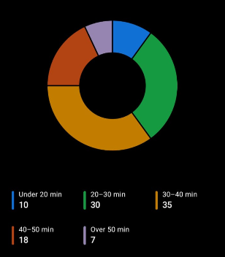
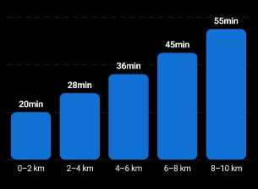
Data Set

Slide 7
List of Modules
Module 1: Food-Delivery Data Collection & Preprocessing
Module 2: Normal Distribution Analysis
Module 3: Exponential Distribution & Reliability Analysis

Slide 8
Module 1 : Food-Delivery Data Collection & Preprocessing
Collect food-delivery time data from different orders.
Record important details such as Order ID, delivery time, distance, and delivery status.
Remove missing, duplicate, or incorrect data.
Organize the data into a structured dataset.
Calculate basic statistical values:
Mean
Median
Variance
Standard Deviation
Prepare the cleaned dataset for probability analysis.

Slide 9
Module 2: Normal Distribution Analysis
Use Normal Distribution to study the overall pattern of delivery times.
Calculate the mean (μ) and standard deviation (σ).
Determine the probability of deliveries occurring:
Within the expected time
Before the expected time
After the expected time
Identify the normal delivery-time range.
Generate a bell-curve graph to visualize delivery times.
Estimate the percentage of on-time deliveries.

Slide 10
Module 3: Exponential Distribution & Reliability Analysis
Use Exponential Distribution to analyze delivery waiting and delay times.
Calculate the rate parameter (λ).
Find the probability that a delivery takes more than a specified time.
Analyze the likelihood of long delivery delays.
Compare the results obtained from Normal and Exponential Distributions.
Calculate the delivery reliability percentage.
Identify whether the delivery service is reliable or requires improvement.
Present the final results using graphs, charts, and tables.

Slide 11
Results & Discussion
The average delivery time was approximately 34 minutes.
Most deliveries were completed within the 25–45 minute range.
The standard deviation was approximately 5.71 minutes, showing moderate variation.
Normal Distribution helps identify the expected delivery-time range.
Exponential Distribution helps analyze waiting and delay probabilities.
The analysis shows that most deliveries are reasonably reliable, while some orders may experience delays.
These results can help improve delivery planning and customer satisfaction.

Slide 12
Future Scope
Use larger and real-time delivery datasets for better accuracy.
Include factors such as traffic, weather, distance, and restaurant preparation time.
Develop an AI-based delivery-time prediction system.
Provide real-time delay alerts to customers and delivery partners.
Improve route planning to reduce delivery time and delays.
Extend the system to analyze delivery performance across different locations and time periods.

Slide 13
Conclusion
The project successfully analyzes food-delivery times using Normal and Exponential Distributions.
Normal Distribution helps understand the overall pattern and variation in delivery times.
Exponential Distribution helps analyze waiting and delay probabilities.
The analysis helps measure delivery-time reliability.
The results can support better delivery planning, efficiency, and customer satisfaction.

Slide 14
References
[1] S. M. Ross, A First Course in Probability, 10th ed. Hoboken, NJ, USA: Pearson, 2026.
[2] R. E. Walpole, R. H. Myers, S. L. Myers, and K. Ye, Probability & Statistics for Engineers and Scientists, 9th ed. Boston, MA, USA: Pearson, 2012.
[3] D. C. Montgomery and G. C. Runger, Applied Statistics and Probability for Engineers, 7th ed. Hoboken, NJ, USA: Wiley, 2018.
[4] B. Illowsky and S. Dean, Introductory Statistics. Houston, TX, USA: OpenStax, 2013.
[5] F. Pedregosa et al., “Scikit-learn: Machine learning in Python,” J. Mach. Learn. Res., vol. 12, pp. 2825–2830, 2011.
[6] Python Software Foundation, “Python 3 Documentation,” Python Software Foundation, 2024.

Slide 15


